Slide 1

TEMPORARY STAFF
CONFIRMATION PROCESS

Slide 2
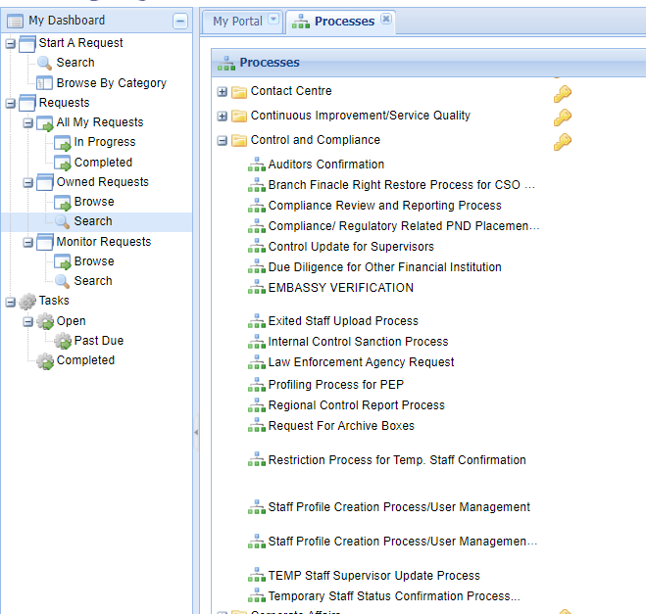
2. Select Control and Compliance Category
1. Start Request
3. Temporary Staff Confirmation Process

Slide 3
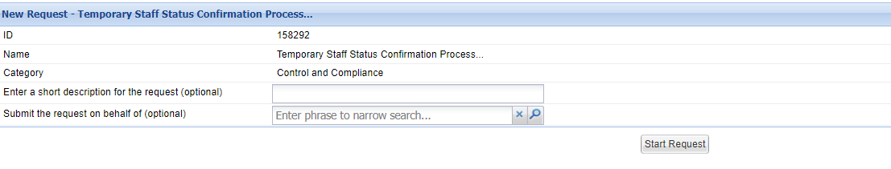
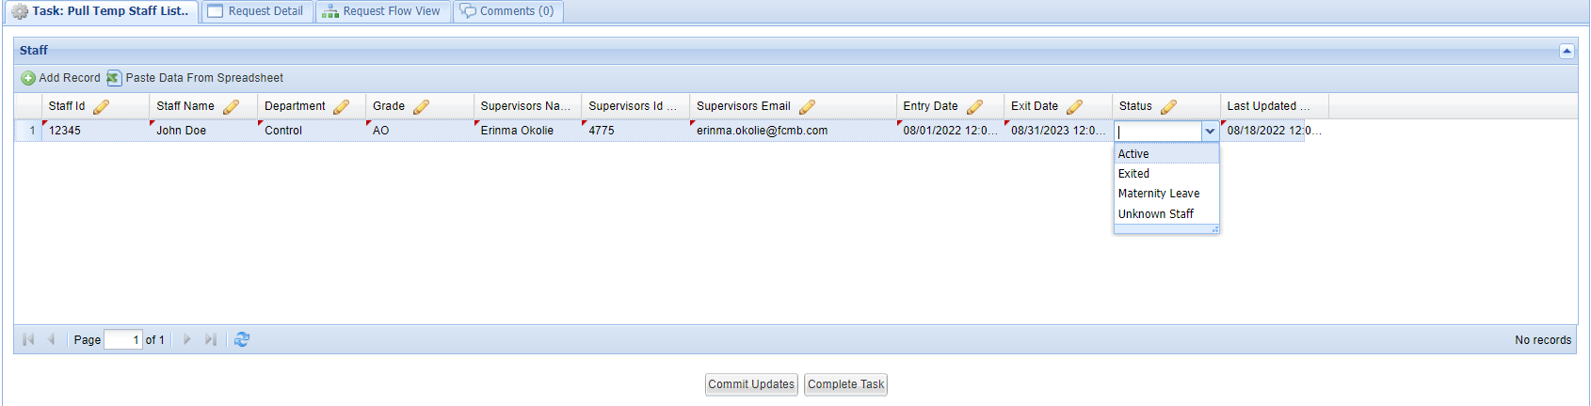
4. Start Request
5. Click “Add Record” to add new staff to the database against your ID.
To add multiple staff, continue clicking “Add Record”
6. All fields must be mandatorily populated.
If a staff is no longer under your supervision, kindly select status to be “ UNKNOWN”
7. Click blank space under status and then click the drop-down to select Status as applicable.
8. Last Updated date must be filled.
8. Click Commit Updates
9. Click Complete Task and Submit

Slide 4
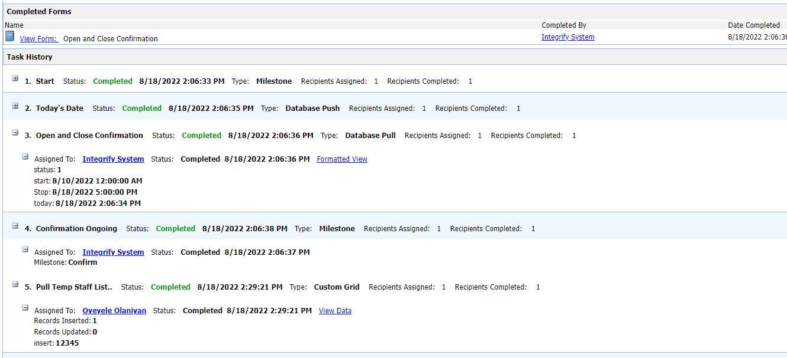
Confirmation page for Record Insertion and Updates

Slide 5


