Slide 1

Sample program:
# Selection commands
# Subroutine to return eligibility to drive
def CheckAge(Age):
if Age > 17:
print("You are old enough to learn to drive a car.")
else:
print("You are not old enough to learn to drive a car.")
# Main program
CheckAge(14)
Notes:
Predict what you think this program does.
Type in the code and run it to see if you were right.
If your code does not work, check the following:
Have you typed every line of code exactly as you see it?
Have you used a tab for code inside structures?
Are the commands in lowercase?
Have you missed a colon?

Slide 2
This program outputs you are old enough to drive a car if Age is greater than or equal to 17.
Understand how the code works:
# Selection commands
# Subroutine to return eligibility to drive
def CheckAge(Age):
if Age > 17:
print("You are old enough to learn to drive a car.")
else:
print("You are not old enough to learn to drive a car.")
# Main program
CheckAge(14)
CheckAge is a subroutine. Because it doesn’t return any values it is also known as a procedure.
Age is a parameter holding the number 14 that was passed into the CheckAge subroutine.
Age is a whole number, known as an integer.
The decision about the next section of code to execute is determined by the “if” selection command.
The logical check if Age is greater or equal to 17 performed by the ALU is known as a condition.
Note there is no ≥ symbol in programming. That’s maths! Use >= instead.
Tabs are used to indicate which sections of code to execute.
Code in the “else” section is only executed if Age was less than 17.
Notes:
Change the program four times to check it definitely works for ages: 16, 17, 18 and 20. This is a more comprehensive test because 16 is a boundary test, 17 checks that equals works, 18 is a boundary test and 20 checks that >17 works. Boundary tests check values closest to the condition being either true or false.
Change the program so that it outputs if a child is eligible to go on a ride at a theme park. The child must be at least 104cm tall.

Slide 3
Sample program:
# Selection commands
# Subroutine to validate month
def ValidMonth(Month):
if Month > 0 and Month < 13:
print("Valid month")
else:
print("Invalid month")
# Main program
ValidMonth(9)
Notes:
Predict what you think this program does.
Type in the code and run it to see if you were right.
If your code does not work, check the following:
Have you typed every line of code exactly as you see it?
Have you used a tab for code inside structures?
Are the commands in lowercase?
Have you missed a colon?

Slide 4
This program determines whether a month number is valid.
Understand how the code works:
# Selection commands
# Subroutine to validate month
def ValidMonth(Month):
if Month > 0 and Month < 13:
print("Valid month")
else:
print("Invalid month")
# Main program
ValidMonth(9)
If Month is greater than zero AND Month is less than 13...
…then this line of code inside the tabulated indent is executed.
…otherwise this line of code inside the tabulated indent is executed instead.
START HERE
The program starts here by running the subroutine called ValidMonth, passing the number 9.
Notes:
Change the program so that is checks if a child is eligible for preschool. The child must be aged between 2 and 5 inclusive, i.e. 2, 3, 4 or 5.
Test your program works with the data: -5, 0, 1, 2, 3, 5, 7.

Slide 5
Sample program:
# Selection commands
# Subroutine to output Key Stage
def YearGroup(Year):
if Year >= 7 and Year <10:
print("Key Stage 3")
elif Year >=10 and Year <12:
print("Key Stage 4")
# Main program
YearGroup(10)
Notes:
Predict what you think this program does.
Type in the code and run it to see if you were right.
If your code does not work, check the following:
Have you typed every line of code exactly as you see it?
Have you used a tab for code inside structures?
Are the commands in lowercase?
Have you missed a colon?

Slide 6
This program outputs the Key Stage a student is in.
Understand how the code works:
# Selection commands
# Subroutine to output Key Stage
def YearGroup(Year):
if Year >= 7 and Year <10:
print("Key Stage 3")
elif Year >=10 and Year <12:
print("Key Stage 4")
# Main program
YearGroup(10)
It is possible to combine multiple if statements using elif.
Notes:
Test the program with the data: 7, 11, 6 and 13.
Change the program so that it outputs Key Stage 1 for years 1-2, Key Stage 2 for years 3-6 and “Sixth Form” for years 12-14.
Change the program to also output “Reception” for year 0, “Error” for <0 and “Post-school” for >14.

Slide 7
Learning points from this objective:
Checking the value of a variable and executing instructions depending on the outcome of the check is known as a selection.
The instructions that are executed as a result of a selection is known as a program branch.
The logical checking of a variable against another value is known as a condition.
Conditions can be enclosed in brackets if you want to combine multiple conditions together into a single expression.
Code for each program branch must be indented with a tab. This also makes it easier to read where a program branch begins and ends.
It is good practice to comment a selection to explain its purpose.
One “if” construct can also be placed inside another “if” construct, this is known as nesting.
The condition is either true or false. E.g. X = 6 : If X > 8 returns false.
Logical operators are used in conditions:
and - And
or - Or
not - Not
== - Equal to
!= - Not equal to
< - Less than
<= - Less than or equal to
> - Greater than
>= - Greater than or equal to
Notes:
Read the summary of the key learning points for this objective.

Slide 8
Program comprehension:
def Sample(Hz):
if Hz == 44100:
print("CD quality")
if Hz < 44100:
print("Low quality")
if Hz > 44100:
print("Compress")
Sample(48000)
ITEM | Identify a selection statement in the program.
 | If Hz = = 44100
 | Identify a condition in the program.
 | Hz == 44100
 | Identify a logical operator in the program.
 | <
STRUCTURE | When Hz is 64000, which line is executed after line 2?
 | 7
 | What must be used to indicate program statements are part of a program branch in Python?
 | identation
 | If Sample returned the string instead of outputting it, what would line 3 be changed to?
 | Return “CD quality”
Notes:
Answer the questions in the tables using the sample code on this slide.
Enter your answer in the row under the question.

Slide 9
Program comprehension:
def Sample(Hz):
if Hz == 44100:
print("CD quality")
if Hz < 44100:
print("Low quality")
if Hz > 44100:
print("Compress")
Sample(48000)
REASON | Why is == used instead of = in line 2?
 | = check that the variable type is the same whereas == check the values are equal
 | What advantage would there be to using “elif” instead of “if” in lines 4 and 6?
 | Treats the entire thing as one conditional
RELATION | What will be the affect on the output from the program if lines 2-3 are swapped around with lines 4-5?
 | No effect
 | What would be the implication of changing line 4 to be: if Hz <= 44100 instead?
 | It would return Low Quality for 44100 aswell
Notes:
Answer the questions in the tables using the sample code on this slide.
Enter your answer in the row under the question.

Slide 10
Keywords introduced in this objective:
if X == "Craig" or X == "Dave“: commands if ((Y > 6 and Y < 10) or Z != 1): commands | Branches to a sequence of instructions based on the condition. In this situation if X is Craig or X is Dave. Multiple conditions can be used with brackets. This means if Y is between 7 and 9 and Z is not 1…
elif | Allows if statements to be nested. If the previous if / elif is false, execute this selection.
else | Catches all other possibilities when the condition is false. It is good practice to ensure all possible outcomes are handled to avoid run-time errors.
Notes:
Use these keywords you learned as a handy reference when you make your own programs.

Slide 11

# Driving test problem
Driving test problem:
1 point.
Write a subroutine that outputs “pass” if a parameter called MinorFaults is less than 16, or “fail” if it is greater than 15.
# Subroutine to output pass or fail for driving test
else:
return "pass"
if MinorFaults < 16:
def PassFail(MinorFaults):
# Main program
return "fail"
print(PassFail(16))
To help you get started, here is all the code you need with the statements jumbled up.
Notes:
Have a go at some of the problems using what you have learned in this objective.
Only use the commands that you have been shown in the example programs.
Avoid using commands that you have not been taught because you may not be able to use these when answering exam questions.
If your teacher does not direct you, aim to achieve 6 points in total in this objective.

Slide 12



Max problem:
1 point.
Write a function called Max that returns the highest of two number parameters. E.g. Max(50,32) would return 50. Output the returned value.
States of water problem:
1 point.
Write a subroutine that will output “gaseous” if the parameter is greater than or equal to 100, “liquid” if the parameter is between 1 and 99 inclusive, and “solid” if the parameter is less than 1. It should allow for decimal numbers, e.g. 37.2.
Notes:
Have a go at some of the problems using what you have learned in this objective.
Only use the commands that you have been shown in the example programs.
Avoid using commands that you have not been taught because you may not be able to use these when answering exam questions.
If your teacher does not direct you, aim to achieve 6 points in total in this objective.

Slide 13
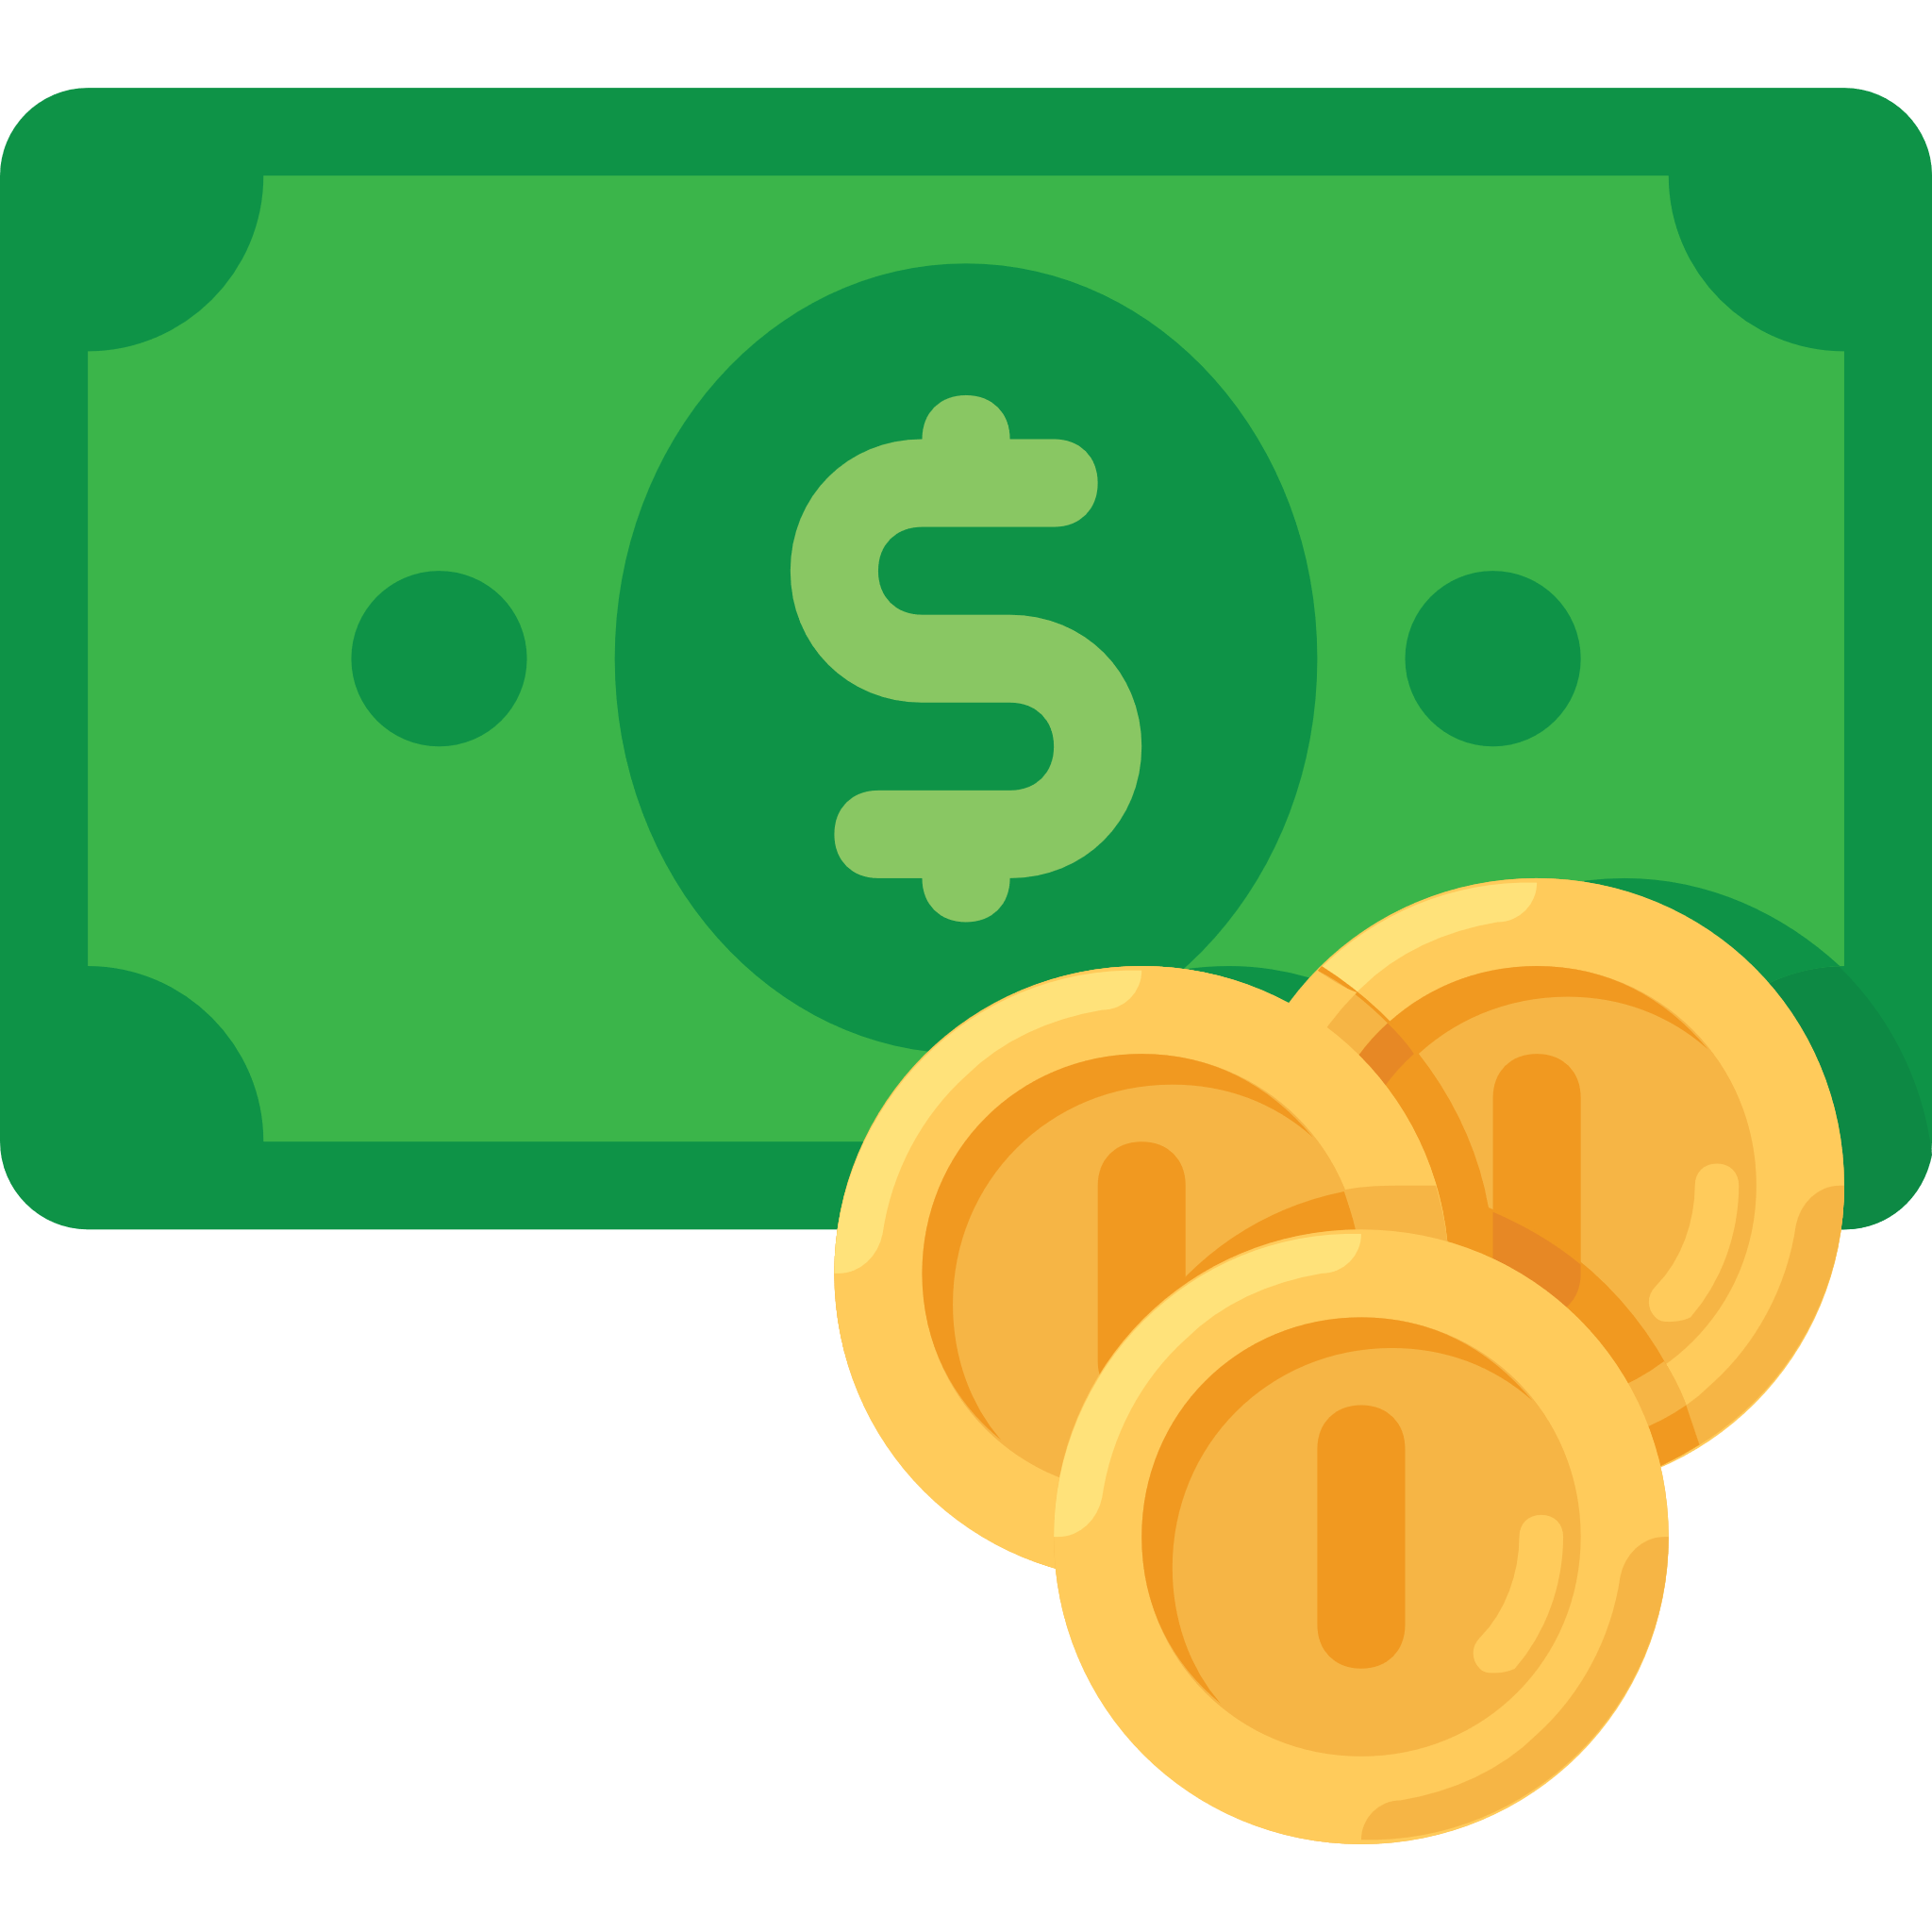
Career quote problem:
2 points.
Write a subroutine that takes a parameter called Job. It outputs a quote as shown in the table below:
Currency converter problem:
2 points.
Find out the latest foreign exchange rates for GBP to USD, Euro, Yuan and Yen.
Write a function that takes two parameters. Pounds and name of currency. The function should convert money based on the current values. The main program should output the result. E.g. 100 GBP = 111.15 Euro.
Job | Quote
Engineer | The engineer has been, and is, a maker of history.
Developer | Logical thinking, passion and perseverance is the paint on your palette.
Analyst | Seeing what other people can’t see gives you great vision.
None of the above | I'm sorry. We could not find a quote for your job.
Notes:
Have a go at some of the problems using what you have learned in this objective.
Only use the commands that you have been shown in the example programs.
Avoid using commands that you have not been taught because you may not be able to use these when answering exam questions.
If your teacher does not direct you, aim to achieve 6 points in total in this objective.

Slide 14

Function Dose
Nitrate problem:
2 points.
When keeping fish, one of the goals to reduce algae is to keep nitrates to a minimum. One way of doing this is to dose a carbon source which nitrifying bacteria within an aquarium consume together with nitrates. The carbon source must be dosed very precisely.
Write this function to determine and return the dose.
The program should output: “For x nitrate dose y ml”
Where x is the parameter and y is the returned value.
Is nitrate above 10?
Yes
No
Is nitrate above 2.5?
Yes
No
Is nitrate above 1?
Return 3
Return 2
Yes
No
Return 1
Return 0.5
End Function
Notes:
Have a go at some of the problems using what you have learned in this objective.
Only use the commands that you have been shown in the example programs.
Avoid using commands that you have not been taught because you may not be able to use these when answering exam questions.
If your teacher does not direct you, aim to achieve 6 points in total in this objective.

Slide 15
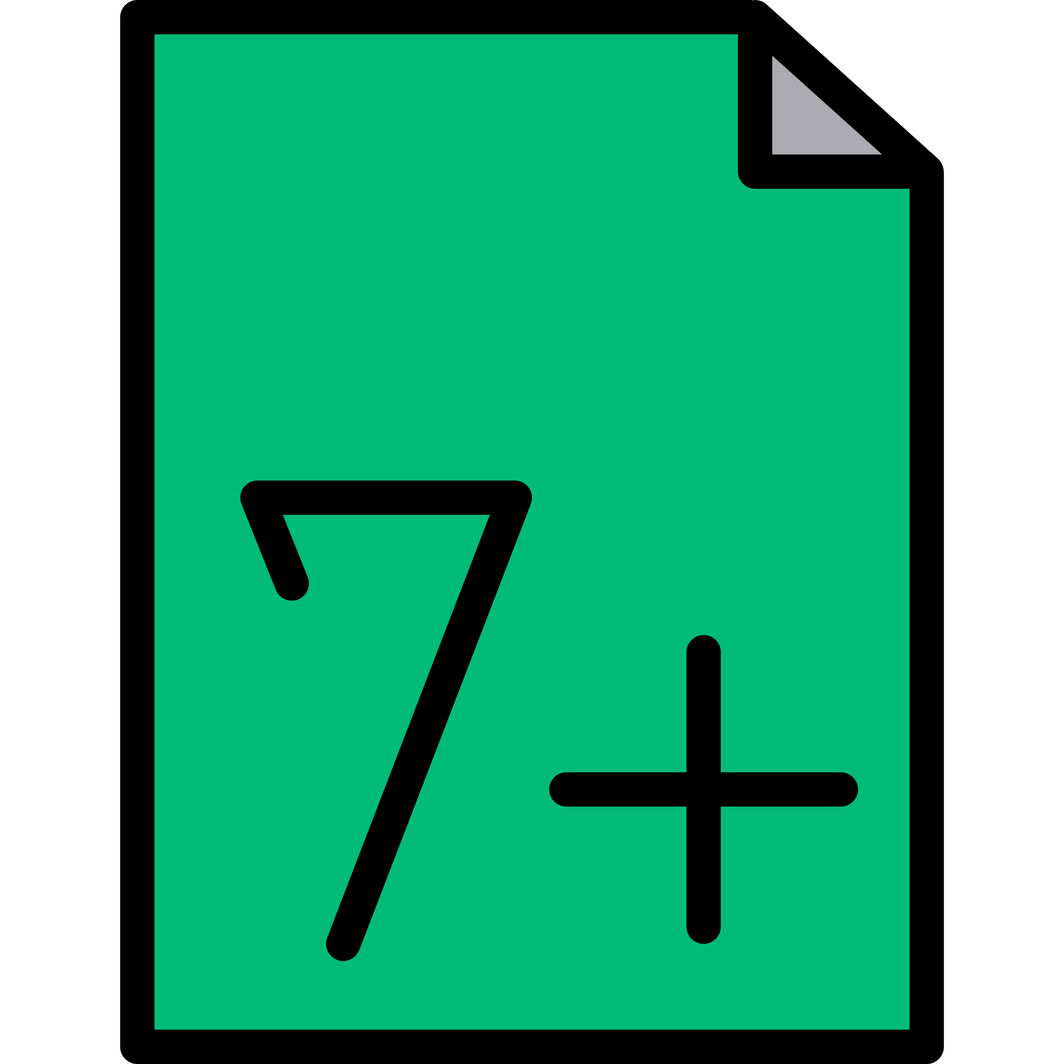
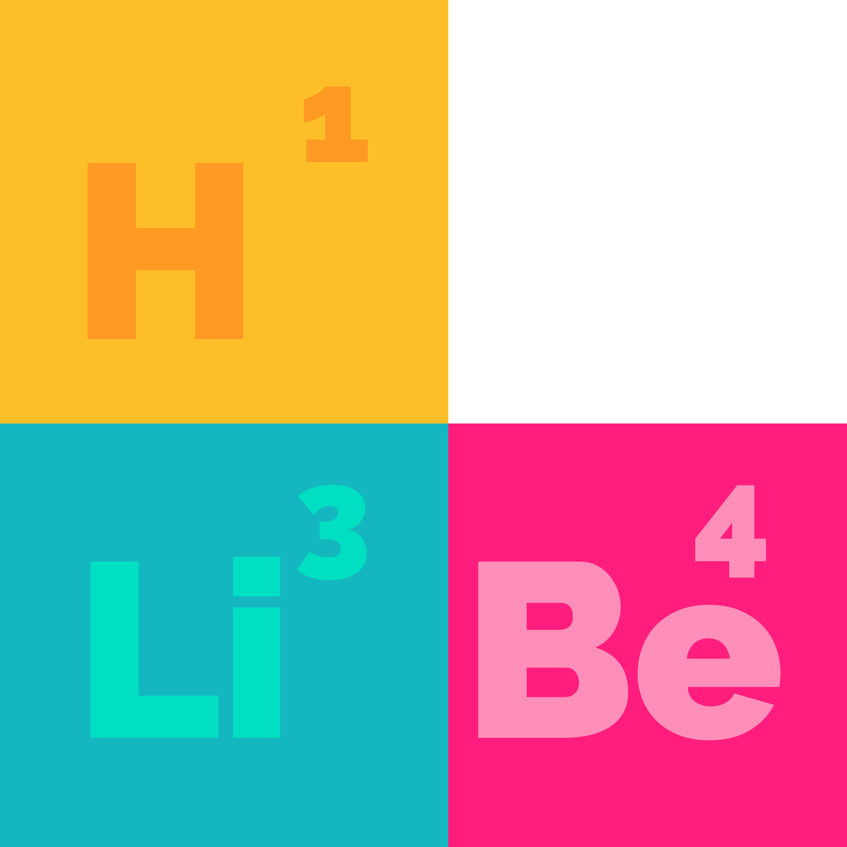
Exam grade problem:
3 points.
Write a function that returns the grade and the number of marks to the next grade from an exam result using the data below. The main program should output a suitable message to the student. E.g. A mark of 59 is grade 7. You needed 8 more marks for the next grade.
Periodic table problem:
3 points.
Find a copy of the periodic table. Write a function that takes a single parameter which could be the name of an element, the symbol or group it belongs to. The function should output the name of the element, its atomic weight and the group it belongs to. E.g. for the parameter “Li” the program would output: Element: Lithium Atomic weight: 6.94 Group: Alkali metals
You only need to use six elements from two different groups.
Mark | <2 | 2 | 4 | 13 | 22 | 31 | 41 | 54 | 67 | 80
Grade | U | 1 | 2 | 3 | 4 | 5 | 6 | 7 | 8 | 9
Notes:
Have a go at some of the problems using what you have learned in this objective.
Only use the commands that you have been shown in the example programs.
Avoid using commands that you have not been taught because you may not be able to use these when answering exam questions.
If your teacher does not direct you, aim to achieve 6 points in total in this objective.

Slide 16

Day format problem:
3 points.
Write a function called DayFormat that takes two parameters, the day as a number (e.g. Monday is 1, Tuesday is 2) and the output format required. The function should return the day formatted as shown:
E.g. DayFormat(2, "day") would return Tuesday.
Parameter | Format returned
day | Monday, Tuesday, Wednesday, Thursday, Friday, Saturday, Sunday
shortday | Mon, Tue, Wed, Thu, Fri, Sat, Sun
char | M, Tu, W, Th, F, Sa, Su
Notes:
Have a go at some of the problems using what you have learned in this objective.
Only use the commands that you have been shown in the example programs.
Avoid using commands that you have not been taught because you may not be able to use these when answering exam questions.
If your teacher does not direct you, aim to achieve 6 points in total in this objective.

Slide 18

Review your solutions:
Did you: | Self-assess: Yes/No
Complete all the requirements for the problems you solved?
Start your programs with a comment to describe what they do?
Use a subroutine for the main algorithm in your code?
Use a comment to describe what the subroutine does?
Use a comment after each program branch to explain the purpose of the section?
Use variable names that describe the data they hold?
Notes:
Self assess your work by evaluating your solutions against these criteria. Enter yes or no in the “Self-assess” column.
Once you have completed the objective, show your programs to your teacher so you can review them together.

