Slide 1
Backbone Bonded Parameters
These corresponds to the ‘extended’ protein parameters:
BB – BB bond = 0.35 nm and FC = 1250 kJ/mol
BB – BB – BB angle = 134 º and FC = 25 kJ/mol
BB – BB – BB – BB angle = 180º and FC = 0 kJ/mol (angle 180 does not represent peptoid)
These are simply a guide and SWARM-CG will be used to refine ALL bonded terms

Slide 2
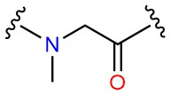
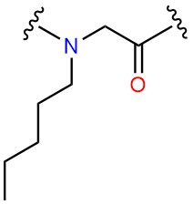
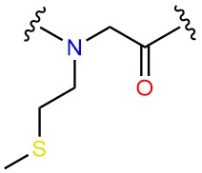
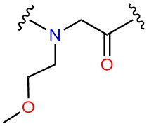
45 amu
Peptoid backbone is Na -> non-polar and acceptor
A000
72 amu
BB -> Na
SC1 -> C1
BB – SC1 bond = 0.40 FC = 2500 kJ/mol
BB – BB – SC1 angle = 100 FC = 25 kJ/mol
AP00
M000
MOA0
BB -> Na
SC1 -> C5
BB -> Na
SC1 -> C5
BB – SC1 bond = 0.40 FC = 2500 kJ/mol
BB – BB – SC1 angle = 100 FC = 25 kJ/mol
BB – SC1 bond = 0.40 FC = 2500 kJ/mol
BB – BB – SC1 angle = 100 FC = 25 kJ/mol

Slide 3
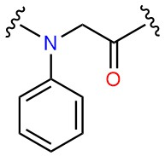
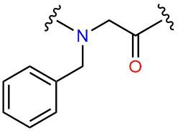
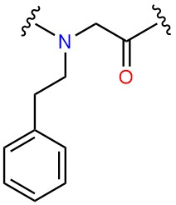
45 amu
BB -> Na
SC1 -> SC4
SC2 -> SC4
72 amu
FN00
BB – SC1 bond = 0.40 FC = 2500 kJ/mol
BB – BB – SC1 angle = 150 FC = 25 kJ/mol
BB – BB – SC1 – SC2 angle = 0 FC = 50 kJ/mol
BB -> Na
SC1 -> SC4
SC2 -> SC4
F000
BB – SC1 bond = 0.40 FC = 2500 kJ/mol
BB – BB – SC1 angle = 150 FC = 25 kJ/mol
BB – BB – SC1 – SC2 angle = 0 FC = 50 kJ/mol
FE00
BB -> Na
SC1 -> SC4
SC2 -> SC4
SC3 -> SC4
Note: increase in linker length will be captured by bonded terms

Slide 4
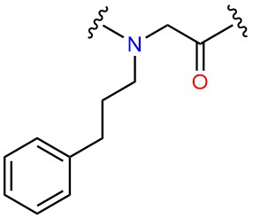
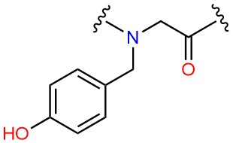
45 amu
BB -> Na
SC1 -> SC4
SC2 -> SC4
SC3 -> SC4
Note: increase in linker length will be captured by bonded terms
72 amu
FP00
BB -> Na
SC1 -> SC4
SC2 -> SC4
SC3 -> SP1
Y000
FES0
BB -> Na
SC1 -> SC4
SC2 -> SC4
SC3 -> SC4
BB – SC1 bond = 0.40 FC = 2500 kJ/mol
BB – BB – SC1 angle = 150 FC = 25 kJ/mol
BB – BB – SC1 – SC2 angle = 0 FC = 50 kJ/mol
FER0

Slide 5
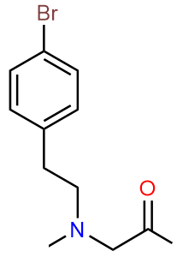
45 amu
BB -> Na
SC1 -> SC4
SC2 -> SC4
SC3 -> SC5
Note: increase in linker length will be captured by bonded terms
72 amu
FEC3
BB – SC1 bond = 0.40 FC = 2500 kJ/mol
BB – BB – SC1 angle = 150 FC = 25 kJ/mol
BB – BB – SC1 – SC2 angle = 0 FC = 50 kJ/mol
BB -> Na
SC1 -> SC4
SC2 -> SC4
SC3 -> SC4
BB – SC1 bond = 0.40 FC = 2500 kJ/mol
BB – BB – SC1 angle = 150 FC = 25 kJ/mol
BB – BB – SC1 – SC2 angle = 0 FC = 50 kJ/mol
FES0

Slide 6
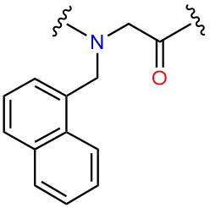
45 amu
BB -> Na
SC1 -> SC4
SC2 -> SC4
SC3 -> SC4
SC4 -> SC4
SC5 -> SC4
SC6 -> SC4
72 amu
FENR
SC2
SC3
SC1
SC4
SC6
Apply this to all and differences will be captured using bonded terms.
SC5
FENS
BB – SC1 bond = 0.40 FC = 2500 kJ/mol
BB – BB – SC1 angle = 100 FC = 25 kJ/mol
BB – BB – SC1 – SC2 angle = 0 FC = 50 kJ/mol
SC4 – SC3 – SC2 –SC1 angle = 0 FC = 200 kJ/mol
SC6 – SC1 – SC2 – SC3 “
SC1 – SC6 – SC5 – SC4 “
SC3 – SC4 – SC5 – SC6 “
FMN0

Slide 7
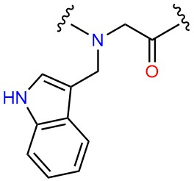
45 amu
BB -> Na
SC1 -> SC4
SC2 -> SP1
SC3 -> SC4
SC4 -> SC4
SC2
72 amu
WE00
BB – SC1 bond = 0.40 FC = 2500 kJ/mol
BB – BB – SC1 angle = 150 FC = 25 kJ/mol
BB – BB – SC1 – SC2 angle = 0 FC = 50 kJ/mol
SC4 – SC3 – SC2 –SC1 angle = 0 FC = 200 kJ/mol
SC6 – SC1 – SC2 – SC3 “
SC1 – SC6 – SC5 – SC4 “
SC3 – SC4 – SC5 – SC6 “
BB -> Na
SC1 -> SC4
SC2 -> SP1
SC3 -> SC4
SC4 -> SC4
SC2
W000

Slide 8
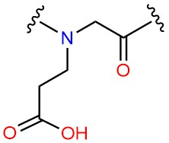
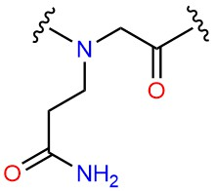
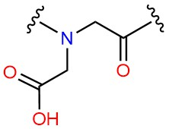
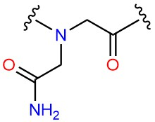
BB -> Na
SC1 -> P5
Q000
E000
D000
BB – SC1 bond = 0.32 FC = 5000 kJ/mol
BB – BB – SC1 angle = 100 FC = 25 kJ/mol
Charged
BB -> Na
SC1 -> Qa
BB -> Na
SC1 -> Qa
Uncharged
BB -> Na
SC1 -> P1
BB -> Na
SC1 -> P4
BB -> Na
SC1 -> P3
N000
BB – SC1 bond = 0.40 FC = 5000 kJ/mol
BB – BB – SC1 angle = 100 FC = 25 kJ/mol
BB – SC1 bond = 0.40 FC = 5000 kJ/mol
BB – BB – SC1 angle = 100 FC = 25 kJ/mol
BB – SC1 bond = 0.40 FC = 7500 kJ/mol
BB – BB – SC1 angle = 100 FC = 25 kJ/mol

Slide 9
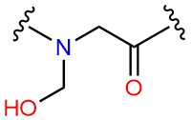
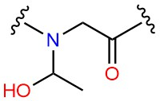
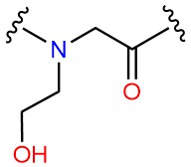
BB -> Na
SC1 -> P1
BB – SC1 bond = 0.25 FC = 7500
BB – BB – SC1 angle = 100 FC = 25 kJ/mol
S000
T000
BB -> Na
SC1 -> P1
BB – SC1 bond = 0.26 FC = constraint
BB – BB – SC1 angle = 100 FC = 25 kJ/mol
SE00
BB -> Na
SC1 -> P2
BB – SC1 bond = 0.26 FC = 5000 kJ/mol
BB – BB – SC1 angle = 100 FC = 25 kJ/mol

Slide 10
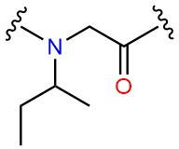
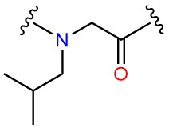
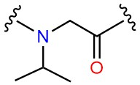
BB -> Na
SC1 -> C1
BB – SC1 bond = 0.31 FC = constraint
BB – BB – SC1 angle = 100 FC = 25 kJ/mol
BB -> Na
SC1 -> C1
BB – SC1 bond = 0.33 FC = 7500 kJ/mol
BB – BB – SC1 angle = 100 FC = 25 kJ/mol
BB -> Na
SC1 -> C2
BB – SC1 bond = 0.265 FC = constraint
BB – BB – SC1 angle = 100 FC = 25 kJ/mol

Slide 11
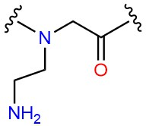
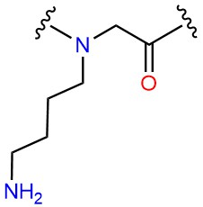
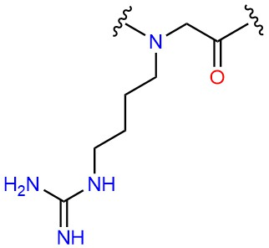
Charged
BB -> Na
SC1 -> Qd
Uncharged
BB -> Na
SC1 -> P1
KE00
BB – SC1 bond = 0.31 FC = 5000 kJ/mol
BB -> Na
SC1 -> C3
SC2 -> Qd
Charged
BB – SC1 bond = 0.31 FC = constraint
SC1 – SC2 bond = 0.33 FC = 5000 kJ/mol
SC2 – SC3 bond = 0.28 FC = 5000 kJ/mol
BB – BB – SC1 angle = 180 FC = 25 kJ/mol
K000
BB -> Na
SC1 -> C3
SC2 -> P1
Uncharged
BB -> Na
SC1 -> N0
SC2 -> Qd
Charged
BB – SC1 bond = 0.31 FC = constraint
SC1 – SC2 bond = 0.33 FC = 5000 kJ/mol
SC2 – SC3 bond = 0.34 FC = 5000 kJ/mol
BB – BB – SC1 angle = 180 FC = 25 kJ/mol
R000
BB -> Na
SC1 -> N0
SC2 -> P4
Uncharged

