Slide 1
Secure programming project Tuukka Salonen

Slide 2
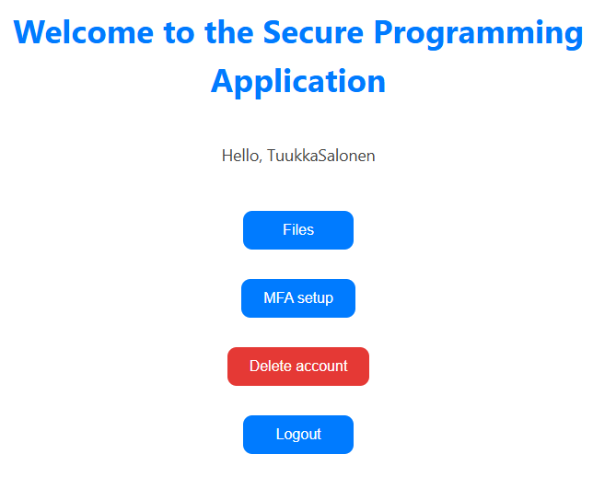
Programming work
File storage application
Multi-factor authentication
QR-code MFA setup
OAuth login options
Google
GitHub
PostgreSQL database
Python backend
Flask
SQLAlchemy
Pytest
React frontend
Redux
Vite
Jest

Slide 3
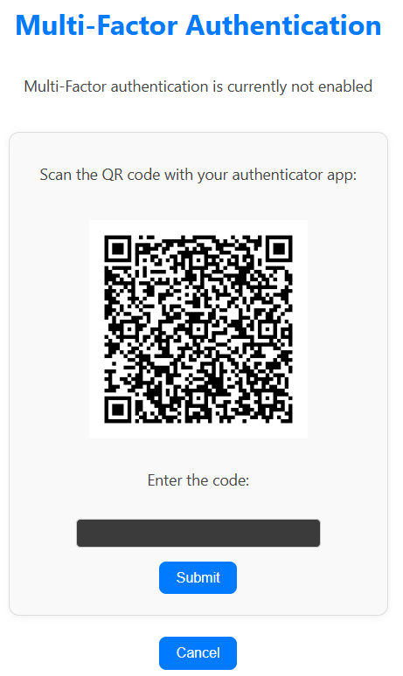
Secure features
Multi-factor authentication
Paired JWT (acess & refresh) and CSRF-tokens
Input validation
Multi-level encrypted files
Logging
Rate limiting
Scheduled database backups
Frontend and backend route protection (JWT token checks)
CORS
Security headers including
Content Security Policy
X-Frame-Options
Cross-Origin policies
Etc.

Slide 4
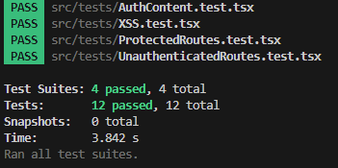
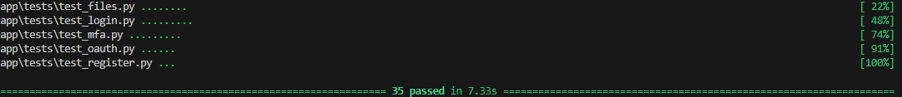
Testing
Backend tests
Route tests
Authentication tests
CSRF-token tests
Frontend tests
Content rendering tests
Protected route tests
Basic XSS tests
Jenkins pipeline
Dast, CycloneDX, Dependency-check, Trivy,
Semgrep
Changes based on results
Pipeline
Added security headers due to DAST-report
Some package version updates
Unit tests
Added file id validation
Prevented access to register/login frontend routes when logged in

Slide 5

AI usage
Debugging
Some simple CSS styles for frontend
Python package recommendations
Encryption solution suggestions

Slide 6
Further development options
File scans
More login options in addition to GitHub and Google
User data modification (password change etc.)
Https
UI improvements
Option to write code instead of reading QR-code

