Slide 1
1
An Advanced Relief Distribution
&
Donation Management System.
Mohaimanul Haque Turas
Hasidul Islam
Tushar Sarkar
ALMS

Slide 2
2
Problems to solve :
Corruption resistant crystalline demonstration
A practical approach to estimate support counts and survival sufficiency requirements
Many people wants to provide financial help or food support to these vulnerable people. But due to the lack of a reliable platform they are not able to do it.

Slide 3
3
The Idea
We are presenting a system that focuses on corruption resistance, support count estimation, and achieving the trust of the financial supporters.
This system will estimate the amount of relief before going there from the NID information and the family member's information provided by the receiver. So the field member will know how much relief is required for a particular area.
As a donor, someone will be able to send his/her support on the website. The donor will be able to see the donations Directly from the Relief list by going to the site. A central authority will be controlling the full system.
Because of its simplicity and transparency, this system will be corruption free and the donors will have trust in the system.

Slide 4
4
The Solution
Getting the receiver data:
People who needs donation they will send SMS on a pre announced number register themselves using their NID card.
On the SMS they will be sharing his/her total number of family member
Estimating support count:
From the user SMS data, receiver of an area will be calculated
A rough estimation of relief for every family will be done using the family data provide by the receiver

Slide 5
The Solution
Giving the relief:
People will get SMS of relief that will include time and place for receiving the relief.
On the provided time the receiver will be present on the provided place with the NID/Birth certificate the family member.
The family member’s NID or Birth certificate numbers will be included under the person so that one NID can not be used by multiple person as family member.
After receiving the relief the receiver will ensure it by providing their finger print. This will indicate that the person has received his/her relief.
The people without NID will contact nearby relief providing place to add them on the relief list.
5

Slide 6
The Solution
Donation:
Any one will be able to donate using our website via various methods.
One can donate using their name/organization name.
If someone wants to donate anonymously they can do it.
6

Slide 7
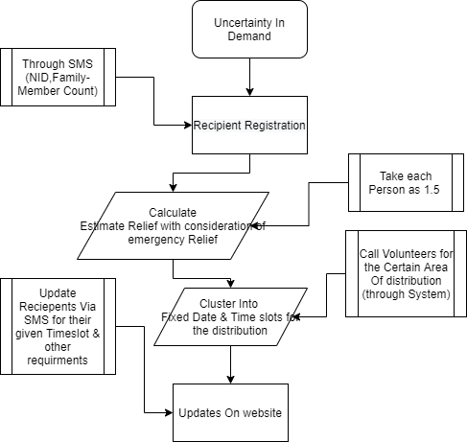
Process Flowchart:
7

Slide 8
The Transparent and Gamified aspect of the system:
The Receiver list
There will be a list of total receiver based on every area. Anyone can see that from our website. Which will ensure transparency of the system and build trust on the system.
The donor list
There will be a donor list on the website. The donors will be listed based on their donation. The top donors will be on the top of the list. This will provide a gamified option. People will be more interested to donate because of this aspect of the system.
8

