Slide 1
Sentence-Level Emotion Apprehension Through Facial Expression & Speech Verification Analysis
Faculty of Science and Technology, Dept. of Computer Science
Undergraduate Thesis
Student Name | ID | Contribution
1. Md. Mohaimanul Haque | 17-33833-1 | 25%
2. Souvik Das Dipta | 17-33872-1 | 25%
3. Abu Fuzail Polin | 17-33658-1 | 25%
4. Ashik Al Habib | 17-33602-1 | 25%
Supervisor: | Victor Stany Rozario

Slide 2
Content
Problem Definition
Motivation / Background
Research Objectives
Methodology
Results / Findings
Synthesis
Future Work
References

Slide 3
Problem Definition
Given the huge influence, Ekman’s work had on the science of emotion, his ideas are pervasive in emotion-detection technology. in recent Studies, it is considered flawed. so, only through facial point recognition prediction is not ideal.
So,
Here, we have tried to develop a system to predict emotion from both users' facial data and also voice data to get a more precise prediction of the users.

Slide 4
Motivation
The market for emotion-detection technology is worth approximately $21.6bn, and its value is prognosticated to more than double by 2024, relinquishing $56bn. Businesses can purchase systems to help them vet job applicants, analyze advertisements for their sentimental impression and test criminal defendants for signs of fraud.
The importance of Emotional state apprehension is widely perceived in social interaction and social intelligence. This analysis has been an active research topic since the 19th century.
Though its importance is vast and huge amount is invested, the system has yet to be in its perfect form.

Slide 5
Literature Review
The Two major literature reviews affecting our study and development are,
It can be seen that Dipankar Das and Shivaji Bandyopadhyay [4] operate a machine learning approach using Conditional Random Field (CRF) which is a 2 step method with a high accuracy of 87.65%. It is limited by the Synonyms set (SynSet) in the Affect list. This model failed to consider words that do not exist in the said list.
The scholars in Paper [5] do an experimental analysis of different approaches to tackle the problem of sentence-level emotion tagging. They use five approaches, which include four knowledge-based ideas and one corpus-based idea.
this paper [5] uses a machine-learning classifier, Naive Bayes that is trained on random social experiment videos to incorporate emotion in a labeled data set. This approach is more practical and has been employed similarly in our model.

Slide 6
Background
Emotion can be classified into several static classifications like happiness, sadness, disgust, anger, fear, and surprise. It can be further improved by combining the image & voice data.
Convolutional Neural Network: CNN model mainly contains 3 different substructures, which includes: convolutional layers, pooling layers, fully connected layers.

Slide 7
Background (cont’d)
The issues with conventional method: Classification of facial expression can sometimes be difficult, surprisingly for humans also. It is shown on several researches that people might recognize different emotions for the same facial expression.
Technical challenges:
The distance between features
Feature Size
Skin Color
Face occlusion and lighting issues
Recognizing incomplete emotions

Slide 8
Research Objectives
To extract data from video for Recognizing sentiment
Extract Every frames
Extract Proper subtitle of the whole Video
To recognize Emotion from video and audio individually
Recognize emotions of every frames of the video
Recognize emotions from the extracted context of the speech
To merge both results

Slide 9
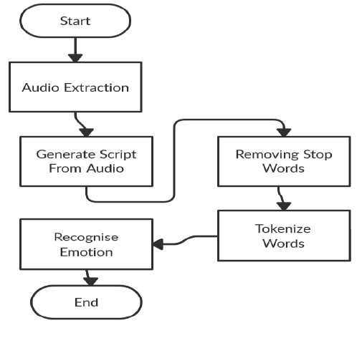
Research Methodology
Work Flow:

Slide 10
Research Methodology (cont’d)
Video Processing:
Video to frame
Video to Audio
Reducing Noise
Audio to Text
Model Creation:
For creating the model the Sequential API from keras library is used. This Model contains four Convolutional Layers, two dense layer and one hidden layer.

Slide 11
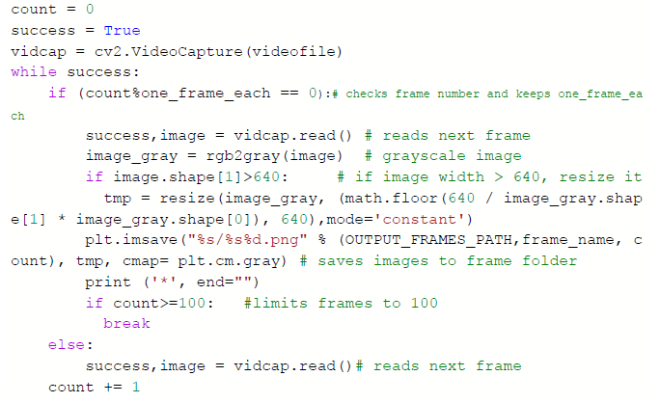
Research Methodology (cont’d)
Algorithm:
Video to Frame:

Slide 12
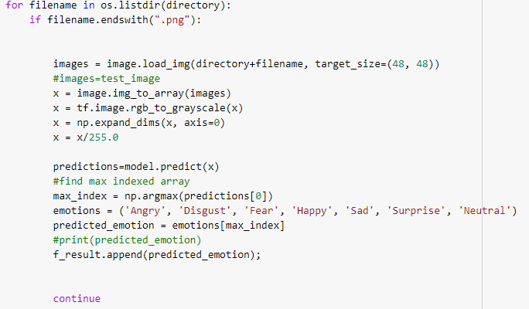
Research Methodology (cont’d)
Prediction from Images:

Slide 13
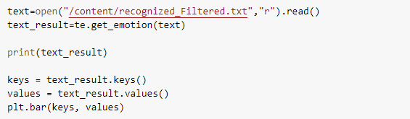
Research Methodology (cont’d)
Prediction form text:

Slide 14
Research Methodology (cont’d)
Training:
In case of Recognition from the Video frames, the task is to categorize each face based on the emotion shown in the facial expression into one of seven categories (0=Angry, 1=Disgust, 2=Fear, 3=Happy, 4=Sad, 5=Surprise, 6=Neutral).
In case of Audio Recognition, the task is to categorize each word based on the meaning into one of five categories on the scale 0 to 1. Which are: Angry, fear, Happy, Sad and Surprise.

Slide 15
Research Methodology (cont’d)
Emotion Recognition from Images:
Image Processing
Gray-scaling every frame
Converting images into 48x48
Prediction
Model Creation
Data Train
Predict Every extracted frame
Emotion Recognition from Audio:
Process Voice Data
Removing Stop words
Tokenize
Prediction

Slide 16
Result
The video which is used, has been compiled into frames of every second and text was extracted from the video.
Figure: Compiled video frames

Slide 17
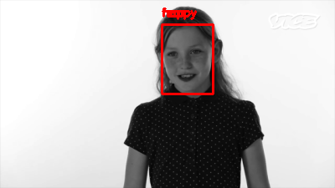
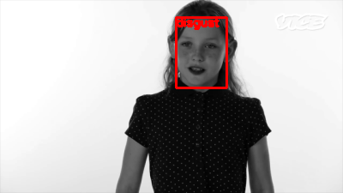
Result (cont’d)
Results we got after successful prediction :
Figure: Happy
Figure: Disgust
Our model’s detection power is slightly weaker because of lower epoch. So the model may sometime confused between neutral and disgust

Slide 18
Result (cont’d)
After Removing stop words from the raw transcript it changed significantly. Thus, our text is ready for processing. Tokenization was automatically done through the process of Text2Emotion as its own feature.
Figure: Results extracted from the video Figure: Video Recognition

Slide 19
Result (cont’d)
A comparison Pi-Chart of these two recognition is given below:
Figure: Visualization Results extracted
from the frames
Figure: Visualization Results extracted
from the Voice Data

Slide 20
Result (cont’d)
Then we Merged Both result Dictionaries into one final dictionary given priority to the image recognized result.
{'Happy': 0.12, 'Angry': 0.25, 'Surprise': 0.5841584158415841, 'Sad': 0.12, 'Fear': 0.12, 'Disgust': 0.4158415841584158}
Figure: Merged Final Result

Slide 21
Synthesis
Implication of our model:
Well-fit for lab conditioned or processed images
Neutral has the worst results; might be because of Neutral and disgust has similar AU points
Accuracy is significantly reduced when used on wild emotions.
Lower accuracy between peak emotions in a video
Need to train on boarder set of data to improve the accuracy of the model

Slide 22
Future work
Different tests and experiments have been left for the future due to the lack of time (i.e. the experiments with real data are usually very time consuming, sometimes requiring even days to finish a single run). Future work concerns the deeper analysis of particular mechanisms or simply curiosity.
There are some improvements we can do to further improve our system.
custom-made dataset for training.
custom model for text recognition/Predict emotion.
Detect Emotion of individual moment combining both data.
Ability to predict results of moving objects in real-time.
Increase range of Emotional predictions such as: drive, threatened, tensed, motivated, Contempt.
Increase accuracy to cope up with real-time detection.
gesture detection to further increase the accuracy of our model.

Slide 23
References
[1] Awad, W. A., ELseuofi, S. M. (2011). MACHINE LEARNING METHODS FOR SPAM E-MAIL CLASSIFICATION. International Journal of Computer Science and Information Technology (IJCSIT), 4(5), 2352–2355.
[2] Almeida,tiago. Almeida, Jurandy.Yamakami, Akebo ” Spam filtering: how the dimensionality reduction affects the accuracy of Naive Bayes classifiers” Journal of Internet Services and Applications, Springer London , February 2011 pp.68–73.
[3] Trivedi, Shrwan Kumar. “A Study of Machine Learning Classifiers for Spam Detection.” 2016 4th International Symposium on Computational and Business Intelligence (ISCBI), Sept. 2016, doi:10.1109/ISCBI.2016.7743279.
[4] Barbara Kitchenham, O. Pearl Brereton, David Budgen, Mark-Turner,John Bailey, Stephen Linkman(2009), Systematic literature reviews in software engineering – A systematic literature review, Elsevier.
[5] Yuchun Tang, Sven Krasser, Yuanchen He, Weilai Yang, Dmitri Alperovitch “Support Vector Machines and Random Forests Modeling for Spam Senders Behavior Analysis” IEEE GLOBECOM, 2008

Slide 24
References (cont’d)
[6] Jane Webster, Richard T. Watson (2002), Analyzing the Past to Prepare for the Future: Writing A Literature Review, MIS Quarterly Vol. 26 No. 2, pp. xiii-xxii.
[7] Shripriya Dongre, Prof. Kamlesh Patidar “E-Mail Spam Classification Using Long Short-Term Memory Method.” International Journal of Scientific Research and Engineering Trends, vol. 5, no. 5, 2019, pp. 1659–1665.
[8] Enrico Blanzieri,Anton Bryl(2009), A survey of learning-based techniques of email spam filtering, Artif Intell Rev, DOI 10.1007/s10462- 009-9109-6.
[9] Asghar, Muhammad Zubair, et al. “Sentence-Level Emotion Detection Framework Using Rule-Based Classification.” Cognitive Computation, vol. 9, no. 6, 2017, pp. 868–894., doi:10.1007/s12559-017-9503-3.
[10] Samson, Andrea C., et al. “Eliciting Positive, Negative and Mixed Emotional States: A Film Library for Affective Scientists.” Cognition and Emotion, vol. 30, no. 5, 2015, pp. 827–856., doi:10.1080/02699931.2015.1031089.

Slide 25
References (cont’d)
[11] Strapparava, C., Mihalcea, R.: SemEval-2007 task 14: affective text. In: Proceedings of the Fourth International Workshop on Semantic Evaluations (SemEval-2007), pp. 70–74 (2007)
[12] Ekman, P.: An argument for basic emotions. Cogn. Emot. 6(3–4), 169–200 (1992)
[13] International Survey on Emotion Antecedents and Reactions data set. https://www. unige.ch/cisa/index.php/download file/view/395/296/
[14] Das, D., Bandyopadhyay, S.: Sentence level emotion tagging. In: 2009 3rd International Conference on Affective Computing and Intelligent Interaction and Workshops, pp. 1–6. IEEE (2009)
[15] Strapparava, C., Mihalcea, R.: Learning to identify emotions in text. In: Proceedings of the 2008 ACM Symposium on Applied Computing, pp. 1556–1560 (2008)
[16] Francisco, V., Gerv´as, P.: Exploring the compositionality of emotions in text: word emotions, sentence emotions and automated tagging. In: AAAI-06 Workshop on Computational Aesthetics: Artificial Intelligence Approaches to Beauty and Happiness (2006)

Slide 26
References (cont’d)
[17] Asghar, M.Z., Khan, A., Bibi, A., Kundi, F.M., Ahmad, H.: Sentence-level emotion detection framework using rule-based classification. Cogn. Comput. 9(6), 868–894 (2017)
[18] Shaheen, S., El-Hajj, W., Hajj, H., Elbassuoni, S.: Emotion recognition from text based on automatically generated rules. In: IEEE International Conference on Data Mining Workshop, pp. 383–392 (2014)
[19] www.theneweconomy.com/technology/the-problem-with-emotion-detection-technology
[20] X. U. Feng and J.-P. Zhang, ‘‘Facial microexpression recognition: A survey,’’ Acta Automatica Sinica, vol. 43, no. 3, pp. 333–348, 2017.
[21] M. S. Özerdem and H. Polat, ‘‘Emotion recognition based on EEG features in movie clips with channel selection,’’ Brain Inf., vol. 4, no. 4, pp. 241–252, 2017.

Slide 27
References (cont’d)
[22] S. K. A. Kamarol, M. H. Jaward, H. Kälviäinen, J. Parkkinen, and R. Parthiban, ‘‘Joint facial expression recognition and intensity estimation based on weighted votes of image sequences,’’ Pattern Recognit. Lett., vol. 92, pp. 25–32, Jun. 2017.
[23] Hongli Zhang , Alireza Jolfaei , and Mamoun Alazab, “A Face Emotion Recognition Method Using Convolutional Neural Network and Image Edge Computing,” IEEE ACCESS, Nov, 2019. 2949741
[24] H. Ma and T. Celik, ‘‘FER-Net: Facial expression recognition using densely connected convolutional network,’’ Electron. Lett., vol. 55, no. 4, pp. 184–186, Feb. 2019.
[25] A. V. Savchenko, ‘‘Deep neural networks and maximum likelihood search for approximate nearest neighbor in video-based image recognition,’’ Opt. Memory Neural Netw., vol. 26, no. 2, pp. 129–136, Apr. 2017.

Slide 28
THANK YOU

