Slide 1
Air Quality Monitoring Dashboard
Web Application Programming
Final Project Presentation
Byambasuren Tuvshinjargal
202355673

Slide 2
Project Overview
Content
The Air Quality Monitoring Dashboard is a responsive app that shows real-time weather and air quality data to help users make informed choices.
Key objectives
Monitor temperature, humidity, wind speed, and visibility.
Track air quality metrics (PM2.5, PM10, CO2, etc.).
Provide data visualization through charts.

Slide 3
Features
Weather: Real-time temperature, humidity, wind speed, visibility, and "feels like" temperature.
AQI: Levels with pollutant details (PM2.5, PM10, CO2).
Visuals: Line, bar, and doughnut charts for trends and comparisons.
Search: Find data by city or current location.

Slide 4
Technologies used
Frontend: HTML5, CSS3, JavaScript
Visualization: Chart.js for interactive charts
API: OpenWeather API for weather and air quality data
Utilities: Moment.js for date and time formatting
Hosting: GitHub Pages or local hosting

Slide 5
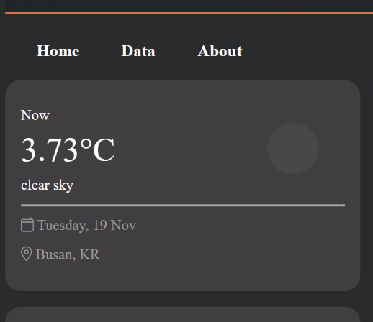
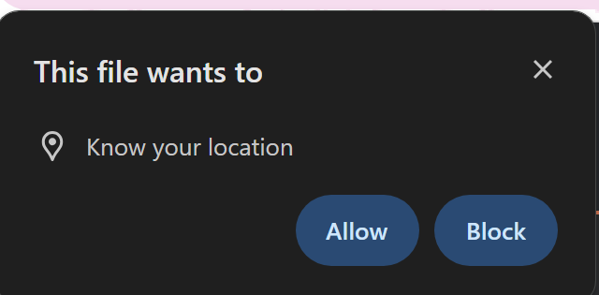
Demo

Slide 6
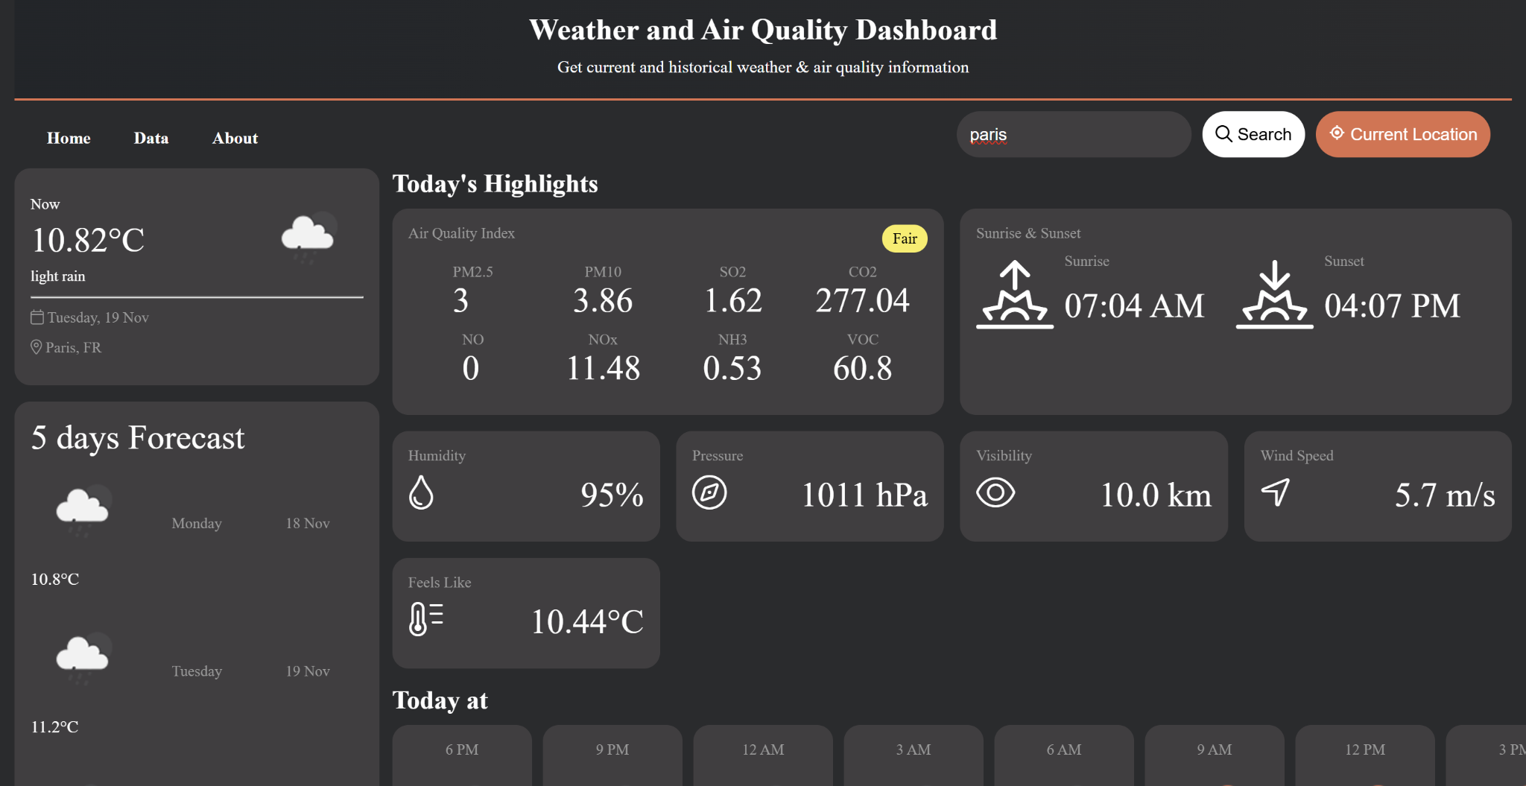
Demo

Slide 7
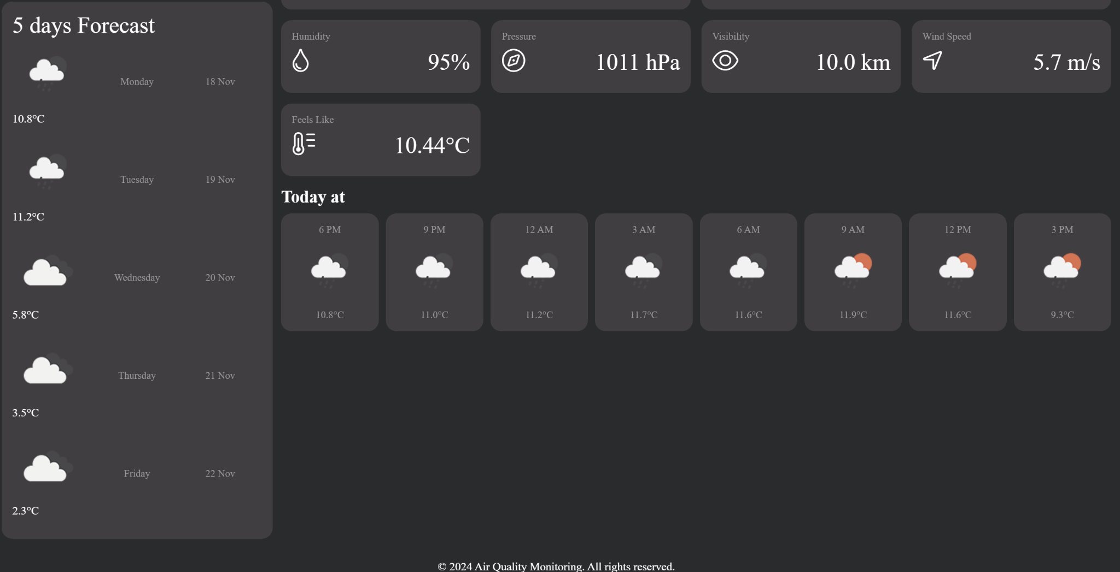
Demo

Slide 8
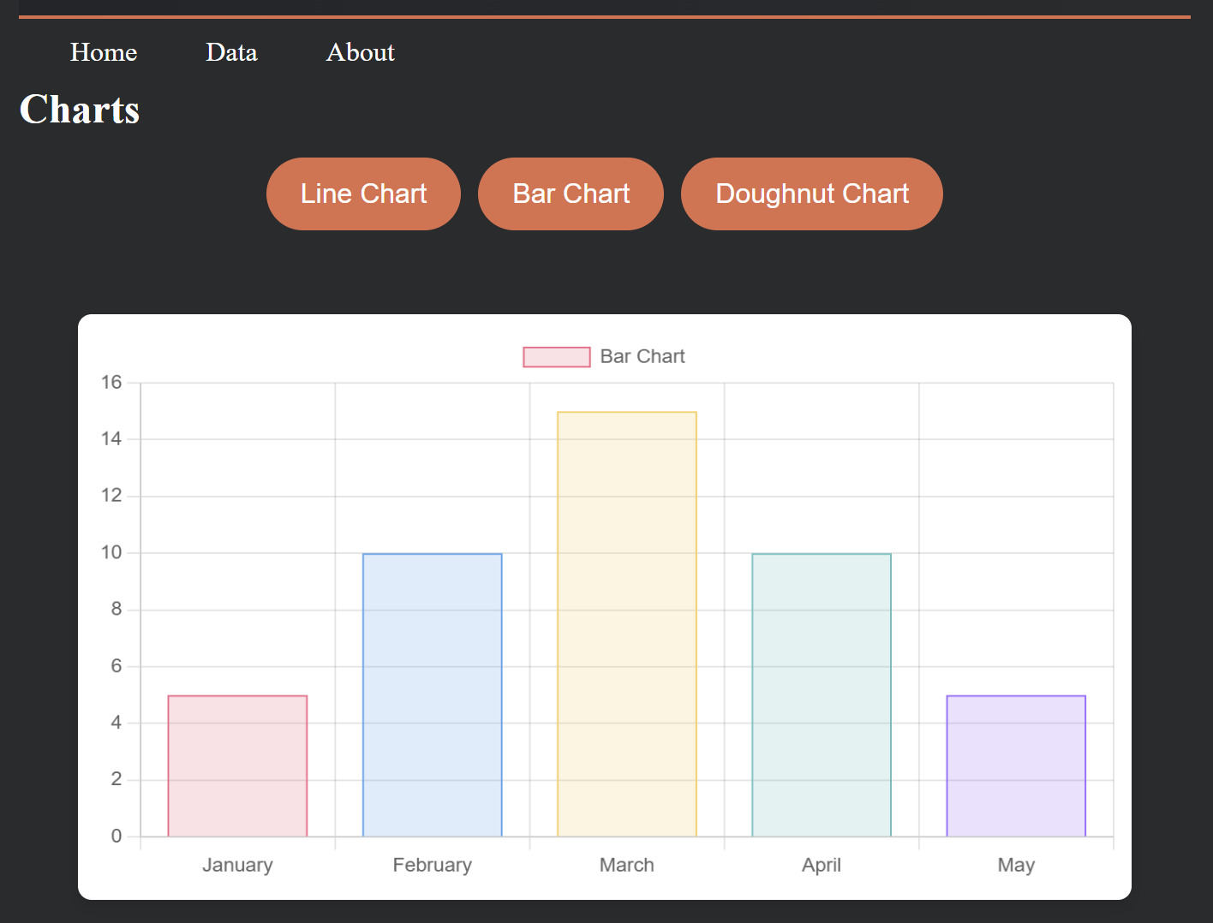
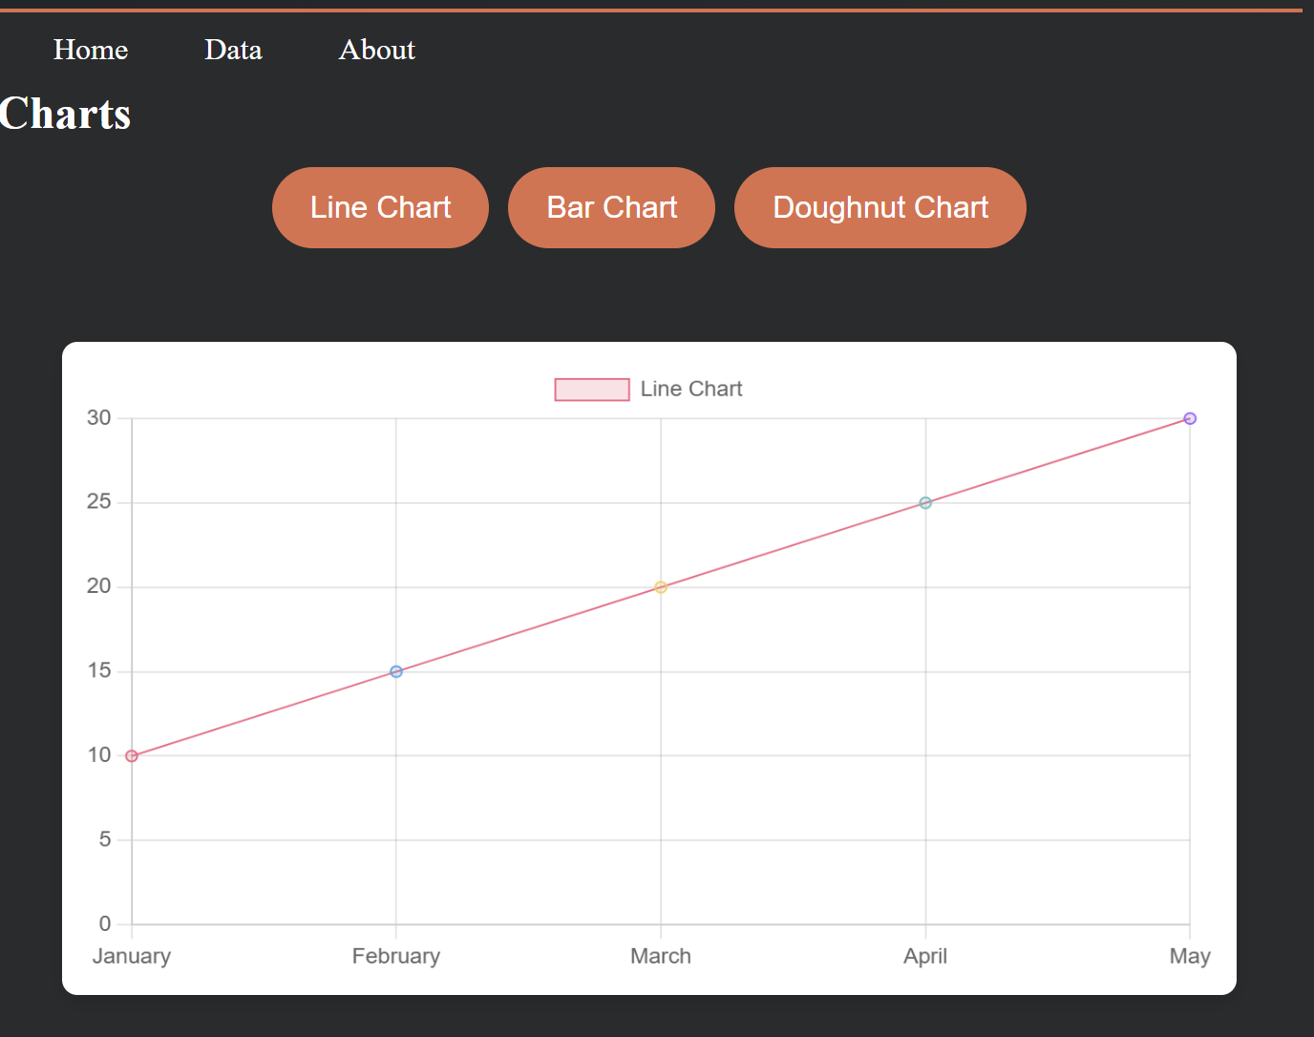
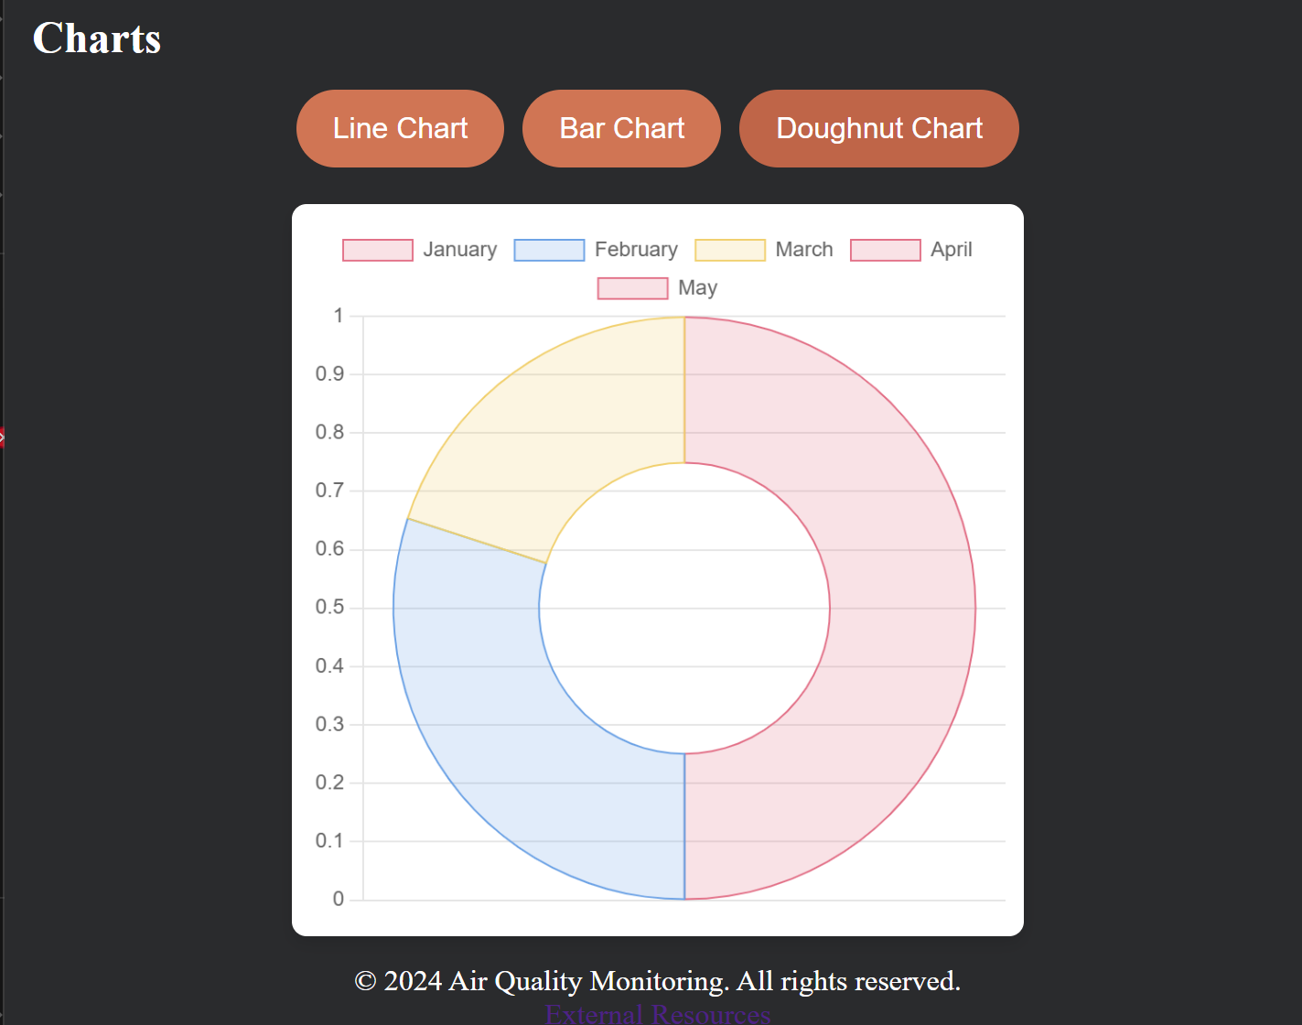

Slide 9
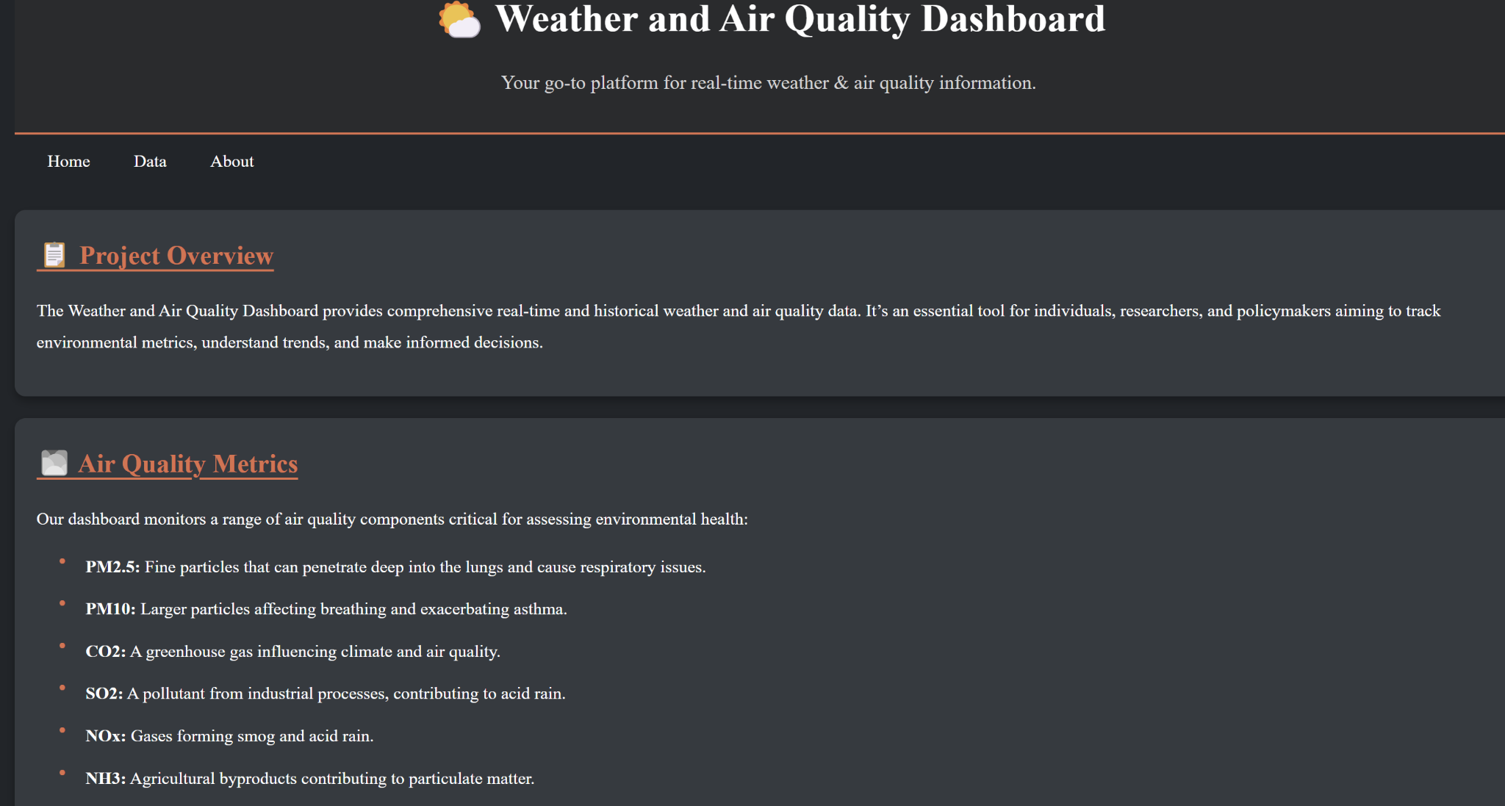

Slide 10
Upcoming features/improvisation
Translation: Add multi-language support.
API Updates: Fix and enhance chart functionality.
UI/UX Upgrades: Refresh design and improve user experience.
Additional Info: Include more relevant data for users.
Hover Effects: Make the interface more interactive and responsive.
Unit Conversion: Add options to toggle between Celsius and Fahrenheit.

