Slide 1
Scrum Management Tool
610557 Munkhzorig Bayartosgt
610561 Tuvshintur Batzorig
610567 Davaaabayar Battogtokh
MUM CS425-2019-10A-10D
1
Maharishi University of Management
Notes:
1

Slide 2

1. Problem scenario
For Software development teams using agile method
The Scrum Management Tool is a TMS (Ticket Management System) that encourages collaboration, transparency among team members.
It facilitates
communication,
organizes workload,
and helps members to plan for multiple iterations
discuss their progress and
bring up any issues that need attention.
2

Slide 3
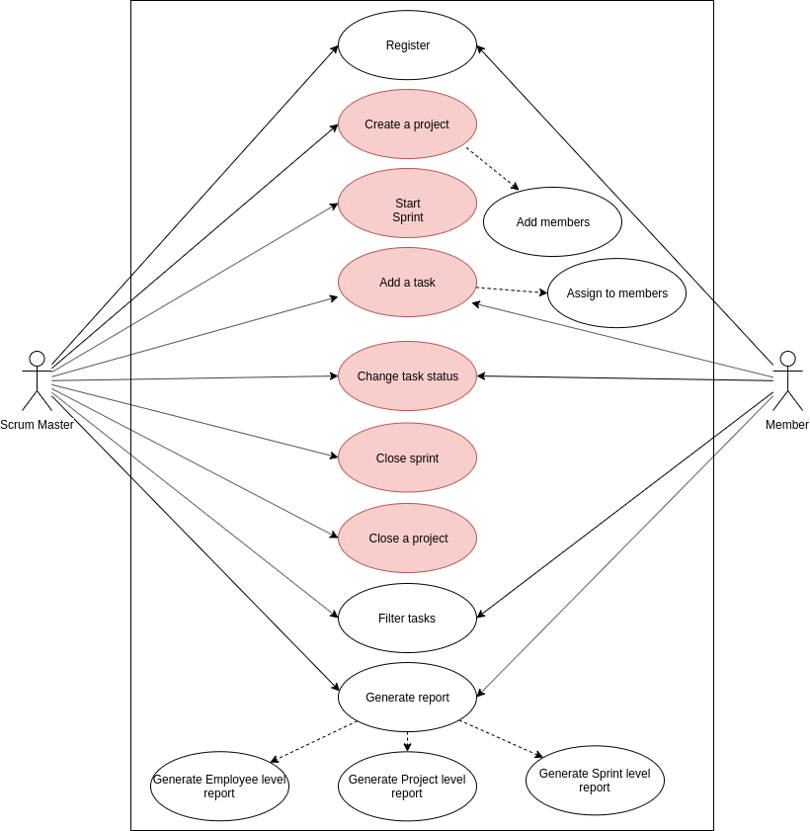
2.Use case diagram
3

Slide 4
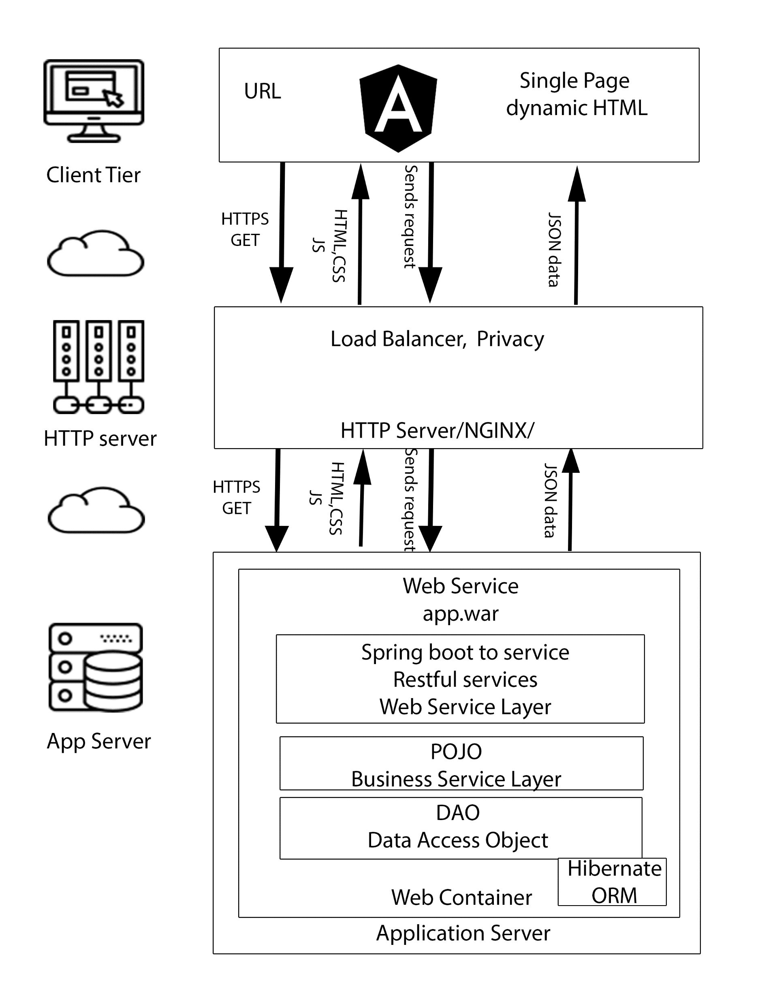


3. High level architecture & Technologies used
4

Slide 5
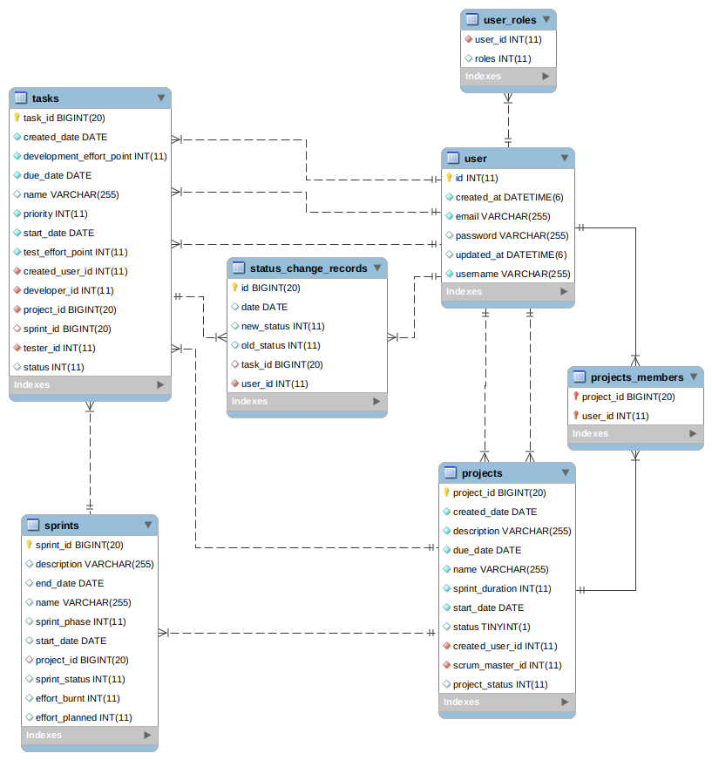
4. Key abstractions vs ERD
Project
Team member
Sprint
Backlog
Task
State Change record
5

Slide 6
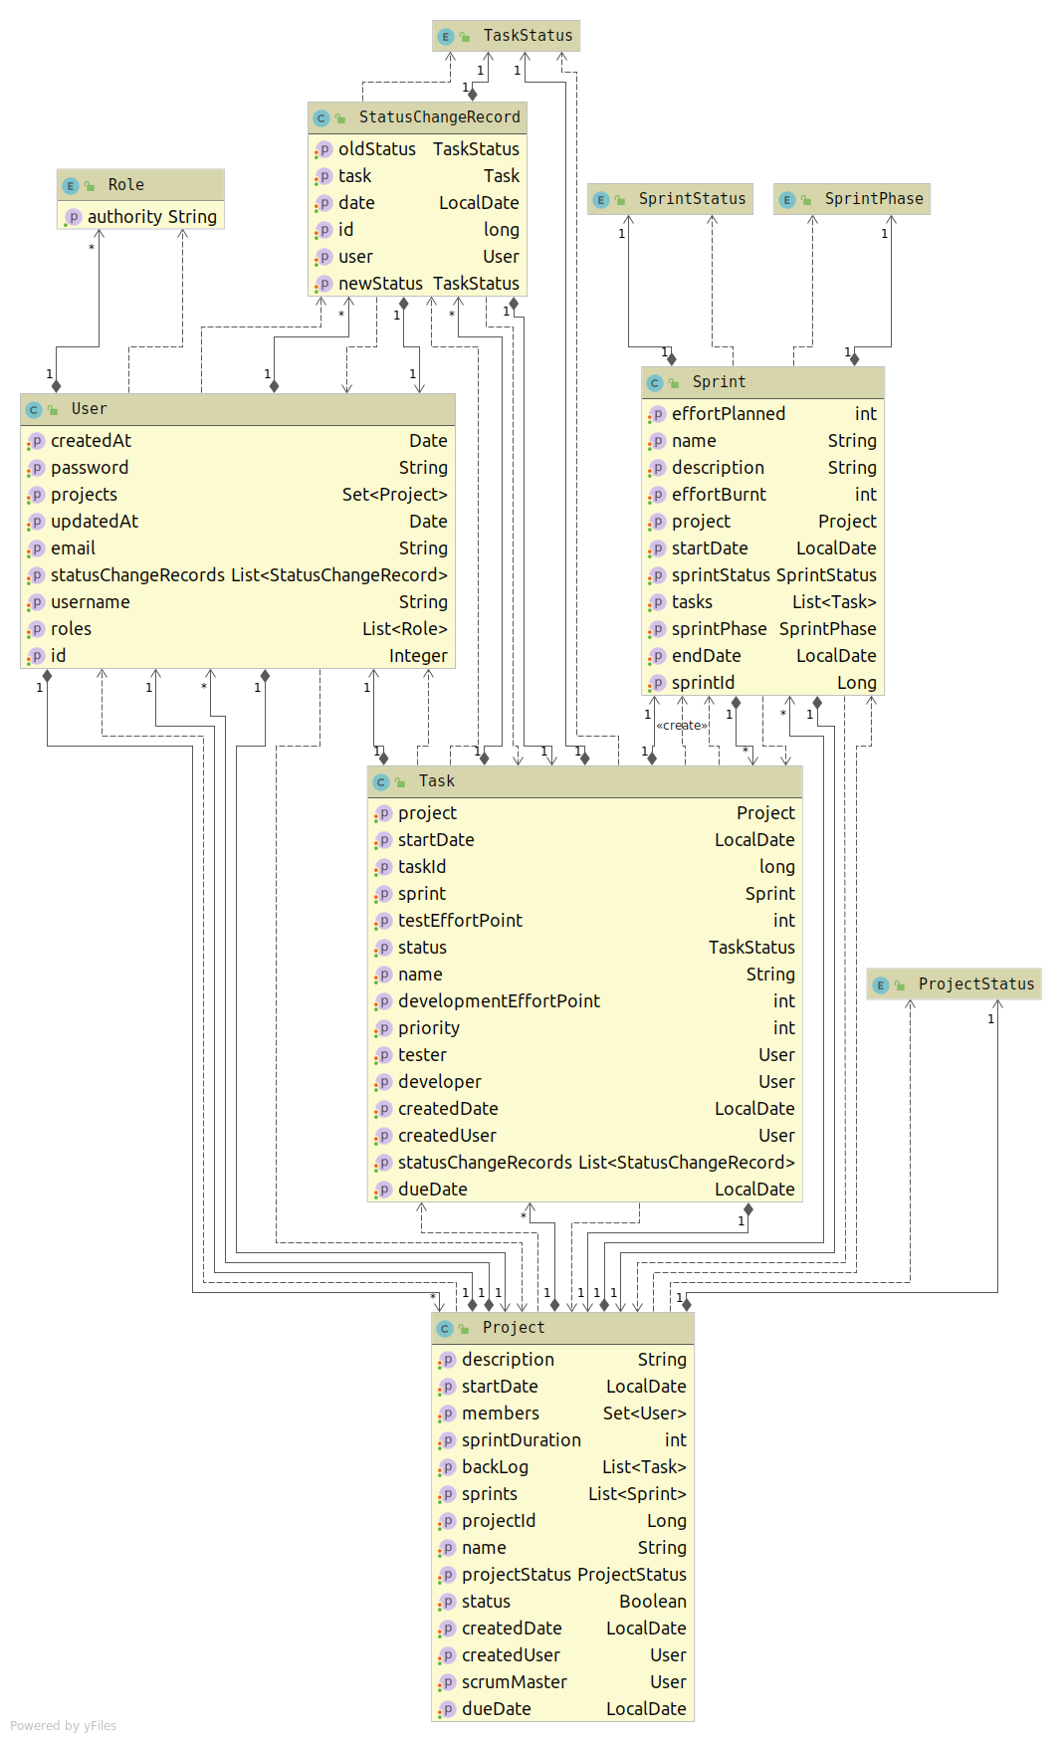
5. Class Diagram
6

Slide 7
6. Sequence Diagram
7

Slide 8
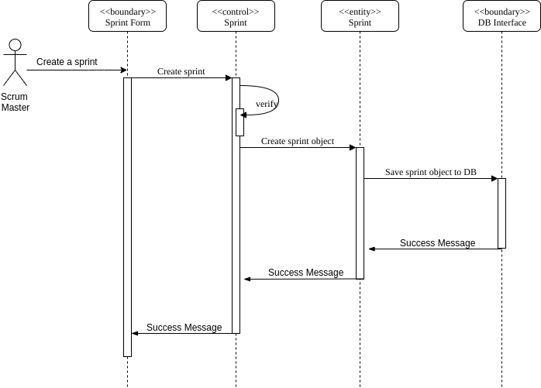
Create sprint
8

Slide 9
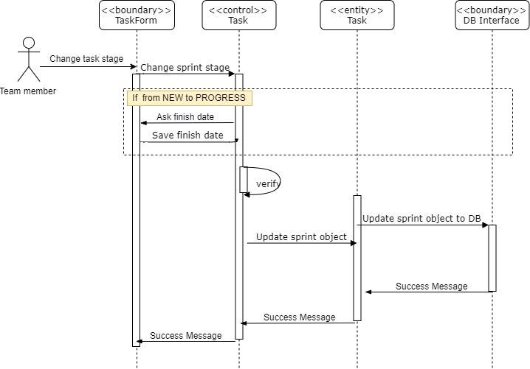
Change task stage
9

Slide 10
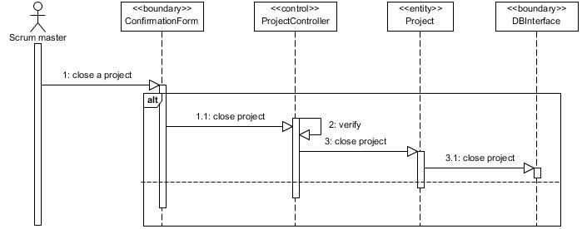
Close project
10

Slide 11
Thank you
Get a little bit of better
every single day.
MUM CS425-2019-10A-10D
11
Maharishi University of Management
Notes:
In Slide Show mode, click the arrow to enter the PowerPoint Getting Started Center.
11

