Slide 1
World University Rankings
Comparing and ranking universities is a complex and subjective task, given the variety of ranking systems and the criticisms they face.

Slide 2
Dataset
Times Higher Education World University Ranking (THE):HEAR
Academic Ranking of World Universities (ARWU):HEAR
Center for World University Rankings (CWUR):HEAR
Widely recognized and influential, THE ranks universities based on several indicators, including research, teaching, citations, industry income, and international outlook.
Also known as the Shanghai Ranking, ARWU emphasizes research power and raw metrics like publications and Nobel laureates.
A less well-known ranking from Saudi Arabia, CWUR uses various indicators like research output and quality of faculty to rank universities.

Slide 3
Answers questions

Slide 4
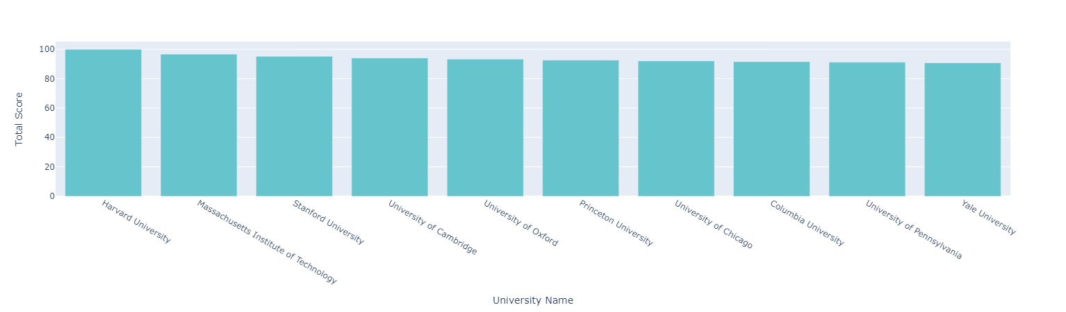
A1-Which universities are ranked in the top 10 globally?

Slide 5
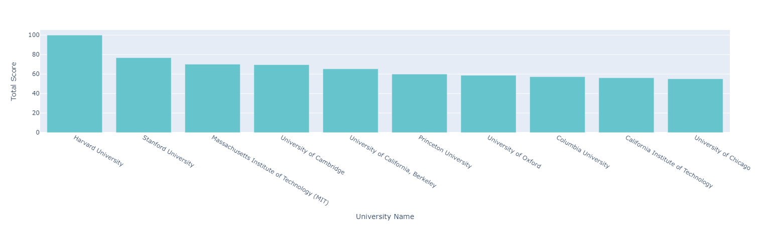
A2-Which universities are ranked in the top 10 globally?

Slide 6
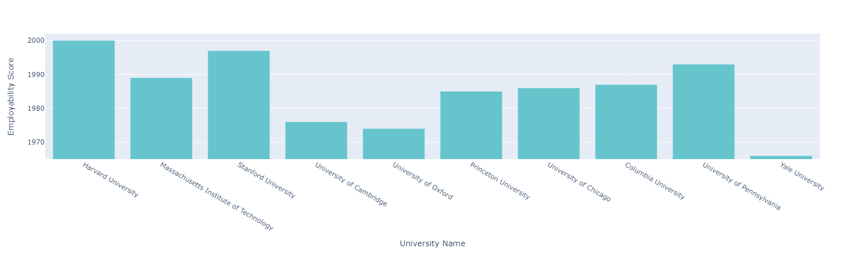
B. Which universities are ranked in the top 10 for employment outcomes?

Slide 7
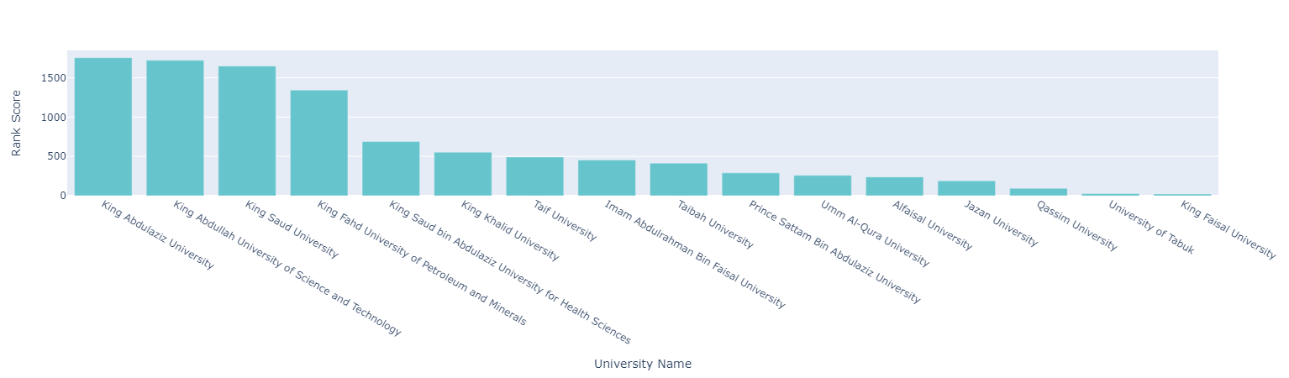
c. What positions do universities in Saudi Arabia hold within the global rankings?

Slide 8
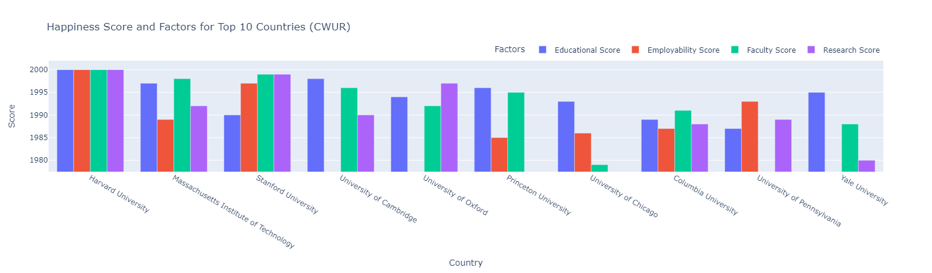
D. Considering various factors such as employment rankings, research rankings, and others, which has the most significant impact on a university's overall ranking?

Slide 9
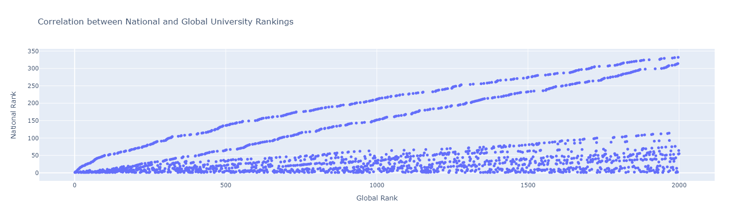
E1. Is there a correlation between national and global university rankings, and based on this information, can you recommend a country that appears to have a high concentration of top-ranked universities?

Slide 10
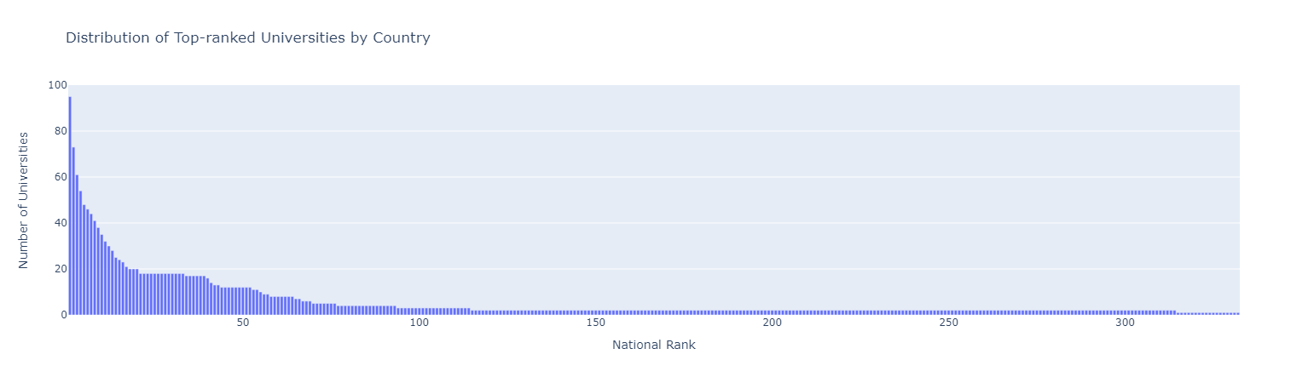
E2. Is there a correlation between national and global university rankings, and based on this information, can you recommend a country that appears to have a high concentration of top-ranked universities?

Slide 11
More question (Bonus)

Slide 12
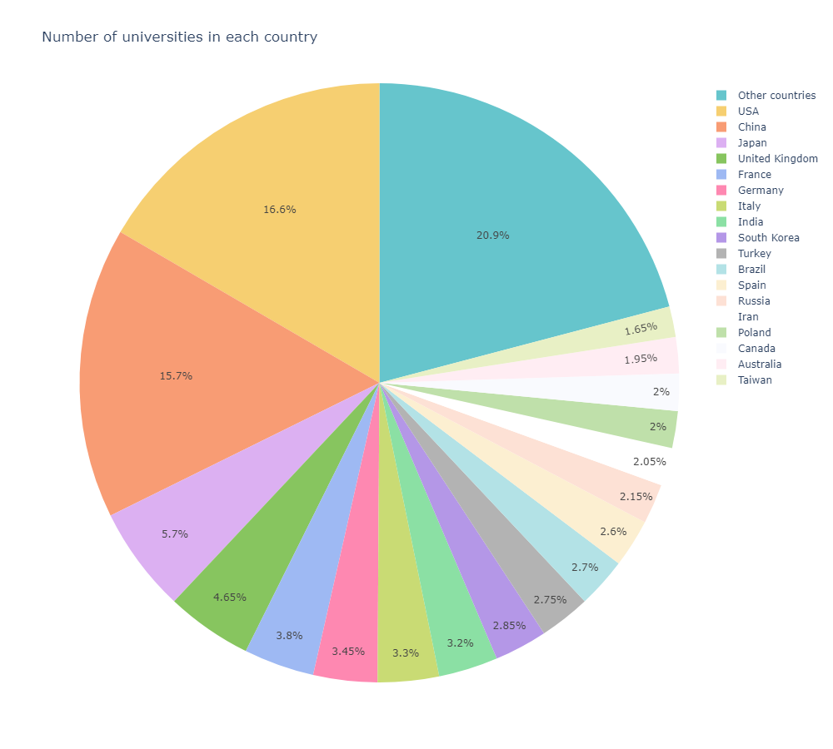
extra1) How many universities are there in each country?

Slide 13
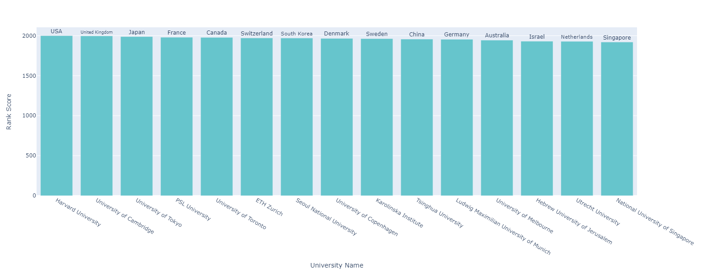
extra2)question what are the top 1 universities in each region or country?

Slide 14
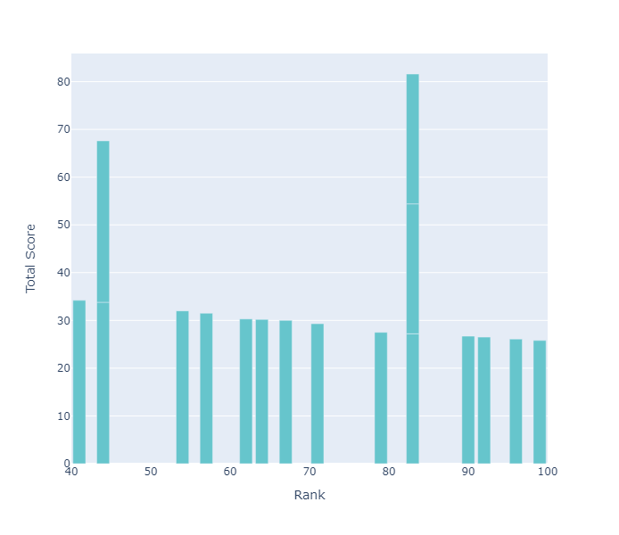
extra3)what is the most competitive rank(most repeated rank)?

Slide 15
Thanks
Any question??

