Slide 1
RANKING UNIVERSTIES
Usecase 3

Slide 2
DATASETS
Center World University Ranking
- fake nulls (for what it looks like unis without rank)
- Wrong data types
- To much outliers because the neccesary dublicats values and the empty nulls
- To much natural outliers

Slide 3
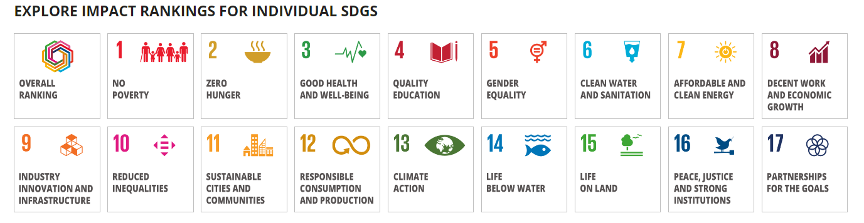
DATASETS
Times Higher Education World University Ranking
- Location 6% missing (we may need to fill it from google)
- missing links (no action needed)
- data date to 2023
SDGs

Slide 4
DATASETS
Shanghai Ranking
- Identical Scores: In the global ranking, there may be duplicates with identical scores.
- Range Ranks: Universities are ranked within ranges rather than precise positions.
- Alphabetical Order: If universities share the same rank, they are ordered alphabetically.
- Outliers: Top university scores are considered outliers as many scores are concentrated below the top 25.
- uplicates: Duplicates may occur within national rankings as well.
- The provided data reflects the year 2022 and has undergone extensive research and matching to ensure accuracy.

Slide 5
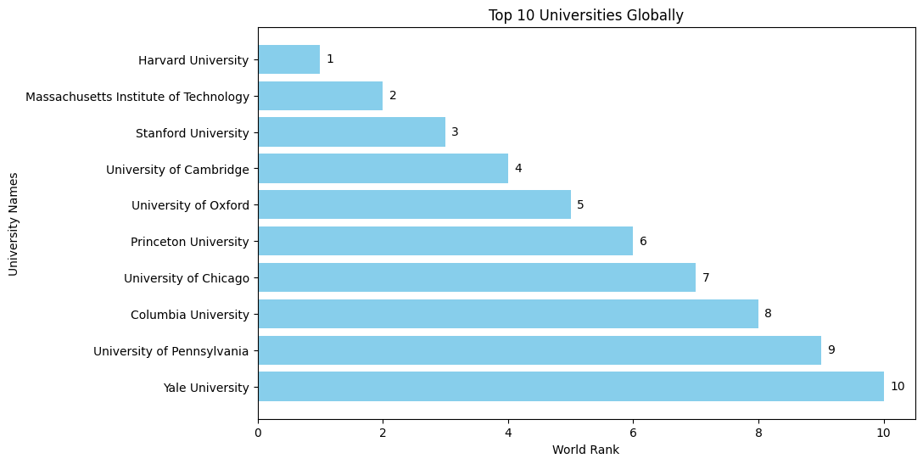
Q1 - Which universities are ranked in the top 10 globally?

Slide 6
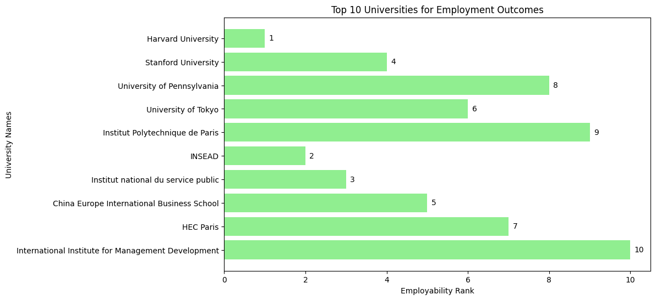
Q2 - Which universities are ranked in the top 10 for employment outcomes?

Slide 7
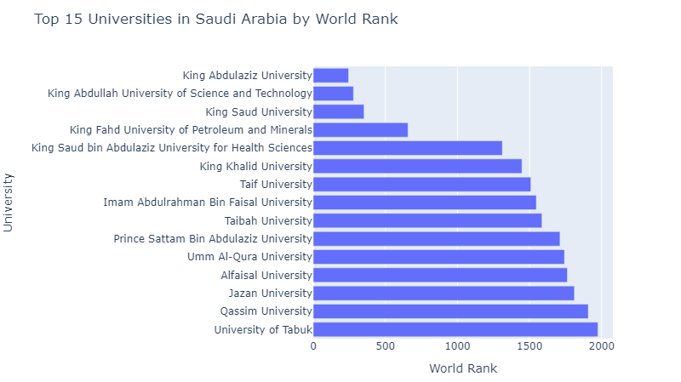
Q3 - What positions do universities in Saudi Arabia hold within the global rankings?
245
279
352
657
1311
1447
1509
1547
1586
1711
1742
1762
1811
1907
1974

Slide 8
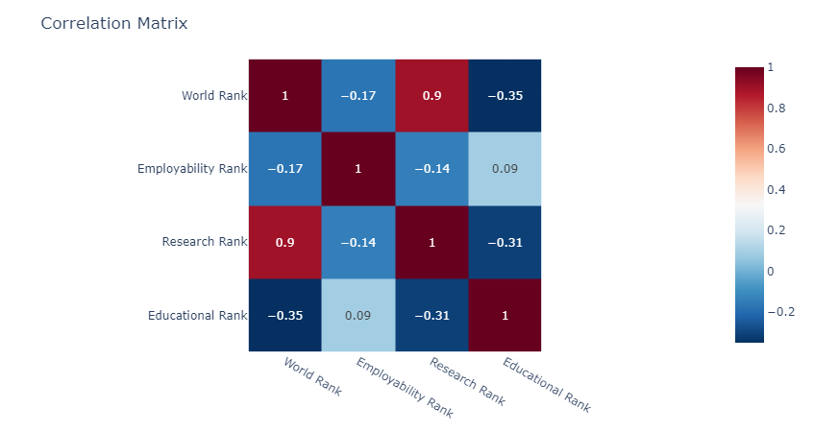
Q4 - Considering various factors such as employment rankings, research rankings, and others, which has the most significant impact on a university's overall ranking?

Slide 9
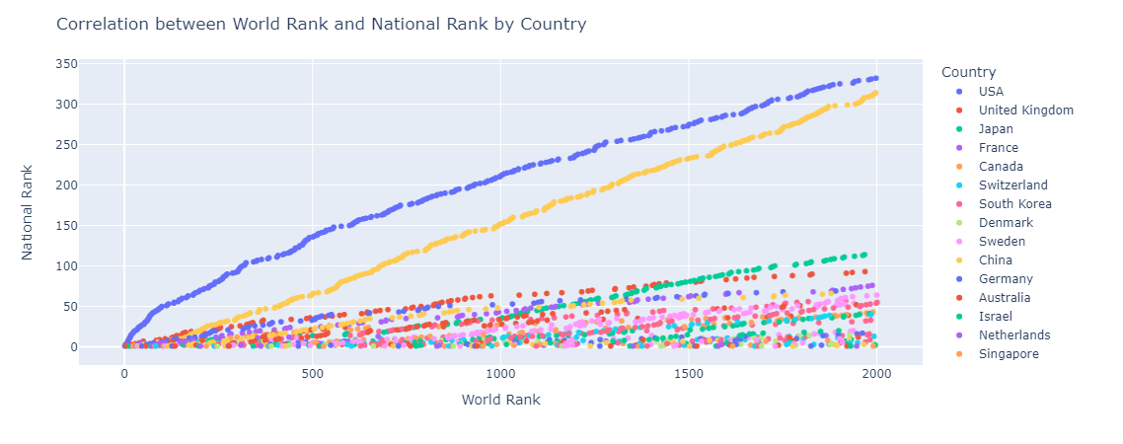
Q5 - Is there a correlation between national and global university rankings, and based on this information, can you recommend a country that appears to have a high concentration of top-ranked universities

Slide 10
THANK YOU
Any Questions?

