Slide 1

Secure Click

Slide 2
Team Members
Razan Alyahya
Munirah Alsahly
Rahaf Aladhyani
Waleed Almutairi

Slide 3
Introduction

Slide 4
Table of Contents
01
Problem Description
05
Data Modeling
02
Dataset
06
Results
03
Tools and Libraries
07
Challenges & Future Work
04
Exploratory Data Analysis

Slide 5
Problem
What is phishing

Slide 6
Did you know that 91% of successful data breaches started with a spear phishing attack?

Slide 7
Dataset
URL
SMS and Email
URLs
Type
Text
Type
Arabic
English

Slide 8



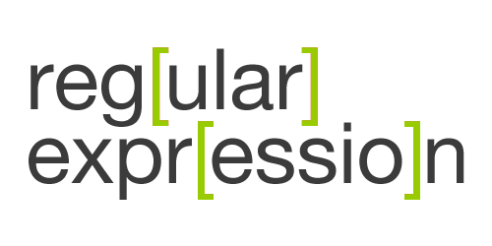

Tools and Libraries

Slide 9
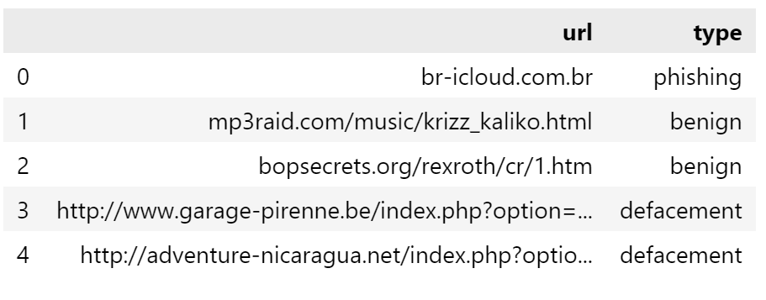
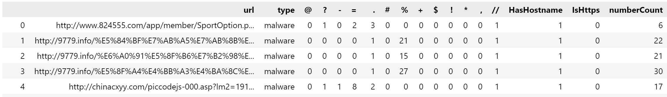
Exploratory Data Analysis (EDA)
For URL dataset:
Apply some feature extraction include extract the number of alphabets and digits, number of symbols , and hostname…etc.

Slide 10
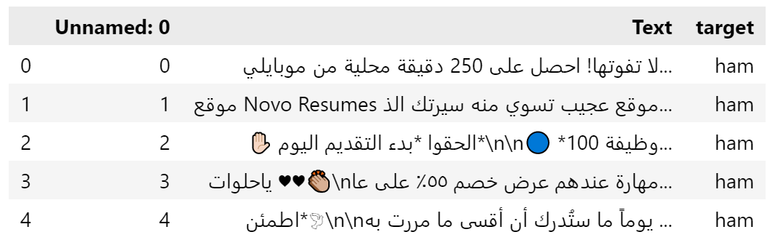
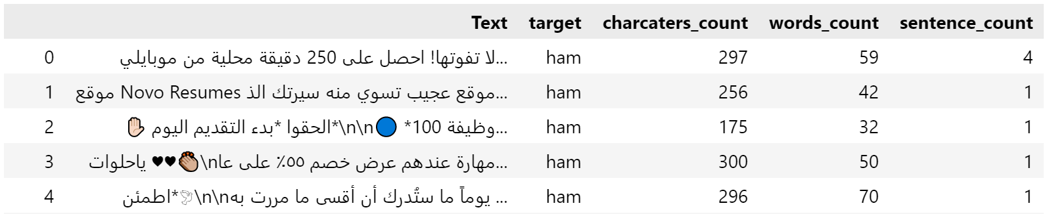
Exploratory Data Analysis (EDA)
For SMS and Email dataset:
Apply some feature extraction include extract the number of words, sentences and characters.

Slide 11
Exploratory Data Analysis (EDA)

Slide 12
Data Modiling
&
Results

Slide 13
URL Models
We used Machine Learning:
Gradient Boosting
Random Forest
Decision Tree
86%
86%
Logistic Regression
85%
80%

Slide 14
SMS and Email Model
We used Deep Learning:
Sequential Model
98%

Slide 15
Website Overview

Slide 16
Security check options
URL
SMS and Email
Website image
To check URL
To check message

Slide 17
Challenges & Future Work

Slide 18
Challenges
Dealing with Arabic Text
Implement Plotly Dashboard
Choose right model

Slide 19
Future Work
01
Develop website as mobile application
02
Add Some advices on the website to avoid phishing.
03
Add a feature to inform authorities about the phishing websites.

Slide 20
Any Questions?

Slide 21
Thank you

Slide 22
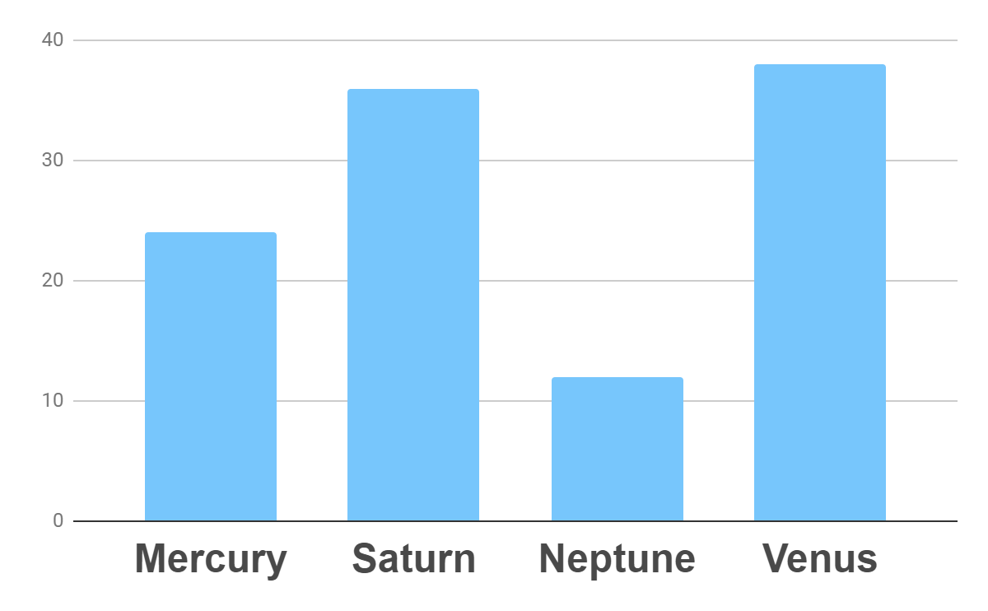
Analysis
Outreach
Top Rated Values
To modify this graph, click on it, follow the link, change the data and paste the new graph here

Slide 23
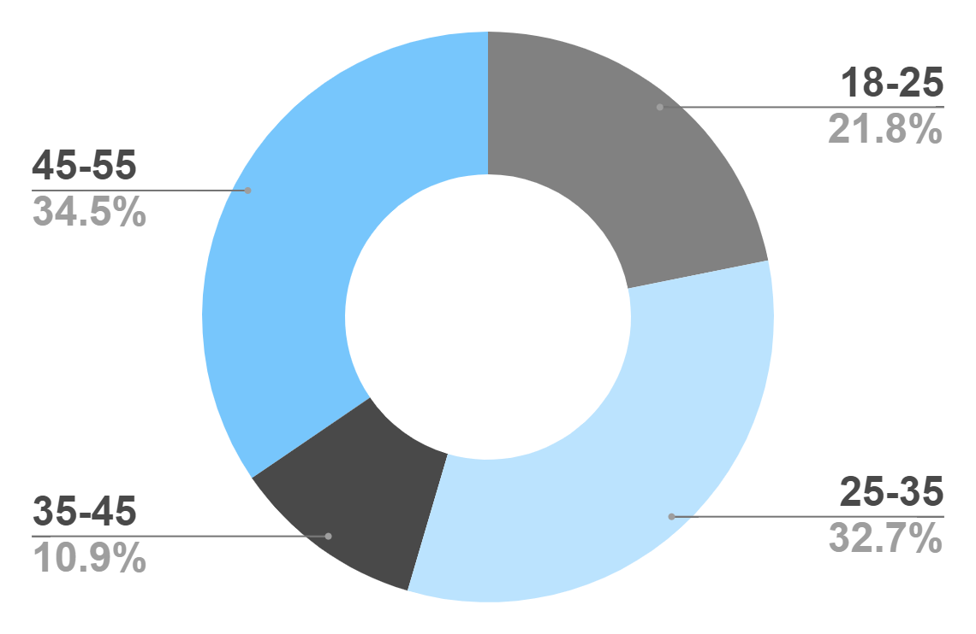
Target
Age
Gender
30%
70%
Interests
Security
Usability
To modify this graph, click on it, follow the link, change the data and paste the new graph here
Interface

Slide 24
Awesome Words

Slide 25
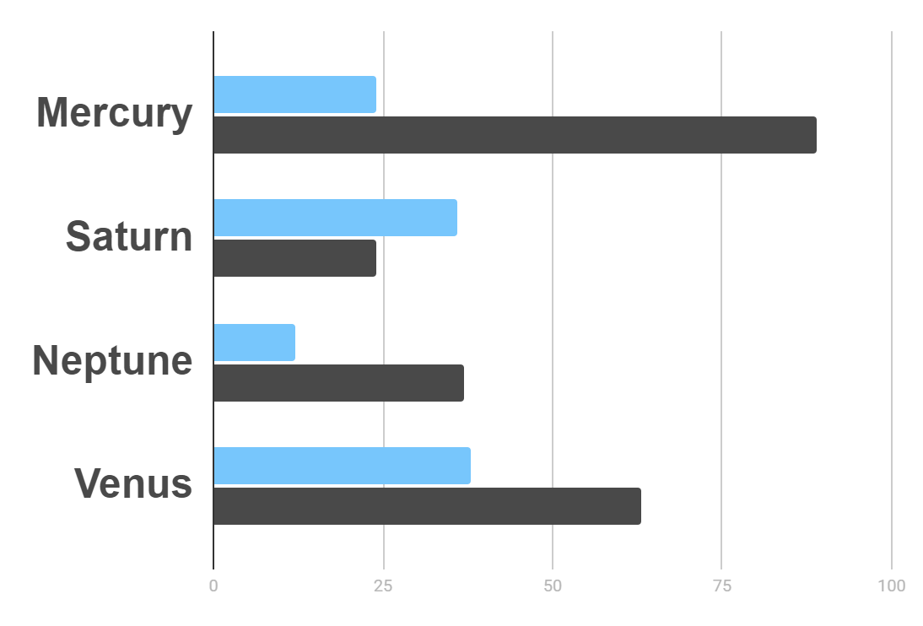
Market Research
Evolution
$20K
Gross Revenue in the Sector
10%
45K
To modify this graph, click on it, follow the link, change the data and paste the resulting graph here
Sector Growth

Slide 26
Whoa!
This could be the part of the presentation where you can introduce yourself, write your email…

Slide 27
Awards
Mercury
It’s the closest planet to the Sun
Venus
Venus is the second planet from the Sun
Jupiter
Jupiter is the biggest planet of them all

Slide 28
Our Partners
Mercury
Jupiter
Neptune
Mercury is the closest planet to the Sun
Jupiter is the biggest planet of them all
Neptune is the farthest planet from the Sun
Saturn
Mars
Venus
Saturn is the ringed one and a gas giant
Despite being red, Mars is actually a cold place
Venus is the second planet from the Sun

Slide 29
Testimonials
Helena James
“Mercury is the closest planet to the Sun”
Jenna Doe
“Jupiter is the biggest planet of them all “
Mary Patterson
“Neptune is the farthest planet from the Sun”

Slide 30
The Slide Title Goes Here!
Do you know what helps you make your point clear? Lists like this one:
They’re simple
You can organize your ideas clearly
You’ll never forget to buy milk!
And the most important thing: the audience won’t miss the point of your
presentation

Slide 31
Alternative Resources
Find more illustrations like these on Stories by Freepik

Slide 32
URL Models
For URL Models, we used Machine Learning:
 | Gradient Boosting | Decision Tree | Random Forest | Logistic Regression
Accuracy | 86% | 85% | 86% | 80%

Slide 33
SMS and Email Model
For SMS and Email Model we used Deep Learning:
 | Sequential Model
Accuracy | 98%

Slide 34
…And the Same Goes for Tables
 | Mass (earths) | Diameter (earths) | Gravity (earths)
Mercury | 0.06 | 0.38 | 0.38
Mars | 0.11 | 0.53 | 0.38
Saturn | 95.2 | 9.4 | 1.16

