Slide 1

Natural Language Processing (NLP)

Slide 2
Text Data
Unstructured data type that is formatted as text.
It is popular in the internet, so it is used in social media (tweets), Microsoft word documents, pdf documents, emails, web content, surveys and reviews, news and articles, etc. Almost everywhere.
As a data scientist, what can we do to prepare the textual data? So that we can make analysis and fed it into machine learning models to get more accurate predictions?
This is why we need Natural Language Processing (NLP).

Slide 3
What is NLP?
It is a subfield of linguistics, computer science, and AI concerned with the interactions between computers and human language.
The main question is, how to program computers to process a large amounts of natural language data?

Slide 4
Applications of NLP
Sentiment Analysis.
Machine Translation.
Auto Completers.
Auto Correctors.
Chatbots.
ChatGPT.
Information Retrieval.
Grammer Checking.
Text Categorization.

Slide 5
NLTK : Natural Language Toolkit Library is a popular open source platform providing Python.
TensorFlow and Keras : Deep Learning Framework platform, Popular for more deep applications.
Other toolkits and frameworks such as PyTorch, Pyarab, CAMeL, etc.
NLP Frameworks and Libraries

Slide 6
NLP Lifecycle
1. Corpus collection : Gather the textual data, such as documents, web pages, tweets, articles, etc.
2. Text cleaning : Remove unwanted characters, such as HTML tags, handle incorrect spellings, etc.
3. Text preprocessing : Tokenization, Sentence segmentation, Lowercasing (Normalization), Remove stop words and punctuation marks, Stemming or lemmatization.

Slide 7
NLP Lifecycle
4. EDA of text : All EDA methods can be used to explore the textual data, such as find insights of the word frequency, distribution, and other relevant statistics.
5. Numerical Representations :Convert the pre processed textual data into numerical representations using techniques like Bag of Words, TF-IDF, Word Embedding, etc.
6. Train the Model : In some tasks such as the sentiment analysis, or text categorization, we can use the machine learning algorithms or neural networks to train the model.

Slide 8
Text Preprocessing and Cleaning

Slide 9
Text Preprocessing
The main question for data scientists, how can I use data science tools to prepare the textual data for training a models.
Will, there are a several techniques used for this situation.
in this lecture we will discover the following techniques :-
Text Cleaning.
Regular Expressions.
Tokenization and Normalization.
Sentence Segmentation.
Stemming or lemmatization.
Remove Stop Words and Punctuation Marks.

Slide 10
Text Cleaning.
It is the process of removing the unwanted characters in the corpus to reduce noisy in texts, such as HTML tags, special characters, extra spaces, numbers, etc.
It depends on the problem you are trying to solve.
You can use regular expressions to solve this situation, or use your logic to solve it!!

Slide 11
Regular Expressions
Grammatical formalism useful for defining regular grammars.
We can use regular expressions for text preprocessing as well.
For example, clean the every tweet that contains a Hyperlinks, Hashtags, or Mentions.
It is useful technique for cleaning the texts in NLP.
It is used to remove all unwanted texts (unimportant words or symbols) from the given text.

Slide 12
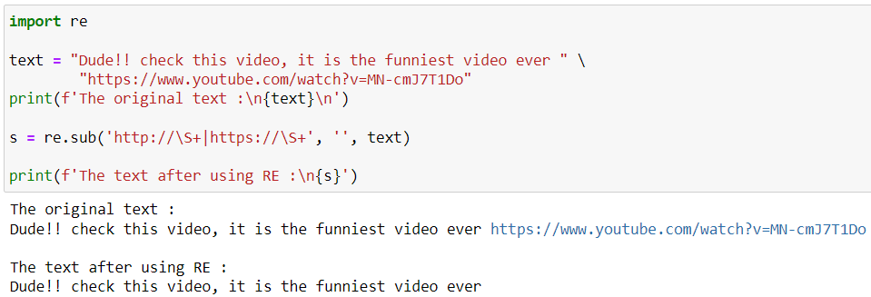
Regular Expressions
Example in Python using RE to remove URLs

Slide 13
Tokenization
The process of breaking up (split) text into words, wordforms, phrases, symbols, or other meaningful elements which are called tokens.
Example :-
Text = ‘Hello, World!’
Tokens = Tokenization(Text)
Print(Tokens)
Output :-
[‘Hello’, ‘,’, ‘World’, ‘!’]

Slide 14
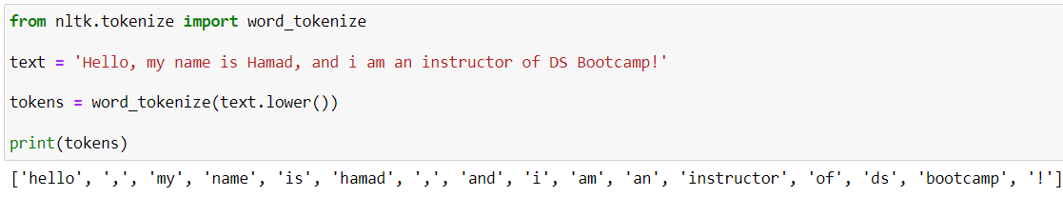
Tokenization
Example in Python using NLTK :-

Slide 15
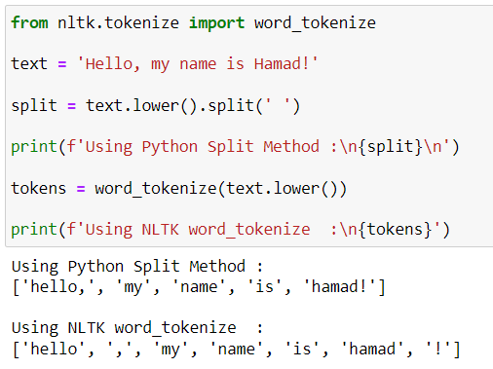
Why Tokenization instead of Normal Split?

Slide 16
Sentence Segmentation
Split the document into a sentences.
Text may contains more than one sentence. It may seem intuitive to split a document into sentences, then tokenize them.
The split method from Python, may not accurate if you split them based on “.”
For instance, see the following document :-
Mr. Hamad is the best.
U.S.A is a north American country.

Slide 17
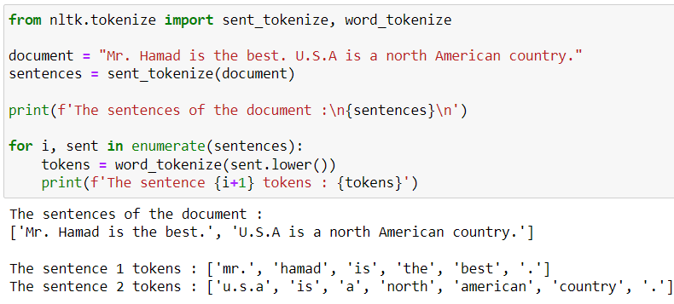
Sentence Segmentation
Example in Python using NLTK

Slide 18
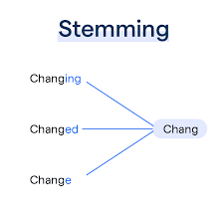
Stemming
Is the process that used to remove suffixes from words to get their root form.

Slide 19
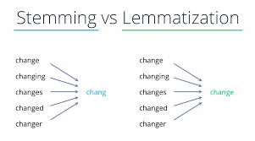
Lemmatization
More complicated than stemming, it reduces words to their base. It is makes sense in the language. To solve this situation, lemmatization requires linguistic resources (dictionaries) and part of speech taggers.

Slide 20
Part of Speech (POS)
Refers to the grammatical category or syntactic class that a word belongs to in a sentence (Noun, Verb, etc).
We use POS for not just lemmatization, also :-
Named Entity Recognition.
Machine Translation.
Grammer Checking.
Text Summarization.

Slide 21
Stemming and Lemmatization
Lemmatization | Stemming | Word
Jump | Jump | Jumping
Fly | Fli | Flies
Information | Inform | Information
Run | Run | Running
Examination | Examin | Examination

Slide 22
Stemming
Advantages of Stemming :-
Speed
Simple
Disadvantages of Stemming :-
Loss of meaning
Over stemming and Under stemming
May reduce the words too much, or may not
reducing words enough.

Slide 23
Lemmatization
Advantages of Lemmatization :-
Linguistic accuracy
Disadvantages of Lemmatization :-
More complex than stemming
Almost all cases, lemmatization requires external dataset

Slide 24
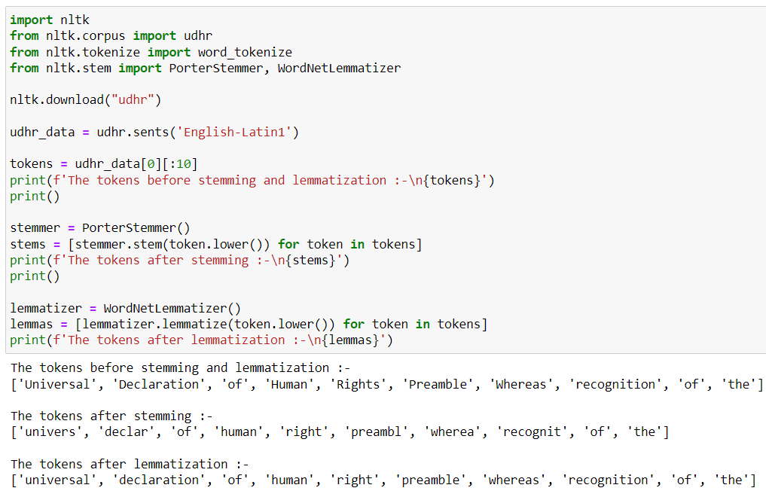
Stemming and Lemmatization

Slide 25
Remove Stop Words and Punctuation Marks.
The process of removing stop words and punctuation marks from a given text.
Stop words are the most common words in a language that are to be filtered out before processing the text data.

Slide 26
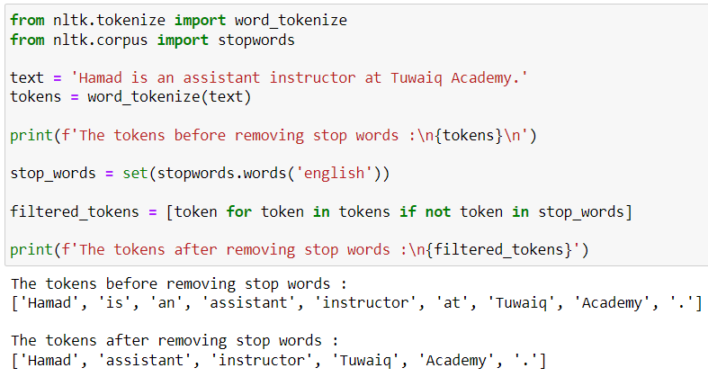
Remove Stop Words.
Example in Python using NLTK

Slide 27
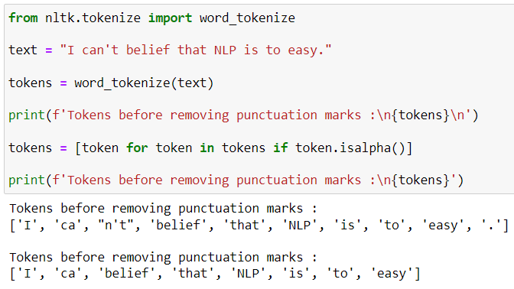
Remove Punctuation Marks.
Example in Python

Slide 28
Putting all together
Collect and Read the Data.
Text Cleaning (remove unwanted characters).
Tokenization or Sentence segmentation.
Normalization or Lowercasing.
Remove stop words and punctuation marks.
Stemming or Lemmatization.

Slide 29
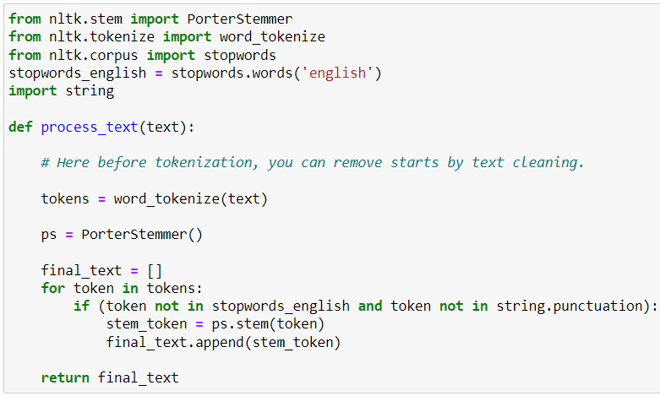
Generalized Text Preprocessing Function

Slide 30
Feature Extraction

Slide 31
Feature Extraction Techniques
It is the process of converting textual data into a numerical representations for machine learning models.
There are several techniques in NLP, such as :-
Bag of Words.
Term Frequency – Inverse Document Frequency (TF-IDF).
Negative and Positive Frequencies.

Slide 32
Bag of Words
Represents text by counting word occurrences in a document, and creating a simple representation.
Each document is a vector representation.
It does not take into account the word order or context, it just consider the word frequency within a document.
Easy to implement.

Slide 33
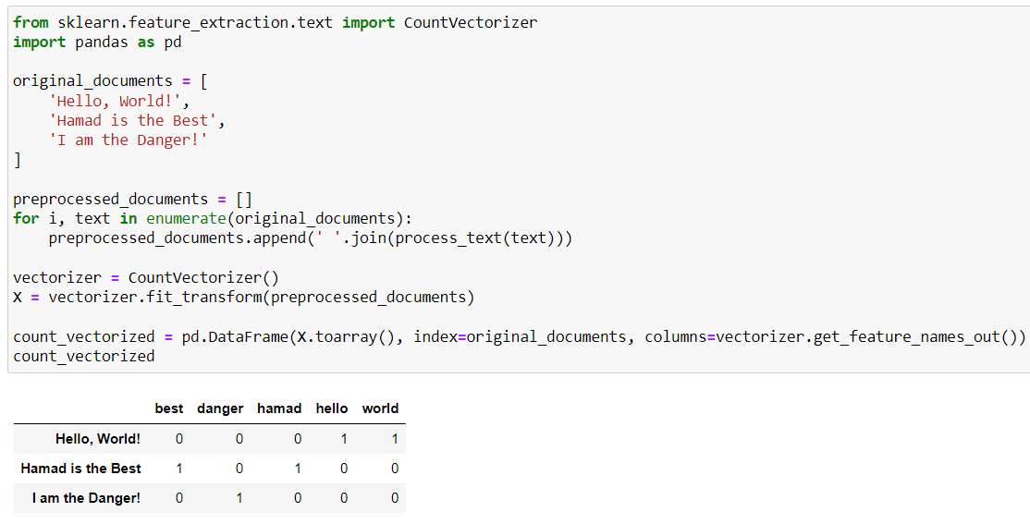
Bag of Words
Example in Python

Slide 34
TF-IDF
Numerical representation that qualifies the importance of a word in a document relative to a collection of documents (dataset).
It represents document as numerical vectors.
It take into account the word importance.
It helps to identify the discriminative terms.

Slide 35
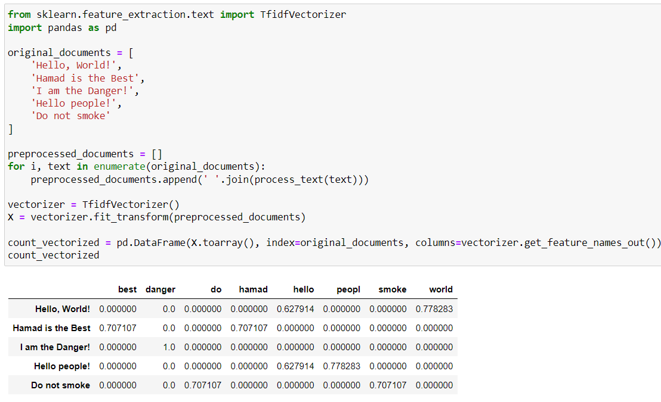
TF-IDF
Example in Python

Slide 36
Problems of Bag of Words and TF-IDF
Sparsity representation : Most entries in the vectors are zeros, which can lead to loss the efficiency, memory space, and computational time.
High Dimensionality : This problem can lead to computational challenges, increase the complexity time, and require a very large amount of data.
Vocabulary size : The number of columns is the number of unique words, it maybe large than the number of rows (documents) in some cases, which is bad thing for some tasks.

Slide 37
Negative and Positive Frequencies
Counting frequencies is the process telling the occurrence of tokens in the corpus. It helps identify which tokens are more common in positive, or negative sentiments.
The main idea of this method is to solve the sparse problem and reduce dimensionality of the dataset.
It is used in text classification and categorization.

Slide 38
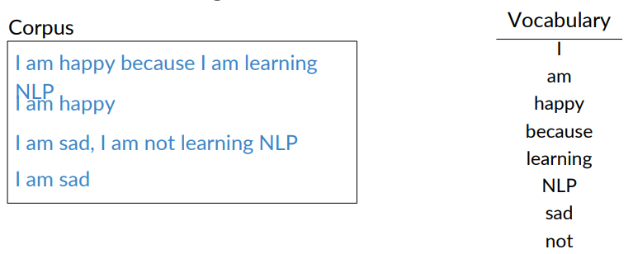
Vocabulary
First, we need a vocabulary, that each element is a unique token, maps to the number of its frequencies in the corpus.
Note : The vocabulary is after preprocess the texts.

Slide 39
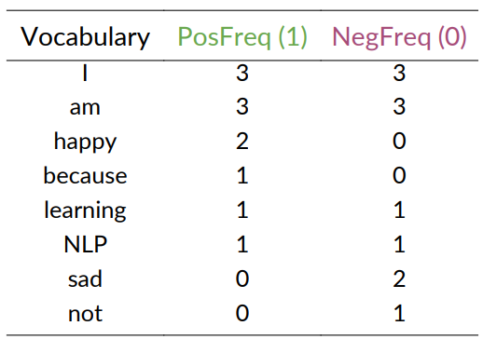
Count Frequencies.
Second, we need to count how many time, that each word occurred in the positive texts, and in the negative texts.

Slide 40
Count Frequencies.
Note : You can use NLTK to use FreqDist Library in Python to Count Frequencies then extract the features.

Slide 41
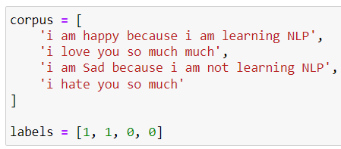
Vocabulary and Count Frequencies.
Suppose you have the following dataset

Slide 42
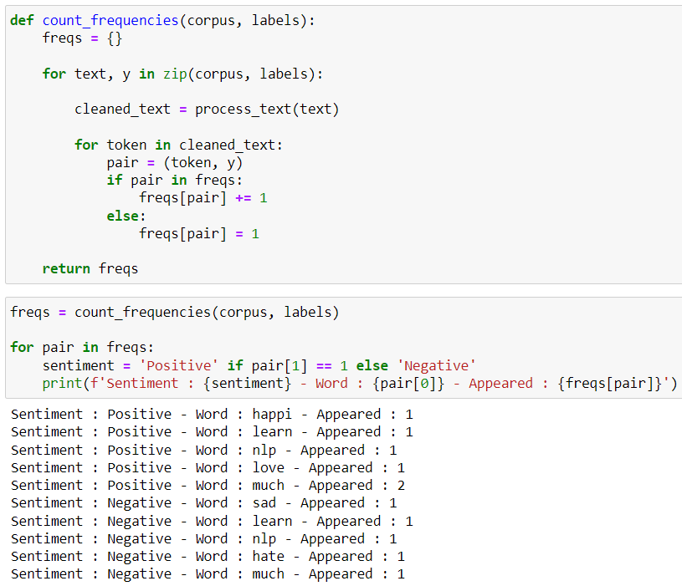
Vocabulary and Count Frequencies.

Slide 43

Feature Extraction using Frequencies.
Feature extraction is the process of transforming textual data into suitable format that the models can use it for sentiment analysis (classification) by using the negative and positive frequencies.
For each text, sum all the frequencies of the positive tokens and sum all the frequencies of the negative tokens.

Slide 44
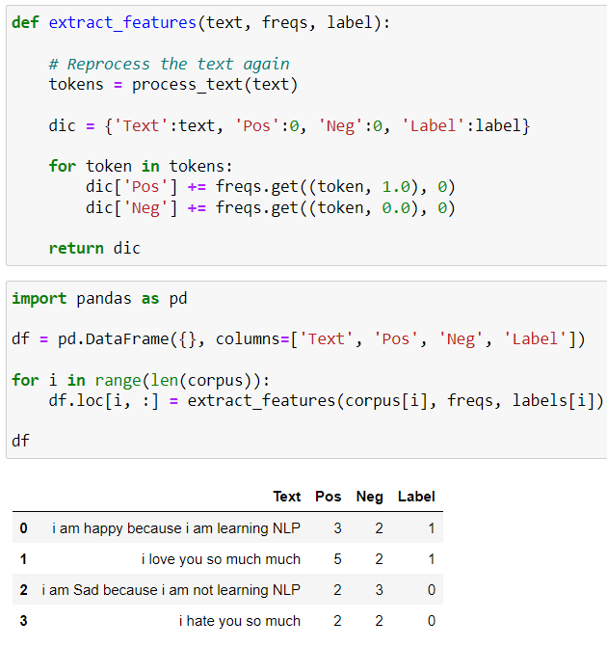
Feature Extraction using Frequencies.

Slide 45
Thank You

