Slide 1

EDA and Data Cleaning

Slide 2
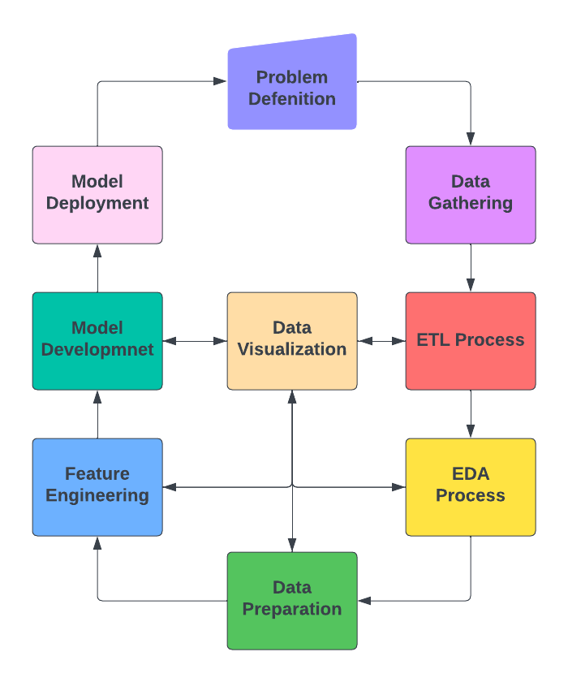
Data Science Life Cycle

Slide 3
EDA
Known as Exploratory Data Analysis (EDA).
It is the step after collecting or gathering the data.
Mainly came after ETL process.
What is EDA?
It is the process of examining data in order to reveal new information.

Slide 4
EDA (Continue)
The Objectives of EDA to make a better decisions
Summarizing the data.
Test and evaluate prior assumptions.
Reveal underlying data structure.
Determine important features/factors.
Identify unwanted elements.
Determine best path forward.
Covering the patterns, relationships between variables, and identify the outliers.
EDA is a flexible and often employs visualizations.

Slide 5
Types of Analysis
Descriptive Analysis
The process of summarizing and understanding the data.
That means using the statistics to see the state of the
data.
Examples in Python :-
df.head(), df.tail(), df.describe(), df.info(), df.shape…
After understanding the data statistically, we need to go forward to visualize these data in a good way.

Slide 6
Types of Analysis
2. Univariate Analysis
The process of understanding the summary of one
variable using data visualization techniques.
Numerical Data | Categorical Data
Histogram | Bar Chart (Ordinal)
Density | Pie Chart (Nominal)

Slide 7
Types of Analysis
3. Multivariate Analysis
The process of understanding the summary of two or more
variables using data visualization techniques.
Numerical Vs. Numerical | Numerical Vs. Categorical | Categorical Vs. Categorical
Scatter Plot | Bar Plot | Clustered Histogram
Line Chart | Scatter Chart | Clustered Bar (Side-by-side Bar)
 | Violin Plot
 | Box plot
 | Clustered Bar
 | Swarm Plot

Slide 8
Types of Analysis
Multivariate Analysis
Bar Chart
Scatter Chart
Line Chart

Slide 9
Univariate Analysis
Distribution Plots | Comparison Plots | Composition Plots
Histogram | Bar Chart | Pie
Frequency Polygon Plot | Line Chart | Waffle
Density Plot | Run Chart | Tree Map
Box Plot | Sparkline | Waterfall
Violin Plot | Lag Plot
Strip Plot | Circular Area (Summary) Plot
Swarm Plot | Cartograms plot

Slide 10
Multivariate Analysis
Distribution Plots | Comparison Plots | Composition Plots | Relationship Plots
Scatter Plot | Side-by-Side Bar Chart | Stacked Area | Scatter Plot
Joint Plot | Heatmap | Stacked Bars | Bubble Chart
Sterogram Plo | Run Chart | Tornado
Surface Area | Cartograms plot
Level Curve
Box Plot
Violin Plot

Slide 11
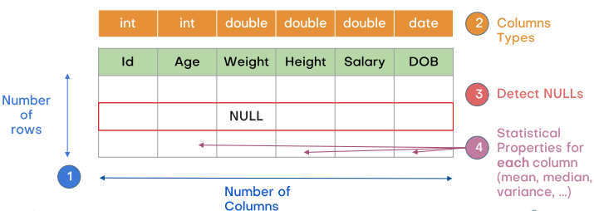
Basic Steps of EDA
How many rows and columns?
What are the data types of these columns?
What are the names of these columns?
Is there any incorrect names?
Is there any duplicated rows?
How many missing data?
How many error data?

Slide 12
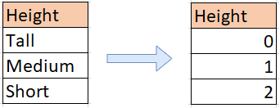
EDA (Continue)
It is easy to identify the data types, but feature types can be more difficult.
Example :-
- Color Feature :
Formatted as Integer (1, 2, 3, ..)
As humans, we see that the color is a category, but
looks ordinal number to the machine.

Slide 13
EDA (Continue)
If features are descriptive enough, you may be able to guess their type, or prior domain knowledge can be helpful!!
However, no fool-proof way to determine feature type, use critical thinking and review data thoroughly.

Slide 14
Feature Relevance
You need to consider how relevant features are to the problem.
Example :
Age might seem to be great predictor of income.
Irrelevant features can impact the usefulness of your model.
Domain knowledge can help you identify feature relevance.

Slide 15
Guidelines for EDA
Spend a fair bit of time interacting with the data you will working with.
Use charts to begin to understand the data.
Use multiple charts of different fields to determine correlation between these fields.
Examine a number of small portions of dataset to understand relationships.

Slide 16
Data Cleaning

Slide 17
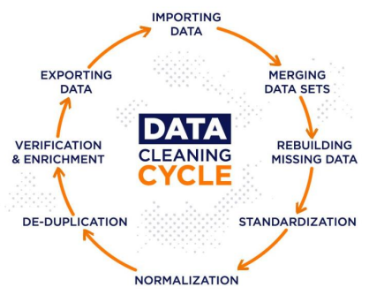
Data Cleaning

Slide 18

Data Cleaning
It came after diagnosing (explore) the data.
It is the process of enhancing the raw data to make the machine learn from it in proper way.
Data cleaning includes :
Handle missing data.
Remove duplicates.
Remove unwanted features.
Fix the data types.
Encoding categorical variables.
Scaling numerical variables.
Standardization and Normalization.

Slide 19
Missing Data
What is the missing data?
- Incomplete information provided by participants.
- Non-response from those who decline to share information.
- Poorly designed surveys.
- Removal of data for confidentiality reasons.
How the missing data represented?
- Common placeholder for missing data is NaN
- NumPy uses the IEEE standard for binary floating point for
arithmetic (IEEE 754). This means that Not a number and is not
equivalent to infinity.
- Pandas has a method called fillna() that can help us with handling NaN
values.
- However, sometimes the missing values are represented as ?, :, *, etc.

Slide 20
Missing Data
Why do we need to handle the missing data? To avoid :
- Bias the conclusions.
- Leading the business to make wrong decisions.
Types of missing data :-
Missing Completely at Random (MCAR)
Missing at Random (MAR).
Missing Not at Random (MNAR).

Slide 21
Types of Missing Data
Missing Completely at Random (MCAR)
- This happens if all variables have the same probability of being
missing.
2. Missing at Random (MAR)
- For MAR, the probability of the value being missing is related to
the value of other variables, or the variable itself.
3. Missing Not at Random (MNAR)
- Most difficult scenario among the three types, the probability of
being missing is completely different for different values of the
same variable.

Slide 22
Handling Missing Data
Data Dropping
- Pros
1. Straightforward and simple to use.
2. Beneficial when missing values have no importance.
- Cons
1. Lead to information loss.
2. This is not appropriate when the data is not MCAR.

Slide 23
Handling Missing Data
Imputation
Mean, Median, and Mode.
Constant value.
Forward filling.
Backward filling.
Random sample imputation.

Slide 24
Best Practice
Type of missing data | Imputation method
Missing Completely At Random | Mean, Median, Mode, or any other imputation method
Missing At Random | Multiple imputation, Regression imputation
Missing Not At Random | Pattern Substitution, Maximum Likelihood estimation

Slide 25
Resources
https://chen5595.cems.umn.edu/SameStats-DifferentGraphs.pdf
https://matplotlib.org/2.1.1/api/_as_gen/matplotlib.pyplot.plot.html
Wes McKinney, 2018, Python for Data Analysis, 2ed edition, O’Reilly Media, US.
https://www.idrc.ca/sites/default/files/sp/Documents%20EN/10-data-visualization-tips-en.pdf

