Slide 1

Data Cleaning

Slide 2
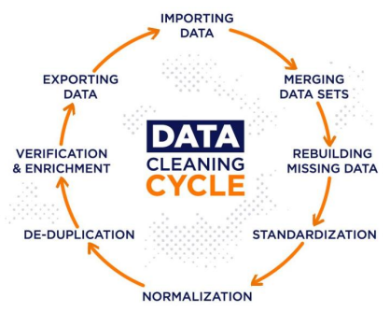
Data Cleaning

Slide 3

Data Cleaning
It came after diagnosing (explore) the data.
It is the process of enhancing the raw data to make the machine learn from it in proper way.
Data cleaning includes :
Handle missing data.
Remove unwanted symbols of data.
Remove duplicates.
Remove unwanted features.
Fix the data types.
Encoding categorical variables.
Scaling numerical variables.
Standardization and Normalization.

Slide 4
Target Feature
Target Feature
The variable you are interested in learning more about.
The variable you are trying to predict, categorize, etc.
Imbalanced Dataset
Dataset has a disproportional frequency of each value in a categorical variable,
specially in the target categorical feature.

Slide 5
Handling Imbalanced Dataset
Random oversampling
Values selected at random with replacement to add new data.
Data from minority class can be duplicated multiple items.
No new information added.
2. Random under sampling
Data examples from majority class are removed to achieve balance.
Might remove useful examples.
3. Synthetic minority oversampling technique (SMOTE)
Create non-naturally observed data examples.
Synthetic data generated by selecting location close by in feature space to existing
data.
Addresses problem of lack of new data in random oversampling.

Slide 6
Errors, Outliers, and Noise
Issue | Description | How to Identify
Errors | Incorrect or missing values. Model can fail to learn patterns or learn wrong patterns. | Incorrect values can be difficult to identify, unless obvious. Missing values are easier to spot.
Outliers | Values outside dataset's main distribution. Result of mistakes in observation or can occur naturally. Cause problems with pattern recognition. | Graphs can visually depict outliers. They will fall outside the main group.
Noise | Makes it difficult for model to "hear" patterns. Unnecessary for estimation, or hinders estimation. Adds to complexity of analysis and model creation. | Several techniques for identifying unnecessary complexities in datasets. In some cases you can see the lack of a pattern using a graph.

Slide 7
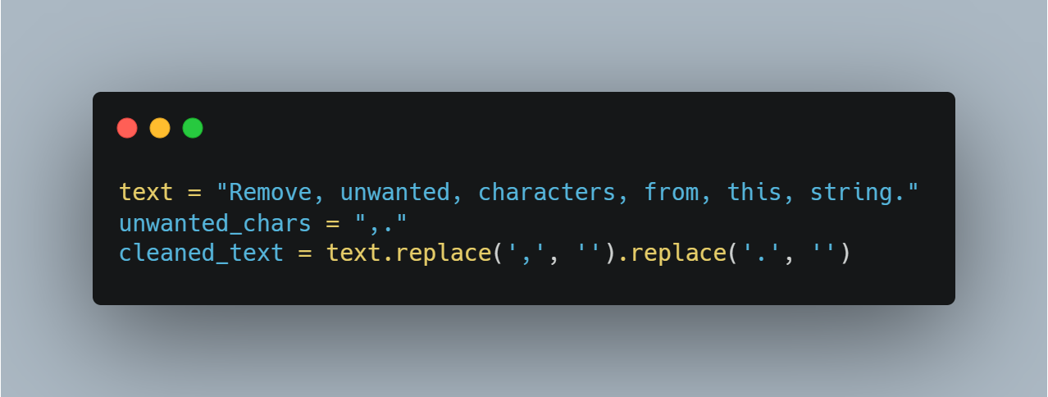
Remove unwanted characters or symbols
Some of the dataset has error data or unwanted characters in the dataset.
There are some techniques to remove them, some of them :
Manual correction.
String manipulation functions.
Regular expressions.

Slide 8
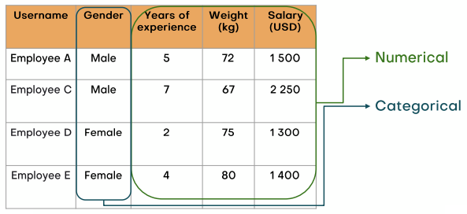
Fix Data Type
The Data Types you need to fix :-
Categorical
Numerical
Data Time

Slide 9
Statistics

Slide 10
Population and Sample
Population and Sample
The sample is a subset of the population, while the population
is the large known dataset.
Example :
The number of employees in the company is N, while the
number of the IT department employees is n.
In some cases, it is hard to detect and notice the volume of the population.

Slide 11
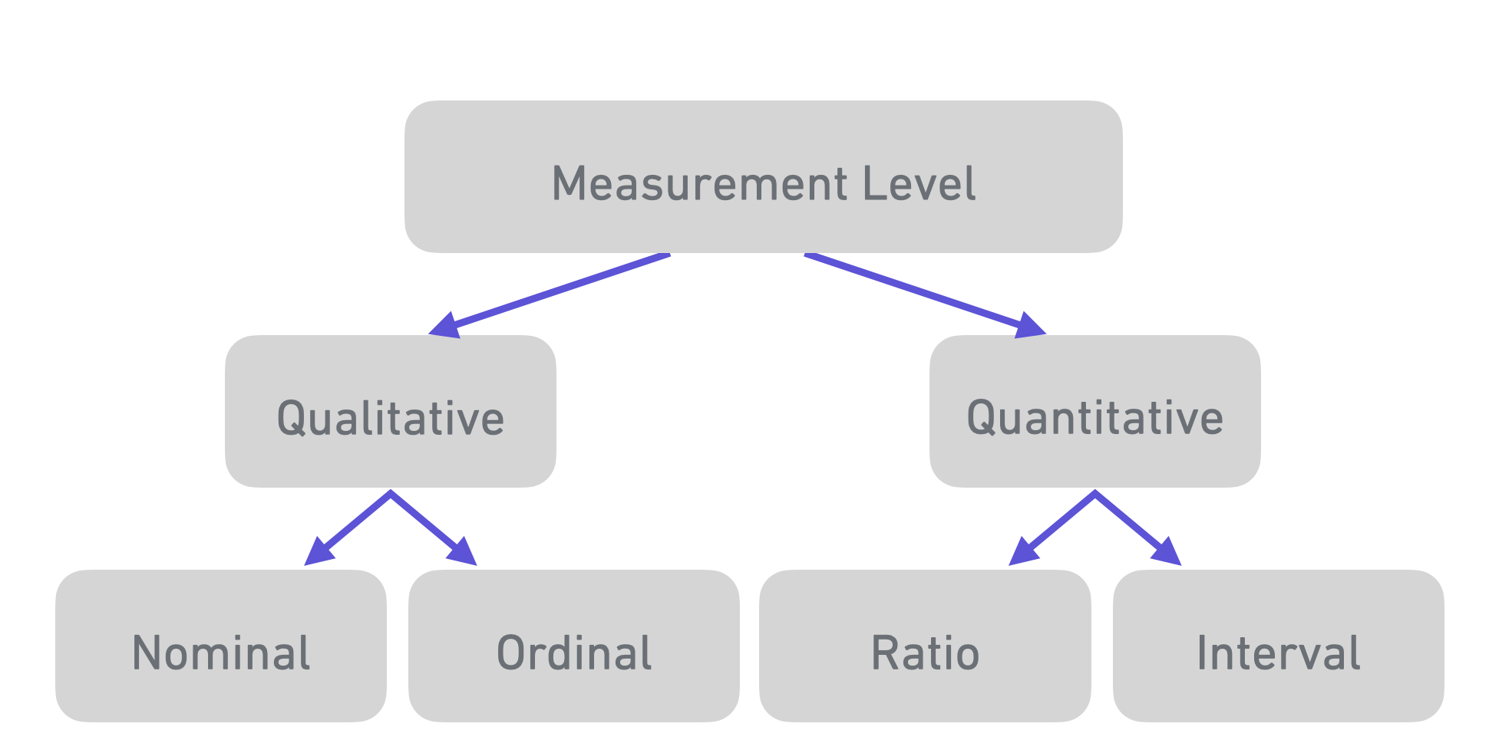
Sample Selection and Measurement Level
There are two conditions to select the sample :
Randomness
Representativeness

Slide 12
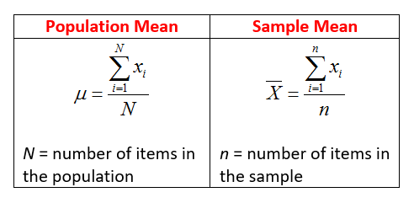
Central Tendency
We can calculate the central tendency by using three main measurements. Mean, Median, and Mode.
Mean (Average)
The sum of the data divided by the number of data.

Slide 13
Central Tendency
The Mean is weak imputation method, when there are outliers in the dataset.
Jeddah | Riyadh | Day
98 | 100 | 1
152 | 150 | 2
140 | 145 | 3
125 | 130 | 4
125 | 500 | 5
The mean of Riyadh city is 205, and the mean of Jeddah city is 128

Slide 14
Central Tendency
Median
The middle data item in the dataset.
Jeddah | Riyadh | Day
98 | 100 | 1
152 | 150 | 2
140 | 145 | 3
125 | 130 | 4
125 | 500 | 5
The median of Riyadh city is 145, and the mean of Jeddah city is 125

Slide 15
Central Tendency
Mode
The frequency of the data for each value.
Jeddah | Riyadh | Day
98 | 100 | 1
152 | 150 | 2
140 | 145 | 3
125 | 130 | 4
125 | 500 | 5
There is no mode in Riyadh city, while in Jeddah city the mode is 125.

Slide 16
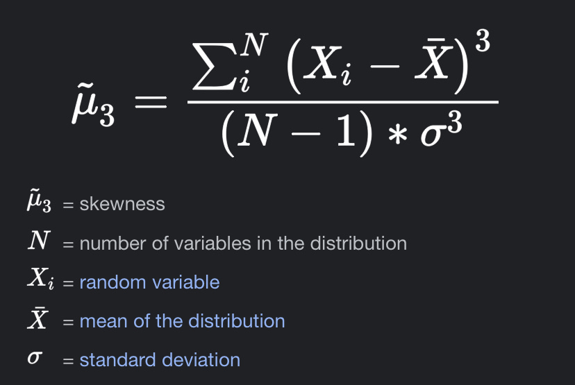
Measure of Asymmetry or Skewness
To measure asymmetry, the skewness must be measured.
The skewness is an indicator of the density and concentration of the data.
Skewness measured using the given formula

Slide 17
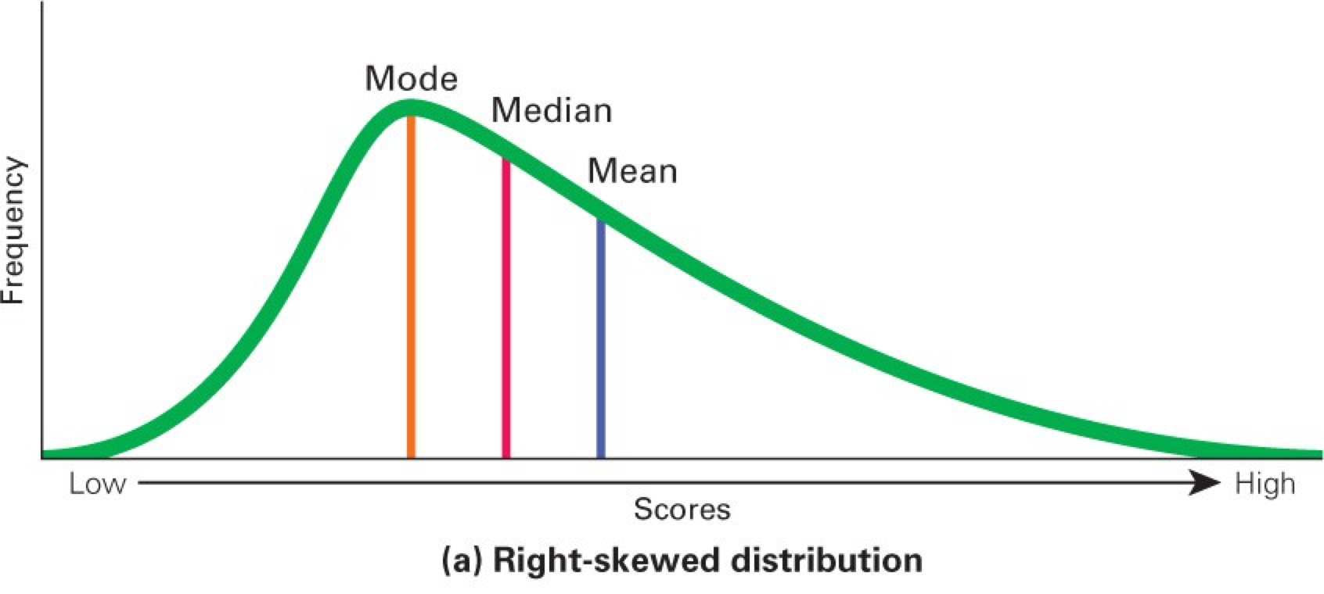
Positive Skewness
The Mean > Median, this is the positive skewness (Right skewness).
The mode in the right skewness is the greater central tendency.
The tail of the skewness is the outliers or noisy data.

Slide 18
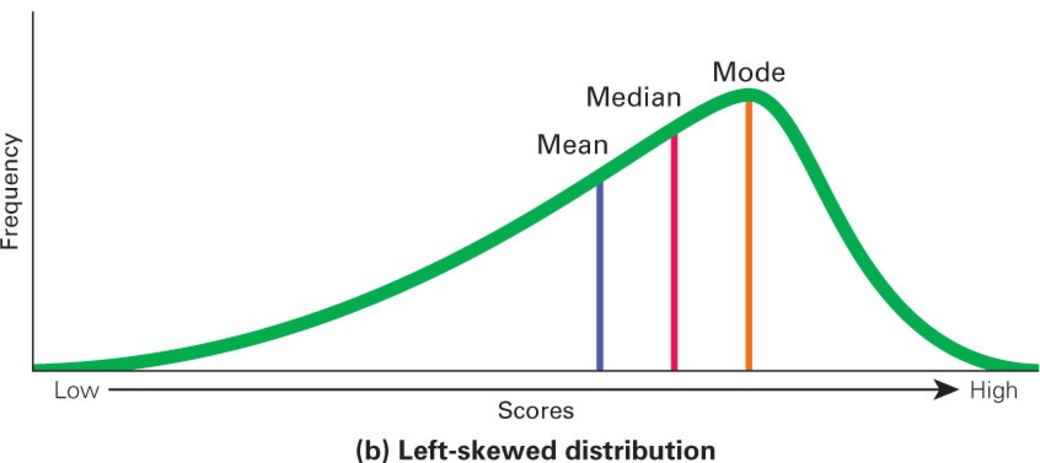
Negative Skewness
The Median > Mean, this is the negative skewness (Left skewness).
The mode in the left skewness is the greater central tendency.
The tail of the skewness is the outliers or noisy data.

Slide 19
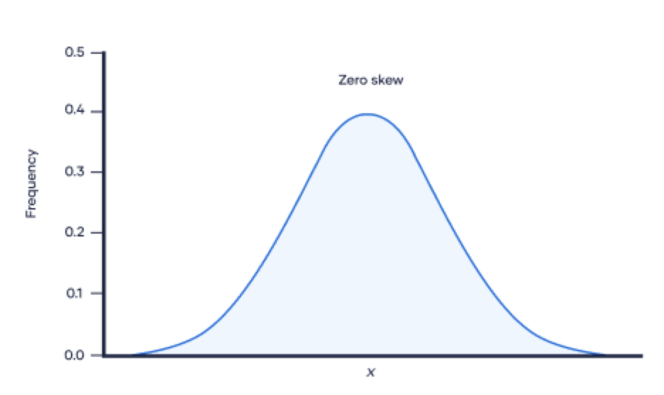
Zero Skewness
The Mean = Median = Mode, it is also referred to the symmetrical distribution.

Slide 20
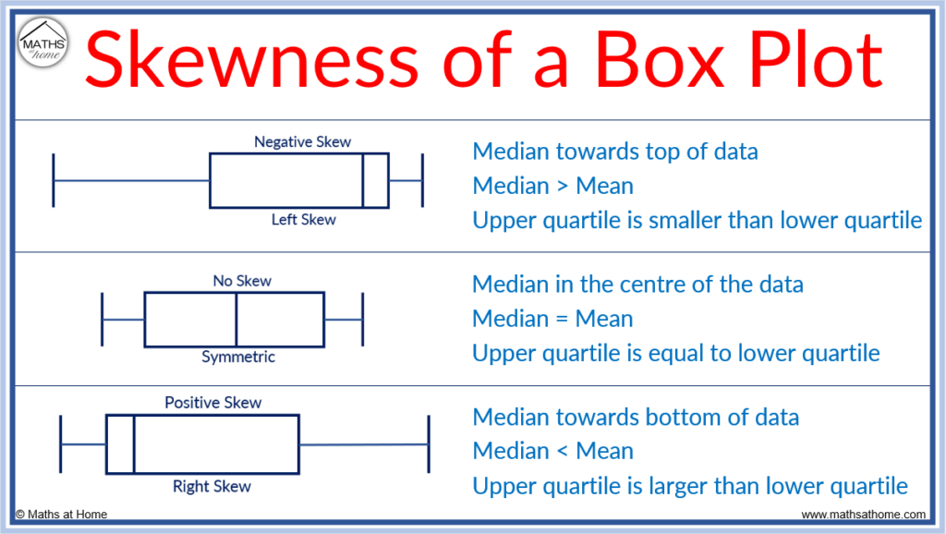
Skewness in the Box Plots

Slide 21
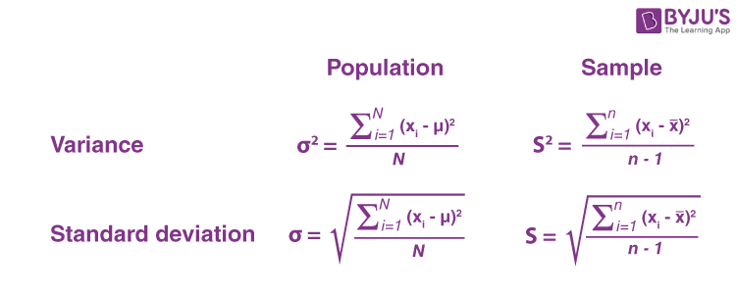
Measure of Variability
We can find the measure of variability by calculating the variance, standard deviation, cofficent of variation.

Slide 22
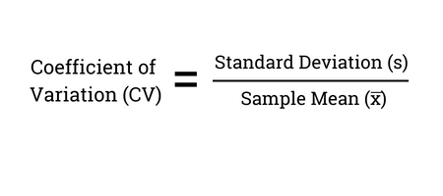
Measure of Variability
Variance
Measures the dispersion of data around the mean.
Standard Deviation
Same as Variance, but the variance is large because it
depends on the squares.
Coefficient of Variation
It is the popular measure of variability in one dataset.

Slide 23
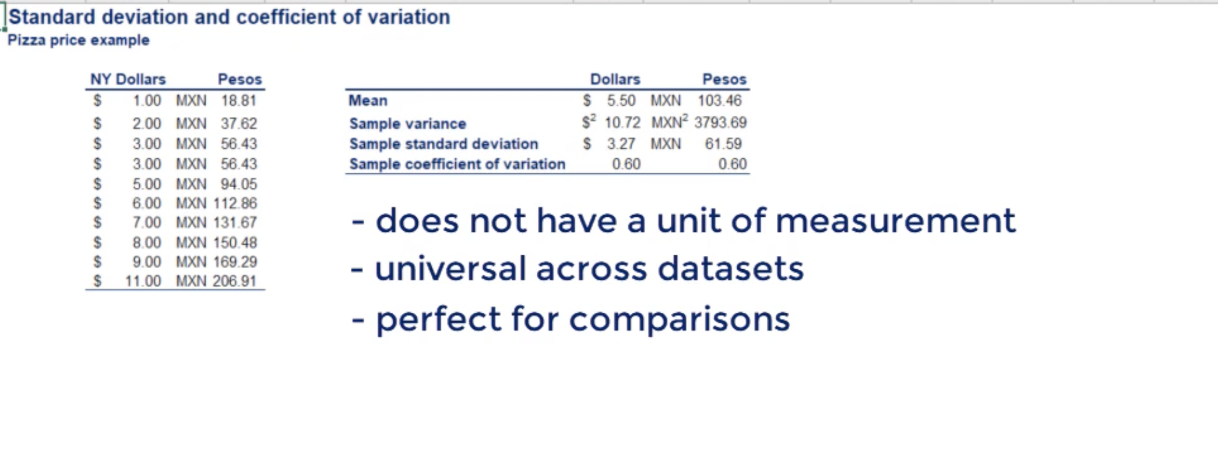
Measure of Variability
Example

Slide 24
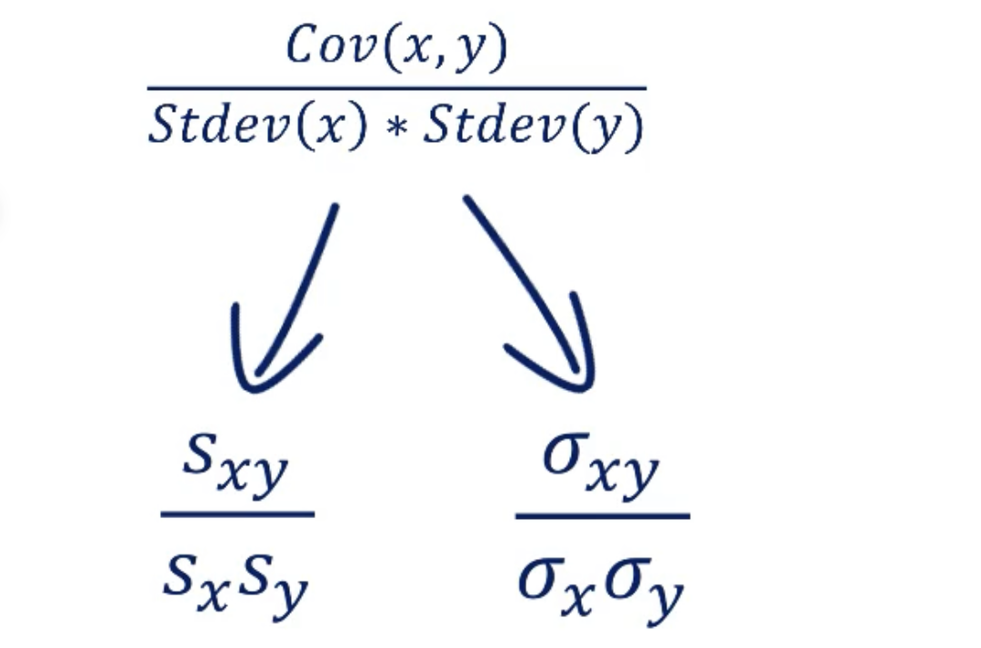
Relationship Between Variables
Correlation Coefficient

Slide 25
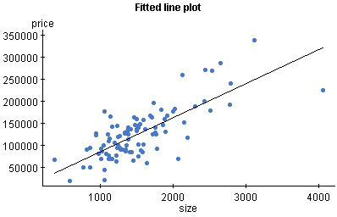
Relationship Between Variables

Slide 26
Relationship Between Variables
Correlation Coefficient | Correlation Coefficient
1 | Perfect Positive Correlation
(1, 0.7) | Strong Positive Correlation
(0.6, 0.4) | Moderate Positive Correlation
(0.3, 0.1) | Weak Positive Correlation
0 | No Correlation
-1 | Perfect Negative Correlation
(-1, 0) | Imperfect Negative Correlation

Slide 27
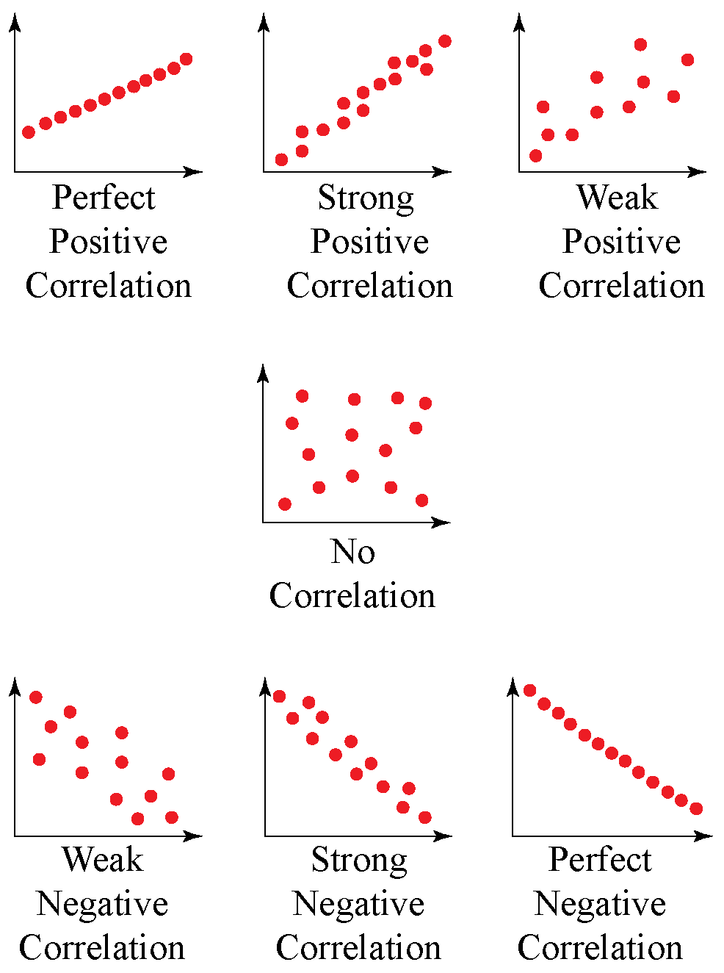
Relationship Between Variables

Slide 28
Resources
Statistics for Data Science and Business Analysis, Packt Publishing, 2021.
https://learning.oreilly.com/videos/statistics-for-data/9781789803259/
https://hbrarabic.com/%D8%A7%D9%84%D9%85%D9%81%D8%A7%D9%87%D9%8A%D9%85-%D8%A7%D9%84%D8%A5%D8%AF%D8%A7%D8%B1%D9%8A%D8%A9/%D9%85%D8%A8%D8%AF%D8%A3-%D8%A8%D8%A7%D8%B1%D9%8A%D8%AA%D9%88/

