Slide 1

Deployment

Slide 2
Introduction
1- Deploying machine learning models is crucial for putting them into real-world applications.
In this presentation, we'll explore the deployment process using three popular Python frameworks: FastAPI, Flask, and Django.

Slide 3
What is API?
- Definition: A set of rules and protocols facilitating communication between software applications.
- Purpose:
  Enables seamless interaction between different systems.
  Allows developers to access the functionality of a service without understanding its internal workings.
- Types:
  Web APIs: Use HTTP for communication (e.g., RESTful APIs).
  Library-based APIs: Provide functions for specific tasks.
  Operating System APIs: Enable interaction with the underlying OS.

Slide 4
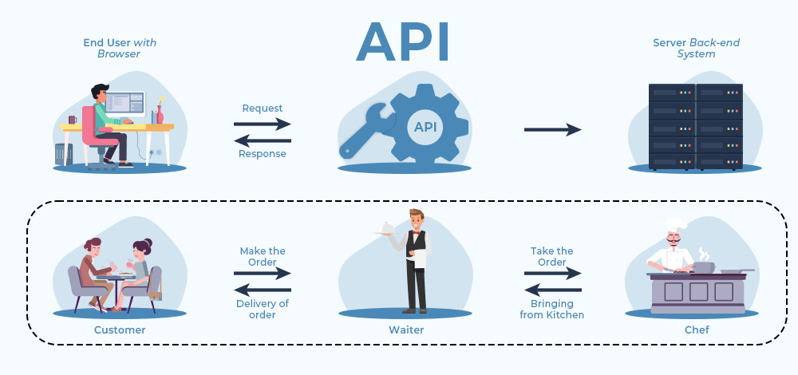
What is API?

Slide 5
Which Better? FastAPI, Flask, Django
Aspect | FastAPI | Flask | Django
Framework | Asynchronous | Asynchronous | Asynchronous
Preformance | Fast | Lightweight | Moderate
Documentation | Automatic OpenAPI | Well-documented | Comprehensive
Flexibility | High | High | Moderate
Ease of Use | Easy | Easy | Moderate
Community | Growing | Large | Very Large

Slide 6
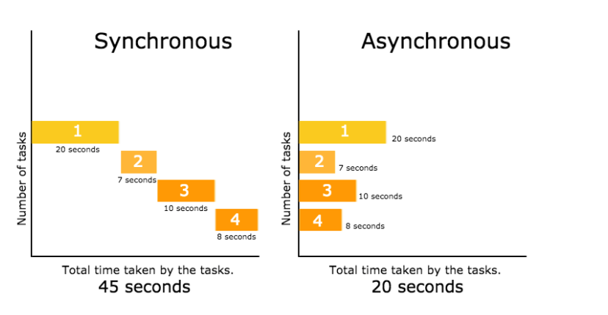
Synchronous Vs Asynchronous

Slide 7
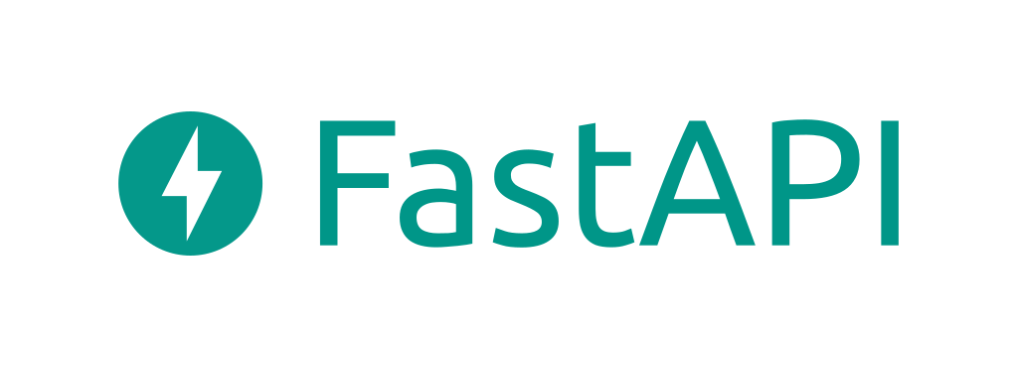
What would we choose?

Slide 8
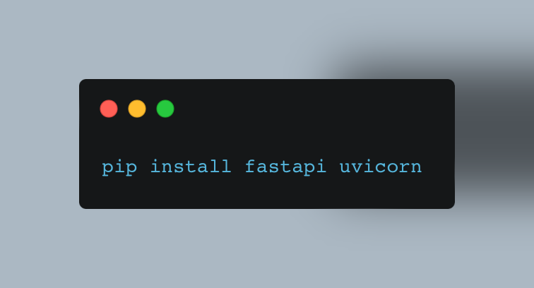
Required Libraries
FastAPI
Uvicorn

Slide 9
Required Environment
Model file (e.g., .h5 for Keras, .pkl for scikit-learn ..etc), the file contains the weights and parameters of your trained model.
Preprocessing Script (If Applied)

Slide 10
Publishing on a Server
Deploying your machine learning model onto a server is crucial for making it accessible over the internet.
This section covers the process of publishing your model, enabling users or applications to interact with it remotely.

Slide 11
Hosting Services
- Alibaba cloud (SCCC)
- Amazon Web Services (AWS)
- Google Cloud
- Azure
- Heroku
- Render
- Digital Ocean

Slide 12
Resources
How to Deploy FastAPI on AWS EC2: Quick and Easy Steps!
Deploy Fast API to Azure App Service under 4min [Easy]

Slide 13
Thank You

