Slide 1

EDA2
POINT BISERIAL

Slide 2
MEASURES THE STRENGTH OF
ASSOCIATIO BETWEEN
TWO VARIABLES
1.CONTINUOUS
2.DICHOTOMOUS (CATEGORICAL)

Slide 3
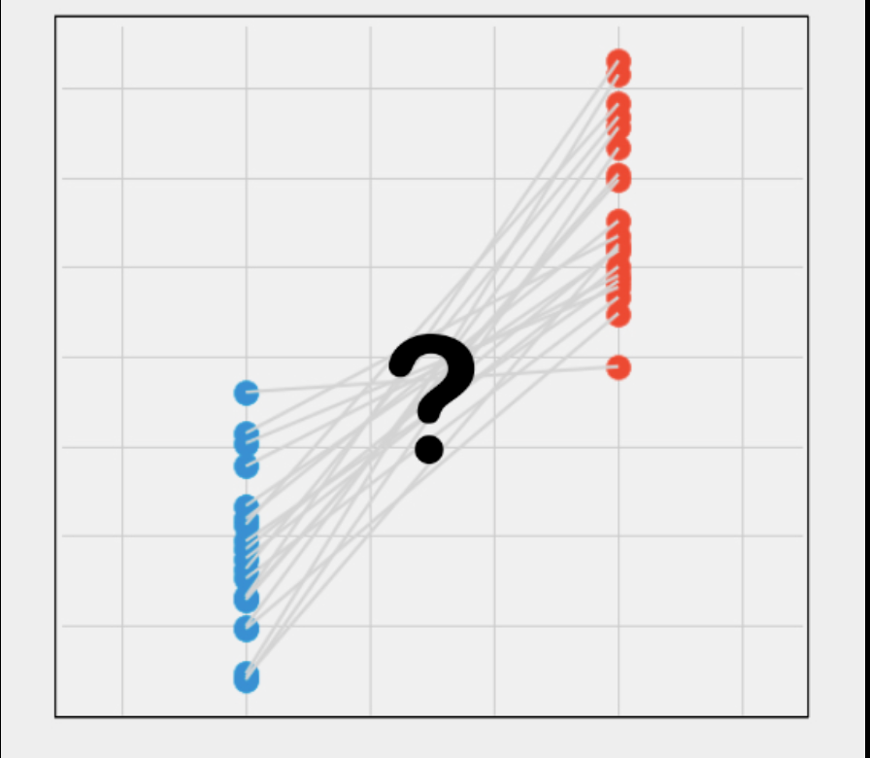

Slide 4
Measure
  -1 indicates a perfect negative association
the strength
of association
from -1 to +1
  +1 indicates a perfect positive association
  0 indicates no association at all

Slide 5

5 assumption to give you a valid result

Slide 6
1# One of your two variables should be measured on a continuous scale
exam performance (measured from 0 to 100)
weight (measured in kg)

Slide 7
2# Your other variable should be dichotomous (Categorical)
gender (male or female)
employment status (employed or unemployed)

Slide 8
3# There should be no outliers for the continuous
variable for each category of the dichotomous variable

Slide 9
4# Your continuous variable should be approximately normally distributed (Shapiro-Wilk test of normality)

Slide 10
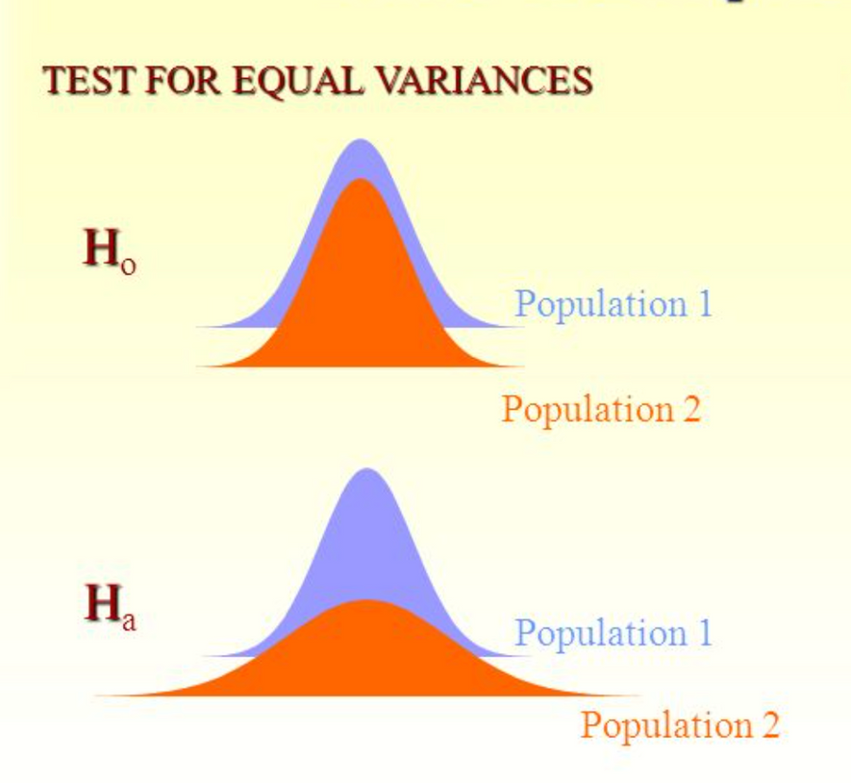
5# Your continuous variable should have equal variances for each category of the dichotomous variable ( Levene's test)

Slide 11
PYTHON CODE

Slide 12
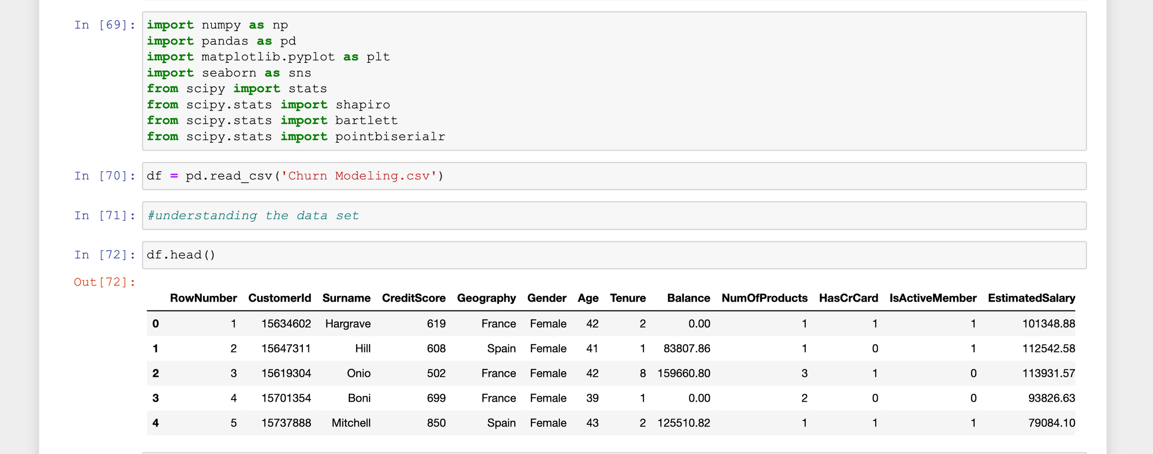

Slide 13
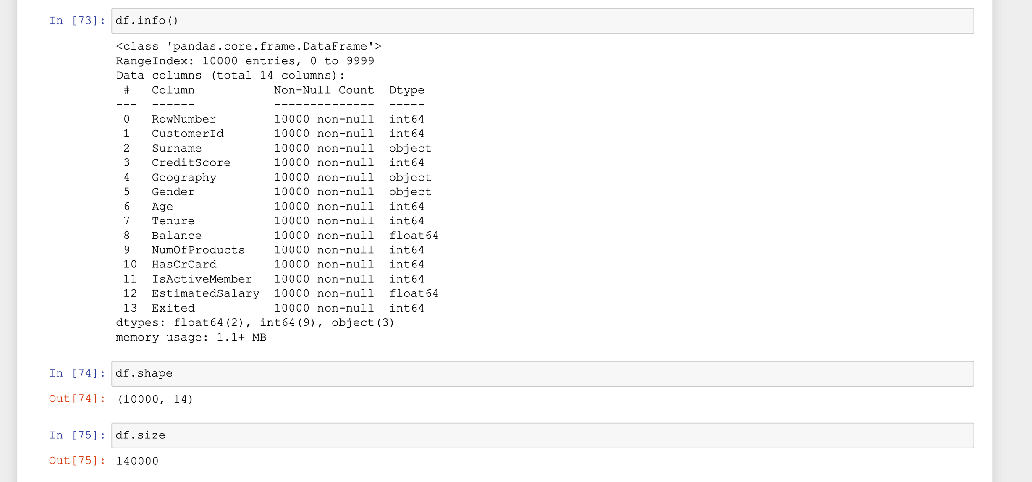

Slide 14
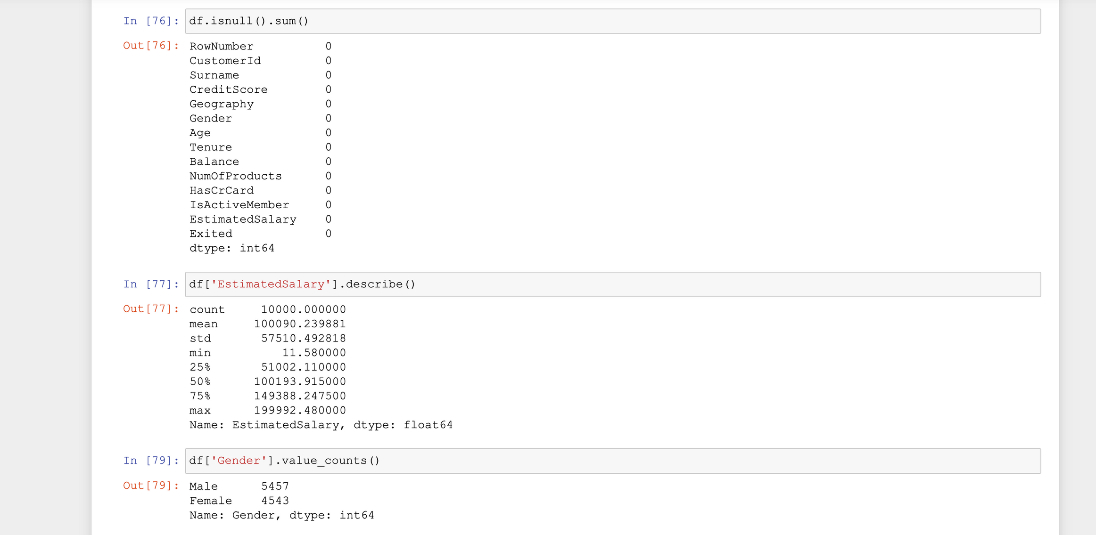

Slide 15
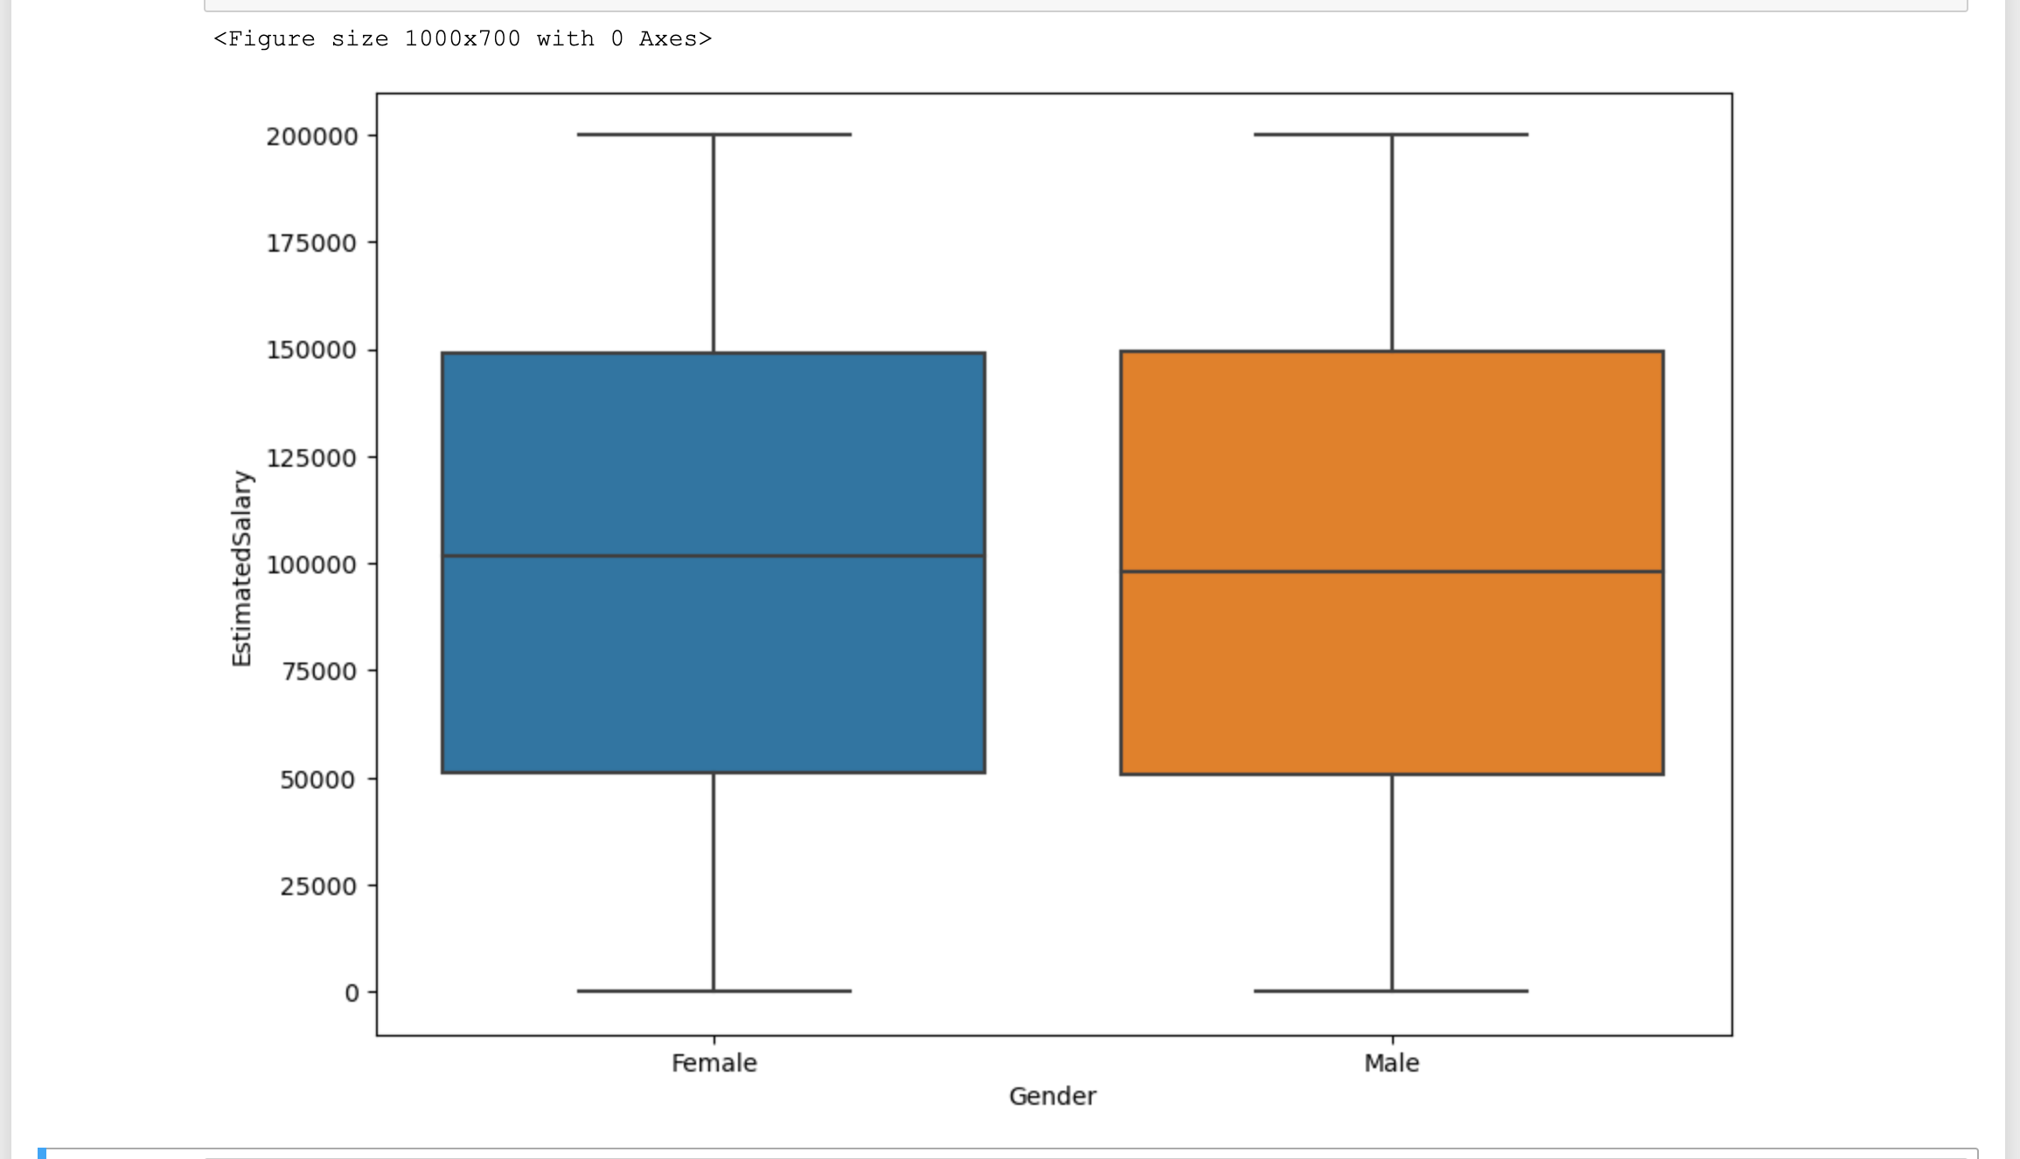

Slide 16
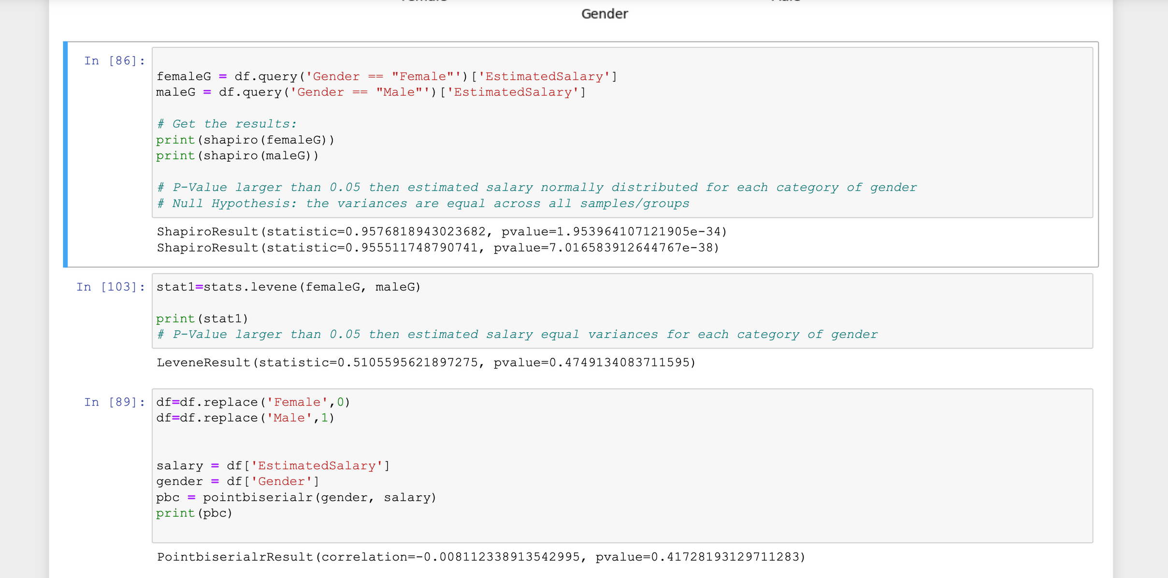
There was a negative correlation between Esalary and gender

Slide 17
THANK YOU

