Slide 1


Command Line

Slide 2
Objective
Know about the Command Line?
Why we use Command Line?
Make files and directory.
View the files
Delete and edit them
How to Navigate

Slide 3
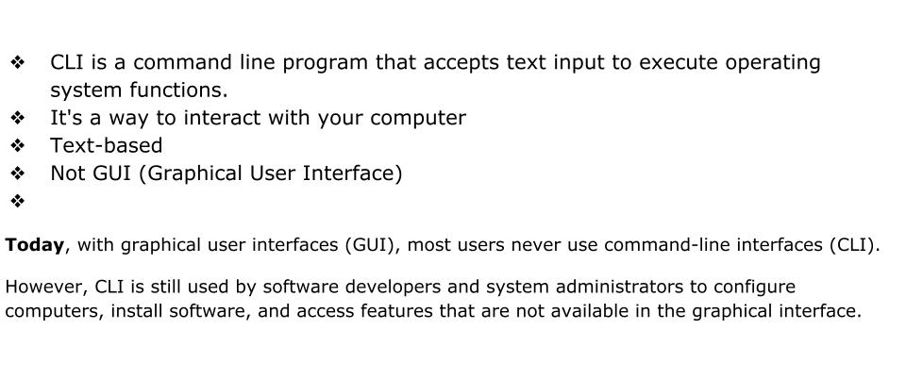
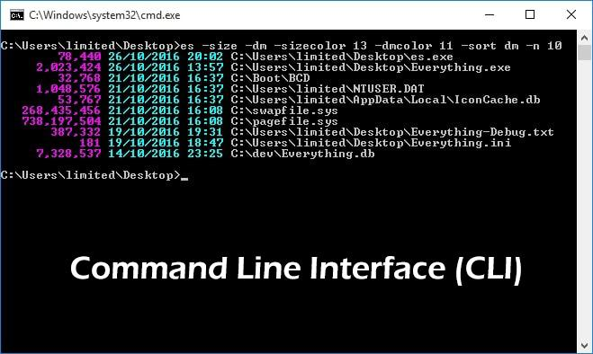
What is Command Line Interface (CLI)?

Slide 4
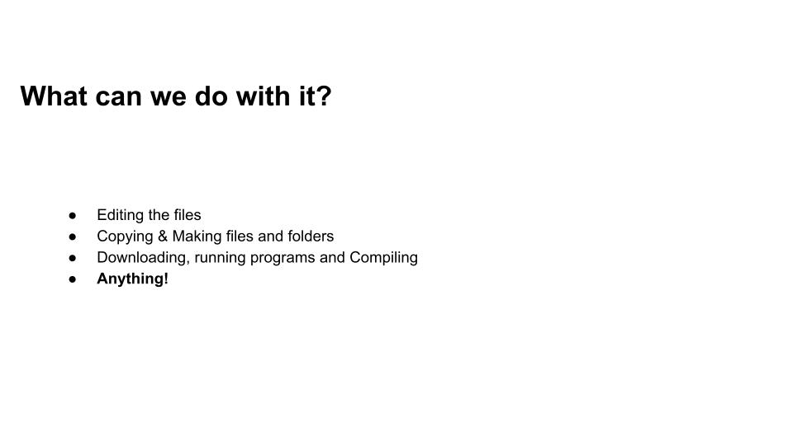
What can we do with it?

Slide 5
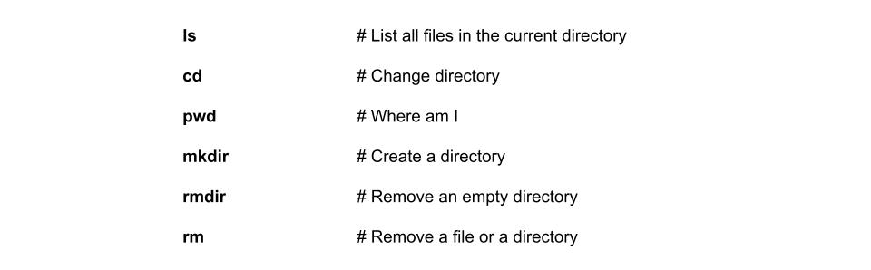
Common Commands

Slide 6
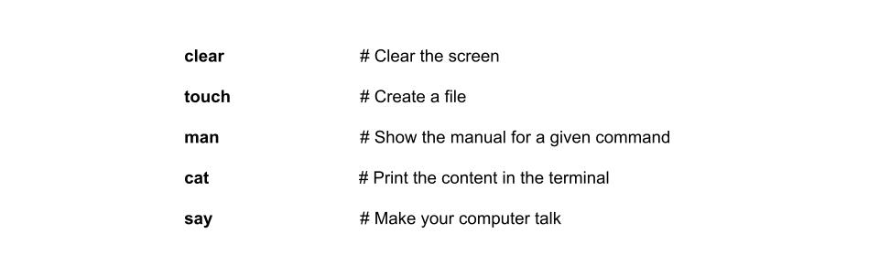
Common Commands

Slide 7
Paths and Directories
Absolute Paths
The absolute path shows the full path of files and it is unique location within the file system. No other files can have this path.
Absolute paths:
Start with leading slash '/'
Always relative to the root directory

Slide 8
Paths and Directories
Relative Paths
The Relative paths are the paths described with respect to the current directory.
There are two special relative directories.
.. parent directory
. current directory

Slide 9
Finding the Command Line
Windows:
Click the Start menu and type cmd in the search box to locate the Command Line.
Or, the Command Line should be one of the options under ‘Programs’ and you can click on the application to open it.
Mac OS:
Open the terminal by opening the Applications folder, navigating to Utilities and then launching Terminal.
Or, search for “terminal” to find the application to launch.

Slide 10
Lab: Make a T1000 directory
~/T1000
├── warmups
├── homeworks_labs
├── lessons
├── projects

Slide 11
Resources
Unix Power Tools
Explain cli w3shools
Command Line Fu
Teaching Unix
Unix Cheat Sheet

Slide 12
Summary
Know about the Command Line
Why we use Command Line?
Make files and directory.
View the files
Delete and edit them
How to Navigate

