Slide 1


HTML II

Slide 2
Objective
Links
Images
Forms
Readability

Slide 3

Links
Links are found in nearly all web pages. Links allow users to click their way from page to page.
You can add links to your web page as follows:
The <a> element is used toadd all links on a webpage. Using this element you can link to other pages in your website, external web pages and enable users to send an emai.l

Slide 4
Images
Images can improve the design and the appearance of a web page.
You can add images to your web page as follows:
<img> does not have a closing tag
<img> attributes that can describe as follows:

Slide 5
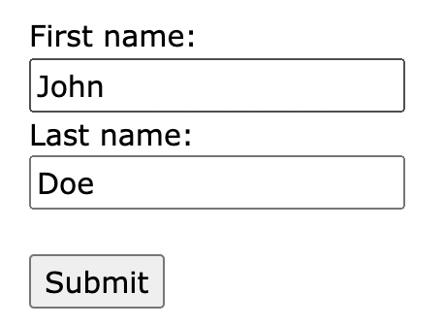
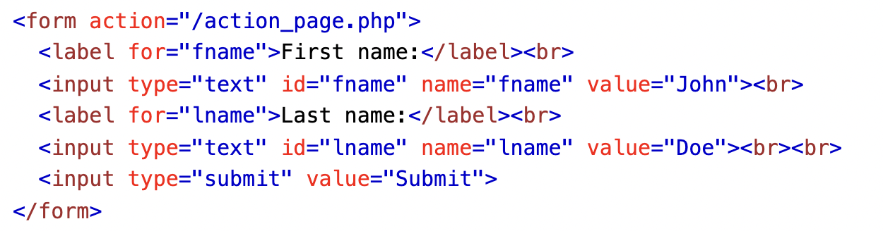
Forms
Different ways we give to the users to enter data in HTML.
At this stage, our forms won’t be functional. You
will create forms that function correctly later
when you learn JavaScript.

Slide 6
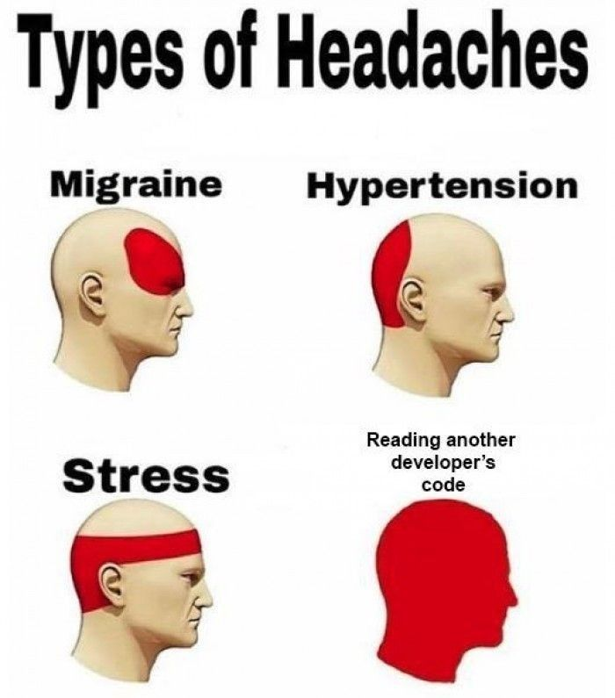
Readability

Slide 7
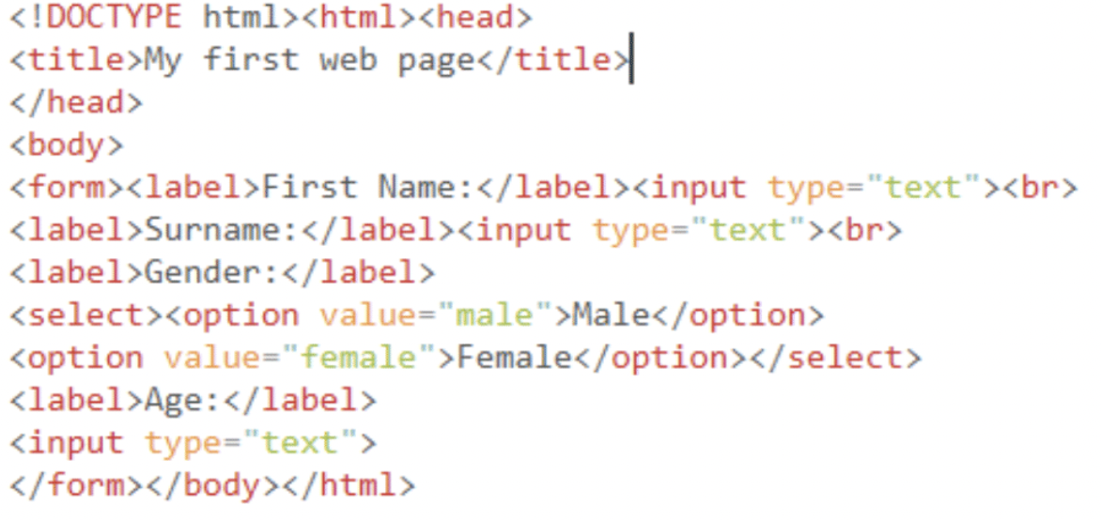
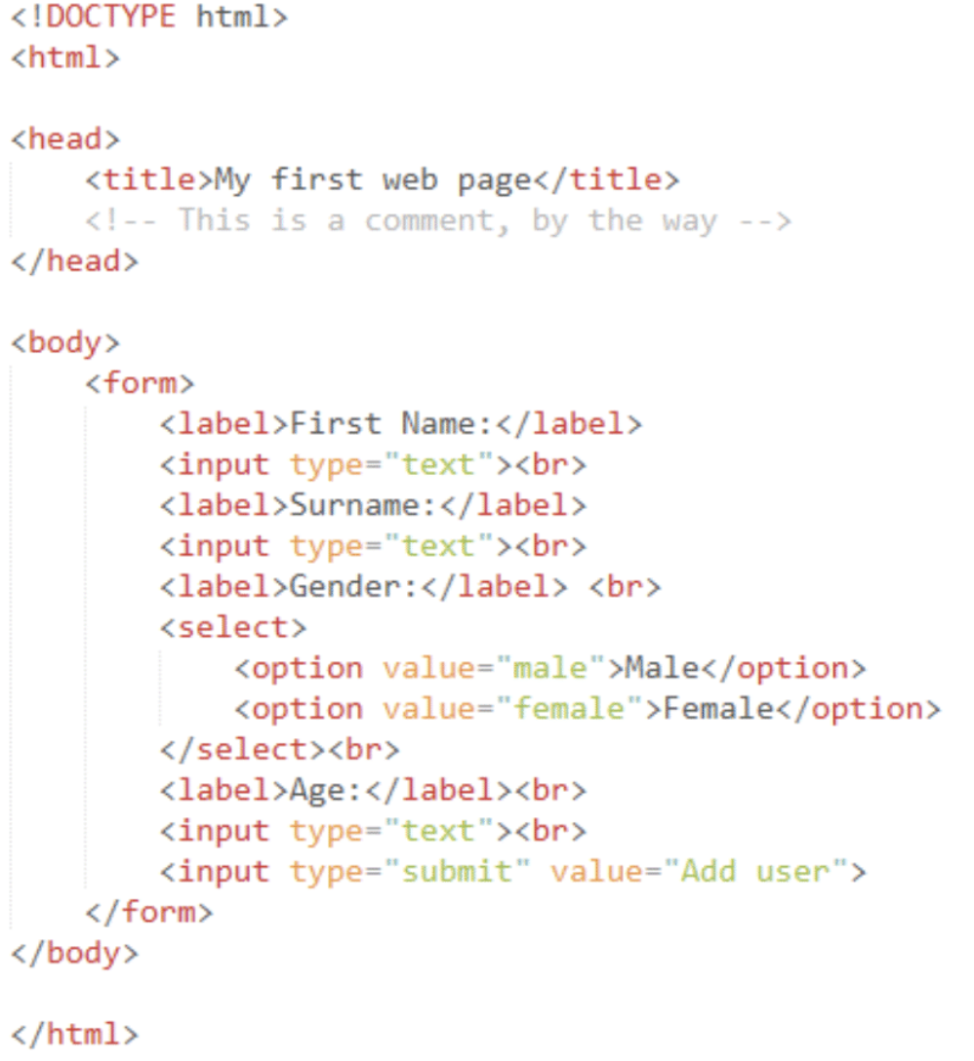

Slide 8
Summary & resources
Links
Images
Forms
Readability

