Slide 1


HTML 1

Slide 2
Objective
Create your first HTML page! Learn what HTML is.
What is HTML elements, tags and attributes.
Titles, paragraphs, and headings, ordered and unordered lists.

Slide 3
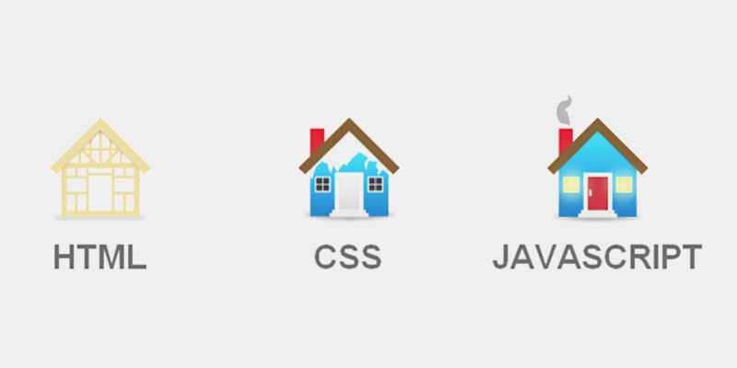
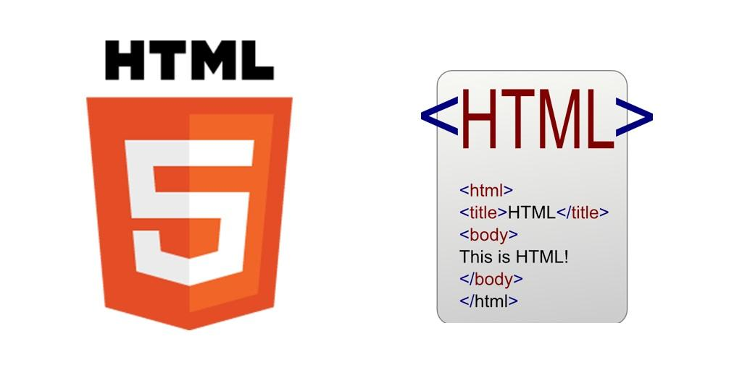
Introduction to HTML
Hypertext Markup Language (HTML): language used to write files that tell the browser how to lay out the text and images on a page
.html
HTML tags: used to define how the page must be structured

Slide 4
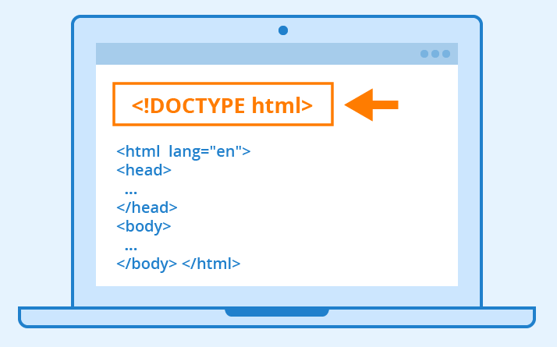
Basic Layout / Template of an HTML Page
Doctype: indicates which version of the HTML to load
html: contains the whole document
head: contains metadata about the page
body: contains the actual content

Slide 5
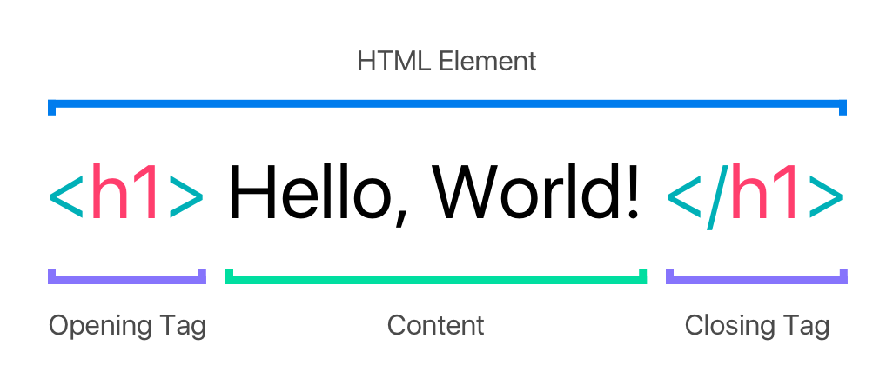
HTML Tags and Elements
<!DOCTYPE html>
<html> <head> <title>My first web page!</title> </head> <body> <p>I am learning to develop a dynamic web application.</p> </body> </html>
👩‍💻👨‍💻Try this:
Right-click in the browser in any website and select the option ‘View page source.’

Slide 6
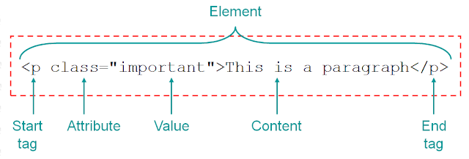
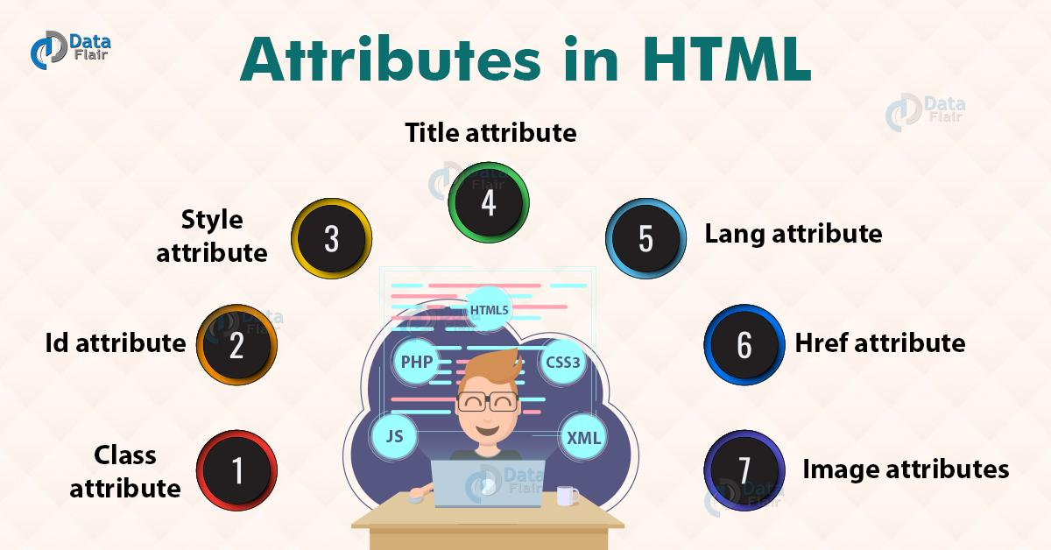
Attributes
Attributes like this are used mainly for the purposes of CSS and JS (JavaScript).
Provide additional information about HTML elements.
Attributes are always specified in the start tag.

Slide 7
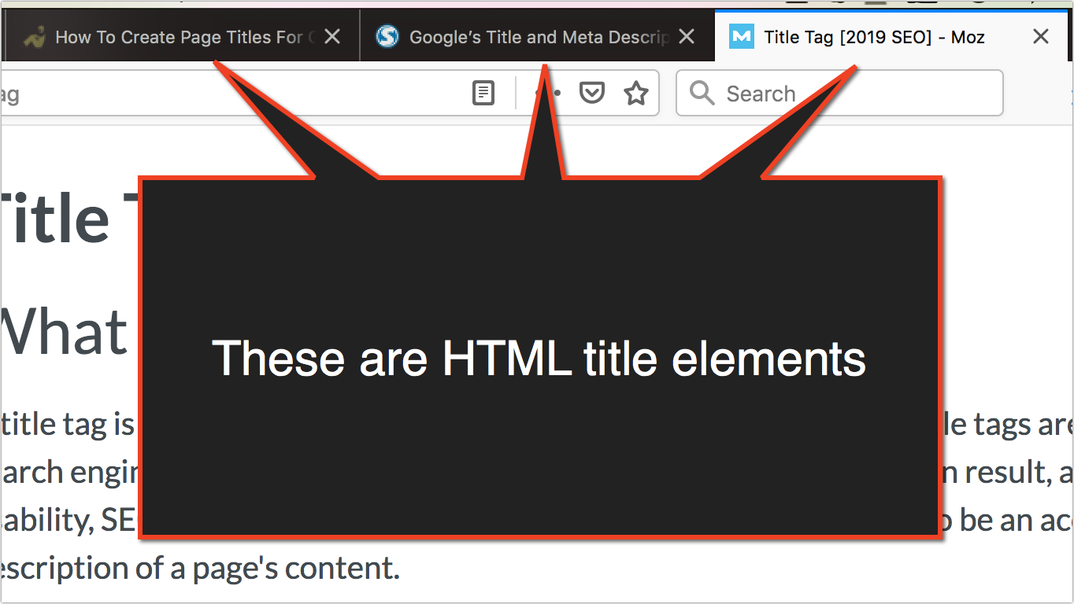
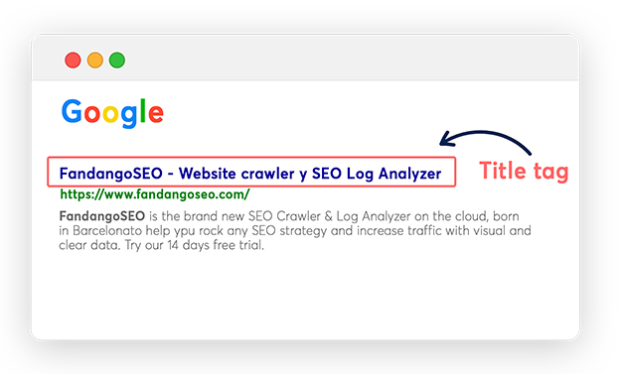
Common HTML Elements
title tag
<head>
<title>Portfolio</title>
</head>
The <title> tag defines the title of the document. The title must be text-only, and it is shown in the browser's title bar or in the page's tab.
The <title> tag is required in HTML documents!
The contents of a page title is very important for search engine optimization (SEO)! The page title is used by search engine algorithms to decide the order when listing pages in search results.

Slide 8
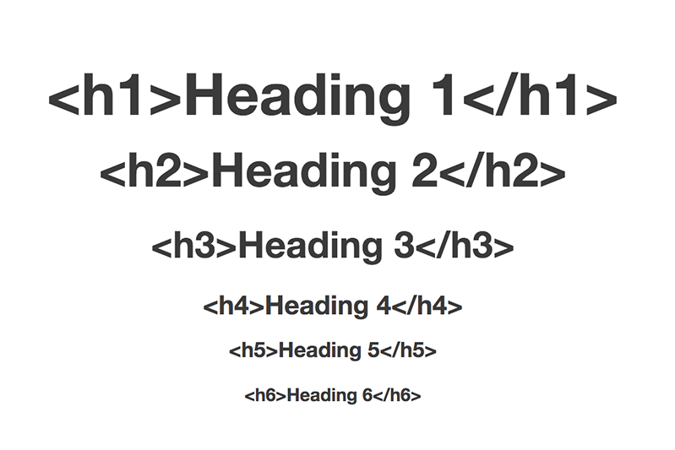
Common HTML Elements
headings
HTML headings are titles or subtitles that you want to display on a webpage.

Slide 9
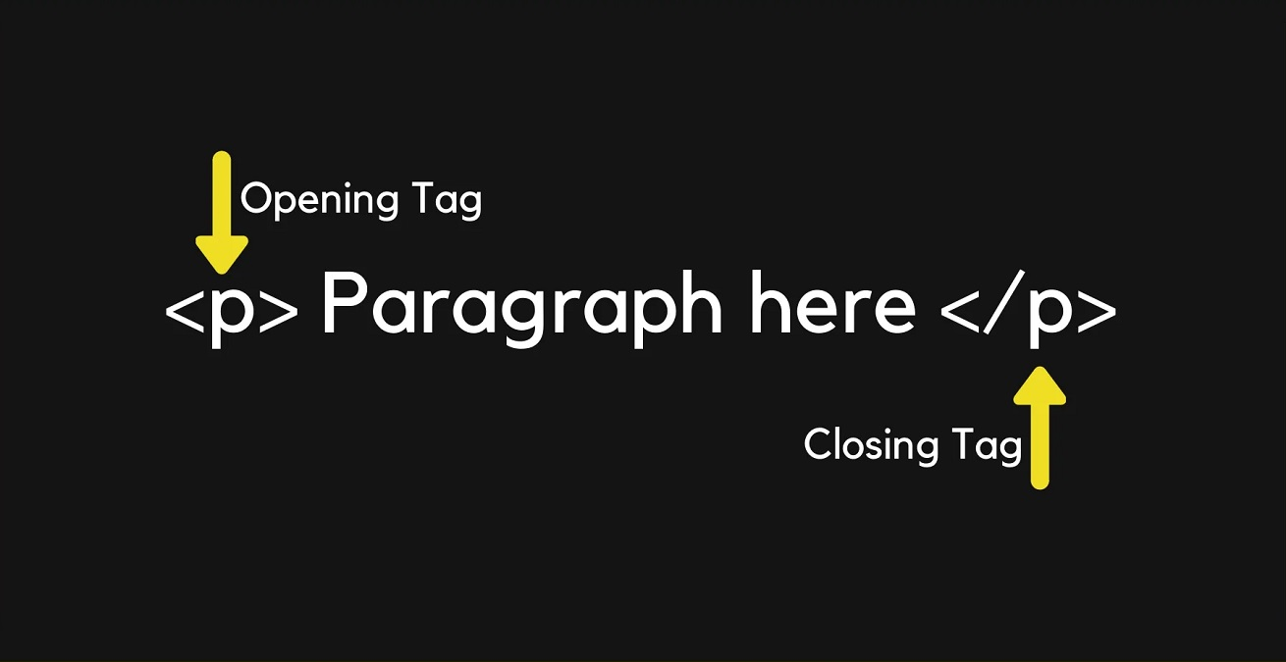
Common HTML Elements
paragraphs
A paragraph always starts on a new line, and is usually a block of text.

Slide 10
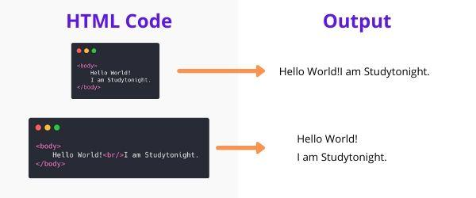
Common HTML Elements
Line breaks
To do the equivalent of pressing enter to get a line break between text, use the <br> element. This element does not have a matching closing tag.

Slide 11
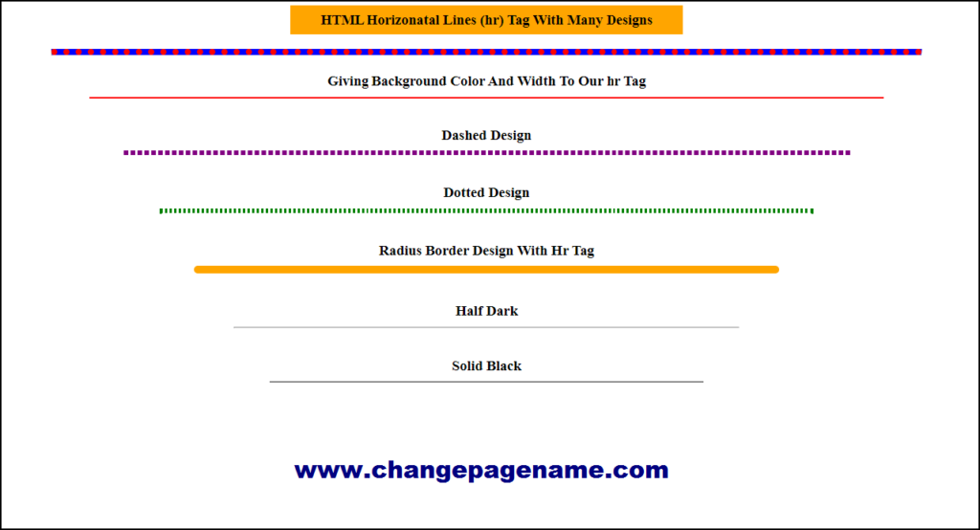
Common HTML Elements
Horizontal rule
The <hr> element is most often displayed as a horizontal rule that is used to separate content (or define a change) in an HTML page.

Slide 12
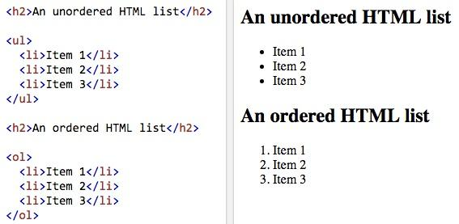
Common HTML Elements
Lists
Lists can either be ordered lists <ol> or unordered lists <ul>. Ordered simply means that the list is numbered, i.e. 1, 2, 3, etc. and unordered is in the form of bullet points.

Slide 13
Common HTML Elements
Tables
HTML tables allow web developers to arrange data into rows and columns.
Table Cells
Each table cell is defined by a <td> and a </td> tag, td stands for table data.
Table Rows
Each table row starts with a <tr> and end with a </tr> tag.
Table Headers
Sometimes you want your cells to be headers, in those cases use the <th> tag instead of the <td> tag:

Slide 14
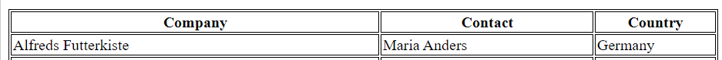
Common HTML Elements
<table style="width:100%">
<tr>
<th>Company</th>
<th>Contact</th>
<th>Country</th>
</tr>
<tr>
<td>Alfreds Futterkiste</td>
<td>Maria Anders</td>
<td>Germany</td>
</tr>
</table>
Tables

Slide 15
Summary
Intro to HTML
Common HTML elements
Basic Layout / Template of an HTML Page
HTML Tags and Elements
Attributes

Slide 16



Resources
W3 school

