Slide 1


CSS II
Grid

Slide 2
Objective
Using CSS grid for layout

Slide 3
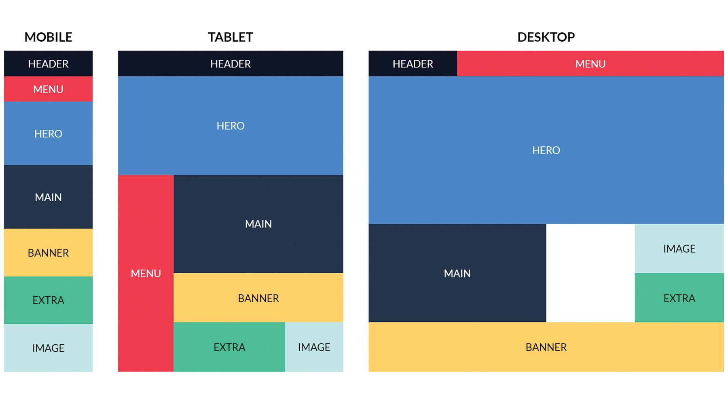
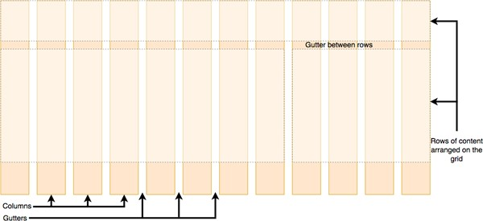
Grid Layout
Grid Layout is a new layout model for CSS that has powerful abilities to control the sizing and positioning of boxes and their contents.
With Grid layout, you can divide up the screen into rows and columns of sizes of your choosing.

Slide 4
Grid Elements
A grid layout consists of a parent element, with one or more child elements.
An HTML element becomes a grid container when its display property is set to grid or inline-grid.
You can adjust the gap size by using one of the following properties:
<div class="grid-container"> <div class="grid-item">1</div> <div class="grid-item">2</div> <div class="grid-item">3</div> <div class="grid-item">4</div> <div class="grid-item">5</div> <div class="grid-item">6</div> <div class="grid-item">7</div> <div class="grid-item">8</div> <div class="grid-item">9</div> </div>
grid-column-gap
grid-row-gap
grid-gap
.grid-container { display: grid; }

Slide 5



Resources
List of CSS3 Properties
CSS Grid Layout - CSS: Cascading Style Sheets | MDN
Grid Garden - A game for learning CSS grid

Slide 6
Summary
CSS Selectors
Cascade: Specificity
Using CSS grid for layout

