Slide 1


Jest

Slide 2
Objective
Learn to write tests for your React application using Jest.

Slide 3
Type of Tests
Manual testing
Documented manual testing
End-to-end testing
Unit tests
Integration testing
Snapshot testing
Notes:
Manual testing: Try to execute a piece of code manually and see if it does what you would expect it to do. You have no doubt done loads of manual testing by now. Console.log() statements are often used in manual testing to check whether variables contain the data you expect them to or whether a function is performing as you expect.
Documented manual testing: As you can probably guess, this is manual testing that is documented. This involves having a documented plan for conducting tests.
End-to-end testing: These are automated tests that simulate the user experience.
Unit tests: Instead of testing the functionality of the system as a whole, this type of test focuses on testing one unit (for example, a single function, class, component etc) at a time.
Integration testing: Once you have tested that individual units work separately, integrations tests ensure that these units work together as expected.
Snapshot testing: Snapshot tests are used to make sure that your UI doesn’t change unexpectedly.

Slide 4
Why we need Testing?
Quality Of Code & Design
Find Issues & Bugs Early
Functionality Documentation

Slide 5
To improve quality:
Performance testing
Usability testing
Security testing
Notes:
Performance testing: This has to do with testing the stability and responsiveness of code. It has to do with testing not just whether the code works, but how well it works. For example, how fast is it?
Usability testing: Tests the way a user interacts with a system. Again, this type of testing is not to determine whether the code works, but whether users find the system easy and intuitive to use.
Security testing: Involves doing tests that try to determine any potential security flaws within a system.
Once your app is deployed, you can use tools like PassMarked to help test the performance and security of your app.
It is considered good practice to create tests early on in the design/development process. Test-driven development (TTD) is an approach to software development where you are encouraged to write tests before you write the actual code.
To assist with testing, there are testing frameworks that can be used. We will learn more about these frameworks in the next section. Once you know about some of the testing frameworks, we will then go on to learn how to use them to create automated unit tests.

Slide 6

Testing Frameworks for React
The official React documentation lists a number of tools that can be used for testing React apps
Jest is automatically installed when you create a React app using the Create React App starter kit that we have been using throughout this level of the Bootcamp.
We will use Jest to test React.

Slide 7
What Is Unit Testing ?
Software Testing Method That Break Your Software To Pieces
Tests Written And Run By The Software Developers .
It Test a Section (Unit) In Your App To Ensure It Work And Behave Like Expected
Unit Test Can Be For One Method
Unit Test Can Be For The Whole Class in OOP
Unit Test Can Be The Whole Module
Unit Test Can Be Done For The Whole Procedure
A Unit is The Smallest Testable Part of Any Software

Slide 8
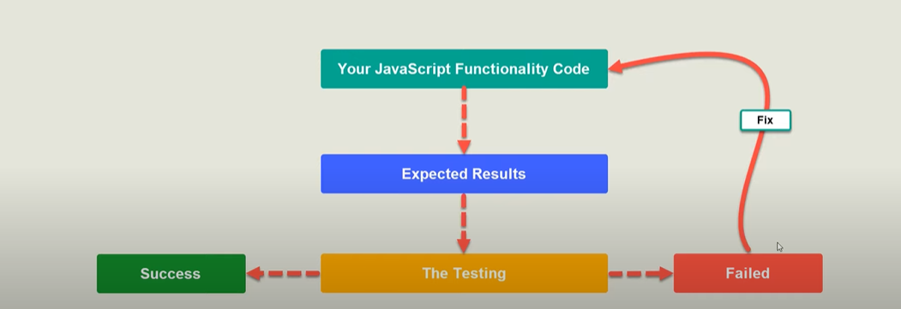
Testing cycle

Slide 9
Testing Rules
Get The Function To Test.
Give Input To The Function.
Define What Is The Output
Check For The Output
TDD => Test Driven Development
Think About What Your Code Will Do
Write The Code
Test The Code

Slide 10
Jest Unit Testing
The Jest test() module and expect() object can be used to write any number of unit tests.
Below we create a test that tests a function that adds two numbers together.
const sum = require('./sum');
test('adds 1 + 2 to equal 3', () => {
expect(sum(1, 2)).toBe(3);
});
Step 1: In the test directory, create a file called ‘sum.test.js’
Step 2: Add the code shown to ‘sum.test.js’ and save the file.
Step 3: Run the test. From the command line interface, type npm test to run the test.

Slide 11
Using Matchers
Jest uses "matchers" to let you test values in different ways
The simplest way to test a value is with exact equality.
In this code, .toBe(4) is the matcher. When Jest runs, it tracks all the failing matchers so that it can print out nice error messages for you.
test('two plus two is four', () => {
expect(2 + 2).toBe(4);
});

Slide 12
Common Matchers
If you want to check the value of an object, use toEqual instead:
test('object assignment', () => {
const data = {one: 1};
data['two'] = 2;
expect(data).toEqual({one: 1, two: 2});
});

Slide 13
Truthiness
toBeNull matches only null
toBeUndefined matches only undefined
toBeDefined is the opposite of toBeUndefined
toBeTruthy matches anything that an if statement treats as true
toBeFalsy matches anything that an if statement treats as false

Slide 14
Numbers
Most ways of comparing numbers have matcher equivalents.
test('two plus two', () => {
const value = 2 + 2;
expect(value).toBeGreaterThan(3);
expect(value).toBeGreaterThanOrEqual(3.5);
expect(value).toBeLessThan(5);
expect(value).toBeLessThanOrEqual(4.5);
// toBe and toEqual are equivalent for numbers
expect(value).toBe(4);
expect(value).toEqual(4);
});

Slide 15



Resources
Elzero Web School
https://github.com/sapegin/jest-cheat-sheet

