Slide 1

General Assembly Python Capstone Project: Loan Approval Indicator
Agenda:
Problem and solution statement
Data overview and visualisations
Modelling
App demonstration
Questions
Closing

Slide 2

Problem:
It can be difficult for home loan applicants to know how likely their loan application is going to be approved.
Solution:
An application which provides a loan application approval likelihood, based on the applicants’ inputs.
Technical solution:
Train a machine learning model.
Build an application that allows the user to input loan application details.
Generate an approval likelihood.

Slide 3
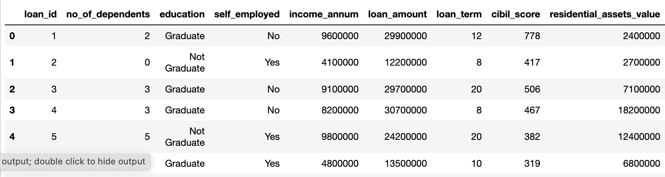
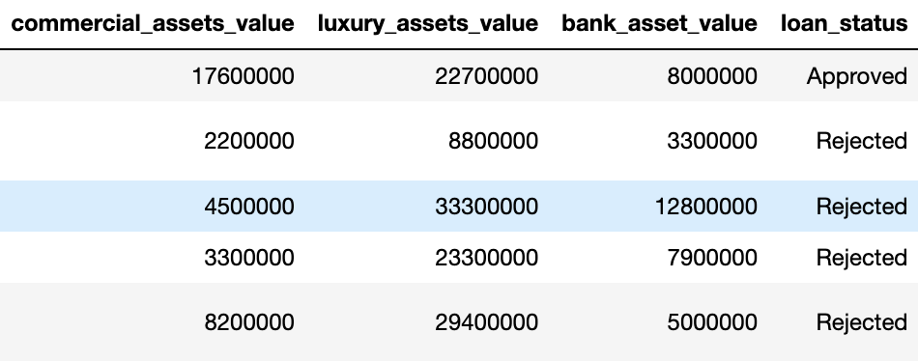
Data Overview
Data source: https://www.kaggle.com/datasets/architsharma01/loan-approval-prediction-dataset

Slide 4
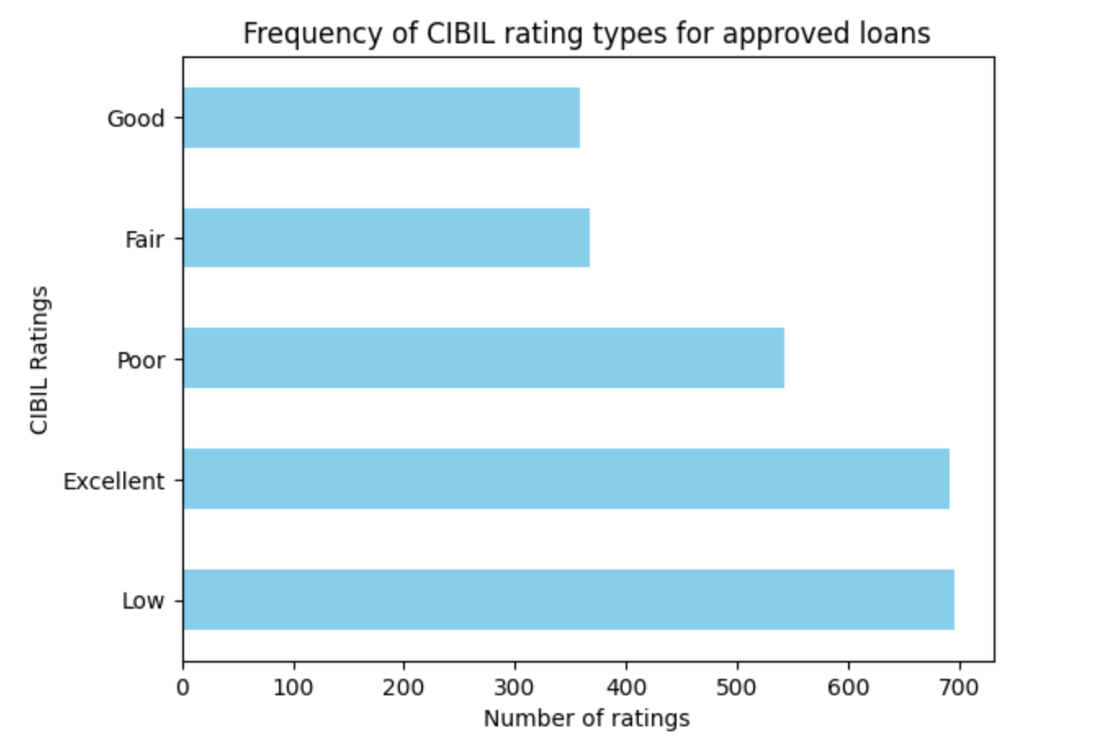
Some data visualisations

Slide 5
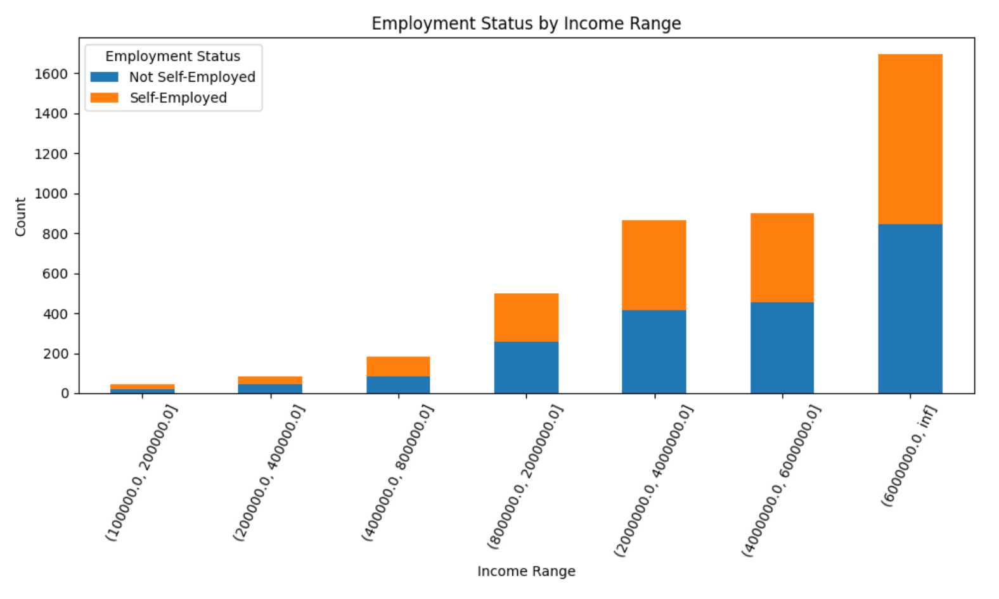
Some data visualisations

Slide 6
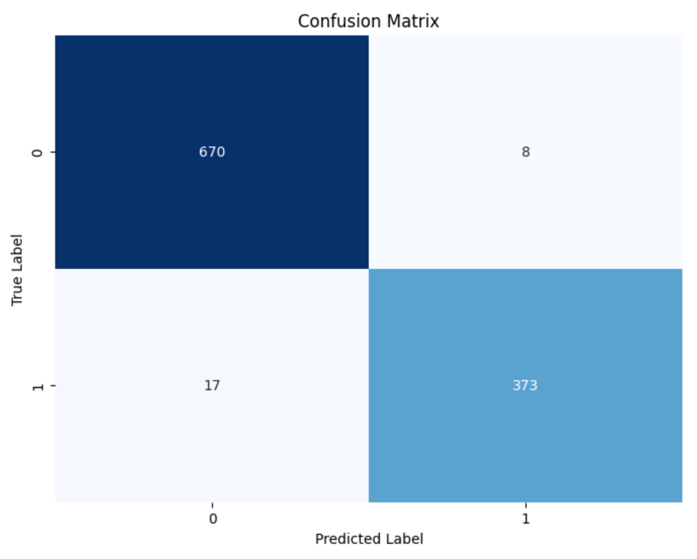
Modelling
Random Forest Classification model
Test accuracy 0.97
25 instances of incorrect predictions out of 1068 instances.

Slide 7
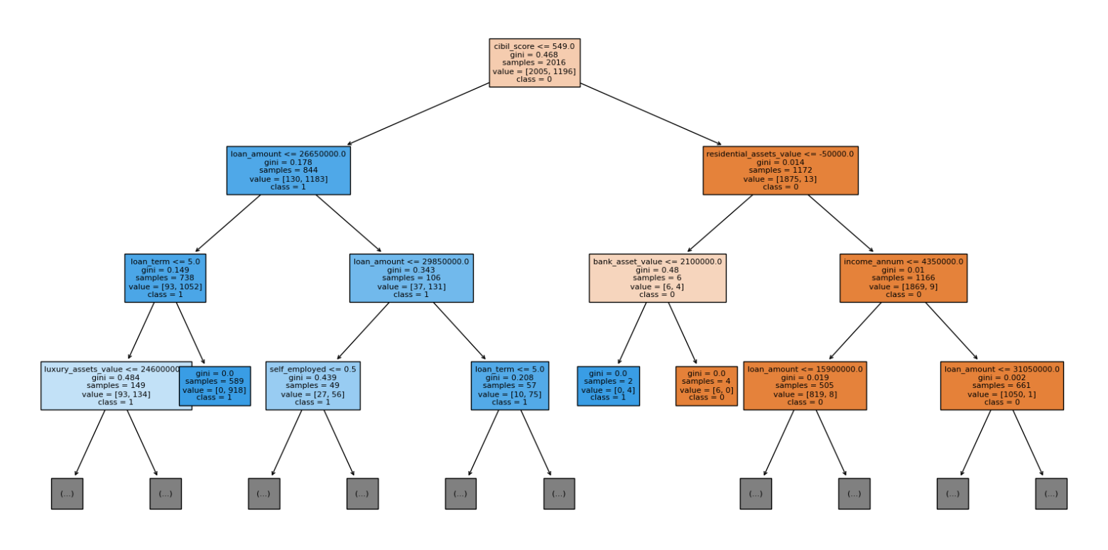
Modelling

Slide 8

App demo

Slide 9

Questions?

Slide 10
Closing
This app is not ‘one size fits all’ as financial institutions have different borrowing criteria and credit policies.
Main use case: for a bank to target their younger customer base.
Future refinements:
Implement user input error validations
Further model refinement and testing
Functionality for the inputs and outcomes to be emailed to the applicant or applicant to request to be contacted by the bank.

