Slide 1
NFC Reader and Data Display using the PIC33
Spencer Callicott (sc2257)
Jack Fletcher (jdf469)
Drew Baker (sab479)

Slide 2
Purpose
scan an RFID tag and display the data contained on it.

Slide 3
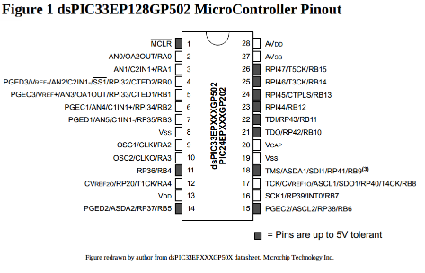
Microprocessor Component
dsPIC33E
Microchip 16-bit MCU @ 60MHZ

Slide 4
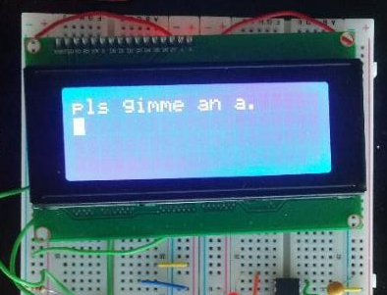
LCD Component
SainSmart I2C LCD
20x4 screen of 5x10 pixel squares
Communicating using I2C protocol

Slide 5
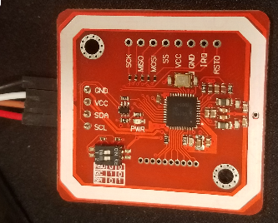
Scanner Component
NXP PN532 NFC RFID Module from HiLetGo
Communicating using HSU (High Speed UART)

Slide 6
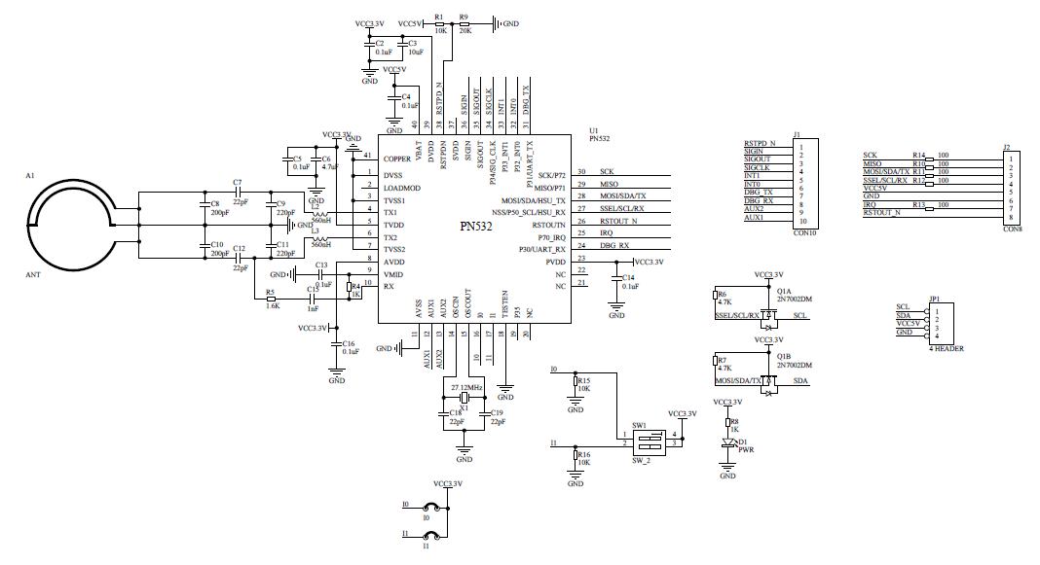
HiLetGo PN532 RFID Reader

Slide 7
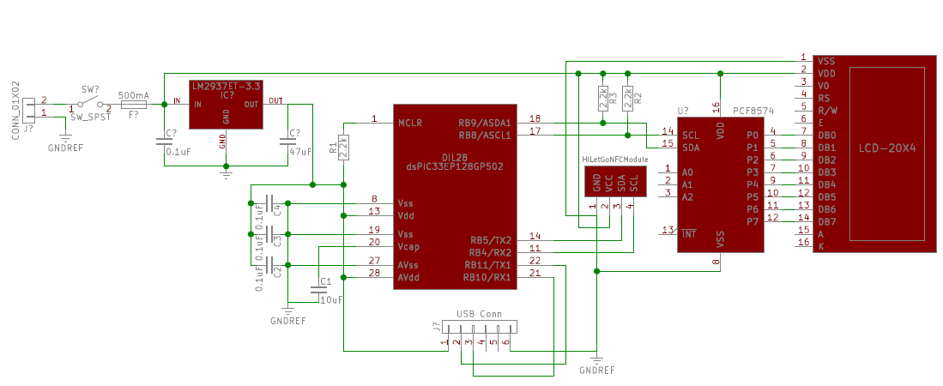
NFC Reader and Data Display Schematic

Slide 8
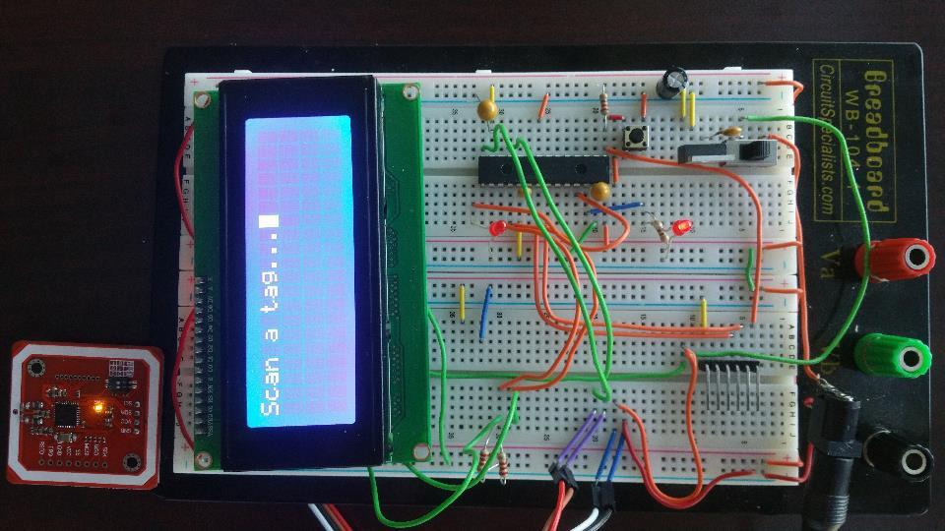

Slide 9
Potential Uses
Card Scanner
Door unlock
Personal Encryption Key
Pet Identification
Quick Access card

Slide 10
Team Roles
Spencer Callicott (sc2257)
Software and hardware development
Financial backing
Jack Fletcher (jdf469)
Schematic design and presentation
Drew Baker (sab479)
LCD Screen interfacing & code optimization

