Slide 1
Clean Code Yellow Grade

Slide 2
Clean Code Yellow Grade
Yellow Grade
Principles
Practice
Questions

Slide 3
Clean Code Yellow Grade
Focussing on the automatized testing
Include SOLID principle and principle of object orientation
Benefits:
Improve code readability, stability, flexibility
Improve maintainability
Stronger teamwork, fast development

Slide 4
Clean Code Yellow Grade Principles
Principles
Interface Segregation Principle (ISP)
Dependency Inversion Principle (DIP)
Liskov Substitution Principle
Principle of Least Astonishment
Information Hiding Principle

Slide 5
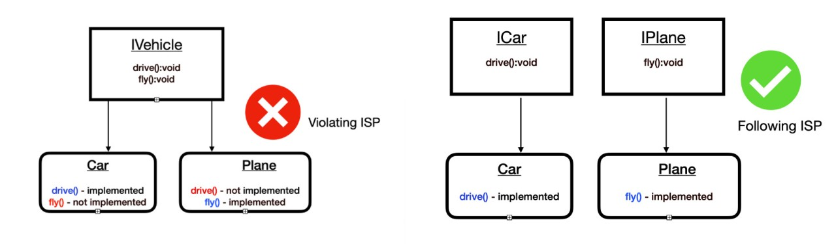
Clean Code Grade Yellow Principles
Interface Segregation Principle (ISP)

Slide 6
Clean Code Grade Yellow Principles
Interface Segregation Principle (ISP)
The I in SOLID principle
A client shall not depend on service details which the client does not use.
Benefits:
Code more modular, reusable, and maintainable.
Reduces code complexity, the amount of duplicate code
Easier addition or removal of features

Slide 7
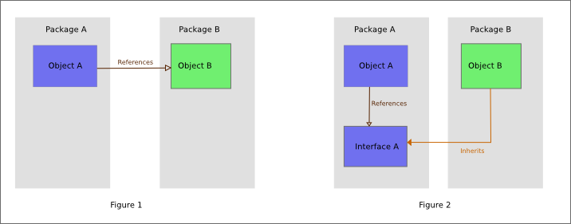
Clean Code Grade Yellow Principles
Dependency Inversion Principle (DIP)

Slide 8
Clean Code Grade Yellow Principles
Dependency Inversion Principle (DIP)
The D in SOLID principle
High-level classes must not depend on low-level classes but both from interfaces.
Interfaces must not depend on details but details on interfaces.
Benefits:
Higher flexibility.
Easier maintainability.
Higher reusability.
Higher modularity

Slide 9
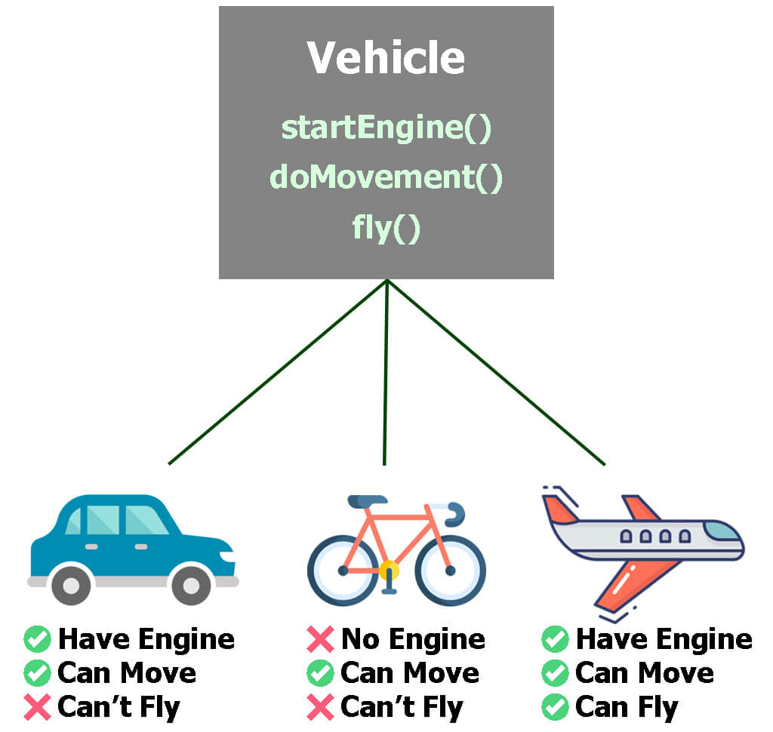
Clean Code Grade Yellow Principles
Liskov Substiution Principle

Slide 10
Clean Code Grade Yellow Principles
Liskov Substitution Principle
The L in SOLID principle
Objects of a superclass should be replaceable with objects of a subclass without affecting the correctness of the program.
Benefits:
Improved code reliability
Higher reusability
Easier maintainability

Slide 11

Clean Code Grade Yellow Principles
Principle of Least Astonishment
If a necessary feature has a high astonishment factor, it may be necessary to redesign the feature
It emphasizes the importance of designing a system (website, app, etc.) that it behaves in a way that aligns with users' expectations
Minimizing user’s confusion and surprises.

Slide 12
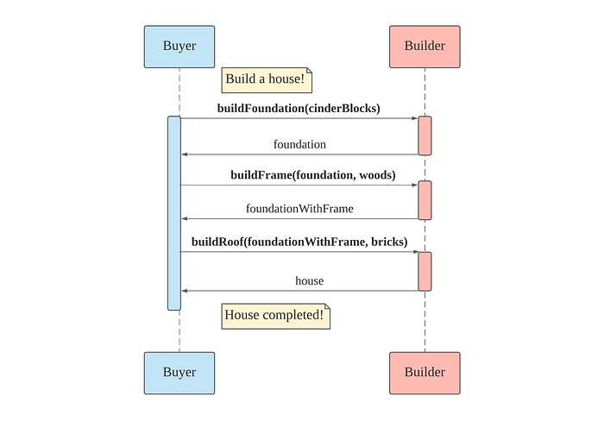
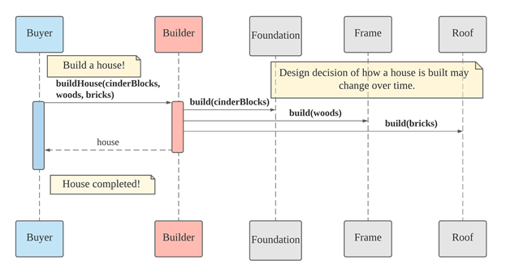
Clean Code Grade Yellow Principles
Information Hiding Principle

Slide 13
Clean Code Grade Yellow Principles
Information Hiding Principle
It emphasizes the idea of restricting access to the internal implementation details of a software component and instead focusing on providing a well-defined interface for interacting with it.
Benefits:
Improved modularity
Higher reusability
Higher maintainability
Reduced coupling between components

Slide 14
Clean Code Yellow Grade
Practice
Automated Unit Tests
Mockups
Code Coverage Analyse
Participation in Professional Events
Complex Refactorings

Slide 15
Clean Code Yellow Grade Practice
Automated Unit Test
Writing small, focused tests that verify the functionality of individual units of code (functions, classes, modules), executed automatically, providing feedback on code
Importance to:
Get early feedback
Refactoring with confidence
Improved code documentation
Continuous Integration (CI pipline)

Slide 16
Clean Code Yellow Grade Practice
Mockups
Using mockups to isolated component test.
Benefits:
Focus on User-Centric Design
Improved Communication
Early Issue Identification

Slide 17
Clean Code Yellow Grade Practice
Code Coverage Analyse
A technique that measures the percentage of source code that is executed during the execution of unit tests
Benefits:
Ensure code quality
Improve testing efficiency
Increase confidence in code
Detect dead code

Slide 18
Clean Code Yellow Grade Principles
Participation in Professional Events
Discussing regularly to other software developers and exchanging experiences.
Attending conferences, workshops, meetups, or other gatherings related to your professional field.
Learning, Networking, Skill Development, Staying Informed

Slide 19
Clean Code Yellow Grade Principles
Complex Refactorings
The process of restructuring and modifying existing code to improve its overall design, maintainability, and performance
Benefits:
Improved saintainability
Enhanced scalability

Slide 20
Answer the questions

