Slide 1
Introduction: Sprint-Review
Purpose: Transparency, Inspection & Adaption
Sharing project status
Sharing lessons learned
Space to gather and give feedback
Align perspectives: developers, QAs & stakeholders
Target Audiences
Stakeholder
Development team
QA

Slide 2

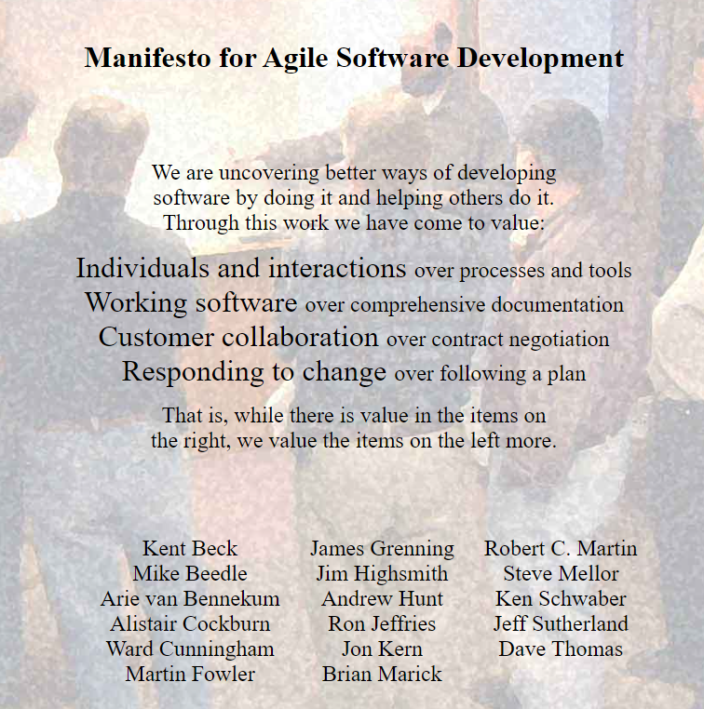
Sprint Review from 2023-12-19 to 2024-01-02
Agenda:
Project Status
AR / Prefab Wall / Prefab Column / Geoso, Khiem, 15min
Construction, Steel and QA Status, Minh, 15min
Rebar Nesting: Vasilii, 10 min
GSI’s Odoo Topics, Huy, 10 min
Weekly DEV-Team-Schedule report from Odoo Timesheets as an end-2-end prototype for GSI's Automation Hub, Tuyen, Thai, LA, 15min
Knowledge Sharing
Automated releases using batch scripts, Tai, 10min

Slide 3
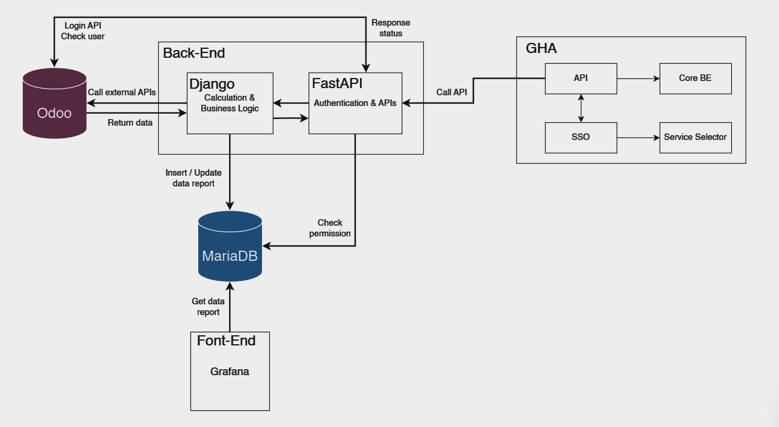
Weekly DEV-Team-Schedule report from Odoo Timesheets
1. Architecture

Slide 4
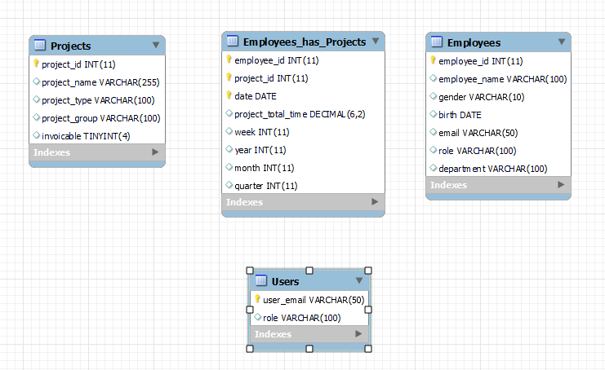
Weekly DEV-Team-Schedule report from Odoo Timesheets
2. Database

Slide 5
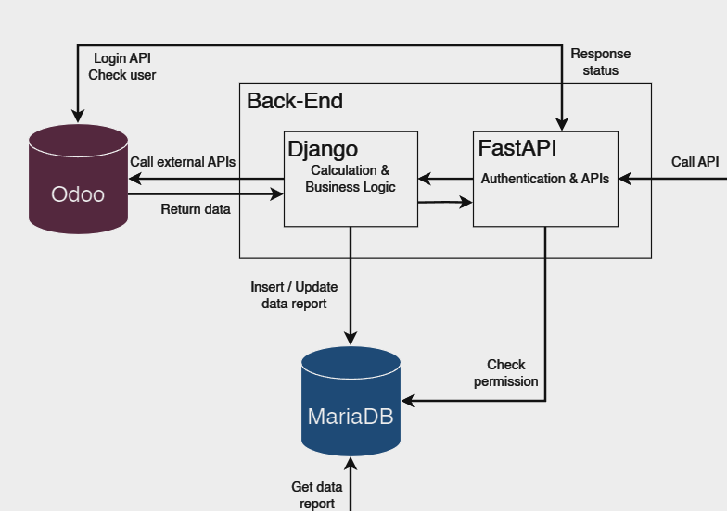
Weekly DEV-Team-Schedule report from Odoo Timesheets
3. Django responsibilities
Connection Odoo & MariaDB
Get data from Odoo
Calculation process
Insert, update data in MariaDB

Slide 6
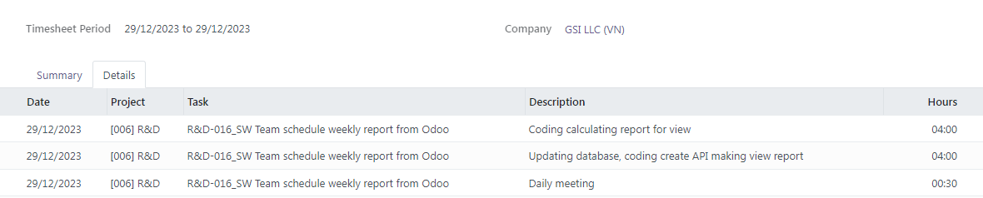
Weekly DEV-Team-Schedule report from Odoo Timesheets
3. Django responsibilities
1. Get all employees, run a loop.
2. Get all timesheets of an employee by input time, run a loop.
3. Get all lines in a timesheet.
4. Calculating, creating data report.

Slide 7
Weekly DEV-Team-Schedule report from Odoo Timesheets
4. FastAPI responsibilities
Middle component
Authentication, authorization
APIs

Slide 8
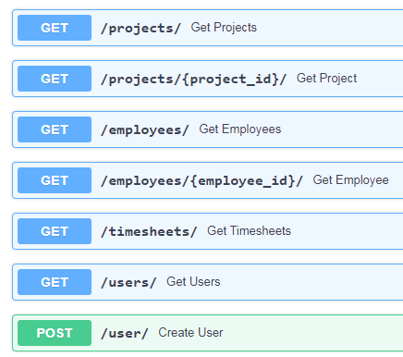
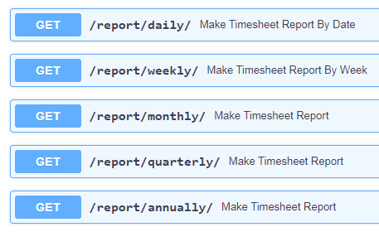
Weekly DEV-Team-Schedule report from Odoo Timesheets
4. FastAPI responsibilities
Have the corresponding input variables.

Slide 9
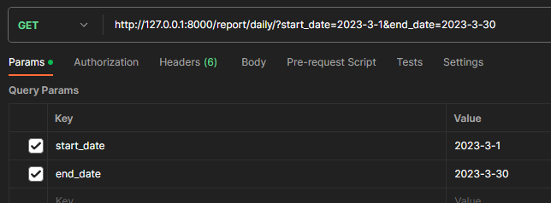
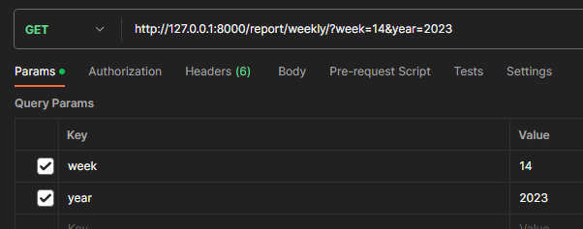
Weekly DEV-Team-Schedule report from Odoo Timesheets

Slide 10
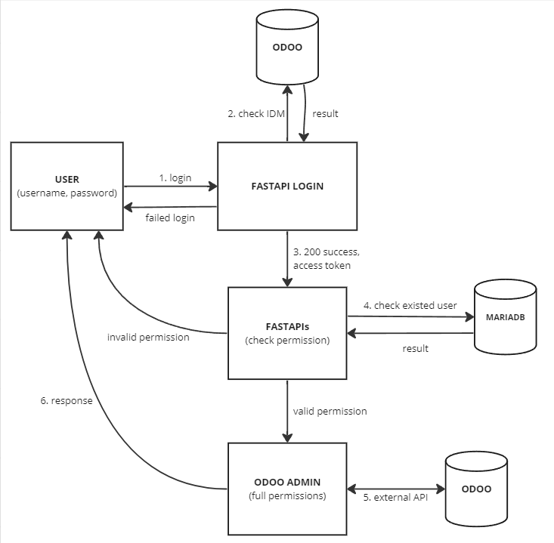

Weekly DEV-Team-Schedule report from Odoo Timesheets
4. FastAPI responsibilities

Slide 11
Weekly DEV-Team-Schedule report from Odoo Timesheets
5. Future planning
Complete views of report
2 modes: manually & automation (ApScheduler)

