Slide 1
Introduction: Sprint-Review
Purpose: Transparency, Inspection & Adaption
Sharing project status
Sharing lessons learned
Space to gather and give feedback
Align perspectives: developers, QAs & stakeholders
Target Audiences
Stakeholder
Development team
QA

Slide 2

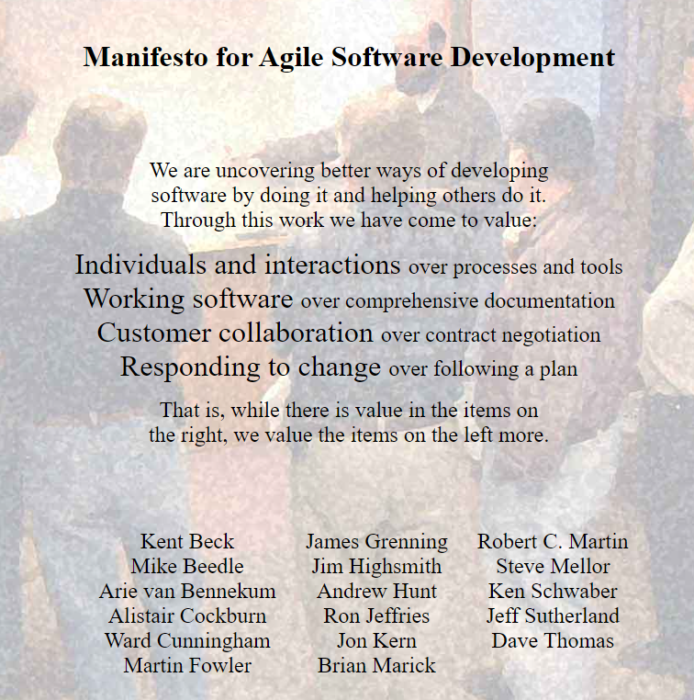
Sprint Review from 2023-12-05 to 2023-12-19
Agenda:
General Topics
Company policy
Project Status
AR/Prefab Wall/Prefab Column/Geoso: Khiem, 15min
Construction, Steel and QA Status: Minh, 15min
Rebar Nesting: Vasilii, 10 min
GSI’s Odoo migration v12 to v16: Huy, 10 min
Knowledge Sharing
How to create Odoo custom module: Thai, 5 min
Employee-Profile web-app with Odoo integration: Tuyen, 5 min
Charity event, Hieu, 5 min

Slide 3
Relational Database Management System (RDBMS)
What is a Relational Database Management System (RDBMS)?
What are the benefits of RDBMS?
What are DB-Views and why we should use them?
What are the best practices in using RDBMS?
What are the limitation of RDBMS?

Slide 4
What is a Relational Database Management System (RDBMS)?
RDBMS was introduced by Edgar F.Codd in 1970.
Type of database management system that is built based on the rules of a relational model.
Organizationally. it includes tables & relations.
Popular RDBMSs: MySQL, PostgreSQL, Oracle Database, Microsoft SQL Server,…

Slide 5
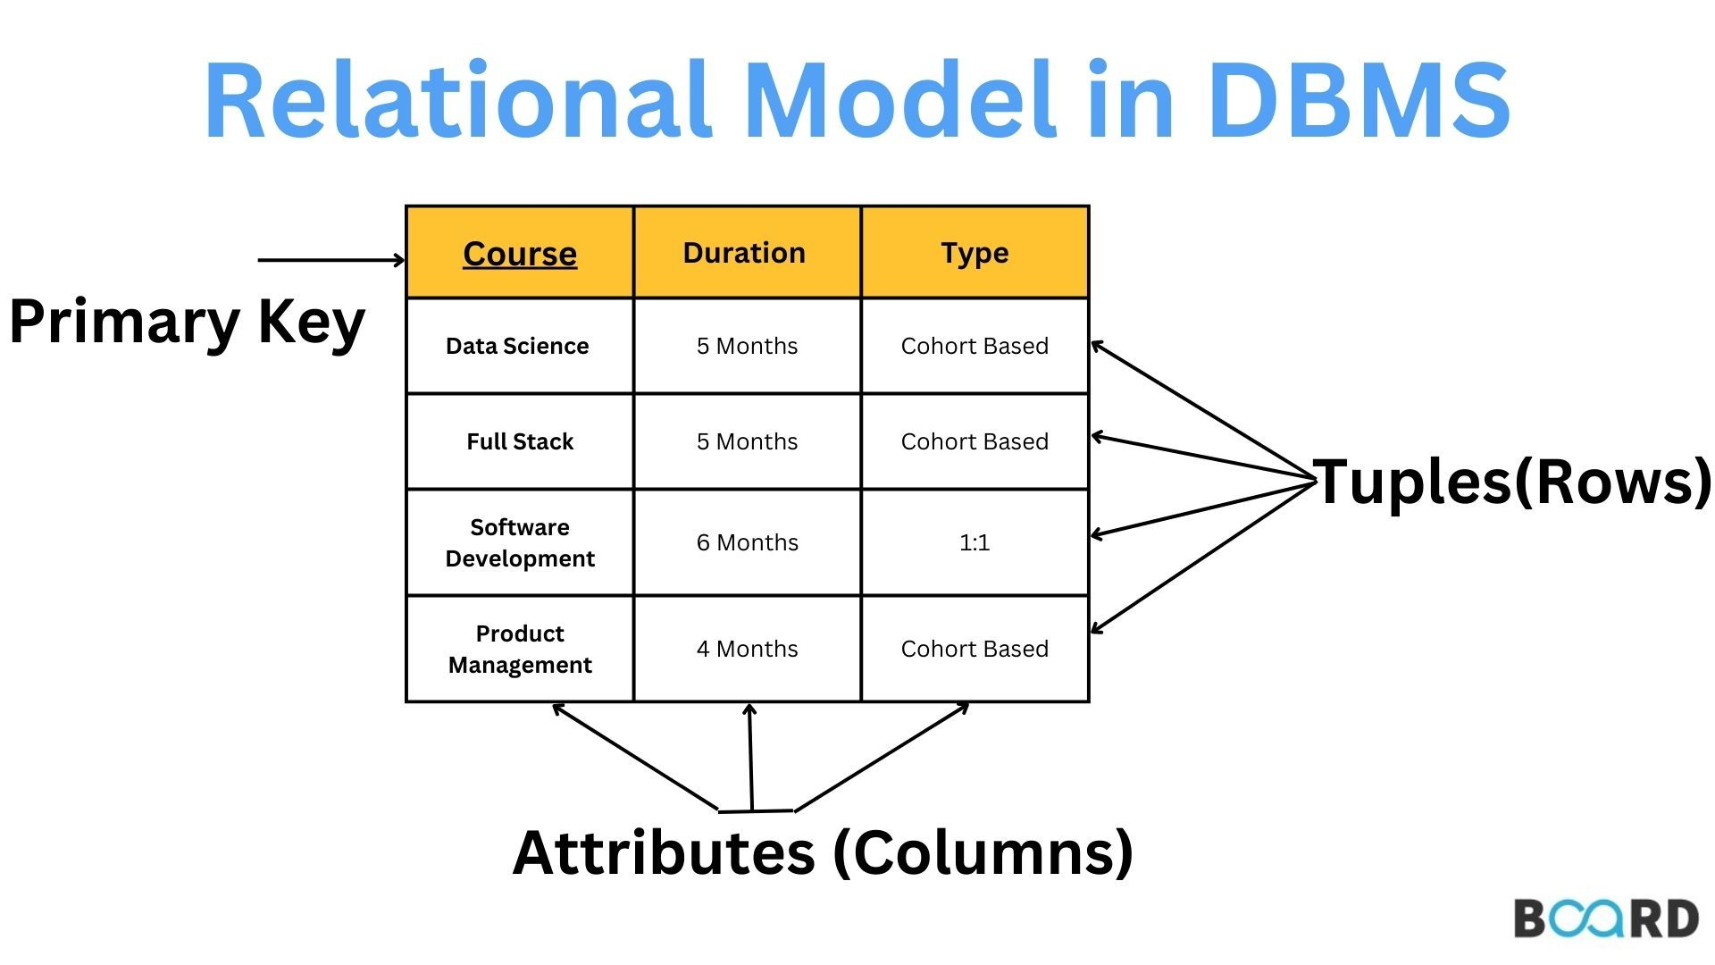
Relational Model

Slide 6
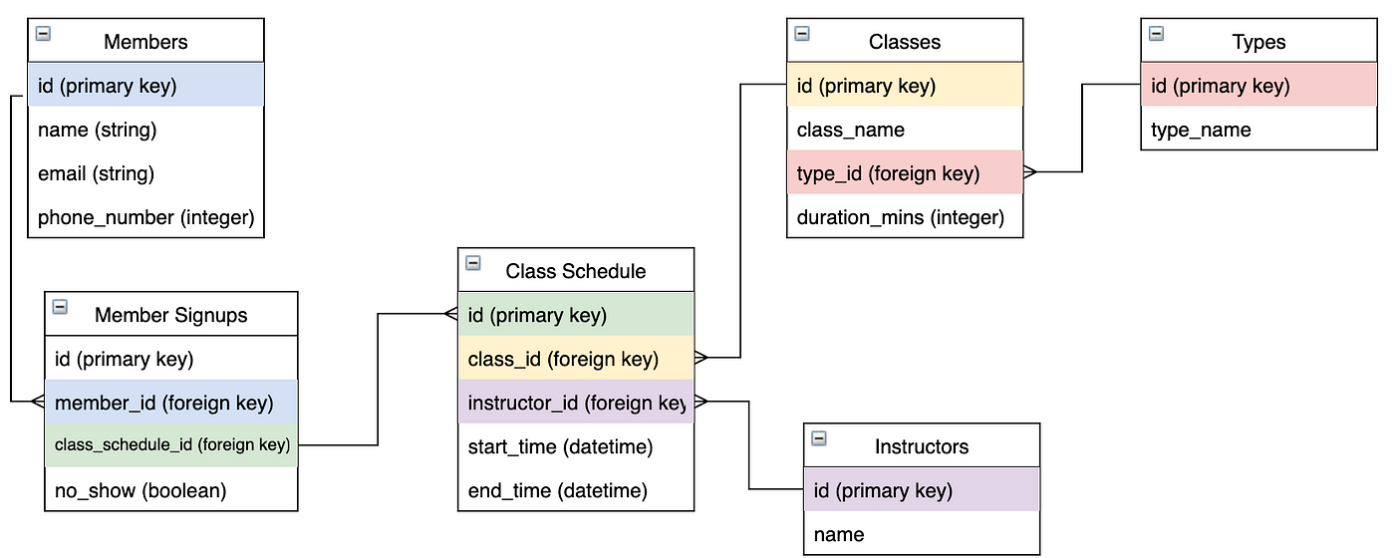
Relational Model

Slide 7
What are the benefits of RDBMS?
Data integrity: ensuring data correctly, consistently, entirely.
Organization & structure: easily understand data structure.
Query flexibility: using SQL, powerful data manipulation capabilities.
Data security: authorization, authentication, access control.
Standardization: ensuring database performance over time.
Scalability: distributing data across multiple servers.
ACID transactions: Atomicity, Consistency, Isolation, Durability.
Data independence: changes of schema or physical storage.
Backup & recovery
Normalization & efficiency: eliminating data redundancy.

Slide 8
What are DB-Views and why we should use them?
View is a logical view or collection of data from one or more tables.
View is also known as virtual table in database. Data in view is defined by a query sentence.
View is only created by the query to get data from the physical tables in the database.
View doesn’t store any data.
View represents and synchronizes the data that is stored in many tables.

Slide 9

What are DB-Views and why we should use them?

Slide 10
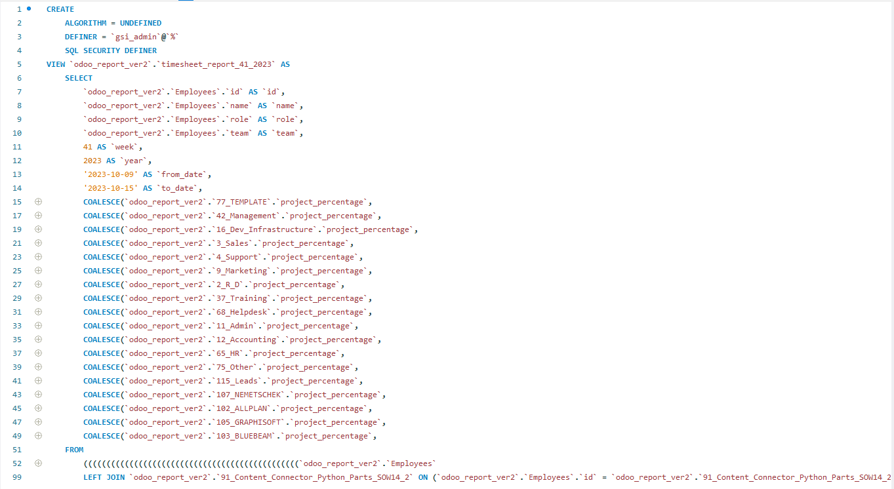

Slide 11
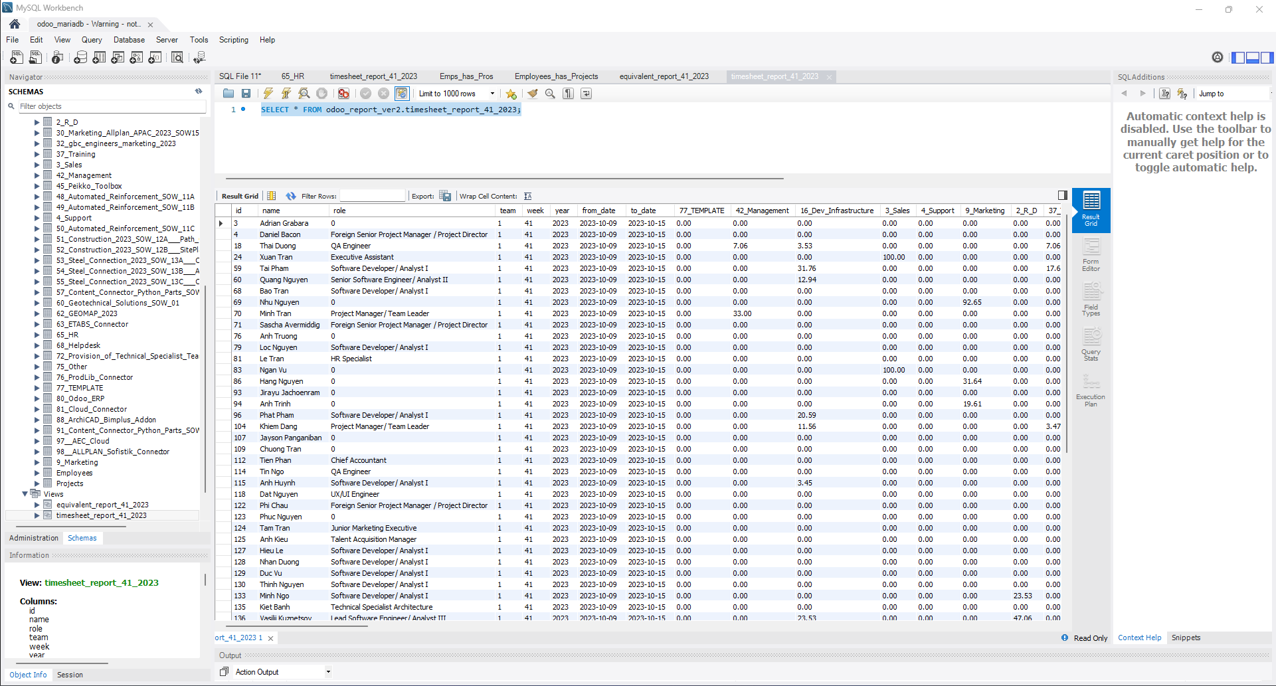

Slide 12
What are DB-Views and why we should use them?
Security: users can be granted permission to access views rather than the underlying tables.
Data abstraction: users can see database less complicated.
Simplifying queries: simplifying the process of querying the database.
Performance optimization: database engine optimize view queries.
Consistent data presentation: ensuring data correctly, consistently from the tables.
Aggregations & calculations: can aggregate, calculate through virtual columns.

Slide 13
What are the best practices in using RDBMS?
Normalization: following rules to organize data efficiently.
Indexes: use for searching data, improving data query performance.
Keys: primary key, foreign key.
Testing & optimization queries
Transactions: ensuring data following ACID rule.
Security: authentication, authorization, encryption data.
Backup & recovery
Regular maintenance
Monitoring & logging: tracking performance metrics.
Scalability planning: design the scalable database.
Documentation

Slide 14
What are the limitation of RDBMS?
Lack of scalability: data is not scalable on different physical storage servers.
Complexity in queries: slowing response time.
Maintenance problem: complexity structure.
Performance over time: a large data
Cost: software & hardware

