Slide 1
Abstract Factory Design Pattern

Slide 2
Abstract Factory Design Pattern
Design Pattern
Abstract Factory
Code Example

Slide 3
Abstract Factory Design Pattern
Design pattern
General solutions for designing & developing software
Advantages:
Optimization
Reusability
Flexibility
Easy to understand code
Fast development
3 patterns: Creational pattern, Structural pattern, Behavioral pattern

Slide 4
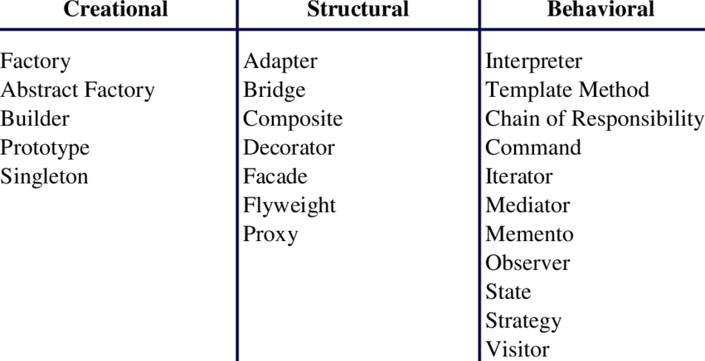
Abstract Factory Design Pattern

Slide 5
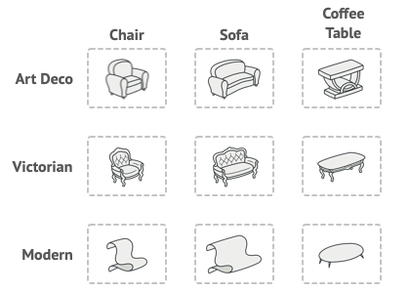
Abstract Factory Design Pattern

Slide 6
Abstract Factory Design Pattern
Abstract Factory
Providing an interface of creating families of related objects, without specifying their concrete classes.

Slide 7
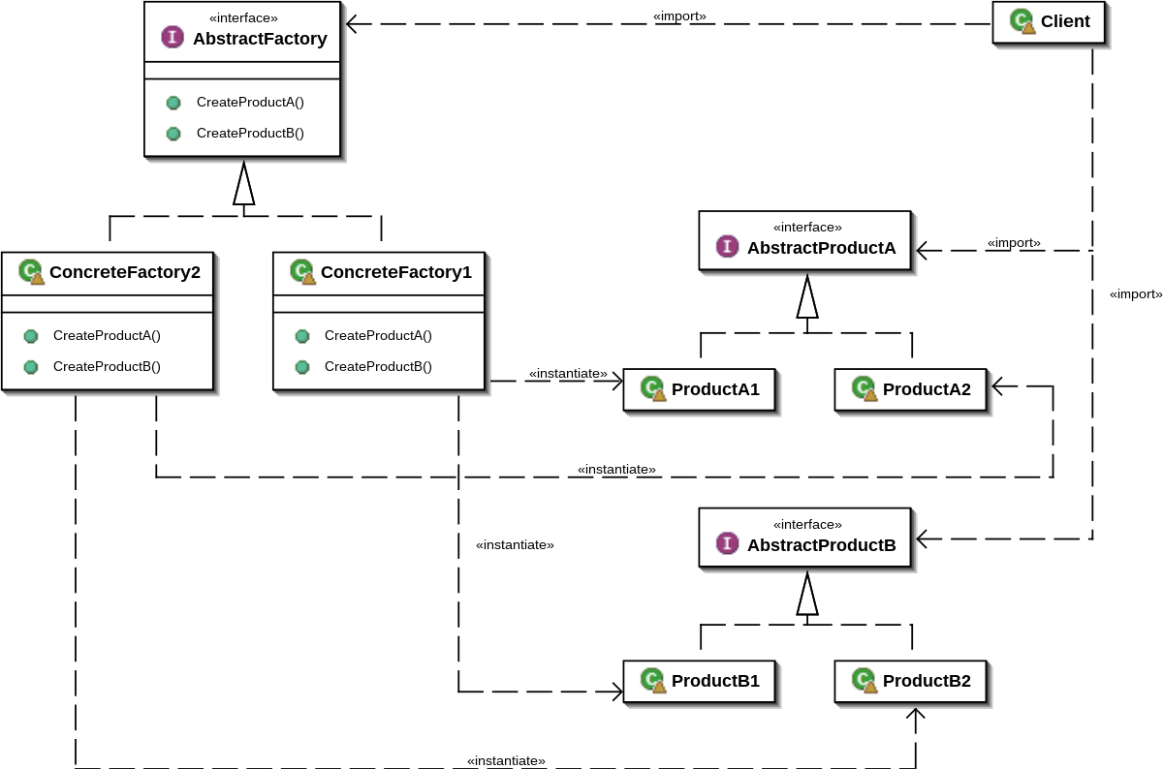
Abstract Factory Design Pattern
Architecture of Abstract Factory
5 components:
Abstract Factory
Concrete Factories
Abstract Products
Concrete Products
Client

Slide 8
Abstract Factory Design Pattern
Advantages of Abstract Factory
Ensure compatibility between objects
Limit direct instantiation from concrete classes
Easy addition of a new object
Separate concrete classes
The consistency among objects

Slide 9
Abstract Factory Design Pattern
When to use Abstract Factory
Multiple families of related products
Flexibility and extensibility

Slide 10
Abstract Factory Design Pattern
Code example
https://github.com/Tuyen92/AbstractFactory
https://github.com/Tuyen92/AbstractFactoryPython

Slide 11
Answer the questions

