Slide 1
Introduction: Sprint-Review
Purpose: Transparency, Inspection & Adaption
Sharing project status
Sharing lessons learned
Space to gather and give feedback
Align perspectives: developers, QAs & stakeholders
Target Audiences
Stakeholder
Development team
QA

Slide 2

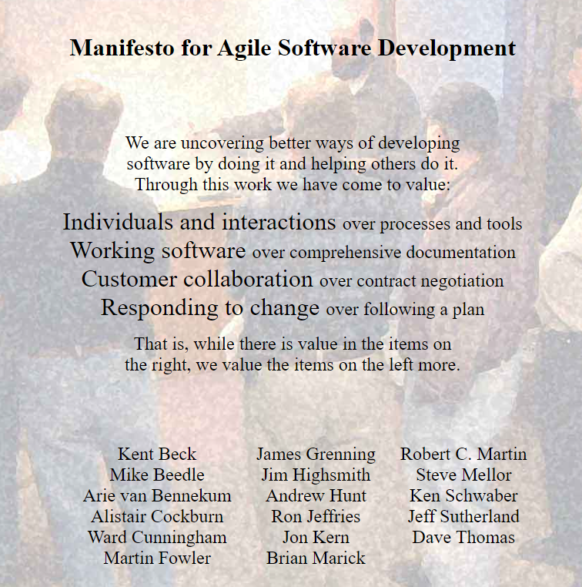
Sprint Review from 2023-12-05 to 2023-12-19
Agenda:
General Topics
Company policy
Project Status
AR/Prefab Wall/Prefab Column/Geoso: Khiem, 15min
Construction, Steel and QA Status: Minh, 15min
Rebar Nesting: Vasilii, 10 min
GSI’s Odoo migration v12 to v16: Huy, 10 min
Knowledge Sharing
How to create Odoo custom module: Thai, 5 min
Employee-Profile web-app with Odoo integration: Tuyen, 5 min
Charity event, Hieu, 5 min

