Slide 1
Clean Code Yellow Grade

Slide 2
Clean Code Yellow Grade
Yellow
Principles
Practice
Questions

Slide 3
Clean Code Yellow Grade
Focussing on the automatized testing
Includes principle of object orientation (encapsulation)
Making code more clean to unsderstand
Keeping the code stable

Slide 4
Clean Code Yellow Grade Principles
Principles
Interface Segregation Principle (ISP)
Dependency Inversion Principle (DIP)
Liskov Substitution Principle
Principle of Least Astonishment
Information Hiding Principle

Slide 5
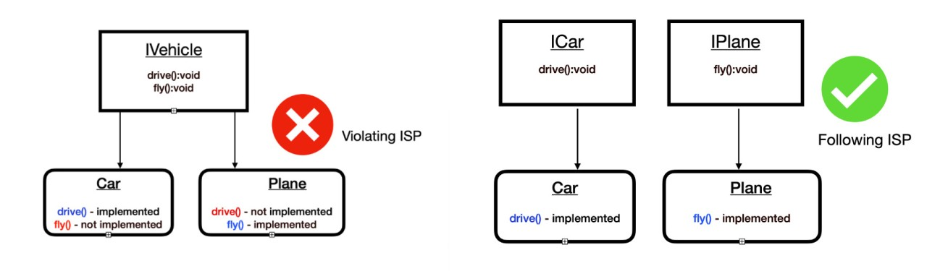
Clean Code Grade Yellow Principles
Interface Segregation Principle (ISP)

Slide 6
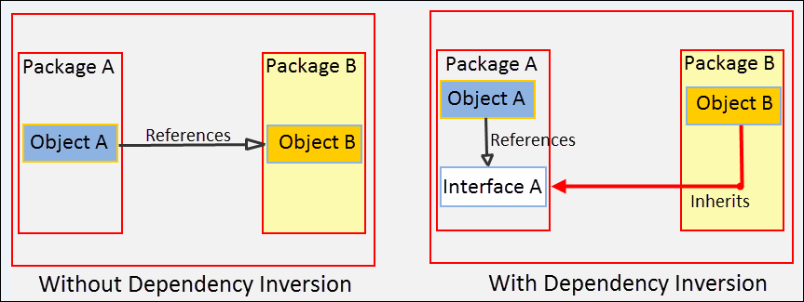
Clean Code Grade Yellow Principles
Dependency Inversion Principle (DIP)

Slide 7
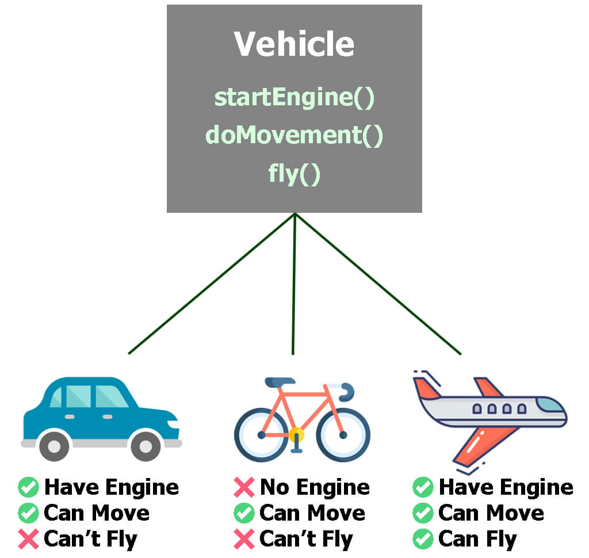
Clean Code Grade Yellow Principles
Liskov Subsitution Principle

Slide 8
Clean Code Grade Yellow Principles
Principle of Least Astonishment
If a necessary feature has a high astonishment factor, it may be necessary to redesign the feature

Slide 9
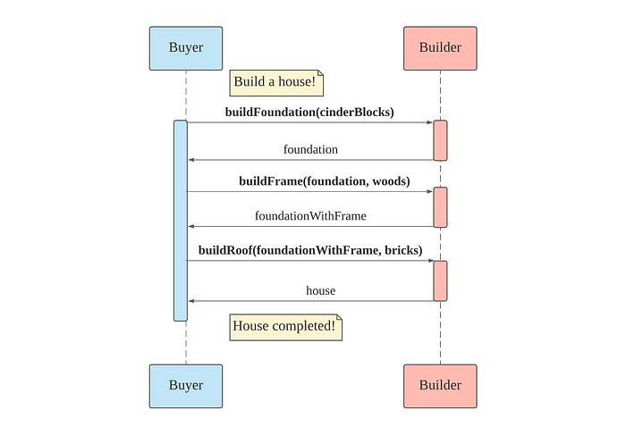
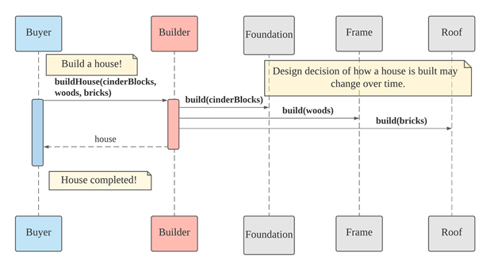
Clean Code Grade Yellow Principles
Information Hiding Principle
Related to encapsulation oop

Slide 10
Clean Code Grade Yellow
Practice
Automatized Unit Tests
Mockups (Testdummies)
Code Coverage Analyse
Participation in Professional Events
Complex Refactorings

Slide 11
Clean Code Grade Yellow Practice
Automated Unit Test
Trustworthy
Maintainable & Readable
Verify a Single Use Case
Isolated
Automated
They save time.
They take fear.

Slide 12
Clean Code Grade Yellow Practice
Mockups (Testdummies)
Components use other components -> remove dependencies
Alter solution using Mockups instead of real component
make controllable tests possible.

Slide 13
Clean Code Grade Yellow Practice
Code Coverage Analyse
Code Coverage Analysis is the process of discovering code within a program that is not being exercised by test cases. This information can then be used to improve the test suite, either by adding tests or modifying existing tests to increase coverage.
Code Coverage Analysis shines a light on the quality of your unit testing. It enables developers to quickly and easily improve the quality of their unit tests which ultimately leads to improved quality of the software under development.

Slide 14
Clean Code Grade Yellow Principles
Participation in Professional Events
The own developer team, a regional user group and national or international conferences

Slide 15
Clean Code Grade Yellow Principles
Complex Refactorings
Fators: source code architecture
Splir or merge classes, modules
Optimize application performance
Changing application Architecture, programming language, framework
improve the quality of the code
Improve the design
Maintain and update

Slide 16
Answer the questions

