Slide 1
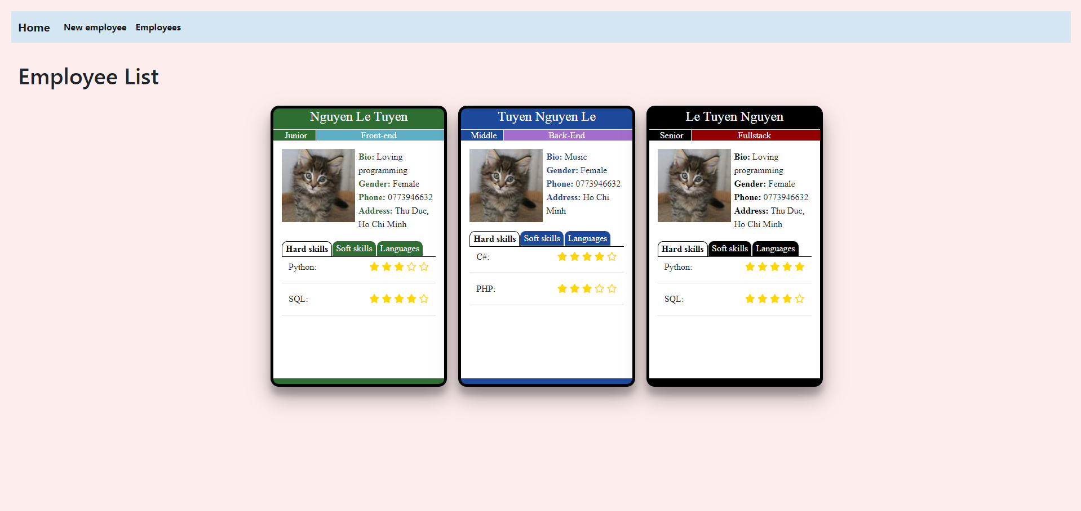
Baseballcards Web Application
Well-know employee’s information & strength
Easily managing employee’s profile
Attractive UI and effective UX for user

Slide 2
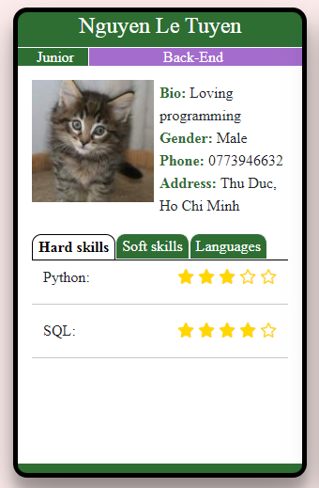
Baseballcards Web Application
name
level
speciality
avatar
persional information
tab of skills
rating
skill

Slide 3
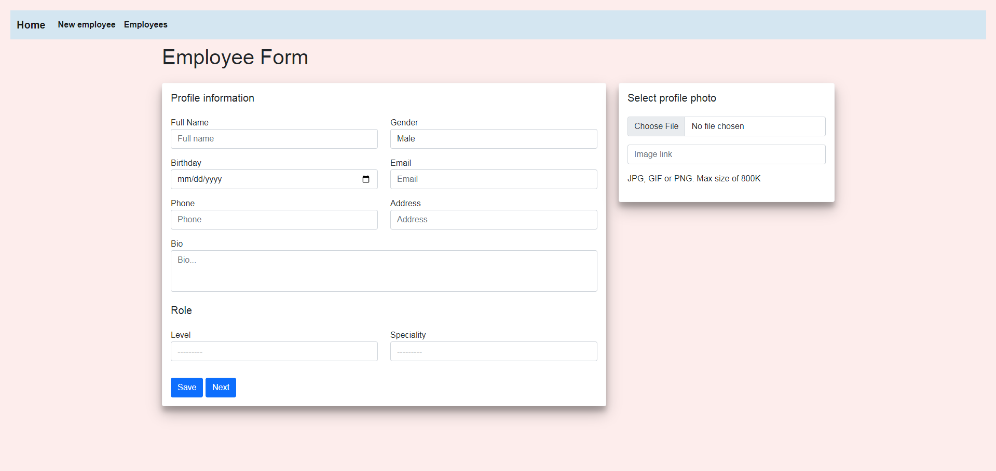
Baseballcards Web Application
Allow user to add new employee’s information quickly

Slide 4
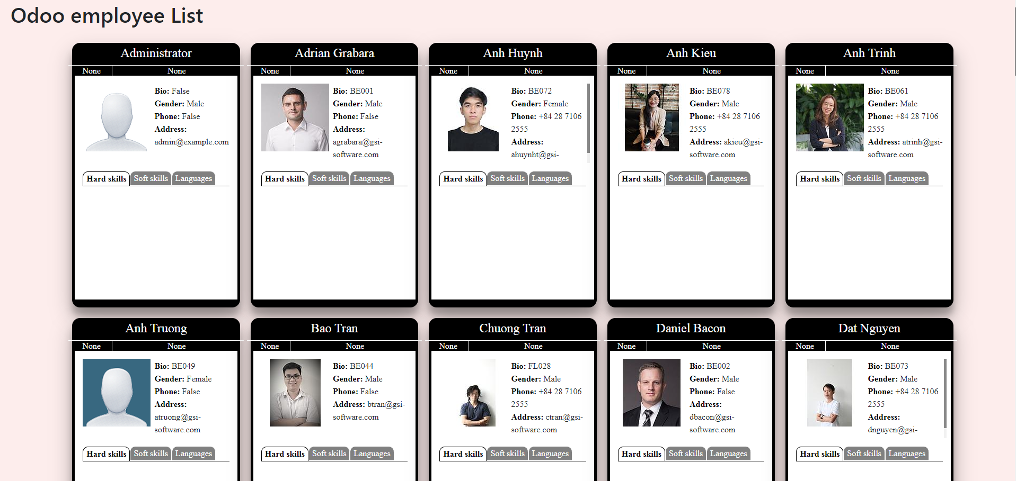
Baseballcards Web Application
Connection with the Odoo, getting all employee’s data

