Slide 2

Ypp 4
bbv Software Services AG | Date: 25/08/2025

Slide 3

From Learning to Practice: My Growth Story
Presented by: Luong Tuyet Mi – Intern, BBV Vietnam | Date: 25/08/2025
Notes:
Xin chào mọi người, hôm nay em sẽ chia sẻ về hành trình học tập và trải nghiệm cá nhân trong chương trình YPP4
Mục tiêu của buổi thuyết trình: chia sẻ những milestone quan trọng và những kỹ năng, kiến thức em đã tích lũy từ đầu chương trình đến giờ

Slide 4
Agenda
Introduction
Learning Journey
Challenges Faced
Lessons Learned
Becoming a Better Me
Q & A

Slide 5

Introduction
Purpose & timeline of my learning journey

Slide 6

Introduction
Joined the Young Professional Program at BBV VietNam
Technical learning:
Requirement analysis, Scrum, BPMN,…
Database design & SQLUnit testing & optimization
Personal development:
English Club
Workshop, Sharing Session: Critical Thinking,Problem Solving,…
Outdoor activities & social gatherings

Slide 7

Learning Journey

Slide 8
Learning Journey
Getting Started
Building Foundations
Expanding Skills
Connecting & Growing
Onboarding to YPP
Basics of database design
Practicing SQL queries
Unit testing & optimization
English Club & soft-skill workshops
Sharing sessions with peers & mentors
Outdoor activities

Slide 9
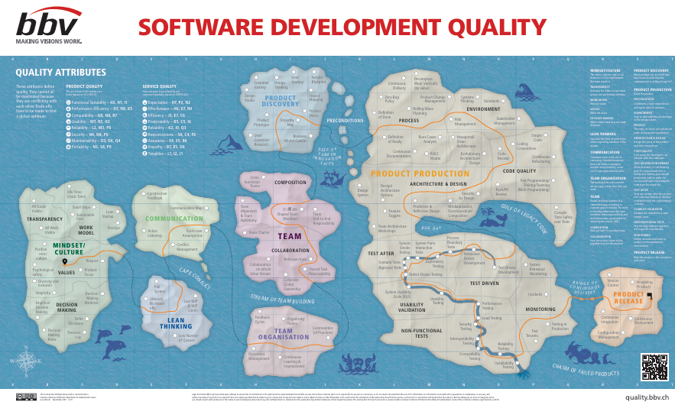
Learning Journey
Building Foundations
Onboarding to YPP & meeting the team
Learning about the Software Development Quality Map
Understanding program structure & expectations
Adapting to a new working environment
First exposure to Top – Down Approach, Scrum, BPMN & S.M.A.R.T questioning,…
Notes:
Được onboarding vào YPP4, làm quen team → giúp mình nhanh chóng hòa nhập.
Tìm hiểu Software Development Quality Map → hiểu rõ tiêu chí chất lượng phần mềm.
Nắm được cấu trúc chương trình & kỳ vọng → có định hướng phát triển rõ ràng.
Thích nghi với môi trường làm việc chuyên nghiệp mới.
Lần đầu tiếp cận Top-Down Approach, Scrum, BPMN, S.M.A.R.T questioning → xây nền tảng kỹ năng quan trọng.

Slide 10
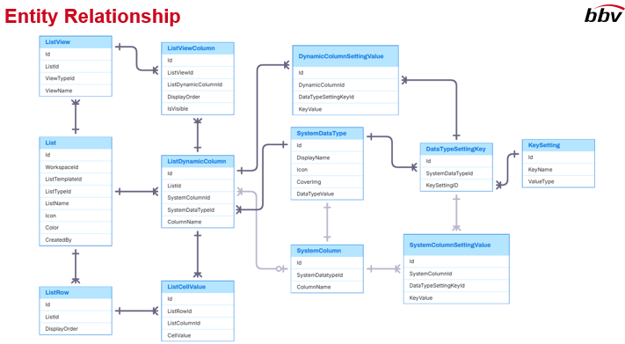
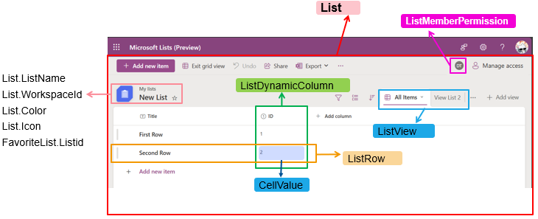
Learning Journey
Building Foundations
Basics of database design
Practicing SQL queries
Identifying necessary entities for the database
Learning basic UI analysis to support design
Applying knowledge to simple exercises
Gaining confidence in technical fundamentals
Notes:
Học các nguyên tắc cơ bản về database design.
Thực hành viết SQL queries để thao tác dữ liệu.
Xác định entities quan trọng trong database.
Làm quen với UI analysis cơ bản để hỗ trợ thiết kế.
Áp dụng kiến thức qua bài tập nhỏ, thực hành đơn giản.
Từ đó dần tự tin hơn với các nền tảng kỹ thuật.

Slide 11
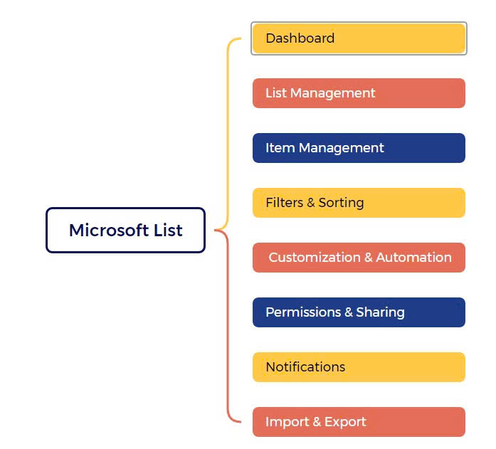
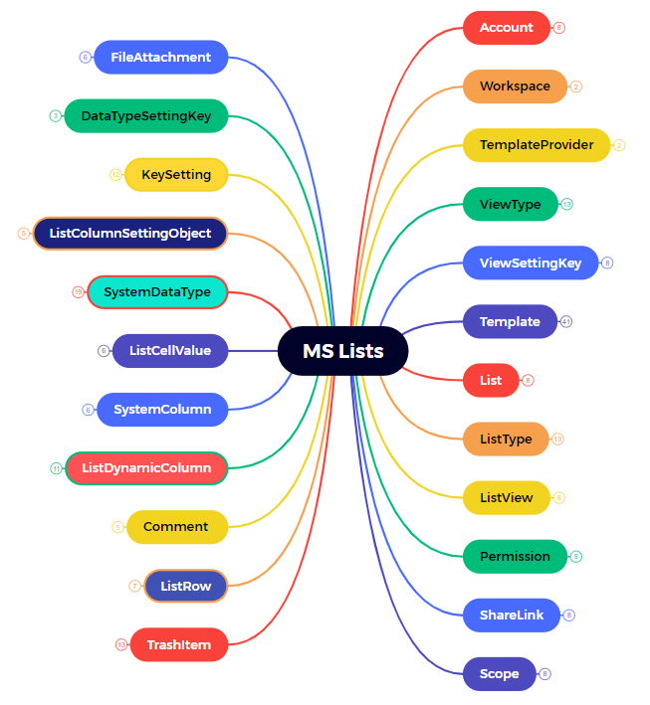
Entity analysis exercises for the main functions of MS Lists
BEFORE
AFTER

Slide 12

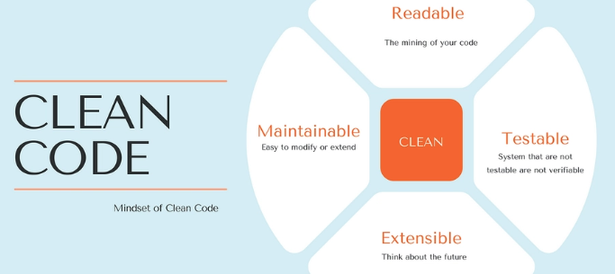
Learning Journey
Expanding Skills
Learned Dapper & Entity Framework (EF) for database interaction
Explored MVC architecture to structure applications
Studied Slowly Changing Dimensions (SCD 1, 2, 3) for data versioning
Applied Clean Code principles: SOLID principles, class design, HATEOAS
Notes:
Học Dapper & Entity Framework để thao tác với database.
Tìm hiểu MVC architecture giúp tổ chức ứng dụng rõ ràng hơn.
Nắm khái niệm Slowly Changing Dimensions (SCD 1,2,3) cho quản lý phiên bản dữ liệu.
Áp dụng Clean Code principles: SOLID, thiết kế class, HATEOAS → viết code dễ bảo trì, dễ mở rộng.
Slowly Changing Dimensions (SCD) là cách quản lý và lưu trữ dữ liệu thay đổi theo thời gian trong Data Warehouse (kho dữ liệu).

Slide 13



Learning Journey
Expanding Skills
English Club: improved communication & presentation skills
Workshops Attended: Critical Thinking, S.M.A.R.T Questions, Problem Solving,…
Teamwork & Collaboration: learned to share ideas, give and receive feedback

Slide 14

Learning Journey
Personal Gains
Gained confidence in writing structured, maintainable code
Better understanding of software design and architecture
Learned to manage evolving data and apply theory in practice
Improved problem-solving and design skills

Slide 15

Learning Journey
Connecting & Growing
Participated in sharing sessions with peers & mentors
Joined team-building and outdoor activities
Applied knowledge to real-life exercises
Learned to collaborate and communicate effectively
Started mentoring and supporting newer participants

Slide 16
Challenges Faced

Slide 17

Challenges Faced
1. Code & Implementation
Code not always clean or well-structured
Some solutions didn’t fully meet requirements
Applying new concepts often led to mistakes
2. Learning & Process
Needed multiple revisions to improve quality
Balancing learning speed with doing things right
Managing multiple new topics at once

Slide 18
Lessons Learned

Slide 19

Lessons Learned
Technical Skills
Improved analytical skills: learned to break down complex problems
Enhanced problem-solving ability: apply logical thinking to design solutions
Developed coding practices: write cleaner, structured, maintainable code (MVC, SQL, unit testing)

Slide 20
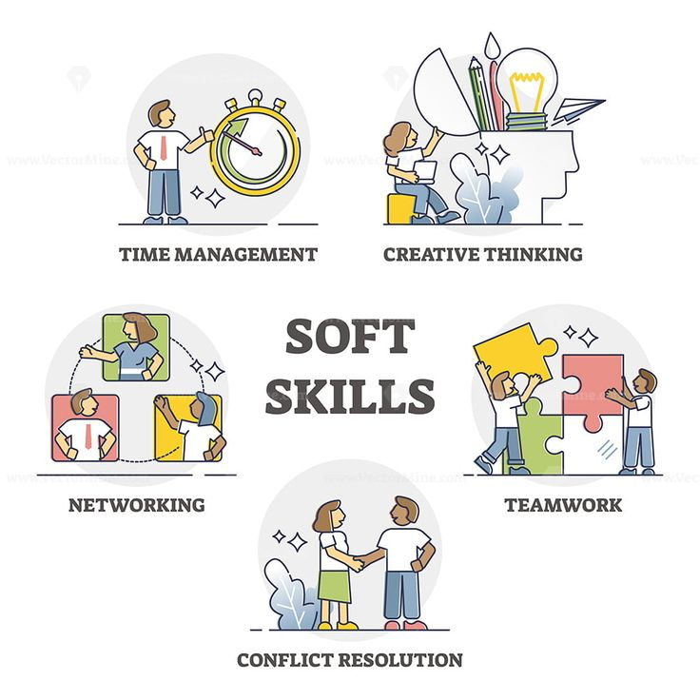
Lessons Learned
Soft Skills
Strengthened communication & teamwork via English Club, sharing sessions, workshops
Gained confidence in presenting ideas, collaborating, and learning from others

Slide 21
Becoming a Better Me

Slide 22

Becoming a Better Me
Grew technically: better coding, database design, problem-solving
Improved soft skills: communication, teamwork, presenting ideas
Built confidence to tackle challenges and learn independently
Keep learning and exploring new skills
Strive to become a better, more capable version of myself

Slide 23

Q & A

