Slide 2

Ypp 4
bbv Software Services AG | Date: 25/08/2025

Slide 3




From Learning to Practice: My Growth Story
Presented by: Luong Tuyet Mi – Intern, BBV Vietnam | Date: 25/08/2025

Slide 4
Agenda
Introduction
Learning Journey
Challenges Faced
Lessons Learned
Becoming a Better Me
Q & A

Slide 5

Introduction
Purpose & timeline of my learning journey

Slide 6

Introduction
Joined the Young Professional Program at BBV VietNam
Technical learning:
Requirement analysis, Scrum, BPMN,…
Database design & SQLUnit testing & optimization
Personal development:
English Club
Workshop, Sharing Session: Critical Thinking,Problem Solving,…
Outdoor activities & social gatherings

Slide 7

Learning Journey

Slide 8
Learning Journey
Getting Started
Building Foundations
Expanding Skills
Connecting & Growing
Onboarding to YPP
Basics of database design
Practicing SQL queries
Unit testing & optimization
English Club & soft-skill workshops
Sharing sessions with peers & mentors
Outdoor activities

Slide 9
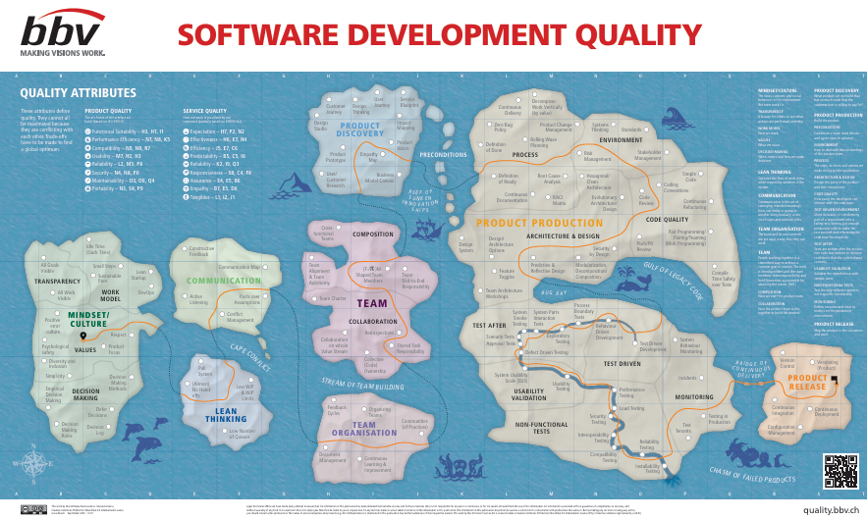
Learning Journey
Building Foundations
Onboarding to YPP & meeting the team
Learning about the Software Development Quality Map
Understanding program structure & expectations
Adapting to a new working environment
First exposure to Top – Down Approach, Scrum, BPMN & S.M.A.R.T questioning,…

Slide 10
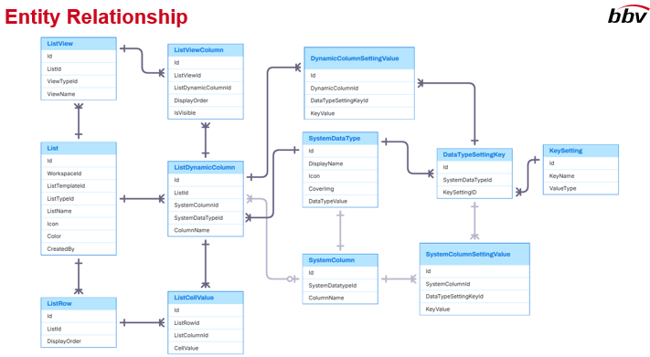
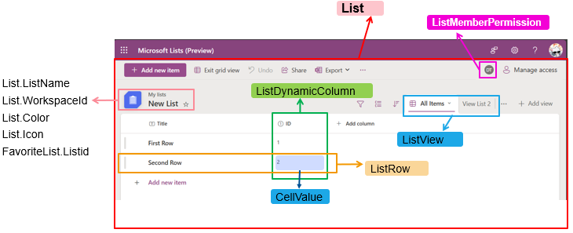
Learning Journey
Building Foundations
Basics of database design
Practicing SQL queries
Identifying necessary entities for the database
Learning basic UI analysis to support design
Applying knowledge to simple exercises
Gaining confidence in technical fundamentals

Slide 11

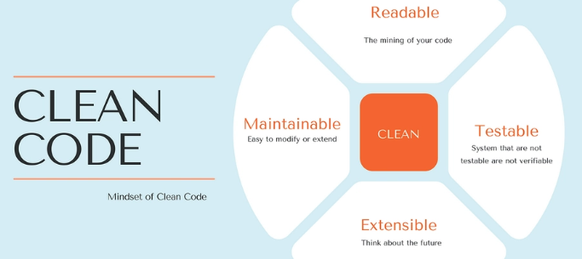
Learning Journey
Expanding Skills
Learned Dapper & Entity Framework (EF) for database interaction
Explored MVC architecture to structure applications
Studied Slowly Changing Dimensions (SCD 1, 2, 3) for data versioning
Applied Clean Code principles: SOLID principles, class design, HATEOAS

Slide 12

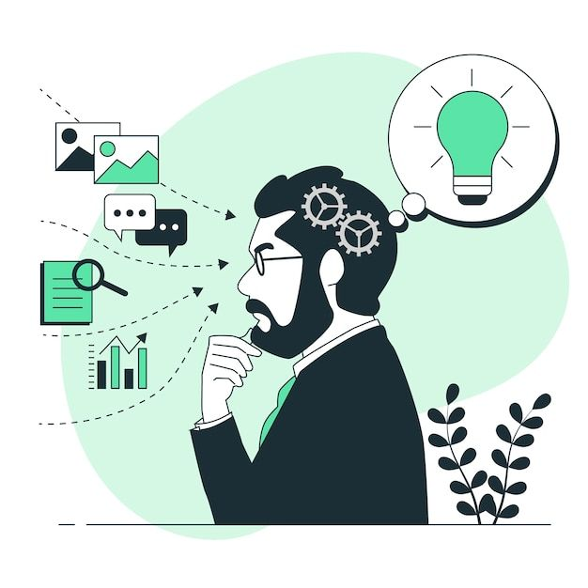
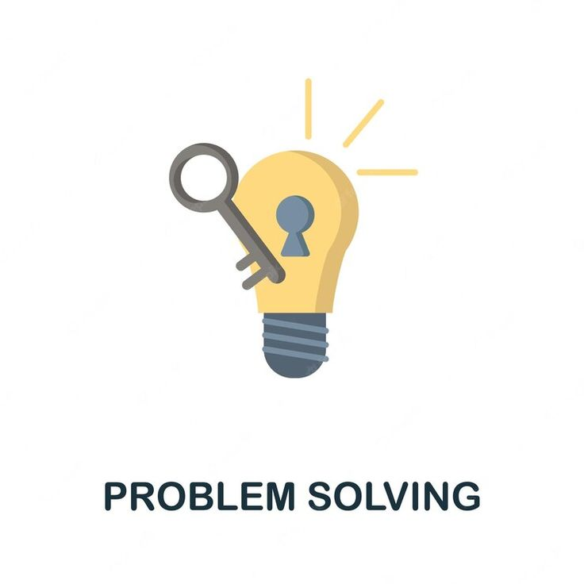
Learning Journey
Expanding Skills
English Club: improved communication & presentation skills
Workshops Attended: Critical Thinking, S.M.A.R.T Questions, Problem Solving,…
Teamwork & Collaboration: learned to share ideas, give and receive feedback

Slide 13

Learning Journey
Personal Gains
Gained confidence in writing structured, maintainable code
Better understanding of software design and architecture
Learned to manage evolving data and apply theory in practice
Improved problem-solving and design skills

Slide 14

Learning Journey
Connecting & Growing
Participated in sharing sessions with peers & mentors
Joined team-building and outdoor activities
Applied knowledge to real-life exercises
Learned to collaborate and communicate effectively
Started mentoring and supporting newer participants

Slide 15
Challenges Faced

Slide 16
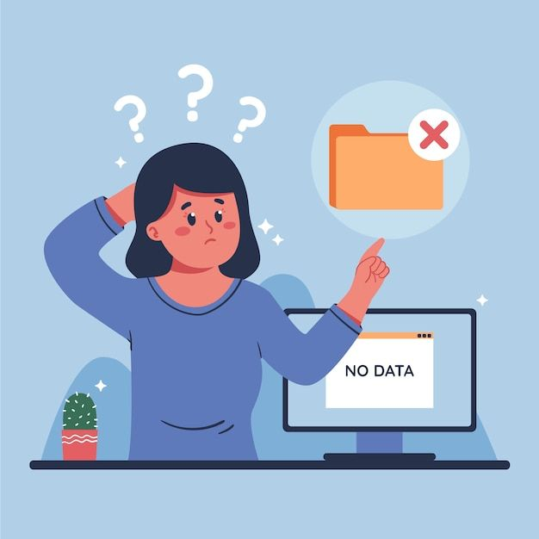
Challenges Faced
1. Code & Implementation
Code not always clean or well-structured
Some solutions didn’t fully meet requirements
Applying new concepts often led to mistakes
2. Learning & Process
Needed multiple revisions to improve quality
Balancing learning speed with doing things right
Managing multiple new topics at once

Slide 17
Lessons Learned

Slide 18
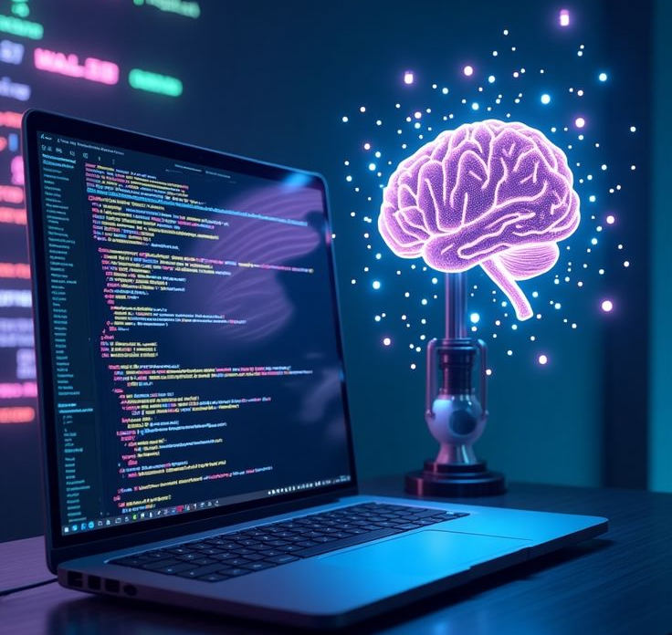
Lessons Learned
Technical Skills
Improved analytical skills: learned to break down complex problems
Enhanced problem-solving ability: apply logical thinking to design solutions
Developed coding practices: write cleaner, structured, maintainable code (MVC, SQL, unit testing)

Slide 19
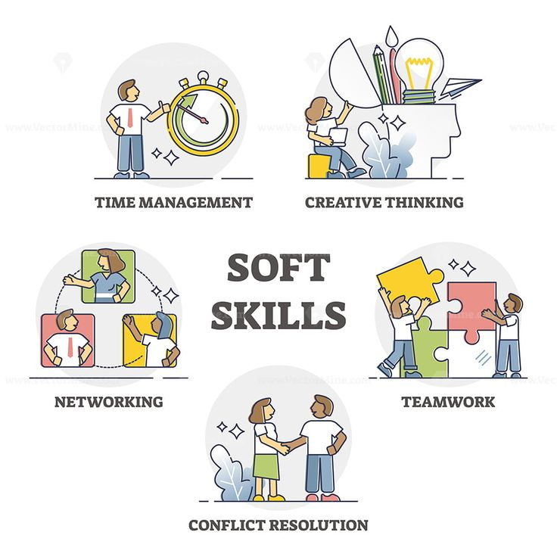
Lessons Learned
Soft Skills
Strengthened communication & teamwork via English Club, sharing sessions, workshops
Gained confidence in presenting ideas, collaborating, and learning from others

Slide 20
Becoming a Better Me

Slide 21

Becoming a Better Me
Grew technically: better coding, database design, problem-solving
Improved soft skills: communication, teamwork, presenting ideas
Built confidence to tackle challenges and learn independently
Keep learning and exploring new skills
Strive to become a better, more capable version of myself

Slide 22
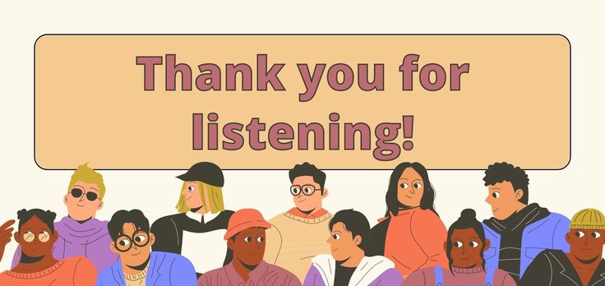
Q & A

