Slide 1


Handan YARICI
Senıor Software Engıneer
linkedin.com/in/handanyarici
github.com/handanyarici

Slide 2
SOFTWARE DEVELOPMENT STEPS
Problem Definition
Understanding the problem and requirements
Analysis
Working on technical requirements for the software
Coding
Developing assigned parts of software with preferred language
Testing
Testing software with the business scenarios
Documentation
Notes:
9 round programından bahset problem definition ve analiz aşamasını detaylandır.

Slide 3
SOFTWARE DesIgn Approaches
Data Flow Chart Approach
Thinking the algorithm with diagrams
Data Structure Approach
Deciding the correct data structure for the data which will be used in project.
Object Oriented Approach
Model this real world problem with the objects and communication messages between objects.
Notes:
Küçük problemler Hesap makinesi

Slide 4
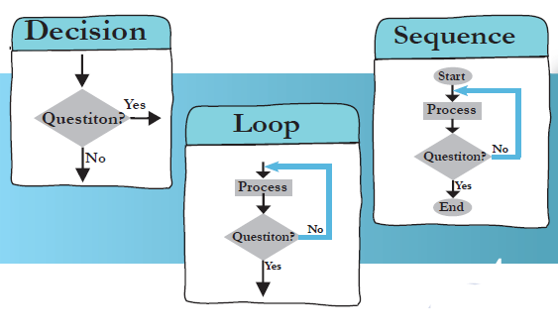
DESIGNING ALGORITHM
A process or set of rules to be followed in calculations or other problem-solving operations
What is a flowchart?
• A flowchart is a picture (graphical representation) of the problem solving process.
• A flowchart gives a step-by-step procedure for solution of a problem
Drawing a flowchart,
• Identify input and output.
• Apply reasoning skills to solve the problem.
• Draw the flowchart using the appropriate symbols and arrows to show the Guidelines sequence of steps in solving the problem.

Slide 5
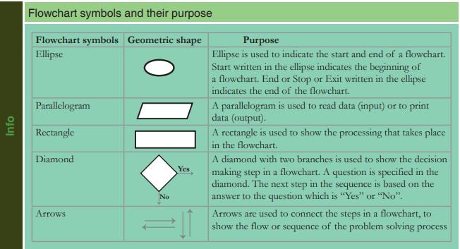
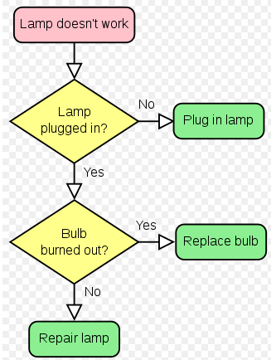
FLOWCHART

Slide 6
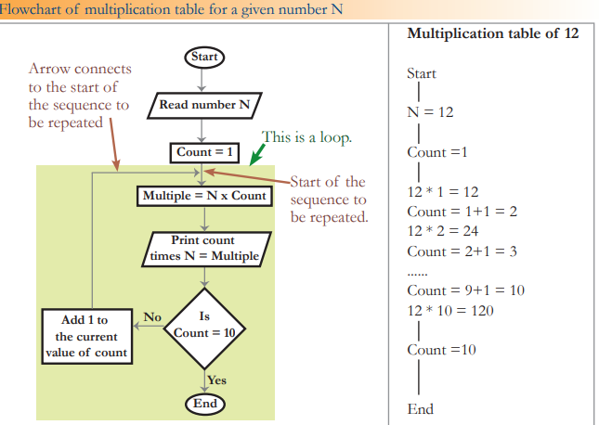
FLOWCHART

Slide 7
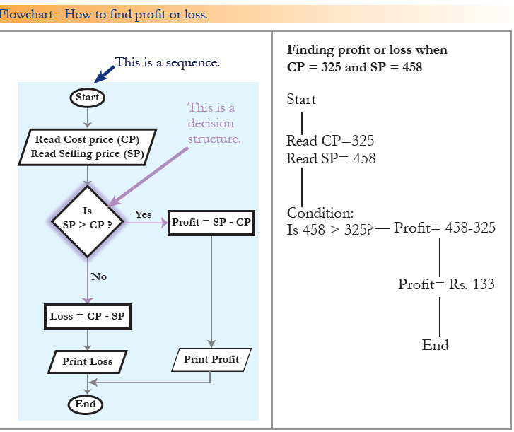
FLOWCHART

Slide 8
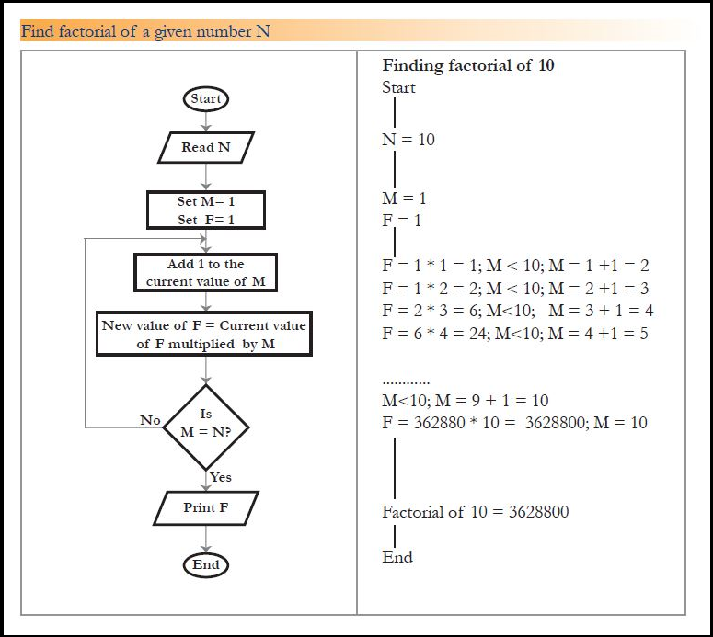
FLOWCHART

Slide 9
LAB STUDY
11.02.2020
Download Java SE
Download Java Editor – Eclipse or Intellij
Develop Hello World Aplication and run at console
Run Hello World Aplication at editor

Slide 10

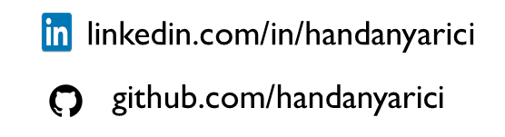
tHANKS!
handanyarici@gmail.com

