Slide 1
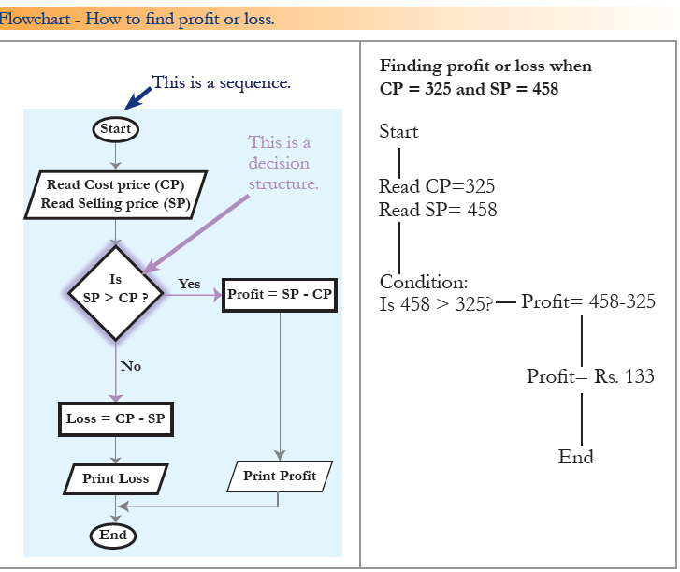
LAB STUDY
Implement the flowchart in Java

Slide 2
Data structure approach
Structured design is a conceptualization of problem into several well-organized elements of solution. It is basically concerned with the solution design. Benefit of structured design is, it gives better understanding of how the problem is being solved. Structured design also makes it simpler for designer to concentrate on the problem more accurately.
A good structured design always follows some rules for communication among multiple modules, namely -
Cohesion - grouping of all functionally related elements.
Coupling - communication between different modules.
A good structured design has high cohesion and low coupling arrangements.

Slide 3
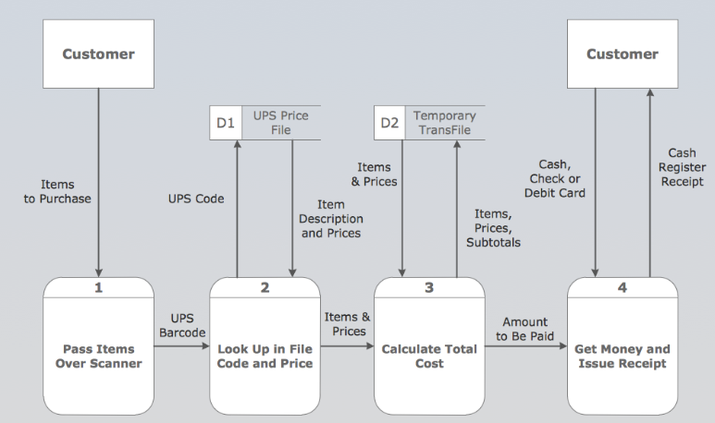
Structured desıgn

Slide 4
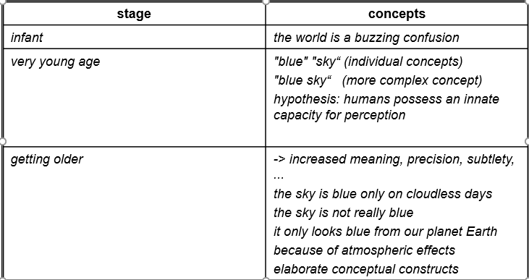
WHY OBJECT ORIENTED
“The "software crises" came about when people realized the major problems in software development were … caused by communication difficulties and the management of complexity”
Concept formation: from chaos to order!

Slide 5


WHAT IS object?
An "object" is anything to which a concept applies, in our awareness
Things drawn from the problem domain or solution space.
E.g., a living person in the problem domain, a software component in the solution space.

Slide 6
Thinking About Objects
Objects
Reusable software components that model real-world items
Look all around you
People, animals, plants, cars, etc.
Attributes
Size, shape, color, weight, etc.
Behaviors
Babies cry, crawl, sleep, etc.

Slide 7
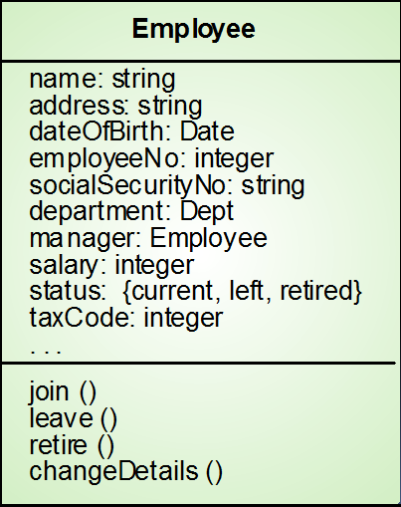
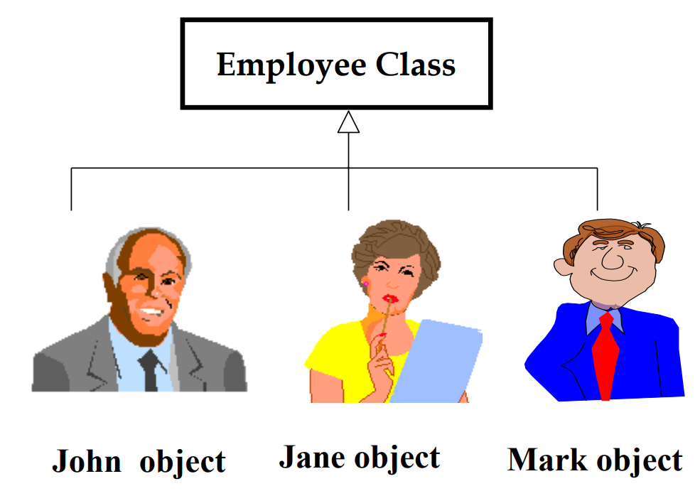
WHAT IS CLASS?
Object classes are templates for objects. They may be used to create objects
Object classes may inherit attributes and services from other object classes

Slide 8
Object-Oriented Style
Programming with Abstract Data Types
ADTs specify/describe behaviors.
Has an Basic Program Unit: Class
Implementation of an ADT.
Abstraction enforced by encapsulation.
Basic Run-time Unit: Object
Instance of a class.
associated state.

Slide 9
Object-Oriented Concepts
Data Abstraction (specifies behavior)
Encapsulation (controls visibility of names)
Polymorphism (accommodates various implementations)
Inheritance (facilitates code reuse)
Modularity (relates to unit of compilation)

Slide 10
More about ood
Object-oriented design (OOD)
Models real-world objects
Models communication among objects
Encapsulates data (attributes) and functions (behaviors)
Information hiding
Communication through well-defined interfaces
Object-oriented language
Programming is called object-oriented programming (OOP)
Java

Slide 11
the Unified Modeling Language
Unified Modeling Language (UML)
Graphical language that uses common notation
Allows developers to represent object-oriented designs
UML Diagrams
Use Case Diagrams
Class Diagrams
Sequence Diagrams

Slide 12
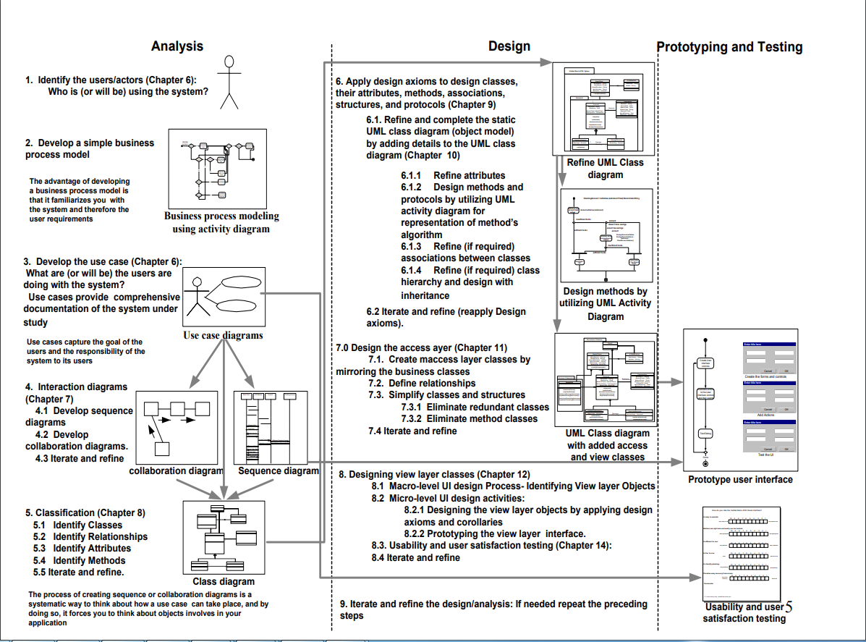

Slide 13
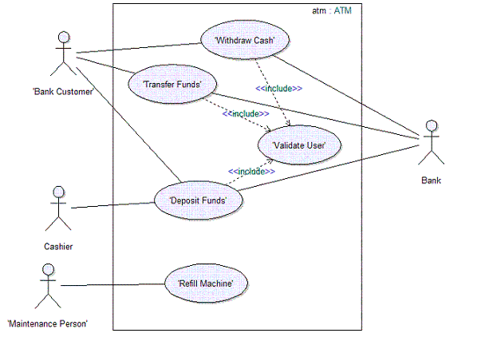
USE CASE DIAGRAM
<<extend>> is used when a use case adds steps to another first-class use case.
<<include>> is used to extract use case fragments that are duplicated in multiple use cases.
The included use case cannot stand alone and the original use case is not complete without the included one

Slide 14
A Case Study - A Payroll Program
Consider a payroll program that processes employee records at a small manufacturing firm. This company has three types of employees:
1. Managers: Receive a regular salary. •
2. Office Workers: Receive an hourly wage and are eligible for overtime after 40 hours.
3. Production Workers: Are paid according to a piece rate

Slide 15
Structured Approach
FOR EVERY EMPLOYEE DO
BEGIN
IF employee = manager THEN
CALL computeManagerSalary
IF employee = office worker THEN
CALL computeOfficeWorkerSalary
IF employee = production worker THEN
CALL computeProductionWorkerSalary
END

Slide 16
What if we add two new types of employees?
Temporary office workers ineligible for overtime,
Junior production workers who receive an hourly wage plus a lower piece rate.

Slide 17
Structured Approach
FOR EVERY EMPLOYEE DO
BEGIN
IF employee = manager THEN
CALL computeManagerSalary
IF employee = office worker THEN
CALL computeOfficeWorkerSalary
IF employee = production worker THEN
CALL computeProductionWorkerSalary
IF employee = temporary office worker THEN
CALL computeTemporaryOfficeWorkerSalary
IF employee = junior production worker THEN
CALL computeJuniorProductionWorkerSalary
END

Slide 18
An Object-OrIented Approach
The goal of OO analysis is to identify objects and classes that support the problem domain and system's requirements.
Some of application’s classes
Employee
Manager
Office Workers
Production Workers

Slide 19
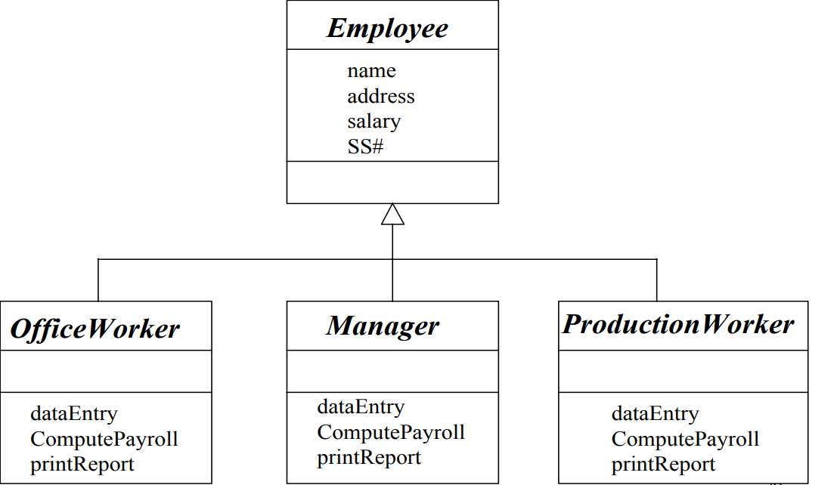
Class HIERARCHY

Slide 20
OO APPROACH
FOR EVERY EMPLOYEE DO
BEGIN
employee computePayroll
END

Slide 21
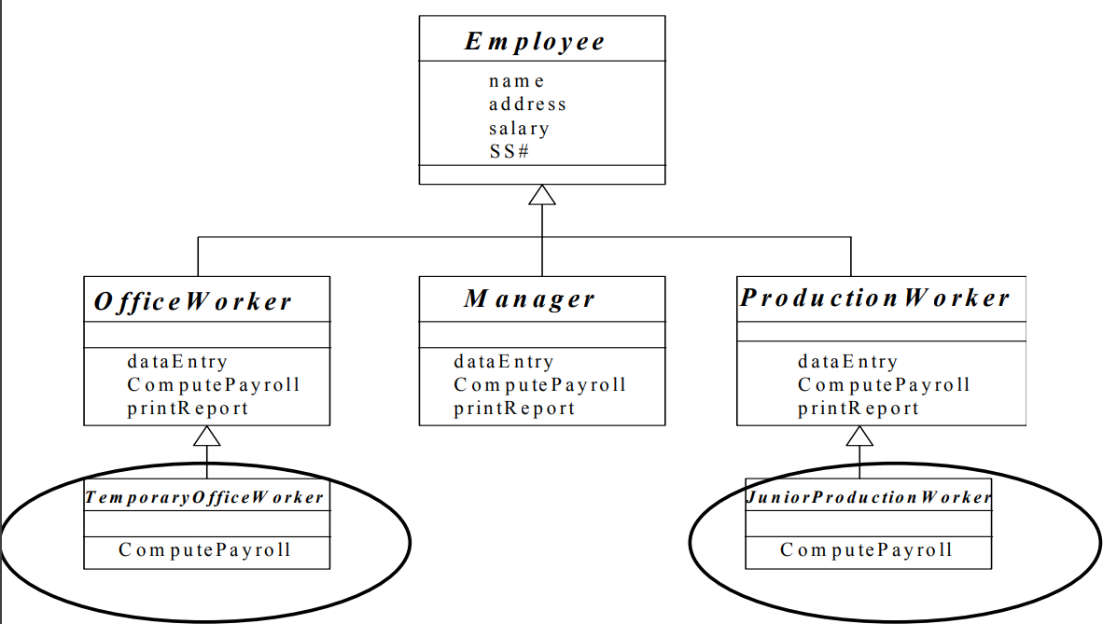
If new types of employees were added…

Slide 22
Basic Characteristics of Java
Java is platform independent: the same program can run on any correctly implemented Java system
Java is object-oriented:
Structured in terms of classes, which group data with operations on that data
Can construct new classes by extending existing ones
Java designed as
A core language plus
A rich collection of commonly available packages
Java can be embedded in Web pages
Classes and Objects

Slide 23
Classes and Objects
The class is the unit of programming
A Java program is a collection of classes
Each class definition (usually) in its own .java file
The file name must match the class name
A class describes objects (instances)
Describes their common characteristics: is a blueprint
Thus all the instances have these same characteristics
These characteristics are:
Data fields for each object
Methods (operations) that do work on the objects

Slide 24
Grouping Classes: The Java API
API = Application Programming Interface
Java = small core + extensive collection of packages
A package consists of some related Java classes:
Swing: a GUI (graphical user interface) package
AWT: Application Window Toolkit (more GUI)
util: utility data structures (important to CS 187!)
The import statement tells the compiler to make available classes and methods of another package
A main method indicates where to begin executing a class (if it is designed to be run as a program)

Slide 25
A Little Example of import and main
import javax.swing.*;
// all classes from javax.swing
public class HelloWorld { // starts a class
public static void main (String[] args) {
// starts a main method
// in: array of String; out: none (void)
}
}
public = can be seen from any package
static = not “part of” an object

Slide 26
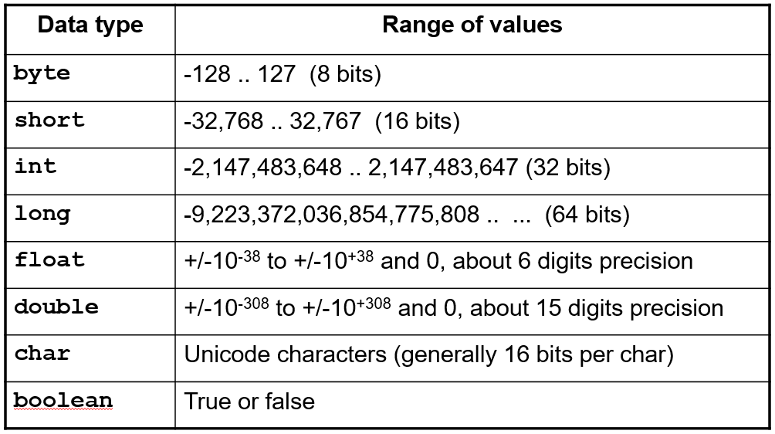
Primitive Data Types

Slide 27
Operators
subscript [ ], call ( ), member access .
pre/post-increment ++ --, boolean complement !, bitwise complement ~, unary + -, type cast (type), object creation new
*/ %
binary + - (+ also concatenates strings)
signed shift << >>, unsigned shift >>>
comparison < <= > >=, class test instanceof
equality comparison == !=
bitwise and &
bitwise or |
logical (sequential) and &&
logical (sequential) or ||
conditional cond ? true-expr : false-expr
assignment =, compound assignment += -= *= /= <<= >>= >>>= &= |=

Slide 28
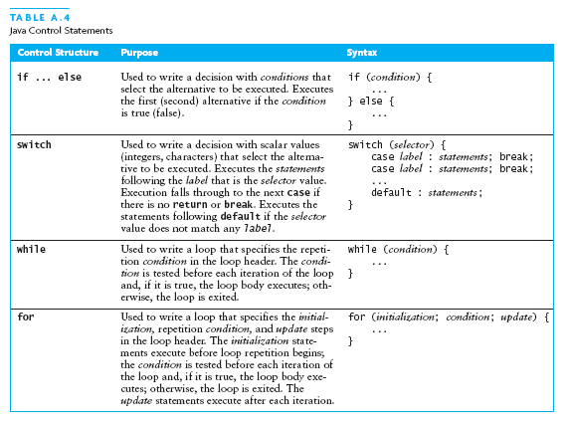
Java Control Statements

Slide 29
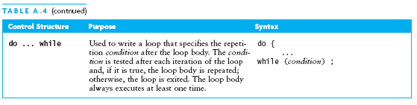
Java Control Statements (continued)

Slide 30
Methods
A Java method defines a group of statements as performing a particular operation
static indicates a static or class method
A method that is not static is an instance method
All method arguments are call-by-value
Primitive type: value is passed to the method
Method may modify local copy but will not affect caller’s value
Object reference: address of object is passed
Change to reference variable does not affect caller
But operations can affect the object, visible to caller

Slide 31
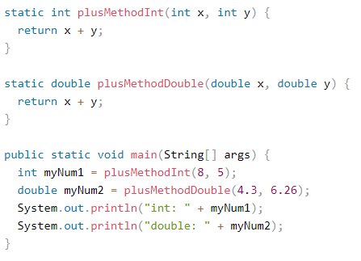
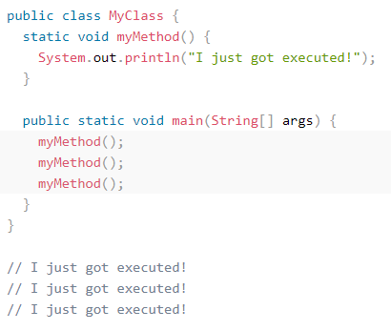
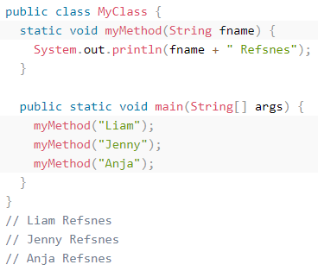
METHOD EXAMPLEs

Slide 32
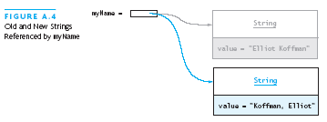
The String Class
The String class defines a data type that is used to store a sequence of characters
You cannot modify a String object
If you attempt to do so, Java will create a new object that contains the modified character sequence

Slide 33
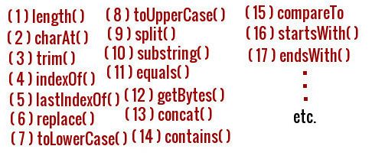
Java Strıng methods

Slide 34
LAB Study
Pull assignment_01 – 02 and 03 from github repository
Implement the methods

Slide 35
thanks
Handan yarıcı

Slide 36
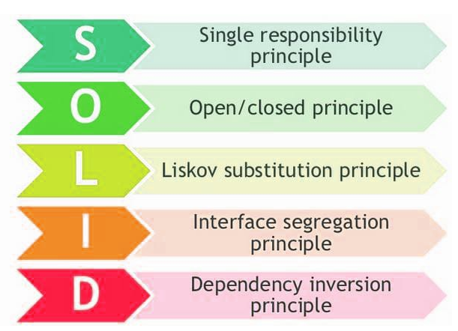
Object Orıented desıgn prıncıples
❑ Manage complexity of a system
❑ Improve software quality factors
❑ Manage changes easily with minimum cost
❑ Facilitate reusability

Slide 37
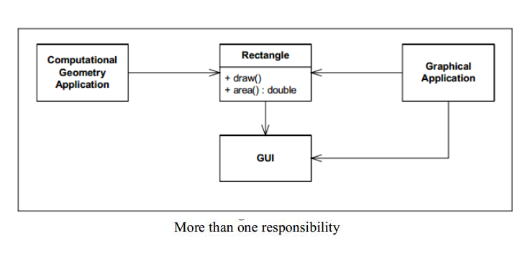
Single Responsibility Principle (SRP)
There should never be more than one reason for a class to change.

Slide 38
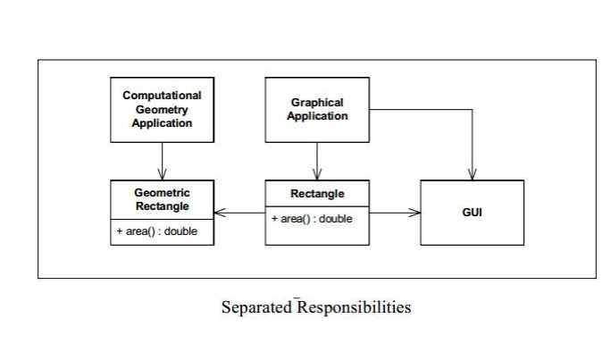
Single Responsibility Principle (SRP)

Slide 39
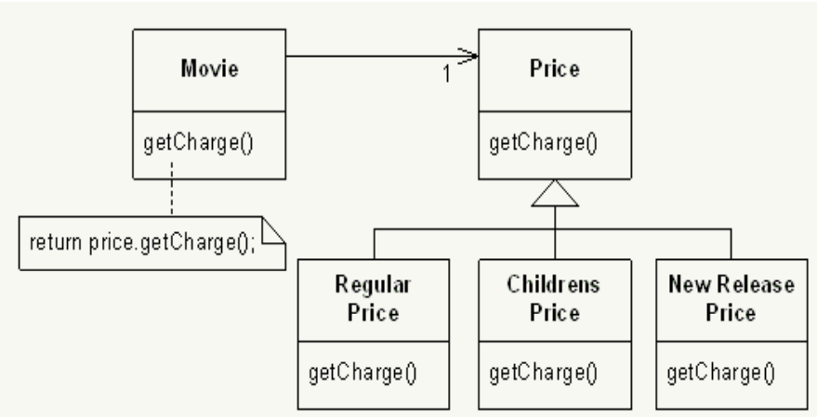
Open/closed prıncıple (Ocp)
A module should be open for extension but closed for modification

Slide 40
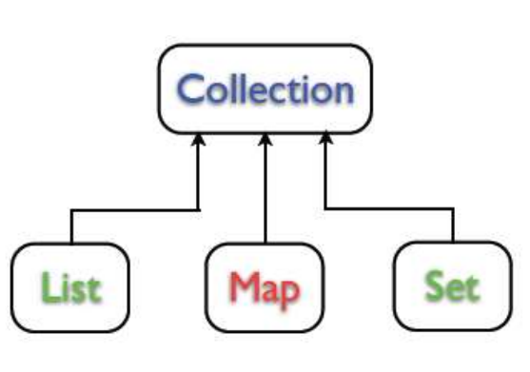
Liskov Substitution Principle (LSP)
Subclasses should be substitutable for their base classes.

Slide 41
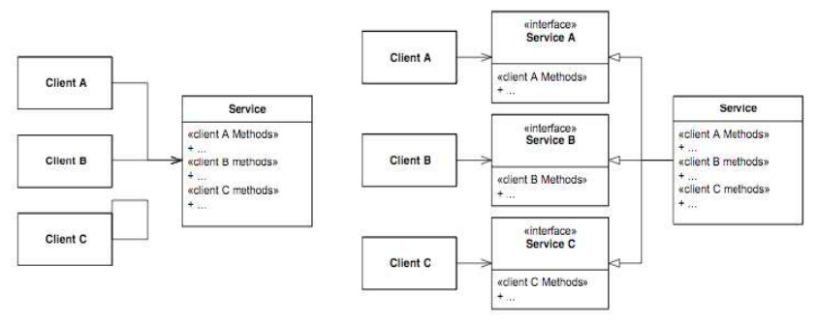
Interface Segregation Principle (ISP)
Many client specific interfaces are better than one general purpose interface.

Slide 42
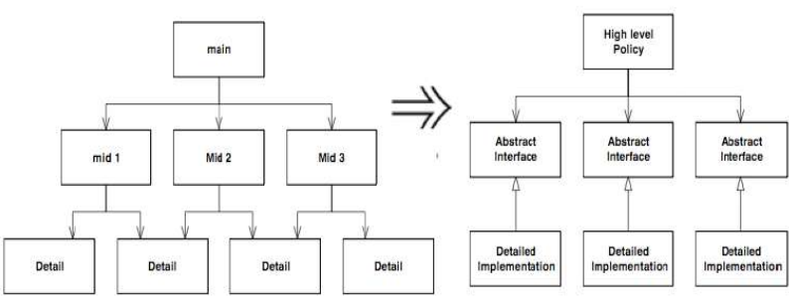
Dependency Inversion Principle (DIP)
Depend upon Abstractions. Do not depend upon concretions

Slide 43
DRY – Don’t Repeat yourself
The Don’t Repeat Yourself (DRY) principle states that duplication in logic should be eliminated via abstraction; duplication in process should be eliminated via automation.
Duplication is Waste Adding additional, unnecessary code to a codebase increases the amount of work required to extend and maintain the software in the future. Duplicate code adds to technical debt.

