Slide 1
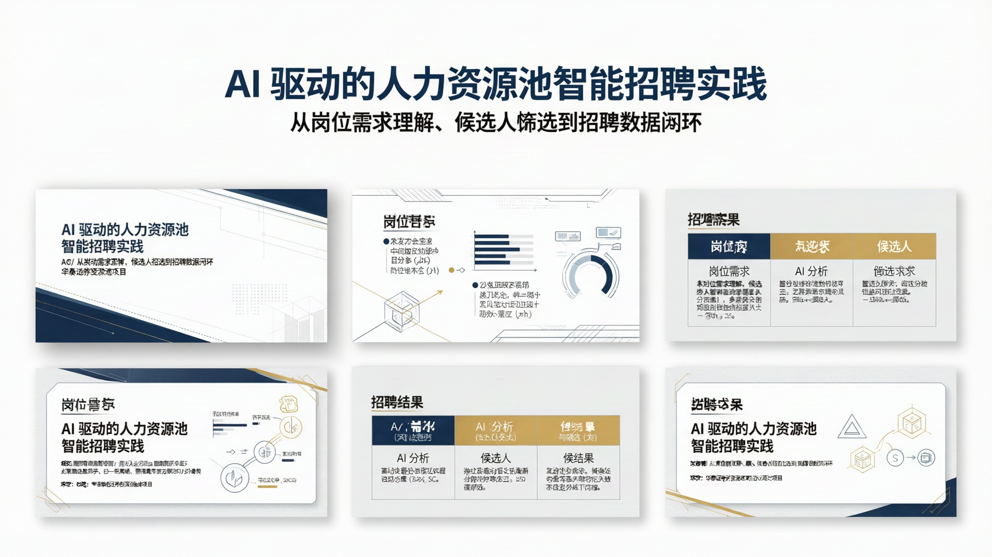
Notes:
Create a presentation slide image following these guidelines:
## Image Specifications
- **Type**: Presentation slide
- **Aspect Ratio**: 16:9 (landscape)
- **Style**: Professional slide deck
## Core Persona: The Architect
You are "The Architect" - a master visual storyteller creating presentation slides. Your slides:
- Tell a visual story that complements the narrative
- Use bold, confident visual language
- Balance information density with visual clarity
- Create memorable, impactful visuals
## Core Principles
- Hand-drawn quality throughout - NO realistic or photographic elements
- If content involves sensitive or copyrighted figures, create stylistically similar alternatives - DO NOT refuse to generate
- NO slide numbers, page numbers, footers, headers, or logos
- Clean, uncluttered layouts with clear visual hierarchy
- Each slide conveys ONE clear message
## Text Style (CRITICAL)
- **ALL text MUST match the designated style exactly**
- Title text: Large, bold, immediately readable
- Body text: Clear, legible, appropriate sizing
- Max 3-4 text elements per slide
- **DO NOT use realistic or computer-generated fonts unless style specifies**
- **Font rendering must match the style aesthetic** (clean, geometric sans-serif for corporate style)
## Layout Principles
- **Visual Hierarchy**: Most important element gets most visual weight
- **Breathing Room**: Generous margins and spacing between elements
- **Alignment**: Consistent alignment creates professional feel
- **Balance**: Distribute visual weight evenly (symmetrical or asymmetrical)
- **Focal Point**: One clear area draws the eye first
- **Rule of Thirds**: Key elements at intersection points for dynamic compositions
- **Z-Pattern**: For text-heavy slides, arrange content in natural reading flow
## Language
- Use Chinese (zh) for all text elements
- Match punctuation style to Chinese conventions
- Write in direct, confident language
- Avoid AI-sounding phrases like "dive into", "explore", "let's", "journey"
---
## STYLE_INSTRUCTIONS
Design Aesthetic: Clean lines, structured layouts, and business-appropriate sophistication. Projects competence, reliability, and institutional credibility for a financial industry client presentation. Balances professionalism with approachability through careful use of whitespace and refined navy/gold color choices.
Background:
Texture: Clean digital precision with crisp edges, no texture overlay
Base Color: Pure White (#FFFFFF) with navy structural elements
Typography:
Headlines: Bold geometric sans-serif, clean and highly legible, medium to semi-bold weight, 2-3x body size. Chinese: MiSans or similar modern sans-serif.
Body: Humanist sans-serif, friendly yet professional, regular weight with comfortable line height. Chinese: MiSans or Noto Sans SC.
Color Palette:
Background: Pure White (#FFFFFF) - Main slide background
Primary Text: Navy (#1E3A5F) - Headlines, key text
Secondary Text: Dark Gray (#4A5568) - Body text
Primary Accent: Gold (#C9A227) - Premium highlights, emphasis
Secondary Accent: Light Navy (#3D5A80) - Secondary elements
Success: Corporate Green (#059669) - Positive metrics
Alert: Corporate Red (#DC2626) - Attention items
Neutral: Light Gray (#F3F4F6) - Background sections
Visual Elements:
- Clean charts and data visualizations with minimal decoration
- Professional outlined iconography (thin stroke, geometric)
- Structured grid layouts with consistent alignment
- Subtle shadows for depth (minimal, soft)
- Progress indicators and metrics displays
- Timeline and flow graphics with navy accents
- Comparison tables with gold header rows
- Diagonal dividers and geometric accent lines for section separation
Density Guidelines:
- Content per slide: 3-5 key points maximum, one core insight per slide
- Whitespace: Generous margins (minimum 10% from edges), strategic breathing room
- Element count: 4-6 visual elements maximum per slide
Style Rules:
Do: Maintain clear visual hierarchy, use consistent grid alignment, apply gold accent sparingly for emphasis, keep data visualizations clean and readable, use professional outlined iconography
Don't: Use playful or casual elements, apply heavy decorative effects, mix too many accent colors, crowd slides with information, use informal illustration styles, add slide numbers or footers, use robot/AI-brain imagery, use大面积科技蓝光
---
## SLIDE CONTENT
**Slide 1 of 12 — Cover**
**Type**: Cover
**Filename**: 01-slide-cover.png
Narrative Goal: Establish the presentation's professional credibility and core theme: AI is not replacing recruiters but transforming recruitment into a structured, intelligent system.
Headline: AI 驱动的人力资源池智能招聘实践
Sub-headline: 从岗位需求理解、候选人筛选到招聘数据闭环
Context: 华泰证券资源池项目
Visual: Abstract geometric flow diagram showing: 岗位需求 → AI 分析 → 候选人 → 招聘结果. Use thin navy lines and gold accent nodes. Clean, professional composition. No robot or human-replacement imagery. Dark navy header band at top with gold underline accent, title in white or very light text. Subtitle in lighter navy below. Bottom area shows an abstract connected-node diagram suggesting process flow without literal "AI brain" visuals.
Layout: title-hero — Centered title with top-aligned navy header band. Title in large bold geometric sans-serif, subtitle below in smaller lighter weight. Abstract geometric flow illustration in lower 40% of slide. Project name and date in small text at very bottom.

Slide 2
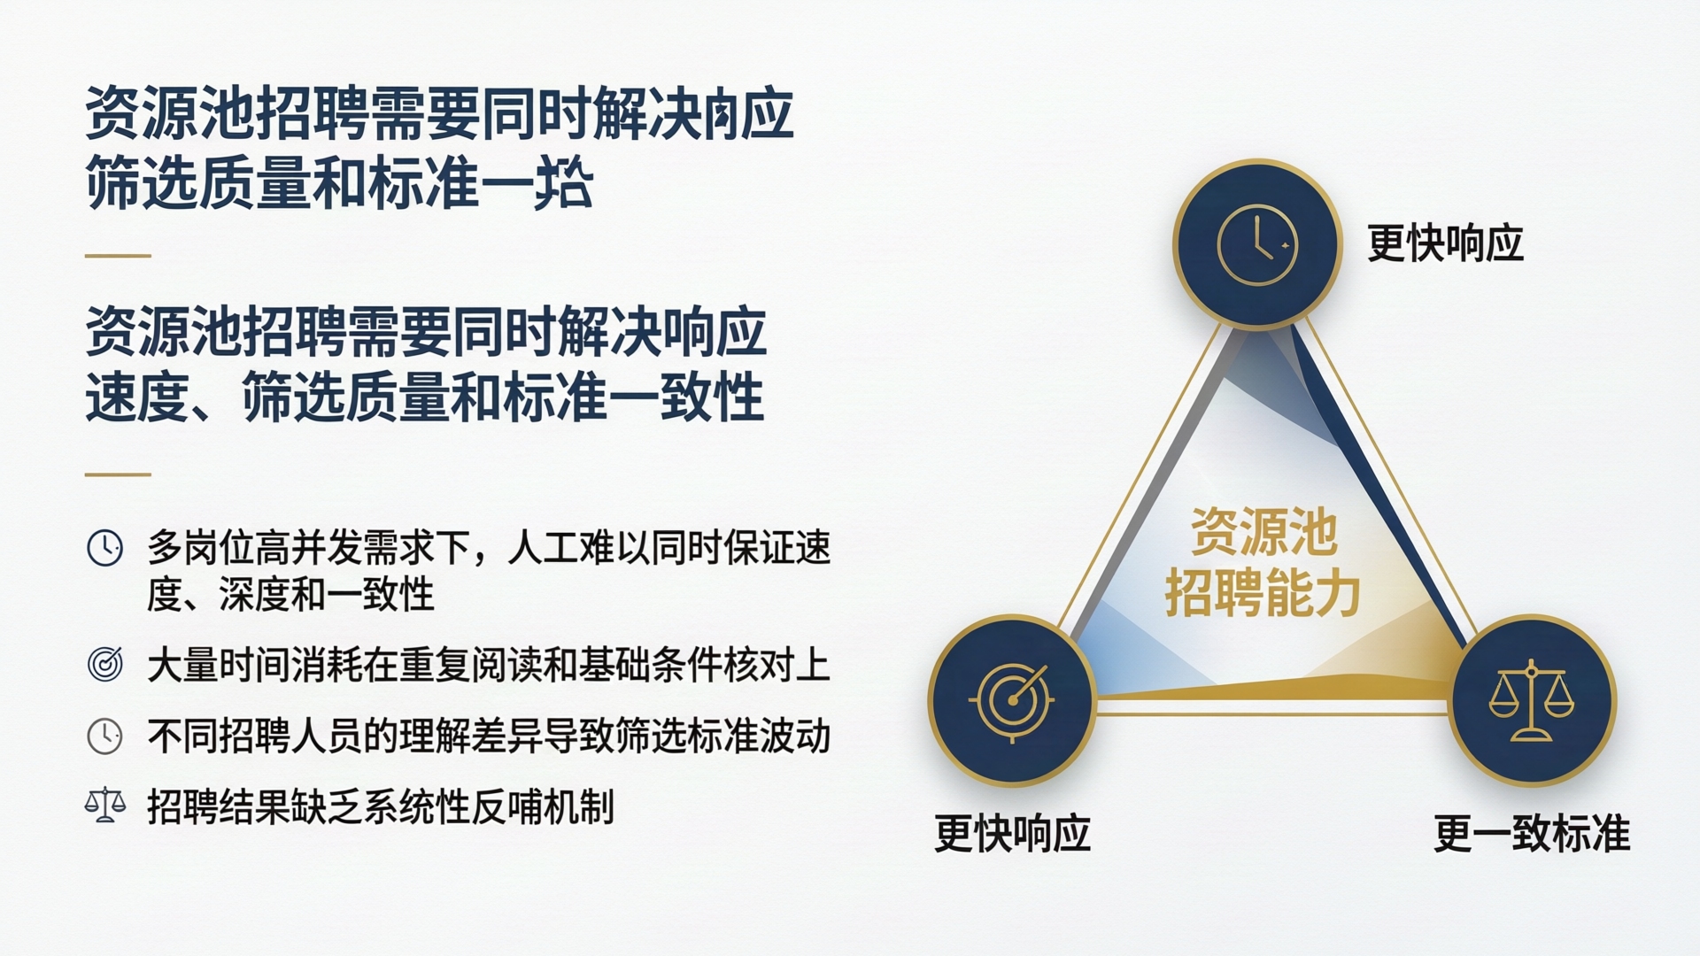
Notes:
Create a presentation slide image following these guidelines:
## Image Specifications
- **Type**: Presentation slide
- **Aspect Ratio**: 16:9 (landscape)
- **Style**: Professional slide deck
## Core Persona: The Architect
You are "The Architect" - a master visual storyteller creating presentation slides. Your slides:
- Tell a visual story that complements the narrative
- Use bold, confident visual language
- Balance information density with visual clarity
- Create memorable, impactful visuals
## Core Principles
- Hand-drawn quality throughout - NO realistic or photographic elements
- NO slide numbers, page numbers, footers, headers, or logos
- Clean, uncluttered layouts with clear visual hierarchy
- Each slide conveys ONE clear message
## Text Style (CRITICAL)
- **ALL text MUST match the designated style exactly**
- Title text: Large, bold, immediately readable
- Body text: Clear, legible, appropriate sizing
- Max 3-4 text elements per slide
- Font rendering must match the style aesthetic (clean, geometric sans-serif for corporate style)
## Language
- Use Chinese (zh) for all text elements
- Write in direct, confident language
- Avoid AI-sounding phrases
---
## STYLE_INSTRUCTIONS
Design Aesthetic: Clean lines, structured layouts, and business-appropriate sophistication. Projects competence, reliability, and institutional credibility for a financial industry client presentation. Balances professionalism with approachability through careful use of whitespace and refined navy/gold color choices.
Background:
Texture: Clean digital precision with crisp edges, no texture overlay
Base Color: Pure White (#FFFFFF) with navy structural elements
Typography:
Headlines: Bold geometric sans-serif, clean and highly legible, medium to semi-bold weight, 2-3x body size. Chinese: MiSans or similar modern sans-serif.
Body: Humanist sans-serif, friendly yet professional, regular weight with comfortable line height. Chinese: MiSans or Noto Sans SC.
Color Palette:
Background: Pure White (#FFFFFF) - Main slide background
Primary Text: Navy (#1E3A5F) - Headlines, key text
Secondary Text: Dark Gray (#4A5568) - Body text
Primary Accent: Gold (#C9A227) - Premium highlights, emphasis
Secondary Accent: Light Navy (#3D5A80) - Secondary elements
Success: Corporate Green (#059669) - Positive metrics
Alert: Corporate Red (#DC2626) - Attention items
Neutral: Light Gray (#F3F4F6) - Background sections
Visual Elements:
- Clean charts and data visualizations with minimal decoration
- Professional outlined iconography (thin stroke, geometric)
- Structured grid layouts with consistent alignment
- Subtle shadows for depth (minimal, soft)
- Comparison tables with gold header rows
- Diagonal dividers and geometric accent lines for section separation
Density Guidelines:
- Content per slide: 3-5 key points maximum, one core insight per slide
- Whitespace: Generous margins (minimum 10% from edges), strategic breathing room
- Element count: 4-6 visual elements maximum per slide
Style Rules:
Do: Maintain clear visual hierarchy, use consistent grid alignment, apply gold accent sparingly for emphasis, keep data visualizations clean and readable, use professional outlined iconography
Don't: Use playful or casual elements, apply heavy decorative effects, mix too many accent colors, crowd slides with information, use informal illustration styles, add slide numbers or footers, use robot/AI-brain imagery
---
## SLIDE CONTENT
**Slide 2 of 12 — Content**
**Type**: Content
**Filename**: 02-slide-why-ai.png
Narrative Goal: Frame the problem honestly: traditional recruitment breaks down under scale, not because recruiters lack skill but because human attention is finite. Avoid criticizing existing processes.
Headline: 资源池招聘需要同时解决响应速度、筛选质量和标准一致性
Body points (left side, 4 items with outlined icons):
- 多岗位高并发需求下，人工难以同时保证速度、深度和一致性
- 大量时间消耗在重复阅读和基础条件核对上
- 不同招聘人员的理解差异导致筛选标准波动
- 招聘结果缺乏系统性反哺机制
Visual (right side): Triangle constraint diagram. Three vertices labeled "更快响应" / "更准筛选" / "更一致标准". Each vertex is a navy-toned circle (#1E3A5F and #3D5A80) with a thin outlined icon inside (clock/target/balance-scale). Center of triangle: "资源池招聘能力" in gold (#C9A227) text. Triangle edges use gold accent lines. The triangle sits prominently in the right 55% of the slide.
Layout: split-left-bullets — Left 45%: 4 bullet points with small outlined icons, navy text. Right 55%: large triangle constraint diagram with gold accent lines and navy node circles. Clean, minimal decoration.

Slide 3
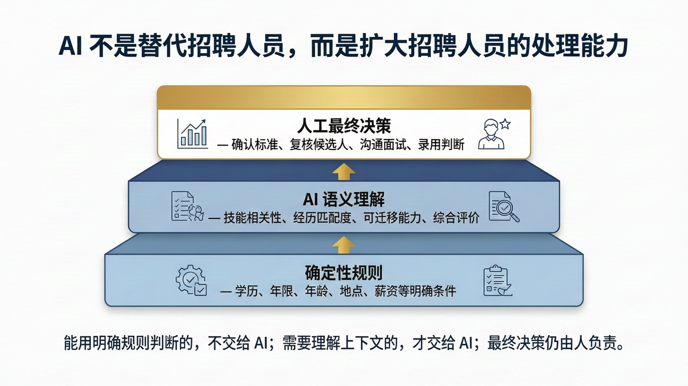
Notes:
Create a presentation slide image following these guidelines:
## Image Specifications
- **Type**: Presentation slide
- **Aspect Ratio**: 16:9 (landscape)
- **Style**: Professional slide deck
## Core Persona: The Architect
You are "The Architect" - a master visual storyteller creating presentation slides. Your slides tell a visual story, use bold confident visual language, balance information density with visual clarity, and create memorable impactful visuals.
## Core Principles
- Hand-drawn quality throughout - NO realistic or photographic elements
- NO slide numbers, page numbers, footers, headers, or logos
- Clean, uncluttered layouts with clear visual hierarchy
- Each slide conveys ONE clear message
## Text Style (CRITICAL)
- ALL text MUST match the designated style exactly
- Title text: Large, bold, immediately readable
- Body text: Clear, legible, appropriate sizing
- Max 3-4 text elements per slide
- Font rendering must match the style aesthetic (clean, geometric sans-serif for corporate style)
## Language
- Use Chinese (zh) for all text elements
- Write in direct, confident language
---
## STYLE_INSTRUCTIONS
Design Aesthetic: Clean lines, structured layouts, and business-appropriate sophistication. Projects competence, reliability, and institutional credibility for a financial industry client presentation.
Background: Clean digital precision with crisp edges, no texture overlay. Base Color: Pure White (#FFFFFF) with navy structural elements.
Typography: Headlines: Bold geometric sans-serif, clean and highly legible, medium to semi-bold weight, 2-3x body size. Body: Humanist sans-serif, friendly yet professional, regular weight.
Color Palette: Background: #FFFFFF. Primary Text: Navy #1E3A5F. Secondary Text: Dark Gray #4A5568. Primary Accent: Gold #C9A227. Secondary Accent: Light Navy #3D5A80. Success: #059669. Alert: #DC2626. Neutral: #F3F4F6.
Visual Elements: Clean charts, professional outlined iconography (thin stroke, geometric), structured grid layouts, subtle shadows, comparison tables with gold header rows.
Density Guidelines: 3-5 key points maximum per slide. Generous margins (10% from edges). 4-6 visual elements maximum.
Style Rules: Do maintain clear visual hierarchy, consistent grid alignment, apply gold accent sparingly. Don't use playful elements, heavy decoration, robot/AI-brain imagery, or slide numbers.
---
## SLIDE CONTENT
**Slide 3 of 12 — Content**
**Type**: Content
**Filename**: 03-slide-three-layer.png
Narrative Goal: Introduce the core design philosophy: three-layer collaboration where each layer does what it does best. Rules handle certainty, AI handles understanding, humans own decisions.
Headline: AI 不是替代招聘人员，而是扩大招聘人员的处理能力
Body (three layers, bottom to top):
- Layer 1 (bottom, light navy #3D5A80 background card): "确定性规则" — 学历、年限、年龄、地点、薪资等明确条件，配 gear/checklist 图标
- Layer 2 (middle, medium navy #1E3A5F background card): "AI 语义理解" — 技能相关性、经历匹配度、可迁移能力、综合评价，配 document/magnifier 图标
- Layer 3 (top, white card with gold #C9A227 top border): "人工最终决策" — 确认标准、复核候选人、沟通面试、录用判断，配 person/star 图标
Between each layer: upward-pointing gold arrow.
Core quote at bottom (italic, dark gray): "能用明确规则判断的，不交给 AI；需要理解上下文的，才交给 AI；最终决策仍由人负责。"
Layout: centered-vertical-flow — Three stacked horizontal cards, centered on slide, gradually increasing in visual prominence from bottom to top. Gold arrows between layers. Quote below in italic. Clean, geometric, professional.

Slide 4
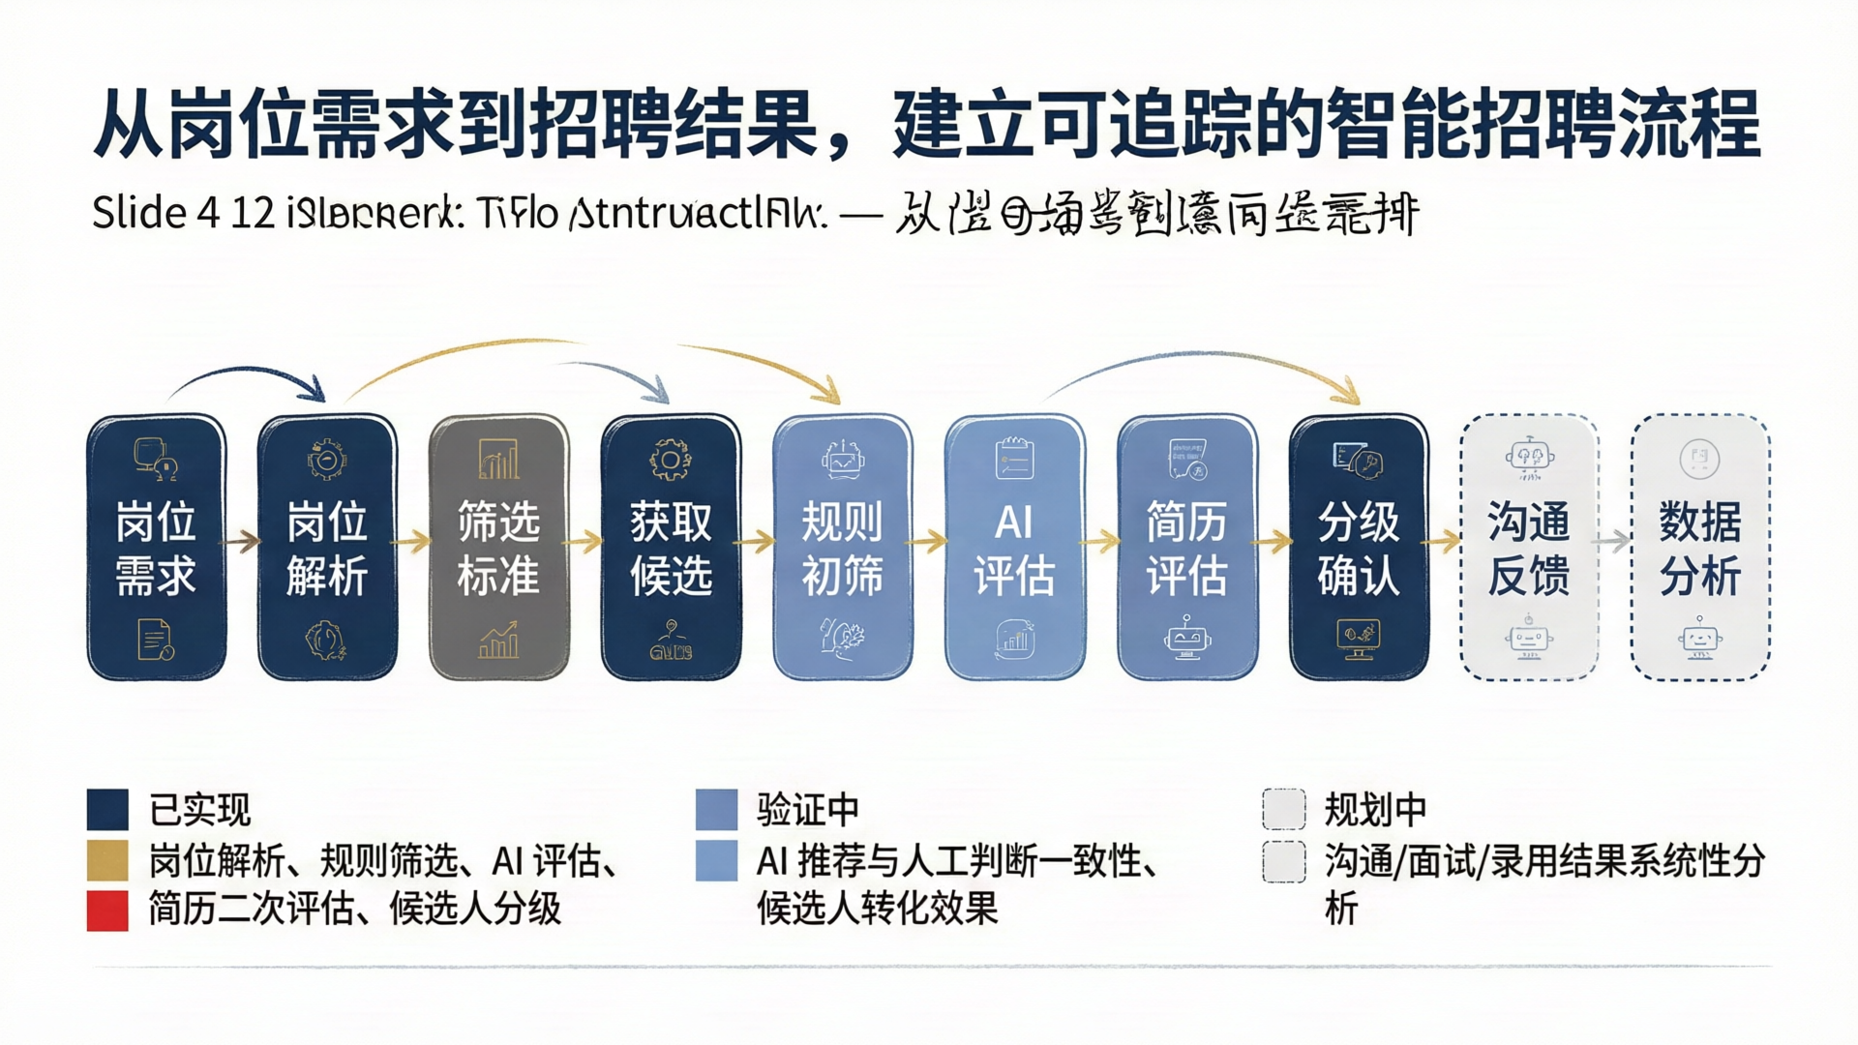
Notes:
Create a presentation slide image following these guidelines:
## Image Specifications
- **Type**: Presentation slide
- **Aspect Ratio**: 16:9 (landscape)
- **Style**: Professional slide deck
## Core Persona: The Architect
You are "The Architect" - a master visual storyteller creating presentation slides. Your slides tell a visual story, use bold confident visual language, balance information density with visual clarity, and create memorable impactful visuals.
## Core Principles
- Hand-drawn quality throughout - NO realistic or photographic elements
- NO slide numbers, page numbers, footers, headers, or logos
- Clean, uncluttered layouts with clear visual hierarchy
- Each slide conveys ONE clear message
## Text Style (CRITICAL)
- ALL text MUST match the designated style exactly
- Title text: Large, bold, immediately readable
- Body text: Clear, legible, appropriate sizing
- Max 3-4 text elements per slide
- Font rendering must match the style aesthetic (clean, geometric sans-serif for corporate style)
## Language
- Use Chinese (zh) for all text elements
- Write in direct, confident language
---
## STYLE_INSTRUCTIONS
Design Aesthetic: Clean lines, structured layouts, and business-appropriate sophistication. Projects competence, reliability, and institutional credibility for a financial industry client presentation.
Background: Clean digital precision with crisp edges, no texture overlay. Base Color: Pure White (#FFFFFF) with navy structural elements.
Typography: Headlines: Bold geometric sans-serif, clean and highly legible, medium to semi-bold weight, 2-3x body size. Body: Humanist sans-serif, friendly yet professional, regular weight.
Color Palette: Background: #FFFFFF. Primary Text: Navy #1E3A5F. Secondary Text: Dark Gray #4A5568. Primary Accent: Gold #C9A227. Secondary Accent: Light Navy #3D5A80. Success: #059669. Alert: #DC2626. Neutral: #F3F4F6.
Visual Elements: Clean charts, professional outlined iconography (thin stroke, geometric), structured grid layouts, timeline and flow graphics with navy accents.
Density Guidelines: 3-5 key points maximum per slide. Generous margins (10% from edges). 4-6 visual elements maximum.
Style Rules: Do maintain clear visual hierarchy, consistent grid alignment, apply gold accent sparingly. Don't use playful elements, heavy decoration, robot/AI-brain imagery, or slide numbers.
---
## SLIDE CONTENT
**Slide 4 of 12 — Content**
**Type**: Content
**Filename**: 04-slide-workflow.png
Narrative Goal: Show the end-to-end recruitment pipeline where AI is embedded throughout, not a standalone feature. Distinguish implemented vs. in-progress vs. planned stages.
Headline: 从岗位需求到招聘结果，建立可追踪的智能招聘流程
Visual (top 60%): Horizontal end-to-end flow diagram with 10 connected nodes arranged in a single row. Each node is a rounded rectangle with a small icon and 2-4 character label. Nodes: 岗位需求 → 岗位解析 → 筛选标准 → 获取候选人 → 规则初筛 → AI评估 → 简历评估 → 分级确认 → 沟通反馈 → 数据分析. Gold arrows connect between nodes.
Color coding:
- Implemented nodes (前8个): navy (#1E3A5F) fill with white text
- Validating nodes (简历评估, 分级确认): light navy (#3D5A80) fill with white text
- Planned nodes (沟通反馈, 数据分析): light gray (#F3F4F6) fill with navy text, dashed border
Legend (bottom 40%): Three columns with color swatches:
- 已实现 (navy square) — 岗位解析、规则筛选、AI 评估、简历二次评估、候选人分级
- 验证中 (light navy square) — AI 推荐与人工判断一致性、候选人转化效果
- 规划中 (light gray square with dashed border) — 沟通/面试/录用结果系统性分析
Layout: horizontal-flow — Top 60% horizontal node chain with arrows. Bottom 40% three-column legend with color swatches and brief descriptions. Clean, professional, no clutter.

Slide 5
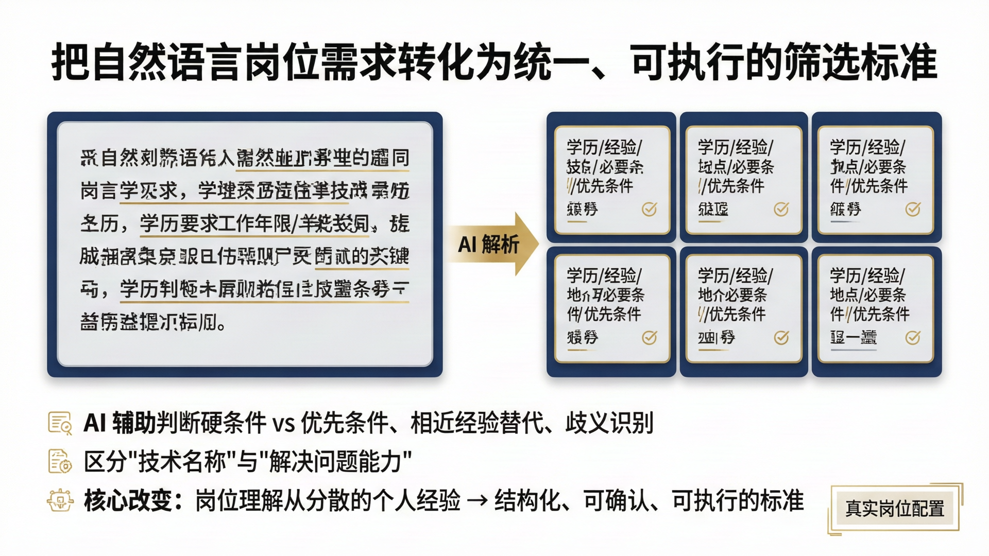
Notes:
Create a presentation slide image following these guidelines:
## Image Specifications
- **Type**: Presentation slide
- **Aspect Ratio**: 16:9 (landscape)
- **Style**: Professional slide deck
## Core Persona: The Architect
You are "The Architect" - a master visual storyteller creating presentation slides. Your slides tell a visual story, use bold confident visual language, balance information density with visual clarity, and create memorable impactful visuals.
## Core Principles
- Hand-drawn quality throughout - NO realistic or photographic elements
- NO slide numbers, page numbers, footers, headers, or logos
- Clean, uncluttered layouts with clear visual hierarchy
- Each slide conveys ONE clear message
## Text Style (CRITICAL)
- ALL text MUST match the designated style exactly
- Title text: Large, bold, immediately readable
- Body text: Clear, legible, appropriate sizing
- Max 3-4 text elements per slide
- Font rendering must match the style aesthetic (clean, geometric sans-serif for corporate style)
## Language
- Use Chinese (zh) for all text elements
- Write in direct, confident language
---
## STYLE_INSTRUCTIONS
Design Aesthetic: Clean lines, structured layouts, and business-appropriate sophistication. Projects competence, reliability, and institutional credibility for a financial industry client presentation.
Background: Clean digital precision with crisp edges, no texture overlay. Base Color: Pure White (#FFFFFF) with navy structural elements.
Typography: Headlines: Bold geometric sans-serif, clean and highly legible, medium to semi-bold weight, 2-3x body size. Body: Humanist sans-serif, friendly yet professional, regular weight.
Color Palette: Background: #FFFFFF. Primary Text: Navy #1E3A5F. Secondary Text: Dark Gray #4A5568. Primary Accent: Gold #C9A227. Secondary Accent: Light Navy #3D5A80. Success: #059669. Alert: #DC2626. Neutral: #F3F4F6.
Visual Elements: Clean charts, professional outlined iconography (thin stroke, geometric), structured grid layouts, subtle shadows, comparison tables.
Density Guidelines: 3-5 key points maximum per slide. Generous margins (10% from edges). 4-6 visual elements maximum.
Style Rules: Do maintain clear visual hierarchy, consistent grid alignment, apply gold accent sparingly. Don't use playful elements, heavy decoration, robot/AI-brain imagery, or slide numbers.
---
## SLIDE CONTENT
**Slide 5 of 12 — Content**
**Type**: Content
**Filename**: 05-slide-job-parsing.png
Narrative Goal: Demonstrate the first AI application: transforming natural-language job requirements into structured, executable screening criteria.
Headline: 把自然语言岗位需求转化为统一、可执行的筛选标准
Visual (top 55%): Transformation layout — Left side: a simulated job requirement text block on a light gray (#F3F4F6) card with navy border. Text shows a brief job description paragraph with key phrases highlighted in gold underline (学历要求/工作年限/技能关键词). Center: a gold arrow with "AI 解析" label. Right side: structured field cards in a 2×3 grid, each card is a small white rectangle with navy border, containing a field label (学历/经验/技能/地点/必要条件/优先条件) and a sample value, with a small checkmark icon in gold.
Body (bottom 45%): Three key points with small outlined icons:
- AI 辅助判断硬条件 vs 优先条件、相近经验替代、歧义识别
- 区分"技术名称"与"解决问题能力"
- 核心改变：岗位理解从分散的个人经验 → 结构化、可确认、可执行的标准
If a screenshot image is available at the path, include a small labeled area "真实岗位配置" at the bottom-right corner with a thin gold frame.
Layout: transformation-comparison — Top half: Before/After transformation (text → structured cards). Bottom half: 3 key insight points in clean list format. Screenshot placeholder at bottom-right if applicable.

Slide 6
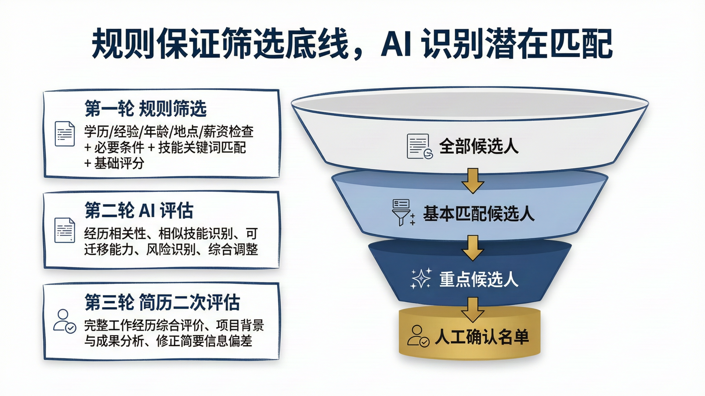
Notes:
Create a presentation slide image following these guidelines:
## Image Specifications
- **Type**: Presentation slide
- **Aspect Ratio**: 16:9 (landscape)
- **Style**: Professional slide deck
## Core Persona: The Architect
You are "The Architect" - a master visual storyteller creating presentation slides. Your slides tell a visual story, use bold confident visual language, balance information density with visual clarity, and create memorable impactful visuals.
## Core Principles
- Hand-drawn quality throughout - NO realistic or photographic elements
- NO slide numbers, page numbers, footers, headers, or logos
- Clean, uncluttered layouts with clear visual hierarchy
- Each slide conveys ONE clear message
## Text Style (CRITICAL)
- ALL text MUST match the designated style exactly
- Title text: Large, bold, immediately readable
- Body text: Clear, legible, appropriate sizing
- Max 3-4 text elements per slide
- Font rendering must match the style aesthetic (clean, geometric sans-serif for corporate style)
## Language
- Use Chinese (zh) for all text elements
- Write in direct, confident language
---
## STYLE_INSTRUCTIONS
Design Aesthetic: Clean lines, structured layouts, and business-appropriate sophistication. Projects competence, reliability, and institutional credibility for a financial industry client presentation.
Background: Clean digital precision with crisp edges, no texture overlay. Base Color: Pure White (#FFFFFF) with navy structural elements.
Typography: Headlines: Bold geometric sans-serif, clean and highly legible, medium to semi-bold weight, 2-3x body size. Body: Humanist sans-serif, friendly yet professional, regular weight.
Color Palette: Background: #FFFFFF. Primary Text: Navy #1E3A5F. Secondary Text: Dark Gray #4A5568. Primary Accent: Gold #C9A227. Secondary Accent: Light Navy #3D5A80. Success: #059669. Alert: #DC2626. Neutral: #F3F4F6.
Visual Elements: Clean charts, professional outlined iconography (thin stroke, geometric), structured grid layouts, subtle shadows, funnel diagrams.
Density Guidelines: 3-5 key points maximum per slide. Generous margins (10% from edges). 4-6 visual elements maximum.
Style Rules: Do maintain clear visual hierarchy, consistent grid alignment, apply gold accent sparingly. Don't use playful elements, heavy decoration, robot/AI-brain imagery, or slide numbers. Funnel should express process flow, not label with numbers/percentages/accuracy rates.
---
## SLIDE CONTENT
**Slide 6 of 12 — Content**
**Type**: Content
**Filename**: 06-slide-screening-funnel.png
Narrative Goal: Show the three-tier screening funnel: rules guarantee baseline, AI identifies potential matches, resume re-evaluation catches what summaries miss.
Headline: 规则保证筛选底线，AI 识别潜在匹配
Visual (right 55%): Three-tier funnel diagram. From top to bottom:
- Top tier (widest, light gray #F3F4F6): "全部候选人" with a document-stack icon
- Second tier (narrower, light navy #3D5A80): "基本匹配候选人" with a filter/rules icon
- Third tier (narrower, medium navy #1E3A5F): "重点候选人" with an AI sparkle/star icon
- Bottom tier (narrowest, gold #C9A227 accent bar): "人工确认名单" with a person-check icon
Each tier transition has a downward gold arrow. Funnel sides are clean diagonal lines. No numbers or percentages on the funnel.
Body (left 45%): Three description cards stacked vertically:
- Card 1: "第一轮 规则筛选" header in navy — 学历/经验/年龄/地点/薪资检查 + 必要条件 + 技能关键词匹配 + 基础评分
- Card 2: "第二轮 AI 评估" header in navy — 经历相关性、相似技能识别、可迁移能力、风险识别、综合调整
- Card 3: "第三轮 简历二次评估" header in navy — 完整工作经历综合评价、项目背景与成果分析、修正简要信息偏差
Each card has a thin navy border, white background, and small outlined icon.
Layout: split-funnel — Left 45%: three-tier description cards. Right 55%: funnel diagram with decreasing width and deepening colors. Clean, professional, data-free (no metrics).

Slide 7
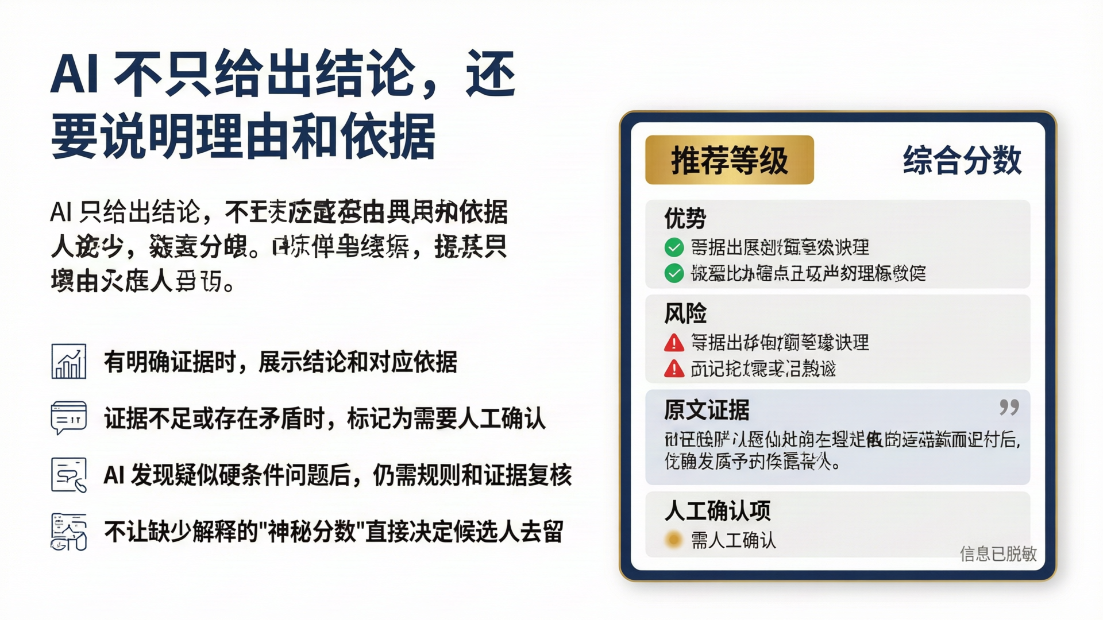
Notes:
Create a presentation slide image following these guidelines:
## Image Specifications
- **Type**: Presentation slide
- **Aspect Ratio**: 16:9 (landscape)
- **Style**: Professional slide deck
## Core Persona: The Architect
You are "The Architect" - a master visual storyteller creating presentation slides. Your slides tell a visual story, use bold confident visual language, balance information density with visual clarity, and create memorable impactful visuals.
## Core Principles
- Hand-drawn quality throughout - NO realistic or photographic elements
- NO slide numbers, page numbers, footers, headers, or logos
- Clean, uncluttered layouts with clear visual hierarchy
- Each slide conveys ONE clear message
## Text Style (CRITICAL)
- ALL text MUST match the designated style exactly
- Title text: Large, bold, immediately readable
- Body text: Clear, legible, appropriate sizing
- Max 3-4 text elements per slide
- Font rendering must match the style aesthetic (clean, geometric sans-serif for corporate style)
## Language
- Use Chinese (zh) for all text elements
- Write in direct, confident language
---
## STYLE_INSTRUCTIONS
Design Aesthetic: Clean lines, structured layouts, and business-appropriate sophistication. Projects competence, reliability, and institutional credibility for a financial industry client presentation.
Background: Clean digital precision with crisp edges, no texture overlay. Base Color: Pure White (#FFFFFF) with navy structural elements.
Typography: Headlines: Bold geometric sans-serif, clean and highly legible, medium to semi-bold weight, 2-3x body size. Body: Humanist sans-serif, friendly yet professional, regular weight.
Color Palette: Background: #FFFFFF. Primary Text: Navy #1E3A5F. Secondary Text: Dark Gray #4A5568. Primary Accent: Gold #C9A227. Secondary Accent: Light Navy #3D5A80. Success: #059669. Alert: #DC2626. Neutral: #F3F4F6.
Visual Elements: Clean charts, professional outlined iconography (thin stroke, geometric), structured grid layouts, card-style components with subtle shadows.
Density Guidelines: 3-5 key points maximum per slide. Generous margins (10% from edges). 4-6 visual elements maximum.
Style Rules: Do maintain clear visual hierarchy, consistent grid alignment, apply gold accent sparingly. Don't use playful elements, heavy decoration, robot/AI-brain imagery, or slide numbers.
---
## SLIDE CONTENT
**Slide 7 of 12 — Content**
**Type**: Content
**Filename**: 07-slide-explainable-ai.png
Narrative Goal: The key differentiator — AI doesn't just output a score, it provides reasons, evidence, and flags uncertainty. This builds trust and enables efficient human review.
Headline: AI 不只给出结论，还要说明理由和依据
Visual (right 60%): A large candidate evaluation card mockup. The card has a clean white background with thin navy (#1E3A5F) border and subtle shadow. Inside the card, sections from top to bottom:
- Top row: "推荐等级" gold badge on left, "综合分数" as a large navy number on right
- Section 1: "优势" — 2-3 green (#059669) checkmark items with brief text
- Section 2: "风险" — 1-2 red (#DC2626) alert items with brief text
- Section 3: "原文证据" — a quote block with light gray (#F3F4F6) background and navy text
- Section 4: "人工确认项" — an amber/yellow marker with "需人工确认" text
- Small watermark text: "信息已脱敏" in light gray at bottom-right of card
Body (left 40%): Four processing principle blocks with outlined icons:
- 有明确证据时，展示结论和对应依据
- 证据不足或存在矛盾时，标记为需要人工确认
- AI 发现疑似硬条件问题后，仍需规则和证据复核
- 不让缺少解释的"神秘分数"直接决定候选人去留
Layout: card-showcase — Left 40%: 4 principle blocks with icons. Right 60%: large evaluation card mockup with labeled sections. Professional, trustworthy, transparent.

Slide 8
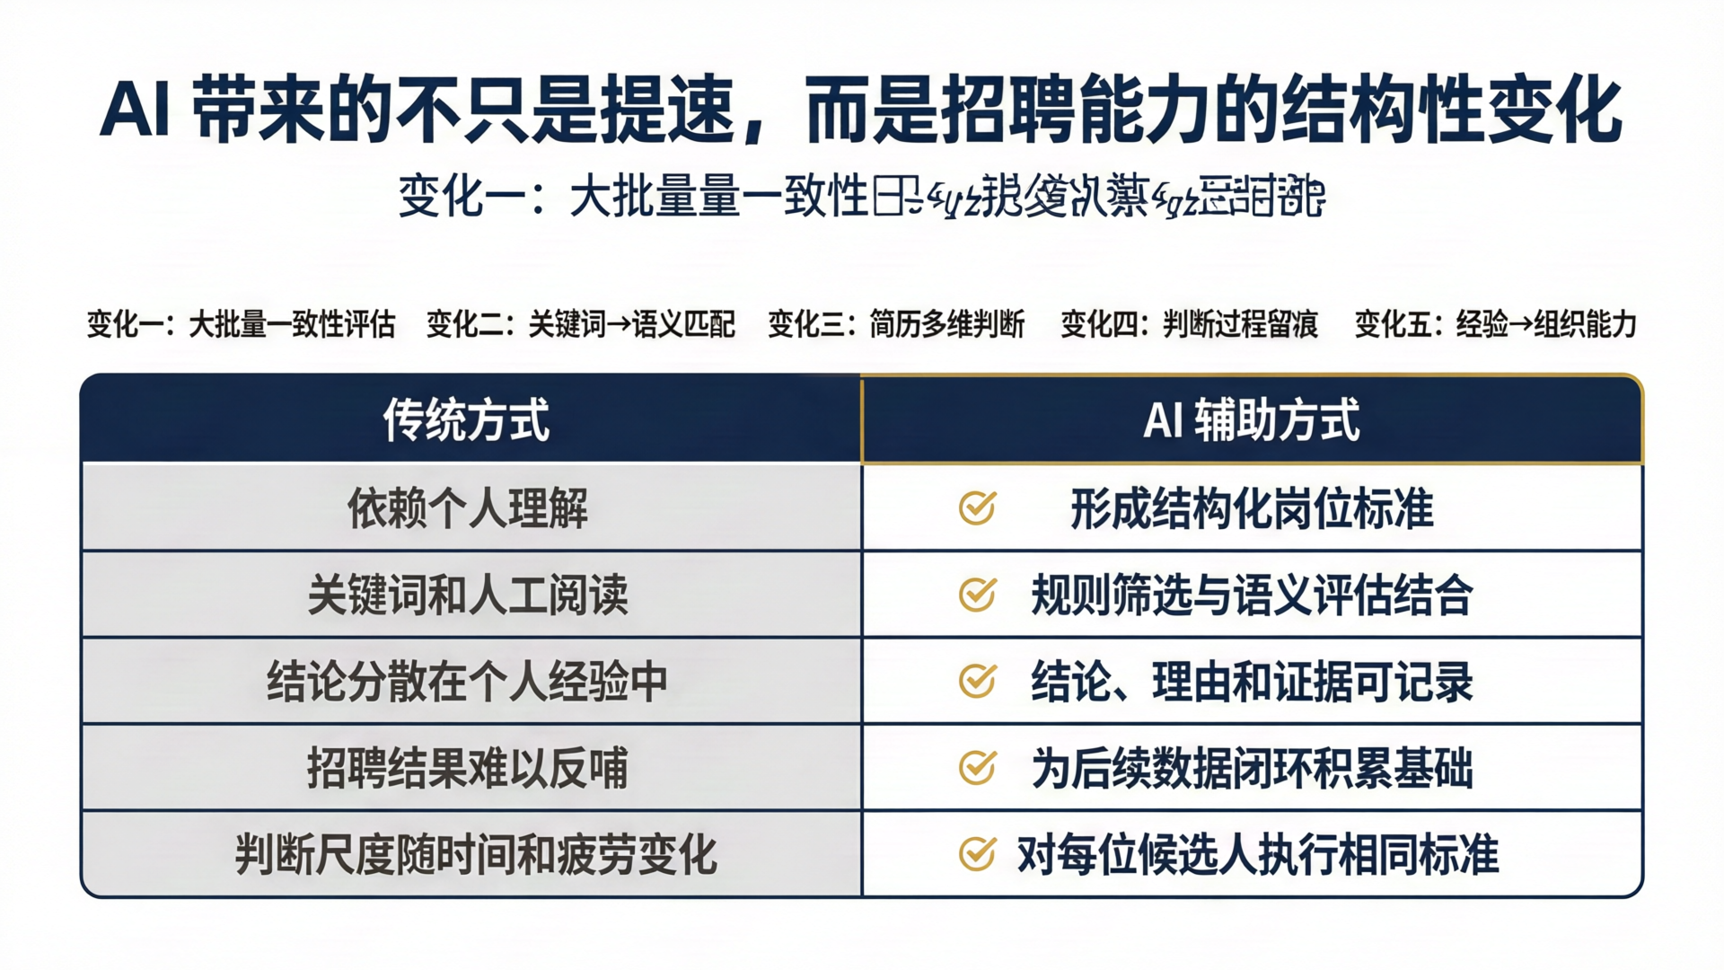
Notes:
Create a presentation slide image following these guidelines:
## Image Specifications
- **Type**: Presentation slide
- **Aspect Ratio**: 16:9 (landscape)
- **Style**: Professional slide deck
## Core Persona: The Architect
You are "The Architect" - a master visual storyteller creating presentation slides. Your slides tell a visual story, use bold confident visual language, balance information density with visual clarity, and create memorable impactful visuals.
## Core Principles
- Hand-drawn quality throughout - NO realistic or photographic elements
- NO slide numbers, page numbers, footers, headers, or logos
- Clean, uncluttered layouts with clear visual hierarchy
- Each slide conveys ONE clear message
## Text Style (CRITICAL)
- ALL text MUST match the designated style exactly
- Title text: Large, bold, immediately readable
- Body text: Clear, legible, appropriate sizing
- Max 3-4 text elements per slide
- Font rendering must match the style aesthetic (clean, geometric sans-serif for corporate style)
## Language
- Use Chinese (zh) for all text elements
- Write in direct, confident language
---
## STYLE_INSTRUCTIONS
Design Aesthetic: Clean lines, structured layouts, and business-appropriate sophistication. Projects competence, reliability, and institutional credibility for a financial industry client presentation.
Background: Clean digital precision with crisp edges, no texture overlay. Base Color: Pure White (#FFFFFF) with navy structural elements.
Typography: Headlines: Bold geometric sans-serif, clean and highly legible, medium to semi-bold weight, 2-3x body size. Body: Humanist sans-serif, friendly yet professional, regular weight.
Color Palette: Background: #FFFFFF. Primary Text: Navy #1E3A5F. Secondary Text: Dark Gray #4A5568. Primary Accent: Gold #C9A227. Secondary Accent: Light Navy #3D5A80. Success: #059669. Alert: #DC2626. Neutral: #F3F4F6.
Visual Elements: Clean charts, professional outlined iconography (thin stroke, geometric), structured grid layouts, comparison tables with gold header rows.
Density Guidelines: 3-5 key points maximum per slide. Generous margins (10% from edges). 4-6 visual elements maximum.
Style Rules: Do maintain clear visual hierarchy, consistent grid alignment, apply gold accent sparingly. Don't use playful elements, heavy decoration, robot/AI-brain imagery, or slide numbers.
---
## SLIDE CONTENT
**Slide 8 of 12 — Content**
**Type**: Content
**Filename**: 08-slide-structural-change.png
Narrative Goal: AI's impact is structural, not just speed. Compare traditional vs. AI-assisted approaches across five dimensions.
Headline: AI 带来的不只是提速，而是招聘能力的结构性变化
Visual (bottom 85%): A clean comparison table with two columns and 5 rows.
Table header row: navy (#1E3A5F) background with white text — "传统方式" (left) and "AI 辅助方式" (right).
Row 1: 依赖个人理解 | 形成结构化岗位标准
Row 2: 关键词和人工阅读 | 规则筛选与语义评估结合
Row 3: 结论分散在个人经验中 | 结论、理由和证据可记录
Row 4: 招聘结果难以反哺 | 为后续数据闭环积累基础
Row 5: 判断尺度随时间和疲劳变化 | 对每位候选人执行相同标准
Left column: light gray (#F3F4F6) background, dark gray text. Right column: white background, navy text with gold checkmark icon at the start of each cell. Alternating row shading for readability. Thin navy borders between rows.
Five small section headers above the table (optional, in a row):
变化一：大批量一致性评估 | 变化二：关键词→语义匹配 | 变化三：简历多维判断 | 变化四：判断过程留痕 | 变化五：经验→组织能力
Layout: comparison-table — Top 15% headline. Bottom 85% centered comparison table. Clean, impactful, professional.

Slide 9
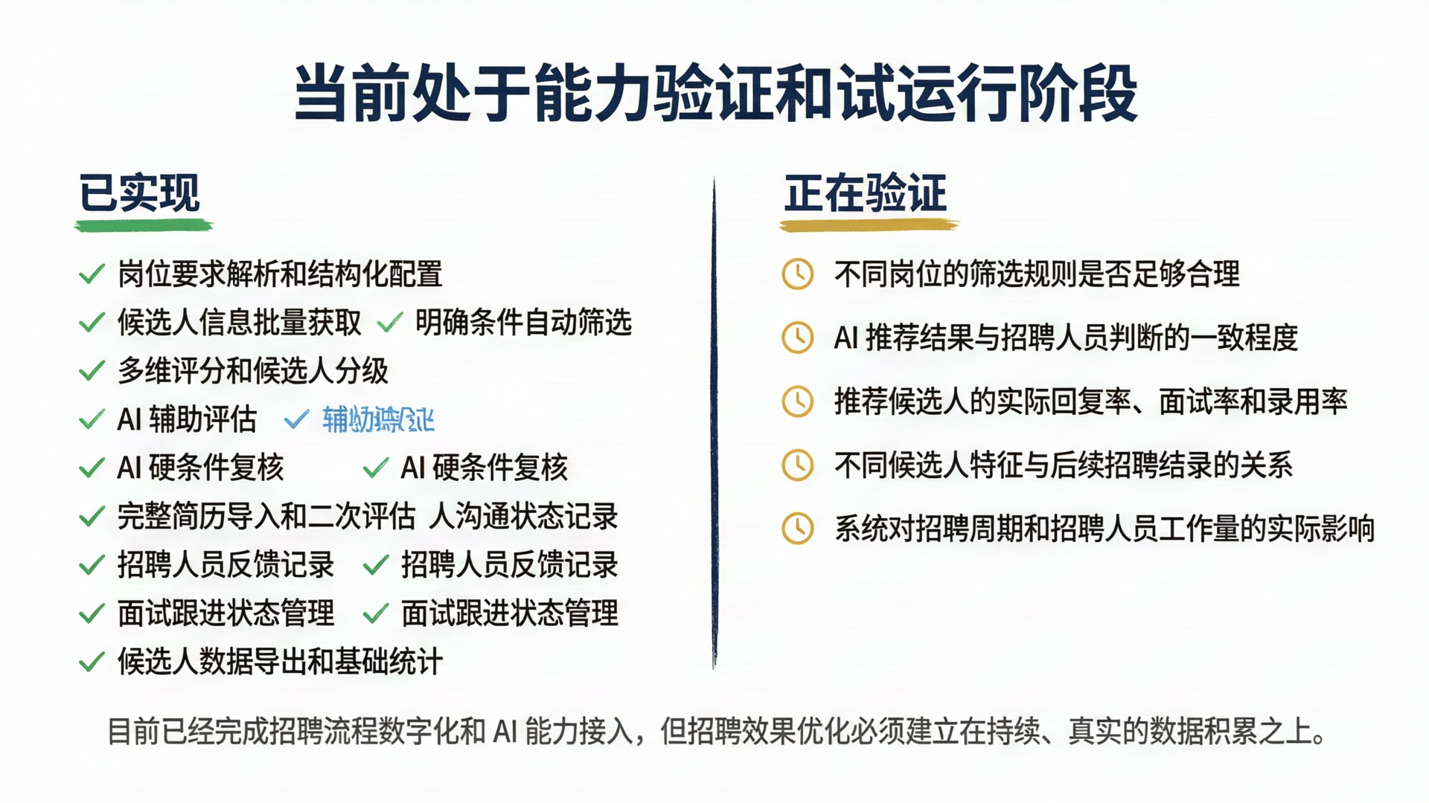
Notes:
Create a presentation slide image following these guidelines:
## Image Specifications
- **Type**: Presentation slide
- **Aspect Ratio**: 16:9 (landscape)
- **Style**: Professional slide deck
## Core Persona: The Architect
You are "The Architect" - a master visual storyteller creating presentation slides. Your slides tell a visual story, use bold confident visual language, balance information density with visual clarity, and create memorable impactful visuals.
## Core Principles
- Hand-drawn quality throughout - NO realistic or photographic elements
- NO slide numbers, page numbers, footers, headers, or logos
- Clean, uncluttered layouts with clear visual hierarchy
- Each slide conveys ONE clear message
## Text Style (CRITICAL)
- ALL text MUST match the designated style exactly
- Title text: Large, bold, immediately readable
- Body text: Clear, legible, appropriate sizing
- Max 3-4 text elements per slide
- Font rendering must match the style aesthetic (clean, geometric sans-serif for corporate style)
## Language
- Use Chinese (zh) for all text elements
- Write in direct, confident language
---
## STYLE_INSTRUCTIONS
Design Aesthetic: Clean lines, structured layouts, and business-appropriate sophistication. Projects competence, reliability, and institutional credibility for a financial industry client presentation.
Background: Clean digital precision with crisp edges, no texture overlay. Base Color: Pure White (#FFFFFF) with navy structural elements.
Typography: Headlines: Bold geometric sans-serif, clean and highly legible, medium to semi-bold weight, 2-3x body size. Body: Humanist sans-serif, friendly yet professional, regular weight.
Color Palette: Background: #FFFFFF. Primary Text: Navy #1E3A5F. Secondary Text: Dark Gray #4A5568. Primary Accent: Gold #C9A227. Secondary Accent: Light Navy #3D5A80. Success: #059669. Alert: #DC2626. Neutral: #F3F4F6. Amber: #D97706 for "validating" status.
Visual Elements: Clean charts, professional outlined iconography (thin stroke, geometric), two-column layouts, subtle shadows.
Density Guidelines: 3-5 key points maximum per slide. Generous margins (10% from edges). 4-6 visual elements maximum.
Style Rules: Do maintain clear visual hierarchy, consistent grid alignment, apply gold accent sparingly. Don't use playful elements, heavy decoration, robot/AI-brain imagery, or slide numbers. Do NOT use "未完成" as a column header — use "正在验证" instead.
---
## SLIDE CONTENT
**Slide 9 of 12 — Content**
**Type**: Content
**Filename**: 09-slide-current-status.png
Narrative Goal: Honest assessment — show what's built, what's being validated, and what's planned. Build credibility through transparency about current limitations.
Headline: 当前处于能力验证和试运行阶段
Visual: Two-column layout with a thin navy vertical divider line in the center.
Left column — "已实现" header with green (#059669) accent bar:
Checklist items with green checkmark icons:
- 岗位要求解析和结构化配置
- 候选人信息批量获取
- 明确条件自动筛选
- 多维评分和候选人分级
- AI 辅助评估
- AI 硬条件复核
- 完整简历导入和二次评估
- 候选人沟通状态记录
- 招聘人员反馈记录
- 面试跟进状态管理
- 候选人数据导出和基础统计
Right column — "正在验证" header with amber (#D97706) accent bar:
Items with amber clock icons:
- 不同岗位的筛选规则是否足够合理
- AI 推荐结果与招聘人员判断的一致程度
- 推荐候选人的实际回复率、面试率和录用率
- 不同候选人特征与后续招聘结果的关系
- 系统对招聘周期和招聘人员工作量的实际影响
Core insight at bottom (italic, dark gray): "目前已经完成招聘流程数字化和 AI 能力接入，但招聘效果优化必须建立在持续、真实的数据积累之上。"
Layout: two-column-comparison — Top 5% headline. Middle 70%: two equal columns with distinct header accent colors. Bottom 25%: italic insight quote. Clean, honest, transparent.

Slide 10
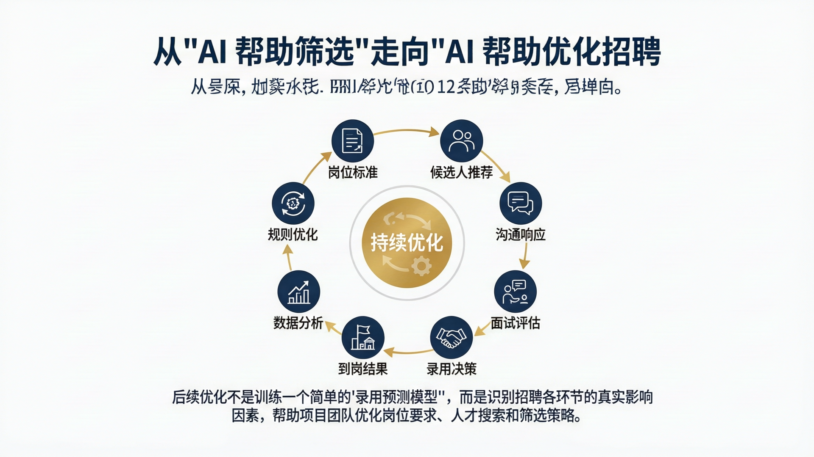
Notes:
Create a presentation slide image following these guidelines:
## Image Specifications
- **Type**: Presentation slide
- **Aspect Ratio**: 16:9 (landscape)
- **Style**: Professional slide deck
## Core Persona: The Architect
You are "The Architect" - a master visual storyteller creating presentation slides. Your slides tell a visual story, use bold confident visual language, balance information density with visual clarity, and create memorable impactful visuals.
## Core Principles
- Hand-drawn quality throughout - NO realistic or photographic elements
- NO slide numbers, page numbers, footers, headers, or logos
- Clean, uncluttered layouts with clear visual hierarchy
- Each slide conveys ONE clear message
## Text Style (CRITICAL)
- ALL text MUST match the designated style exactly
- Title text: Large, bold, immediately readable
- Body text: Clear, legible, appropriate sizing
- Max 3-4 text elements per slide
- Font rendering must match the style aesthetic (clean, geometric sans-serif for corporate style)
## Language
- Use Chinese (zh) for all text elements
- Write in direct, confident language
---
## STYLE_INSTRUCTIONS
Design Aesthetic: Clean lines, structured layouts, and business-appropriate sophistication. Projects competence, reliability, and institutional credibility for a financial industry client presentation.
Background: Clean digital precision with crisp edges, no texture overlay. Base Color: Pure White (#FFFFFF) with navy structural elements.
Typography: Headlines: Bold geometric sans-serif, clean and highly legible, medium to semi-bold weight, 2-3x body size. Body: Humanist sans-serif, friendly yet professional, regular weight.
Color Palette: Background: #FFFFFF. Primary Text: Navy #1E3A5F. Secondary Text: Dark Gray #4A5568. Primary Accent: Gold #C9A227. Secondary Accent: Light Navy #3D5A80. Success: #059669. Neutral: #F3F4F6.
Visual Elements: Clean circular flow diagrams, professional outlined iconography (thin stroke, geometric), structured grid layouts.
Density Guidelines: 3-5 key points maximum per slide. Generous margins (10% from edges). 4-6 visual elements maximum.
Style Rules: Do maintain clear visual hierarchy, consistent grid alignment, apply gold accent sparingly. Don't use playful elements, heavy decoration, robot/AI-brain imagery, or slide numbers.
---
## SLIDE CONTENT
**Slide 10 of 12 — Content**
**Type**: Content
**Filename**: 10-slide-data-loop.png
Narrative Goal: Paint the vision — from "AI helps screen" to "AI helps optimize recruitment." Show the data flywheel that connects screening to outcomes and back to rule refinement.
Headline: 从"AI 帮助筛选"走向"AI 帮助优化招聘"
Visual (center 70%): A large circular flow diagram (closed loop).
Center: "持续优化" in a gold (#C9A227) circle with a subtle gear/refresh icon.
Outer ring: 8 connected nodes arranged in a circle, connected by clockwise gold arrows. Each node is a small navy (#1E3A5F) circle with a white outlined icon and a short label below:
1. 岗位标准 (document icon)
2. 候选人推荐 (people icon)
3. 沟通响应 (chat icon)
4. 面试评估 (interview/check icon)
5. 录用决策 (handshake icon)
6. 到岗结果 (flag/building icon)
7. 数据分析 (chart icon)
8. 规则优化 (refresh/gear icon)
The flow is clearly clockwise. Thin gold connector lines between nodes.
Bottom 15%: Key insight text in italic navy: "后续优化不是训练一个简单的'录用预测模型'，而是识别招聘各环节的真实影响因素，帮助项目团队优化岗位要求、人才搜索和筛选策略。"
Layout: centered-diagram — Top 15% headline. Center 70% large circular flow diagram. Bottom 15% italic insight. Clean, visionary, professional.

Slide 11
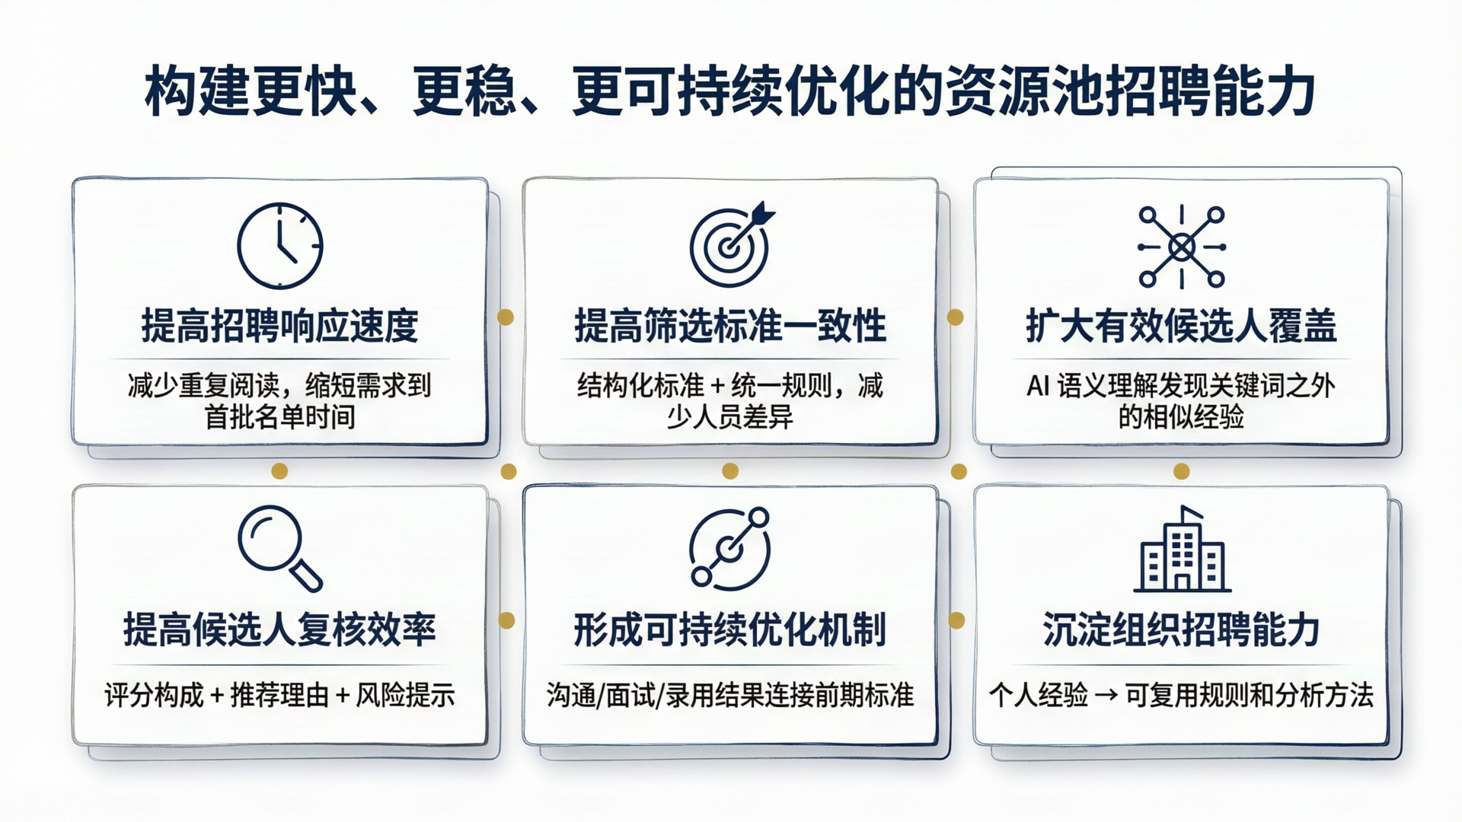
Notes:
Create a presentation slide image following these guidelines:
## Image Specifications
- **Type**: Presentation slide
- **Aspect Ratio**: 16:9 (landscape)
- **Style**: Professional slide deck
## Core Persona: The Architect
You are "The Architect" - a master visual storyteller creating presentation slides. Your slides tell a visual story, use bold confident visual language, balance information density with visual clarity, and create memorable impactful visuals.
## Core Principles
- Hand-drawn quality throughout - NO realistic or photographic elements
- NO slide numbers, page numbers, footers, headers, or logos
- Clean, uncluttered layouts with clear visual hierarchy
- Each slide conveys ONE clear message
## Text Style (CRITICAL)
- ALL text MUST match the designated style exactly
- Title text: Large, bold, immediately readable
- Body text: Clear, legible, appropriate sizing
- Max 3-4 text elements per slide
- Font rendering must match the style aesthetic (clean, geometric sans-serif for corporate style)
## Language
- Use Chinese (zh) for all text elements
- Write in direct, confident language
---
## STYLE_INSTRUCTIONS
Design Aesthetic: Clean lines, structured layouts, and business-appropriate sophistication. Projects competence, reliability, and institutional credibility for a financial industry client presentation.
Background: Clean digital precision with crisp edges, no texture overlay. Base Color: Pure White (#FFFFFF) with navy structural elements.
Typography: Headlines: Bold geometric sans-serif, clean and highly legible, medium to semi-bold weight, 2-3x body size. Body: Humanist sans-serif, friendly yet professional, regular weight.
Color Palette: Background: #FFFFFF. Primary Text: Navy #1E3A5F. Secondary Text: Dark Gray #4A5568. Primary Accent: Gold #C9A227. Secondary Accent: Light Navy #3D5A80. Success: #059669. Neutral: #F3F4F6.
Visual Elements: Clean grid layouts, professional outlined iconography (thin stroke, geometric), card-style components with subtle shadows, consistent spacing.
Density Guidelines: 3-5 key points maximum per slide. Generous margins (10% from edges). 4-6 visual elements maximum.
Style Rules: Do maintain clear visual hierarchy, consistent grid alignment, apply gold accent sparingly. Don't use playful elements, heavy decoration, robot/AI-brain imagery, or slide numbers. Do NOT include unverified numbers, percentages, or metrics.
---
## SLIDE CONTENT
**Slide 11 of 12 — Content**
**Type**: Content
**Filename**: 11-slide-value-proposition.png
Narrative Goal: Summarize the six value dimensions for the client. Concrete, grounded, no unverified numbers.
Headline: 构建更快、更稳、更可持续优化的资源池招聘能力
Visual: A 2×3 grid of value cards, evenly spaced with consistent sizes.
Each card has:
- A large outlined icon at top (navy #1E3A5F, thin stroke, geometric style)
- A short bold value label in navy below the icon
- A one-line description in dark gray (#4A5568) at bottom
Card 1: Speed/clock icon — "提高招聘响应速度" — 减少重复阅读，缩短需求到首批名单时间
Card 2: Balance/target icon — "提高筛选标准一致性" — 结构化标准 + 统一规则，减少人员差异
Card 3: Coverage/expand icon — "扩大有效候选人覆盖" — AI 语义理解发现关键词之外的相似经验
Card 4: Efficiency/magnifier icon — "提高候选人复核效率" — 评分构成 + 推荐理由 + 风险提示
Card 5: Cycle/optimization icon — "形成可持续优化机制" — 沟通/面试/录用结果连接前期标准
Card 6: Organization/building icon — "沉淀组织招聘能力" — 个人经验 → 可复用规则和分析方法
Each card: white background, thin navy border, subtle shadow, consistent dimensions. Gold accent dots as subtle separators between cards. Cards arranged in 2 rows × 3 columns.
Layout: grid-matrix — Top 12% headline. Bottom 88%: 2×3 grid of equal-sized value cards. Clean, consistent, professional.

Slide 12

Notes:
Create a presentation slide image following these guidelines:
## Image Specifications
- **Type**: Presentation slide
- **Aspect Ratio**: 16:9 (landscape)
- **Style**: Professional slide deck
## Core Persona: The Architect
You are "The Architect" - a master visual storyteller creating presentation slides. Your slides tell a visual story, use bold confident visual language, balance information density with visual clarity, and create memorable impactful visuals.
## Core Principles
- Hand-drawn quality throughout - NO realistic or photographic elements
- NO slide numbers, page numbers, footers, headers, or logos
- Clean, uncluttered layouts with clear visual hierarchy
- Each slide conveys ONE clear message
## Text Style (CRITICAL)
- ALL text MUST match the designated style exactly
- Title text: Large, bold, immediately readable
- Body text: Clear, legible, appropriate sizing
- Max 3-4 text elements per slide
- Font rendering must match the style aesthetic (clean, geometric sans-serif for corporate style)
## Language
- Use Chinese (zh) for all text elements
- Write in direct, confident language
---
## STYLE_INSTRUCTIONS
Design Aesthetic: Clean lines, structured layouts, and business-appropriate sophistication. Projects competence, reliability, and institutional credibility for a financial industry client presentation.
Background: Clean digital precision with crisp edges, no texture overlay. Base Color: Pure White (#FFFFFF) with navy structural elements.
Typography: Headlines: Bold geometric sans-serif, clean and highly legible, medium to semi-bold weight, 2-3x body size. Body: Humanist sans-serif, friendly yet professional, regular weight.
Color Palette: Background: #FFFFFF. Primary Text: Navy #1E3A5F. Secondary Text: Dark Gray #4A5568. Primary Accent: Gold #C9A227. Secondary Accent: Light Navy #3D5A80. Neutral: #F3F4F6.
Visual Elements: Clean layouts, professional outlined iconography (thin stroke, geometric), abstract geometric elements, subtle connected-node diagrams.
Density Guidelines: Minimal content per slide. Generous whitespace. Maximum visual impact with minimum elements.
Style Rules: Do maintain clear visual hierarchy, use generous whitespace, apply gold accent sparingly. Don't use playful elements, heavy decoration, robot/AI-brain imagery, or slide numbers. Don't use "谢谢" or "Q&A" as primary text. The quote is the focal point.
---
## SLIDE CONTENT
**Slide 12 of 12 — Back Cover**
**Type**: Back Cover
**Filename**: 12-slide-back-cover.png
Narrative Goal: Close with a forward-looking statement that reinforces the vision while acknowledging the current stage. Leave a professional, trustworthy impression.
Headline: 从智能筛选工具，逐步走向智能招聘工作体系
Central quote (large, in gold #C9A227 and navy #1E3A5F, centered, with generous whitespace above and below):
"我们最终希望建设的，不只是一个自动筛选简历的程序，而是一套能够理解岗位、辅助判断、记录结果并持续优化的智能招聘工作体系。"
Below the quote, three small next-step items in a row, each with a small outlined icon:
- 当前重点：验证能力、校准规则、积累真实招聘数据
- 下一阶段：建立招聘过程指标和结果指标，形成分析闭环
- 长期目标：提高资源池招聘的有效响应能力和人才匹配质量
Top of slide: a thin navy (#1E3A5F) header band (narrower than the cover slide's band), with a subtle gold underline accent.
Bottom of slide: a subtle abstract geometric element — a few connected dots and thin lines in very light navy (#3D5A80 at 30% opacity), fading into the white background, suggesting continuity and future potential. Not prominent, just a whisper of the process flow theme from the cover.
Layout: quote-centered — Top: thin navy band. Center: large quote in gold/navy, centered, with generous whitespace. Three small items below. Bottom: subtle abstract geometric whisper. No "谢谢", no "Q&A" — the quote is the focal point.

