Slide 1
1. 现阶段问卷发放情况

Slide 2
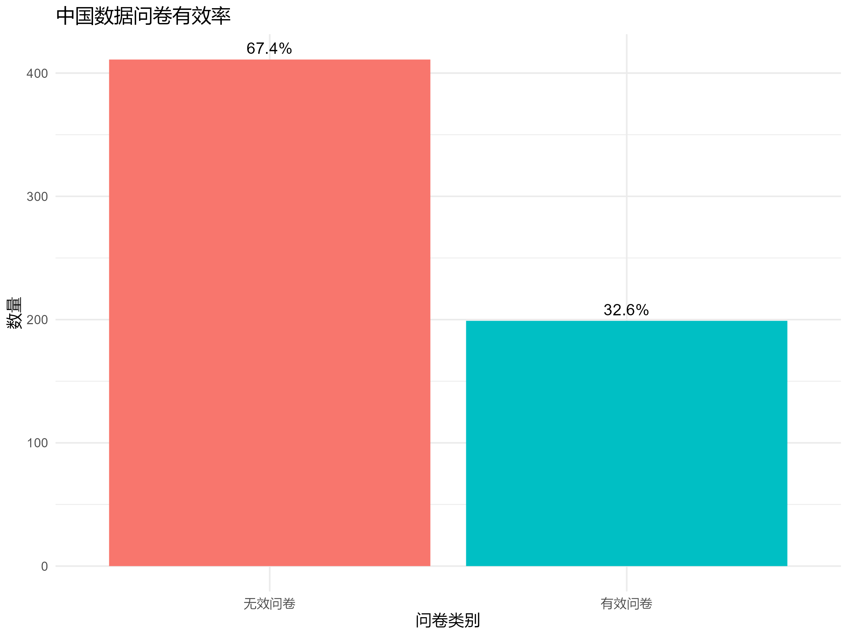
中国数据总计收回610份问卷，
有效199份，有效率32.6%
邮件发送1700封，响应率约为10%
Total China data: 610 questionnaires
collected, 199 valid, validity rate 32.6%
Emails sent: 1700, response rate about 10%

Slide 3
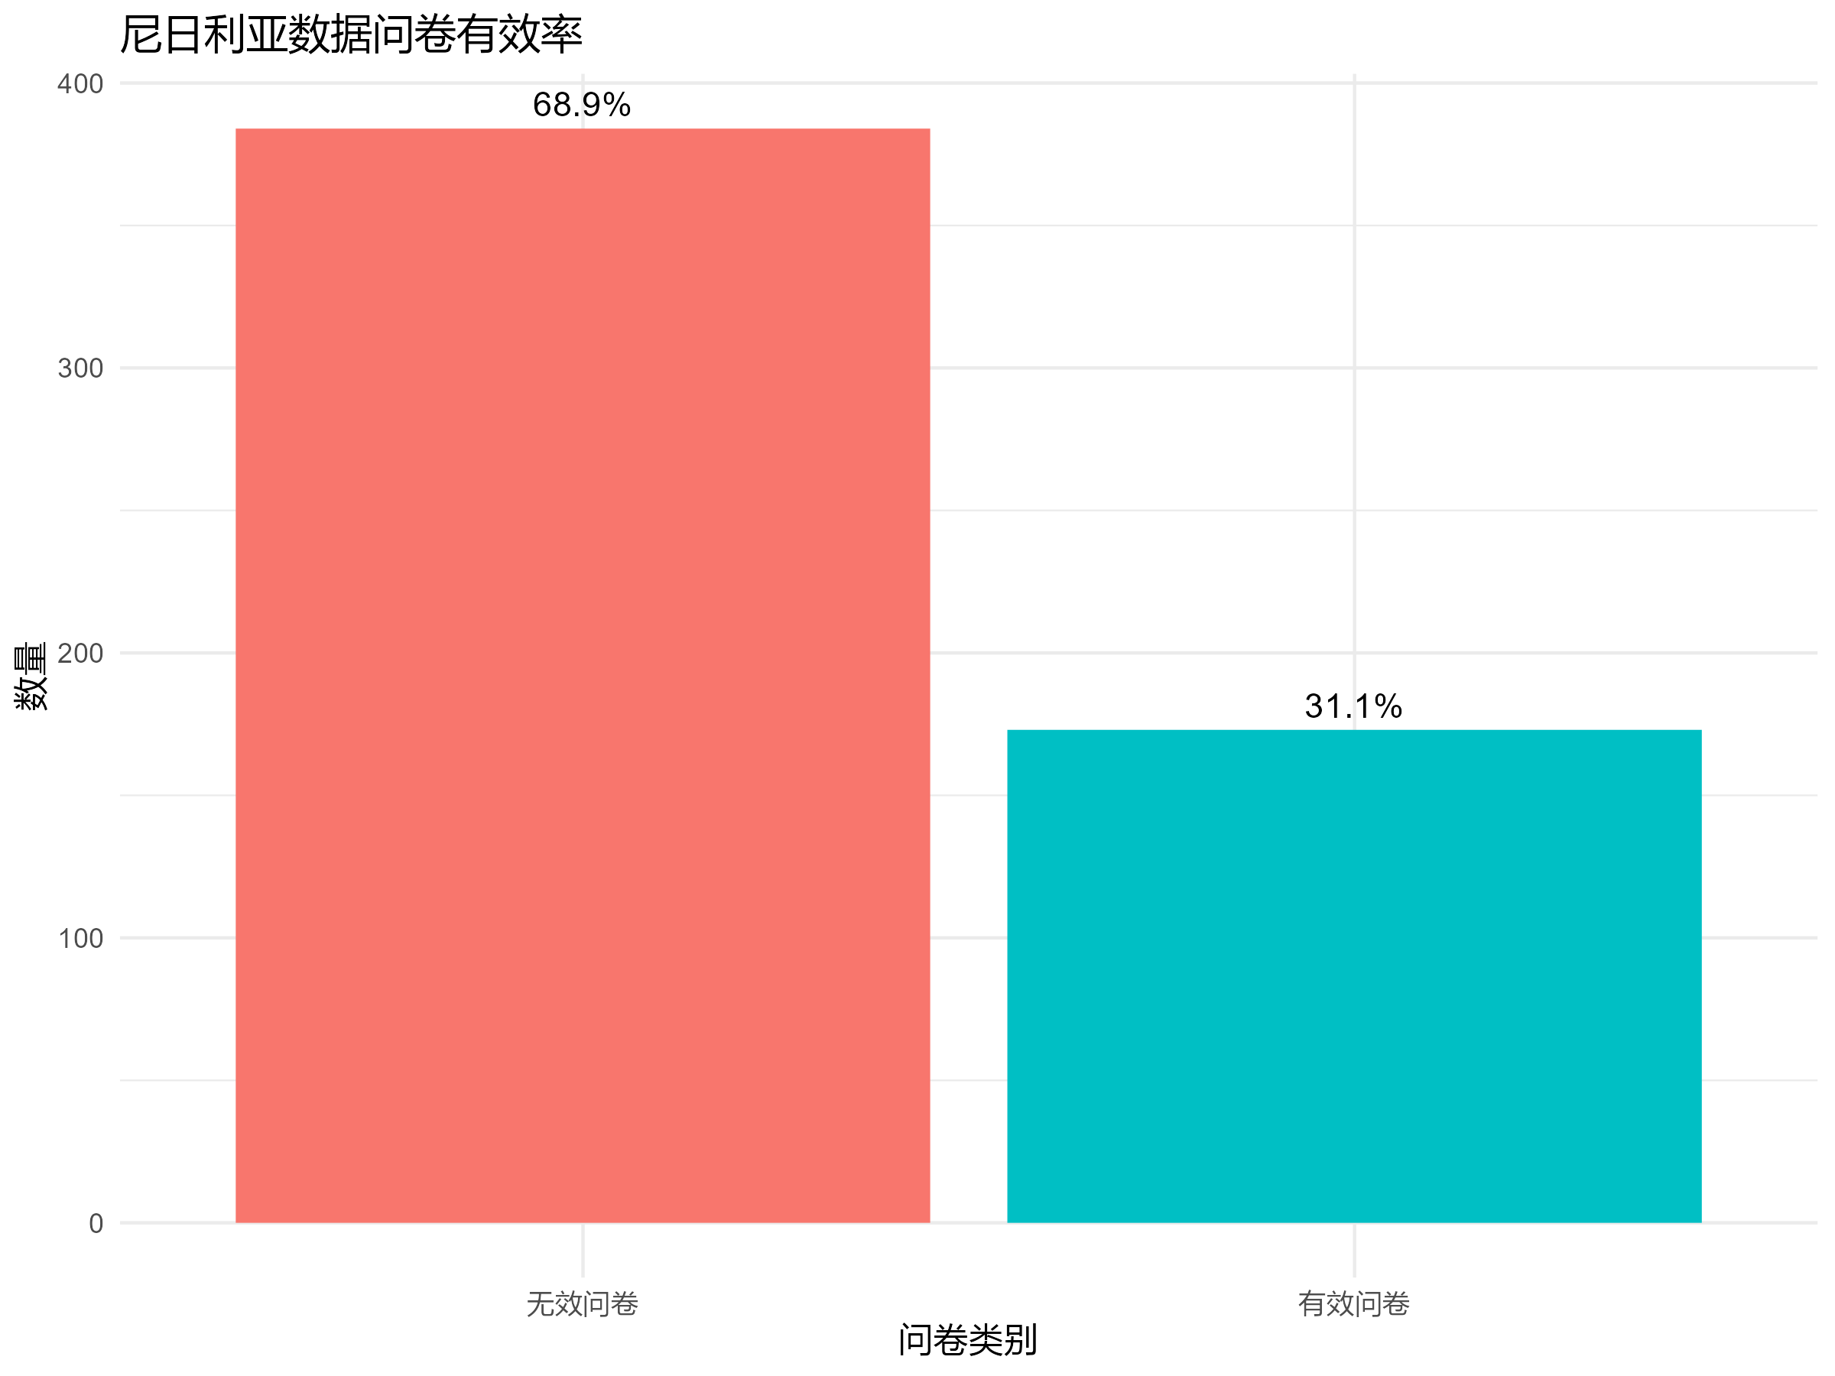
尼日利亚数据总计收回557份问卷，
有效173份，有效率31.1%
Total Nigeria data: 557 questionnaires
collected, 173 valid, validity rate 31.1%

Slide 4
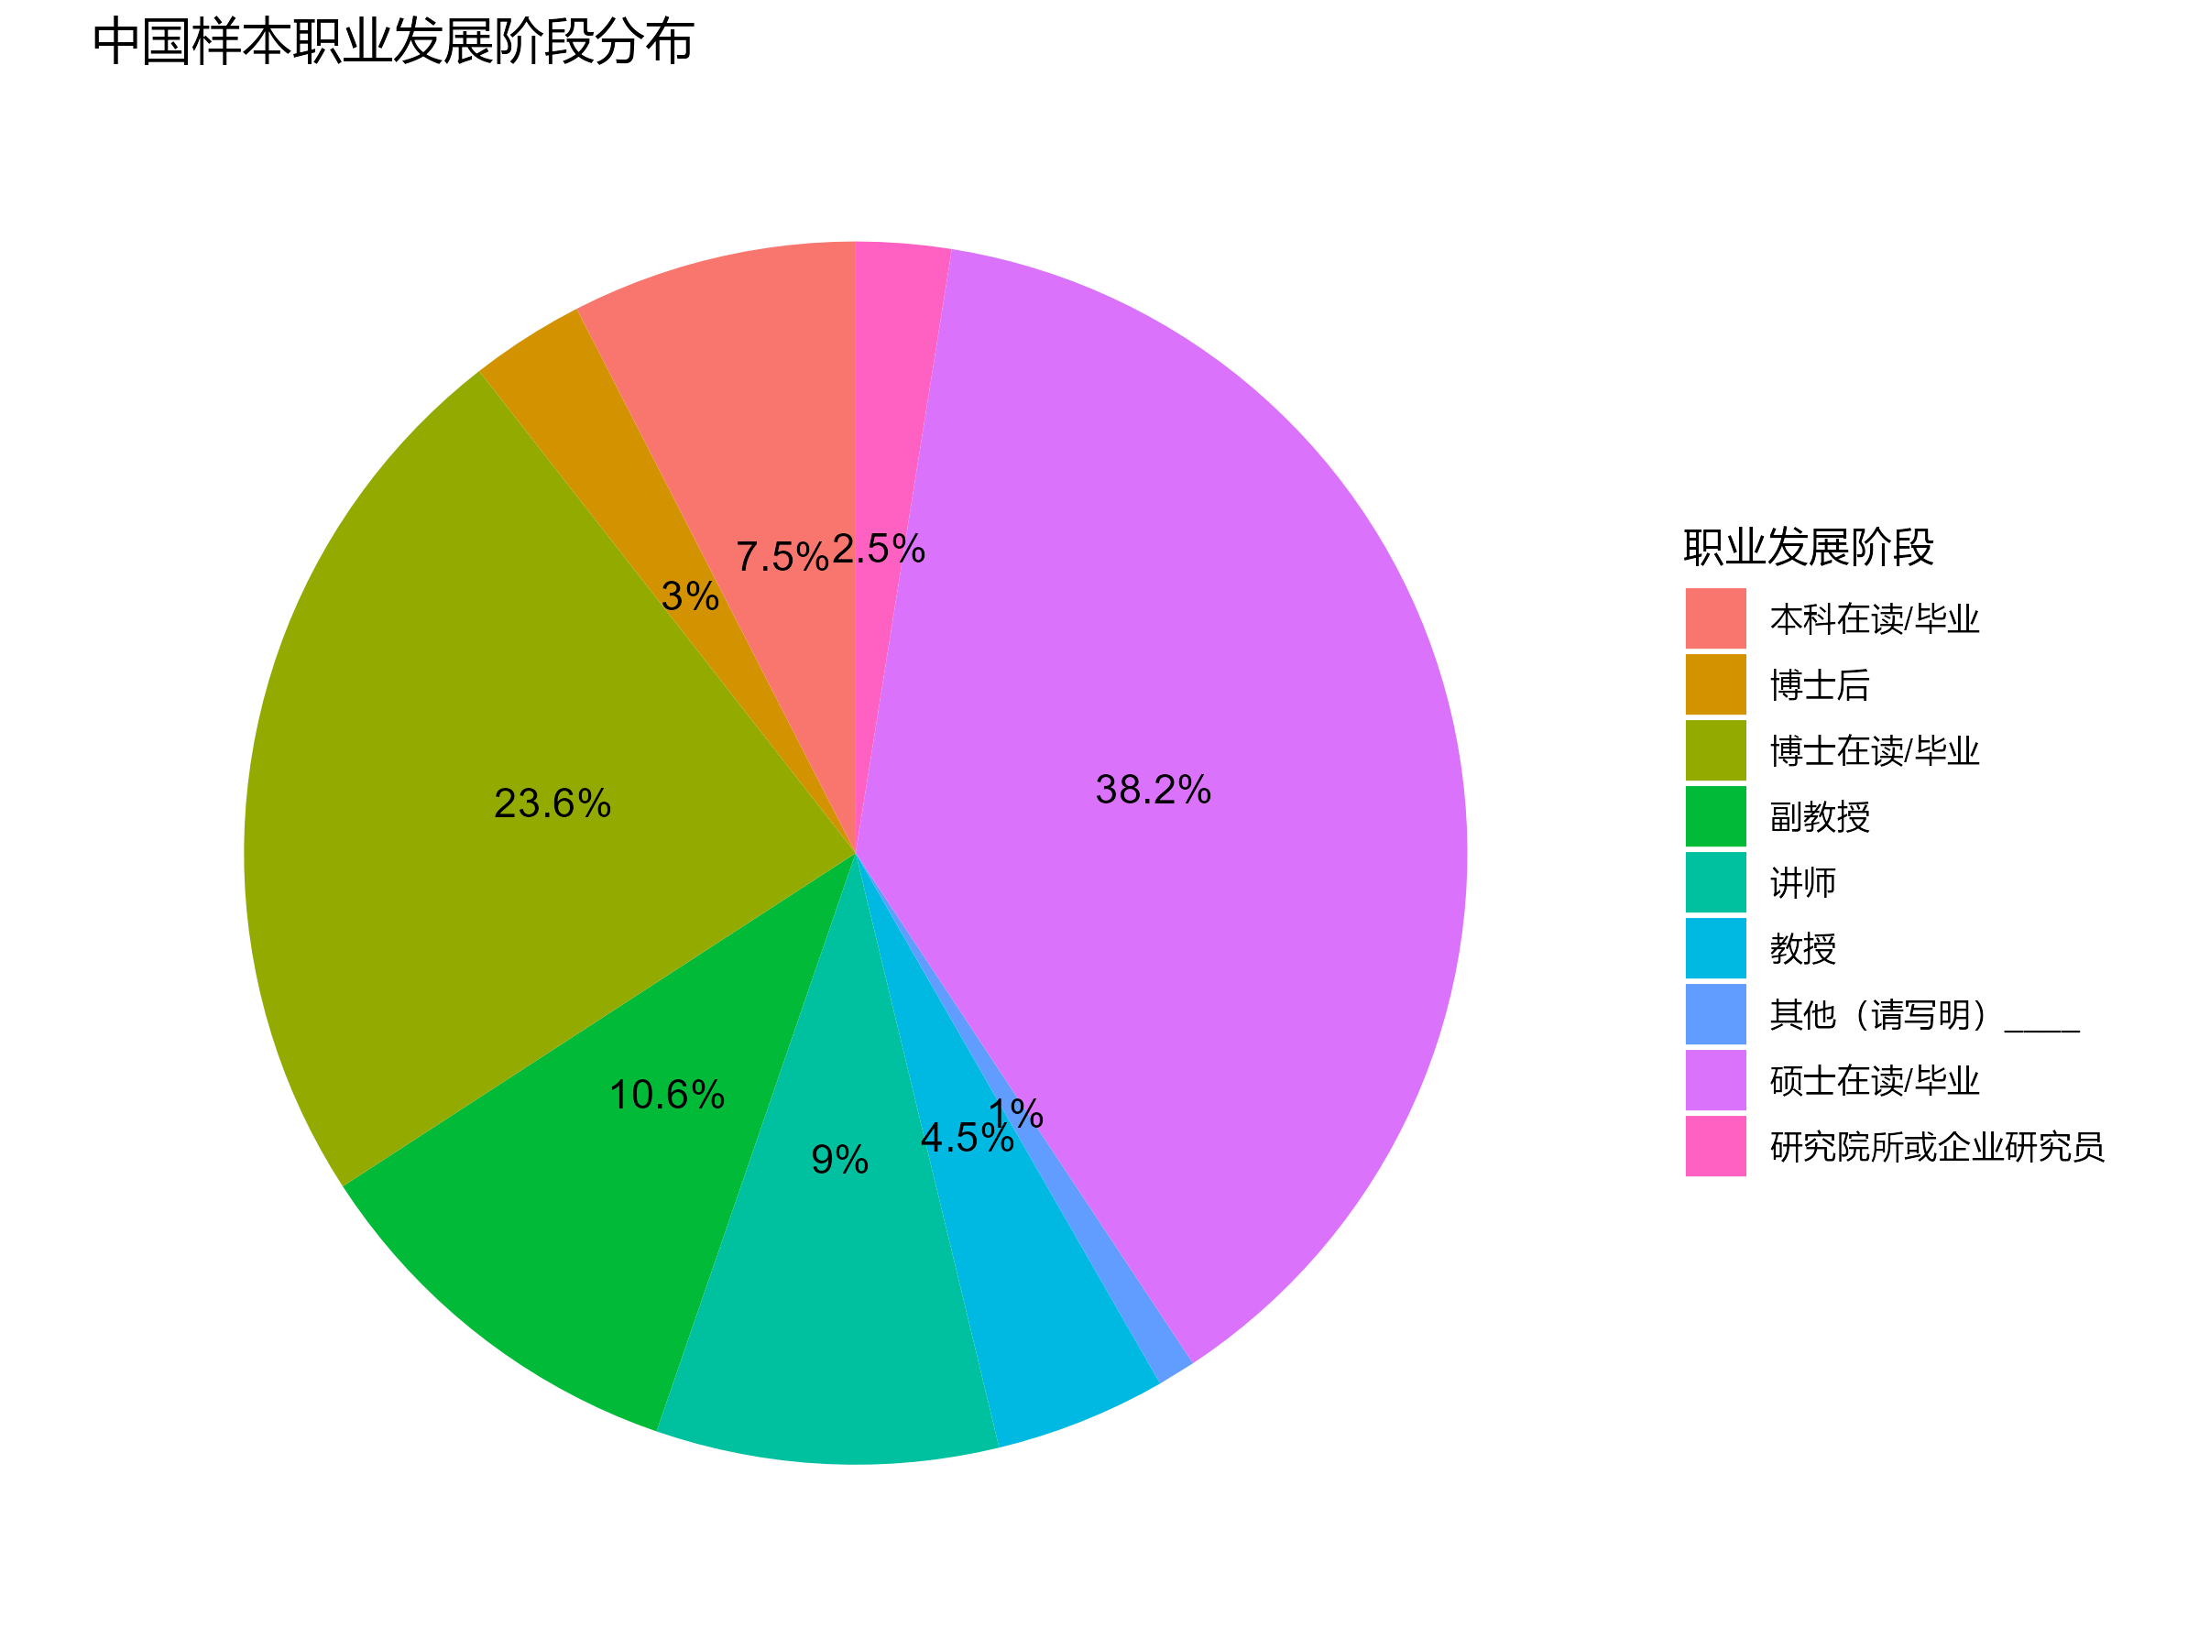
中国样本的职业发展阶段分布中，
硕士和博士最多，但是也有约四
分之一的讲师、副教授和教授
In the distribution of career stages
in the Chinese sample, masters and
doctoral candidates are the most
numerous, but there are also about
one-quarter who are lecturers, associate
professors, and professors.

Slide 5
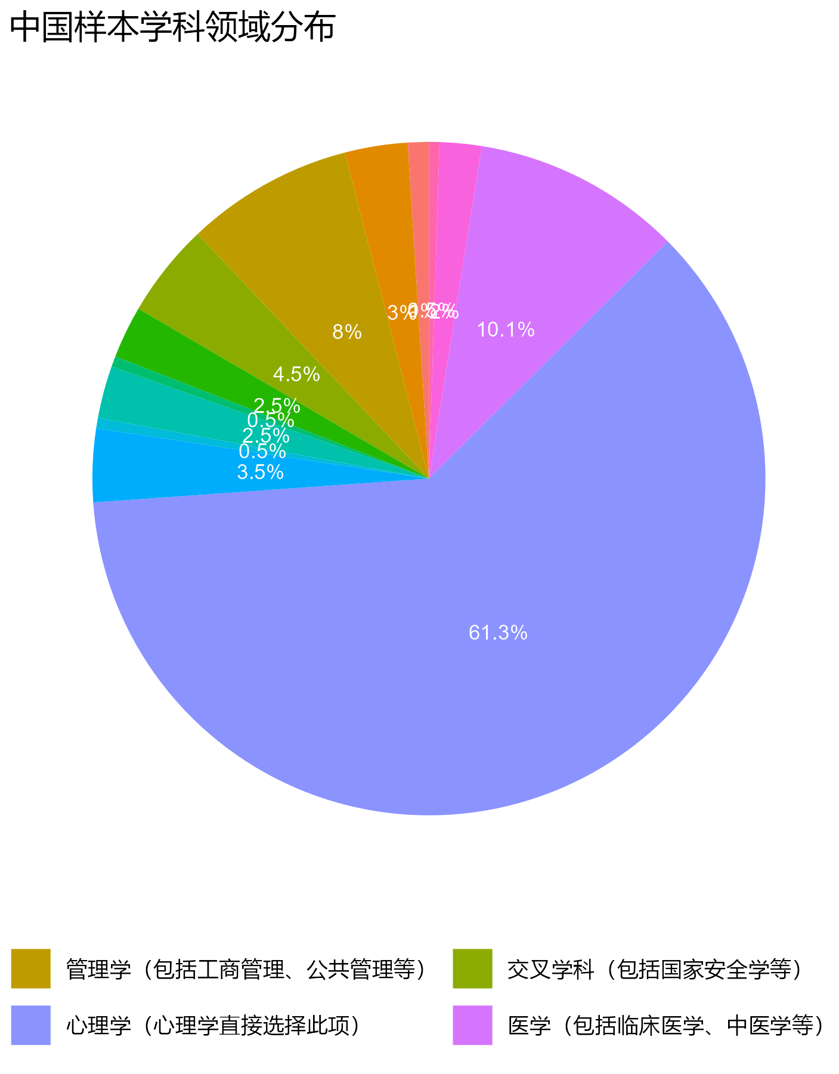
中国的学科分布大部分是心理学以及
医学管理学，这可能跟我们的发布方式
有关，在邮件发放的时候我们优先选择
了心理学的研究者。
The distribution of disciplines in China is
mostly in psychology and medical management.
This may be related to our method of distribution,
as we prioritized researchers in psychology when
sending out emails

Slide 6
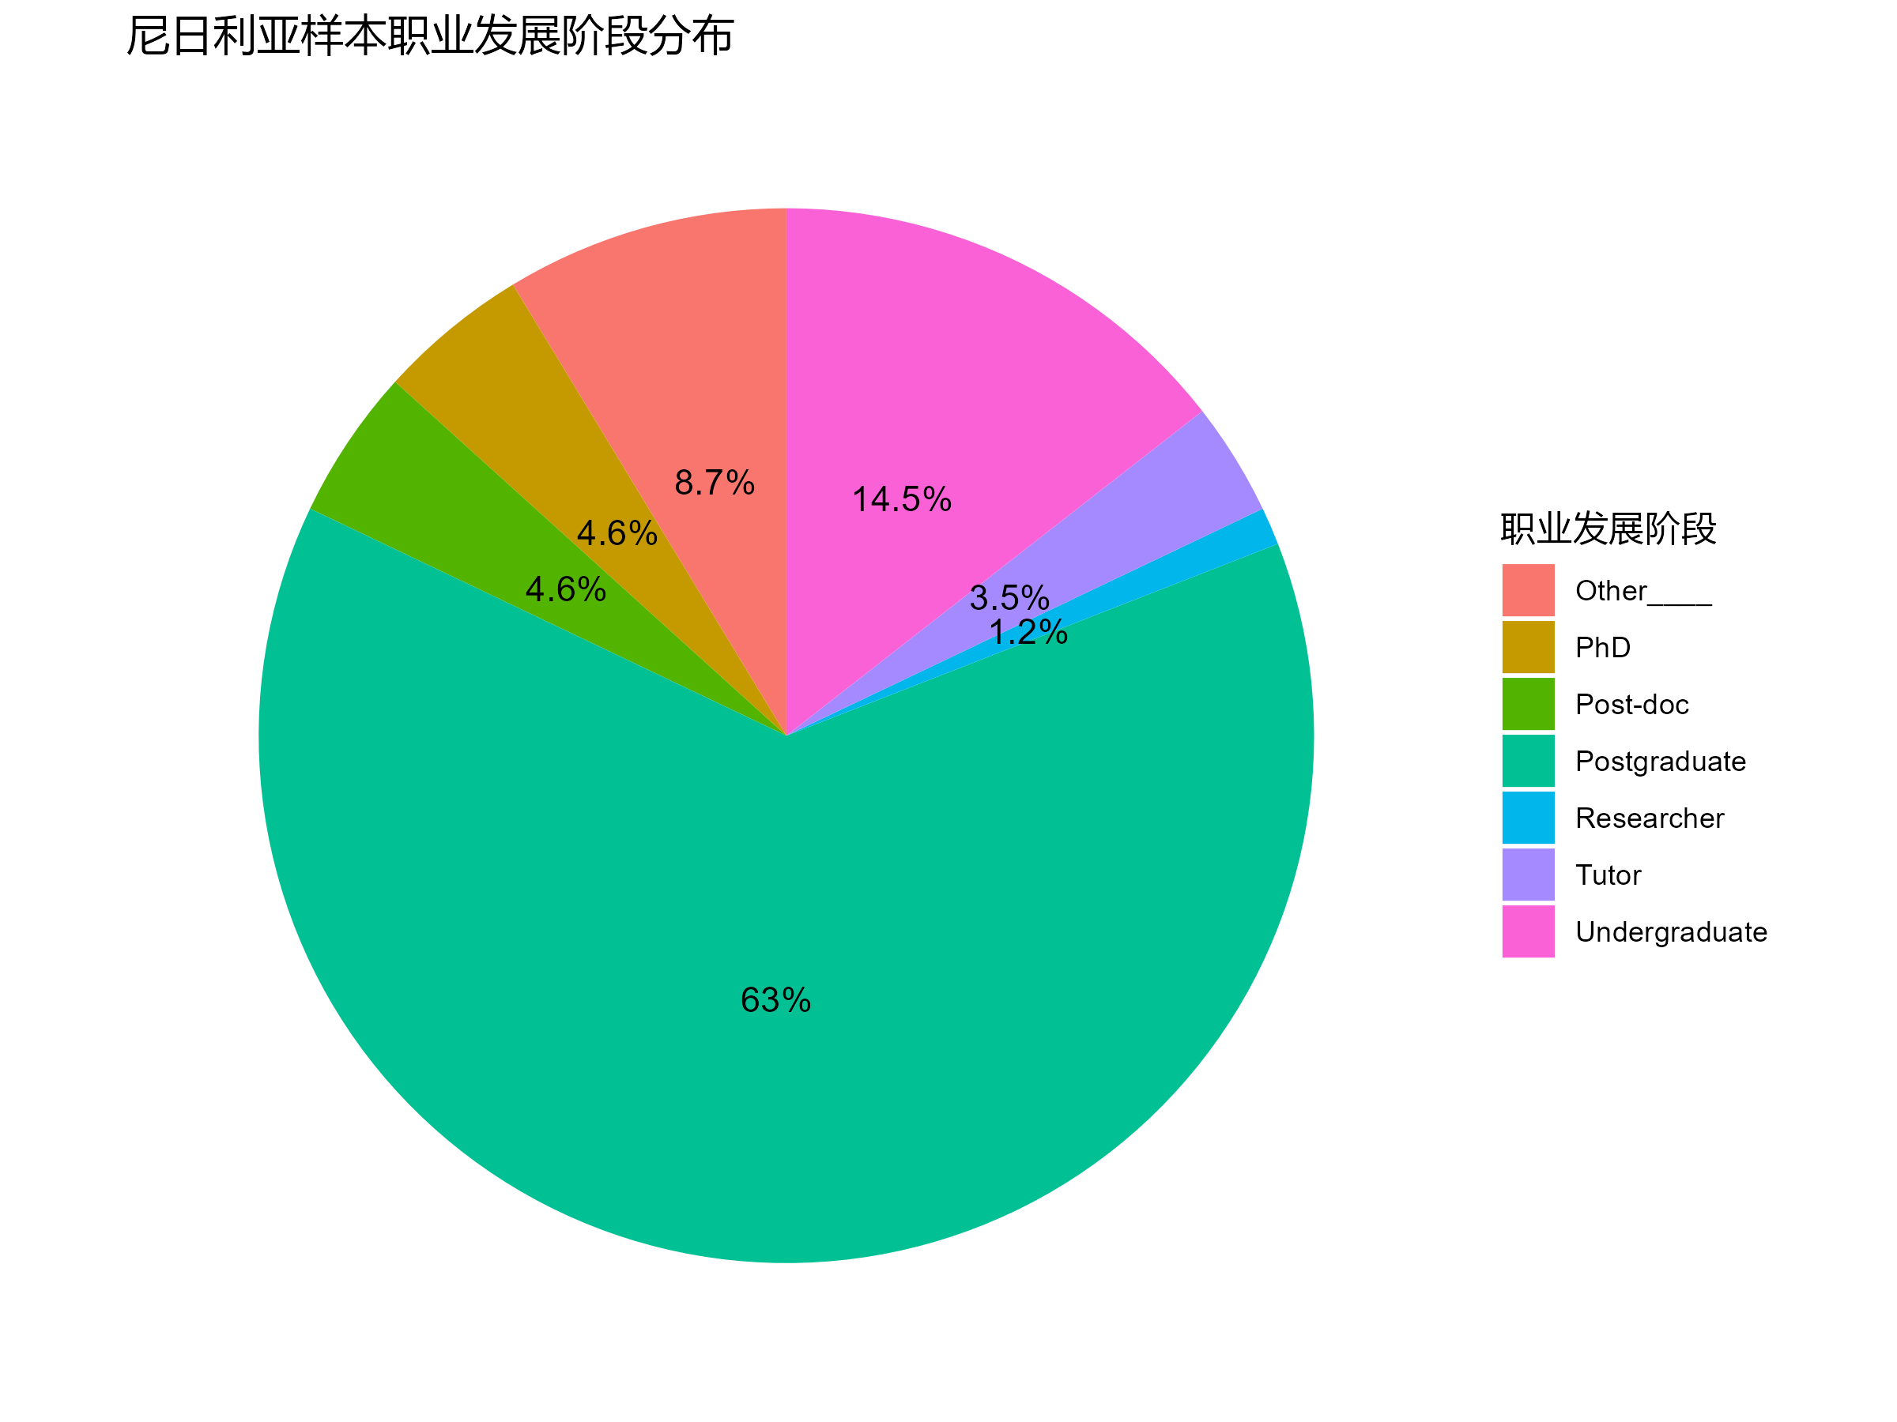
尼日利亚样本的职业发展阶段分布中，
绝大多数是研究生和本科生
In the distribution of career stages
in the Nigerian sample, the vast
majority are graduate and undergraduate
students.

Slide 7
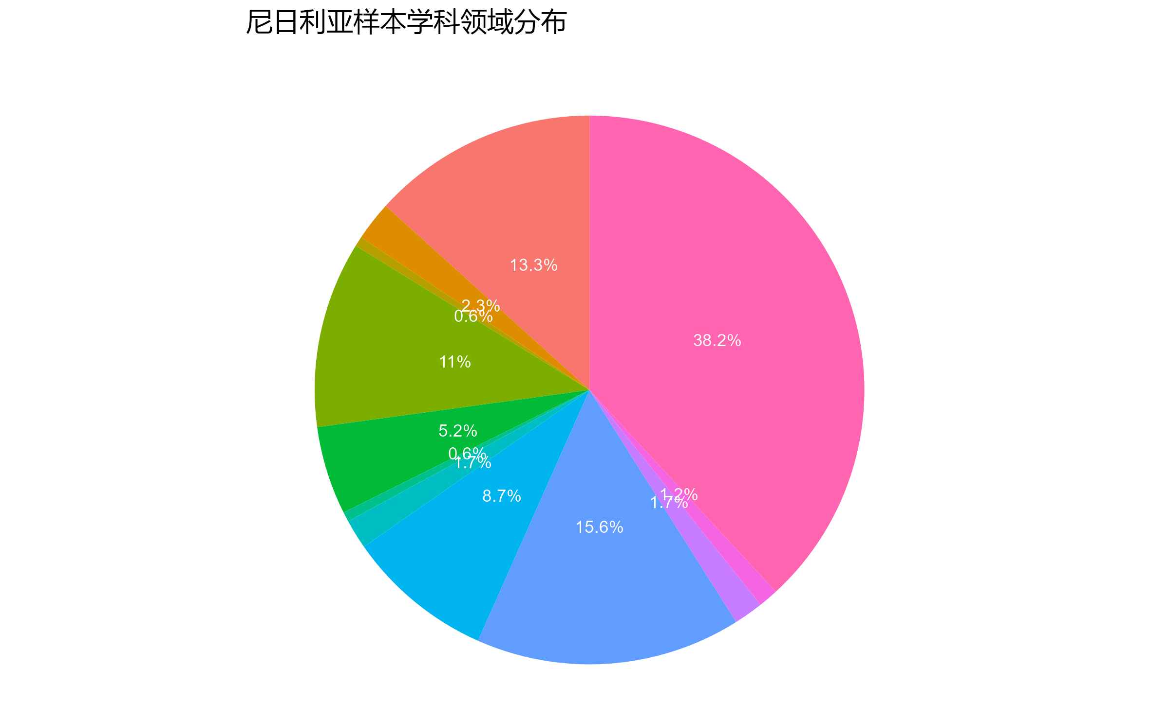
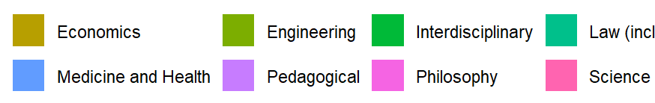
尼日利亚样本则主要集中在科学学科
和医药健康学科
The Nigerian sample mainly focuses on
scientific disciplines and medical health
sciences.

Slide 8
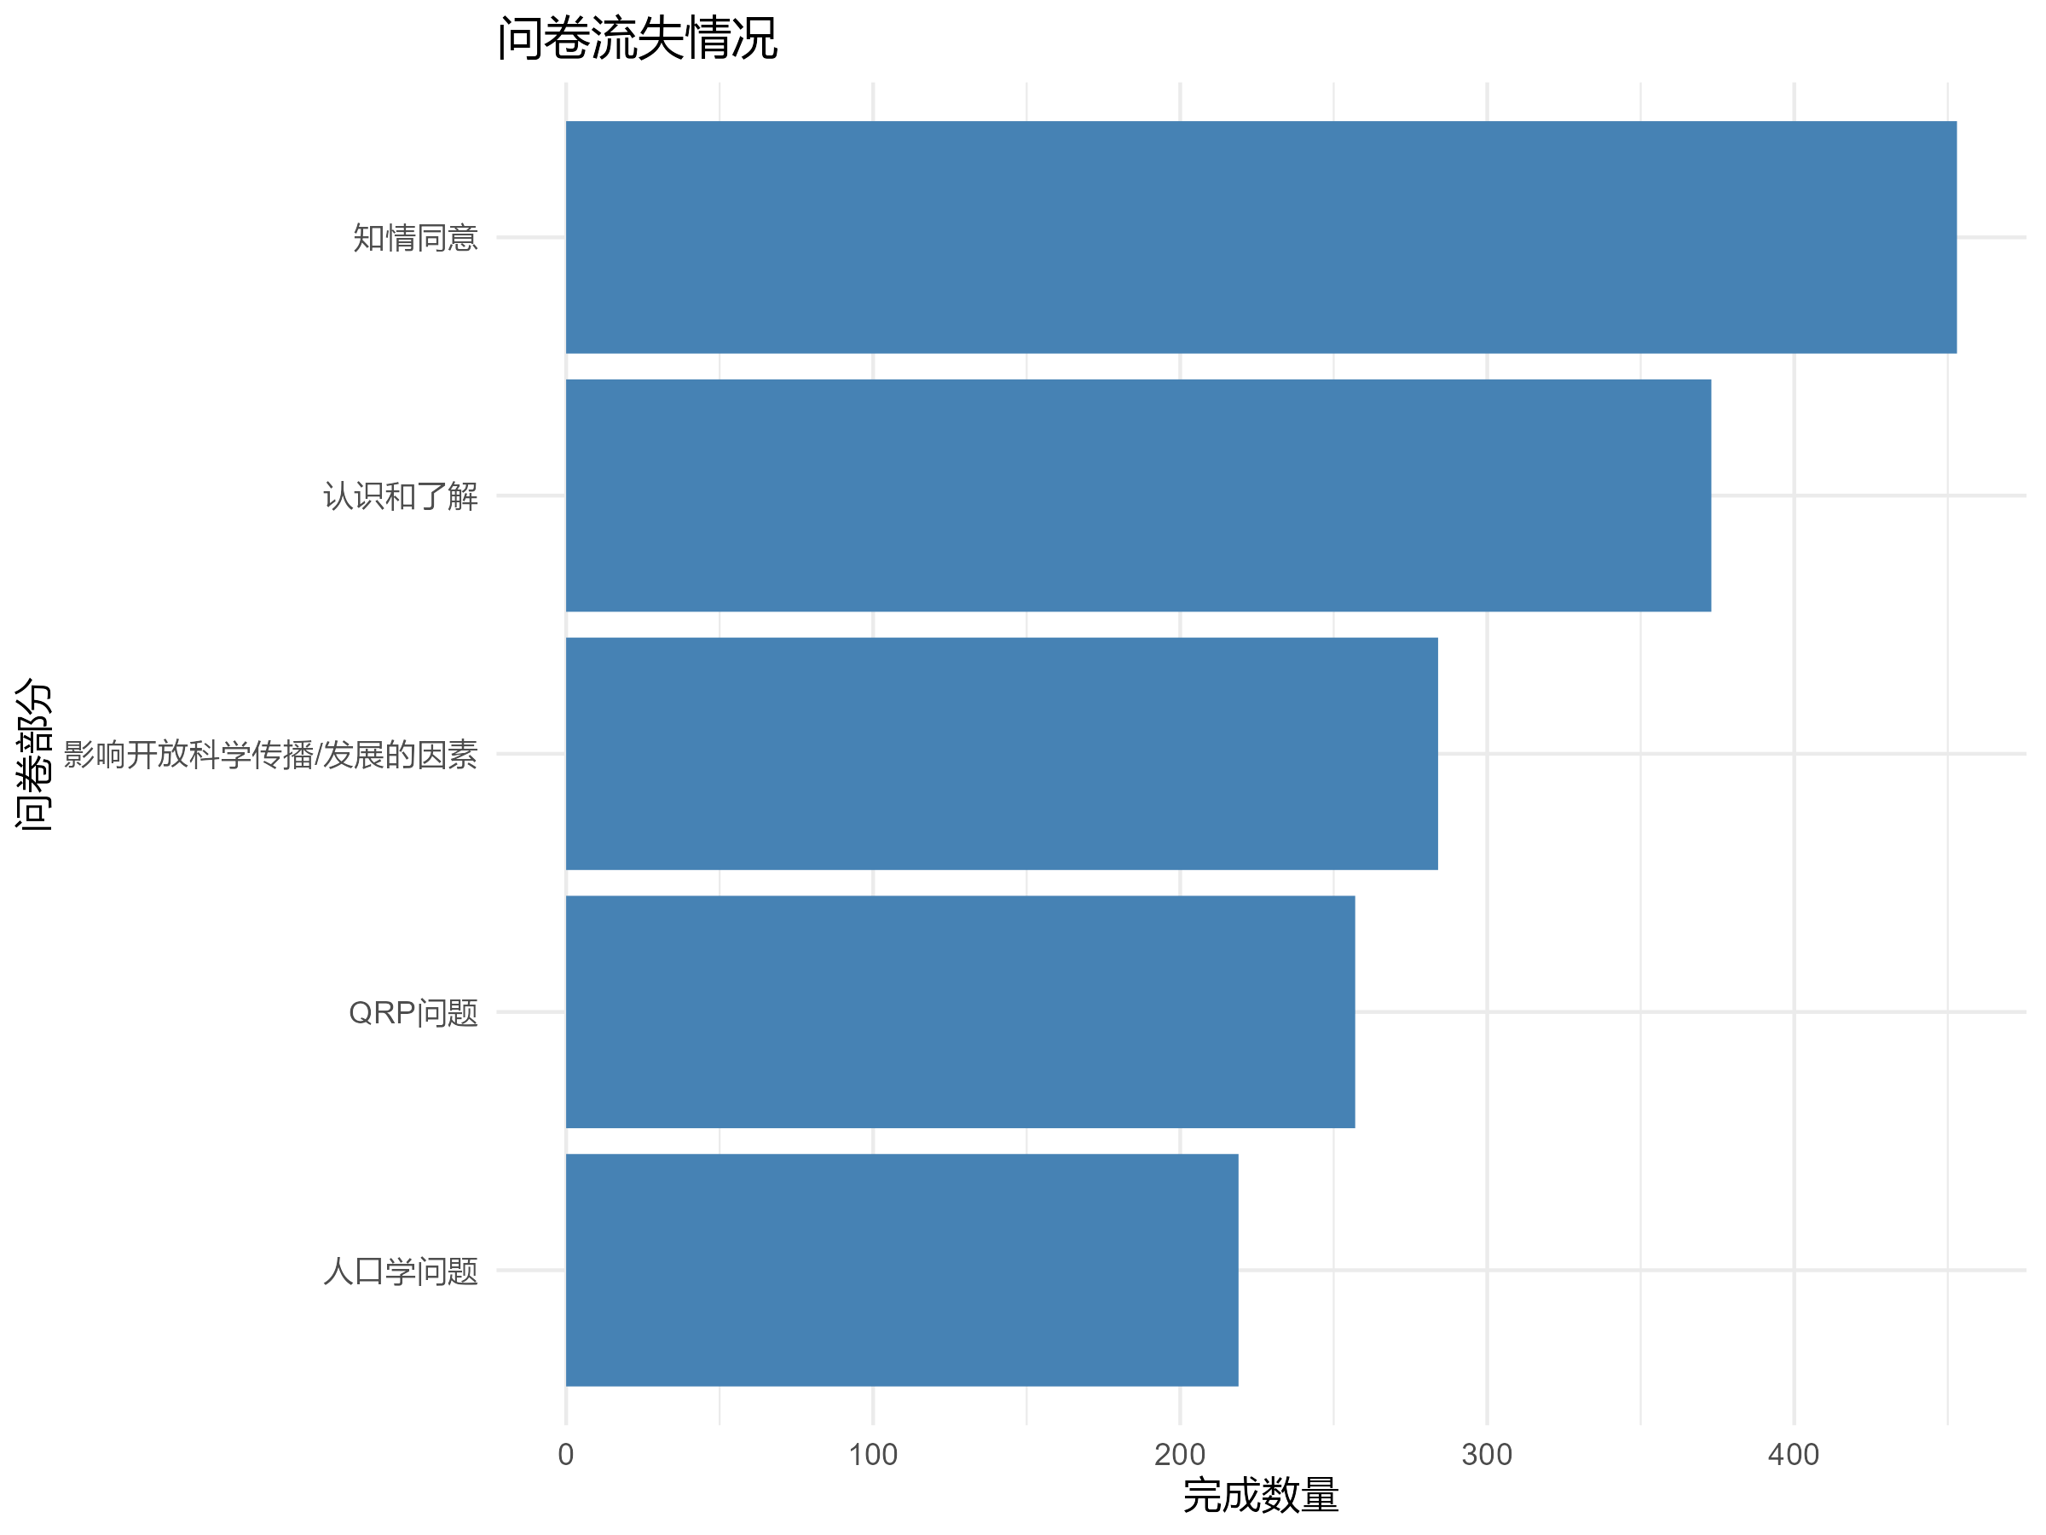
中国的问卷流失情况比较平滑
与事先预想的QRP部分会有大
量流失不同，在每个阶段都有
流失，尤其是做到一半的时候，
主要流失原因可能还是长度
The attrition of questionnaires in China
was relatively smooth, which differs from
the initial expectation that there would be
significant attrition in the QRP section.
Attrition occurred at every stage, especially
halfway through, and the main reason for
attrition is likely the length of the questionnaire.

Slide 9
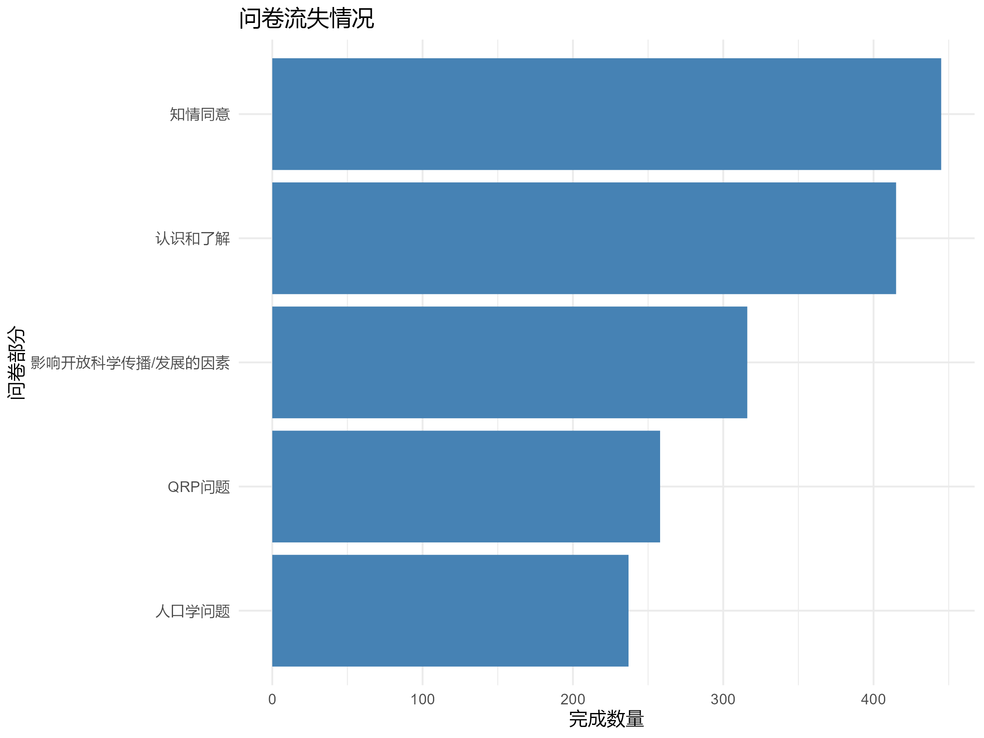
尼日利亚这边和中国的流失情况
类似，也是大约做到一半左右，
也就是开始做多选题的时候有很
多人退出。
The attrition situation in Nigeria is
similar to that in China, with many
people dropping out about halfway
through, which is when they start
answering multiple-choice questions.

Slide 10
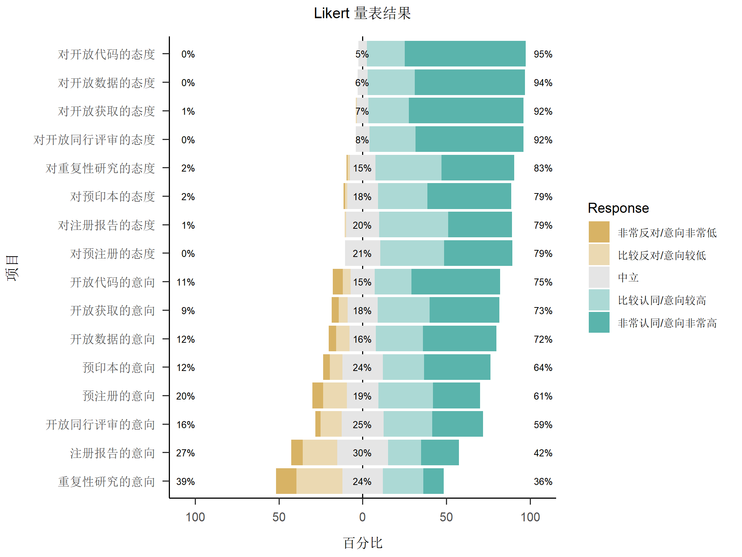

Slide 11
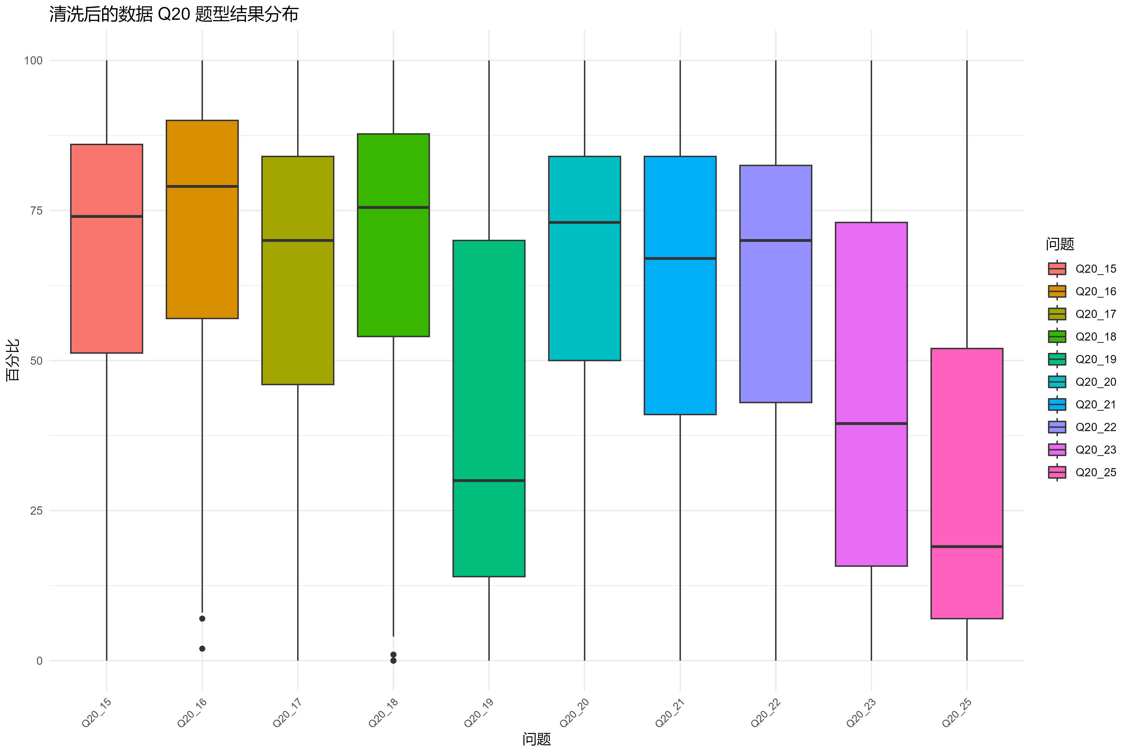
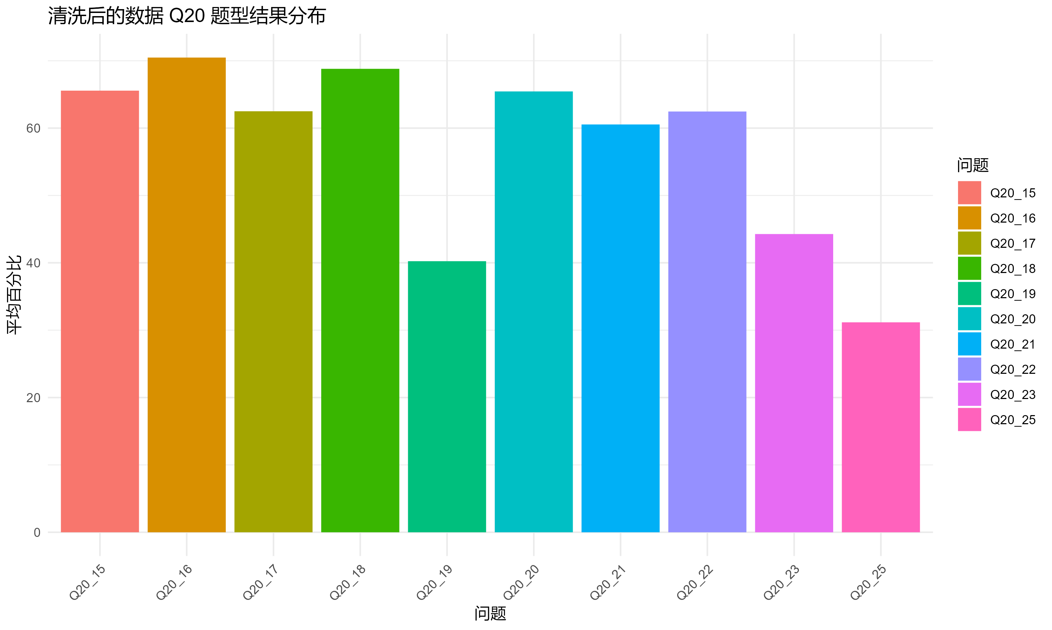

Slide 12
2. 需要讨论的问题

Slide 13
1.关于扩大发放问卷——学科上是否要避开心理学做一些平衡；是否要改
变题目顺序或缩减题目；按10%的响应率和30%的有效率来看还需要发多
少问卷。
2.关于数据分析——中国和尼日利亚的数据是分开讨论还是整合在一起讨
论，这涉及主题问题，我们是以中国为主题还是以发展中国家为主题
因为后需要写出来投稿所以在数据分析之前我们需要明确要解决的问题
3.关于交接
Regarding the distribution of questionnaires: Should we avoid psychology
in the discipline to maintain balance? Should we change the order of questions
or reduce the number of questions? Given a 10% response rate and a 30% validity
rate, how many questionnaires do we need to distribute?
Regarding data analysis: Should the data from China and Nigeria be discussed
separately or integrated together? This involves the thematic issue of whether
our theme is focused on China or on developing countries.
Regarding handover

