Slide 1

Senior Design Project Review
Multi-Modal Deep Learning for Parkinson’s
Detection
SDP ID: 20250854
Presented By:
Name of the Student(s) with Regd. No.:
Tanguturi Venkata Thanuj (22BCE20003)
Katam Krishna Chaitanya (22BCE7359)
Pathakuntla Narendar Reddy (22BCE7707)
SCOPE
VIT-AP University,
Amravati, India
1

Slide 2
Presentation Outline
Introduction
Project Overview and Problem Statement
Motivations
Background & Related Work/ Literature Review
Existing Solutions / Literature Survey
Gaps Identified / Improvements Over Existing Solutions
Project Objectives
Proposed Solution
System Architecture /Workflow Diagram /Model Diagram /Block Diagram/UML diagrams
Key Components/Features/Modules
Algorithms Used/Technologies, Frameworks, and Tools Used
Simulation and Results
Summary ( Findings, Limitations, Future Directions )
References
2

Slide 3
Introduction
Project Overview
Parkinson’s Disease (PD) is a progressive neurodegenerative disorder where significant neuronal damage occurs before visible symptoms appear, making early detection essential. This project proposes a multimodal deep learning framework that combines handwriting and speech biomarkers for non-invasive PD screening. Using EfficientNet-B0, XLS-R 300M, and a novel Cross-Modal Attention Fusion Network (CMAFN), the system achieves 96.94% accuracy and 0.9995 AUC-ROC, while supporting real-time clinical screening through a Flask-based web application.
Problem Statement
Traditional Parkinson’s Disease diagnosis depends on subjective clinical assessments such as UPDRS and expensive neuroimaging techniques like DaTSCAN, which are costly, clinician-dependent, and often detect the disease only at later stages. Therefore, there is a strong need for an automated, low-cost, and non-invasive screening system that can identify early Parkinson’s biomarkers from simple handwriting drawings and short speech recordings.
3

Slide 4
Introduction
Motivations
Need for Early Detection Parkinson’s Disease symptoms appear only after significant neuronal damage, making early diagnosis essential for timely treatment and disease management.
Limitations of Traditional Diagnosis Current methods such as UPDRS and DaTSCAN are expensive, subjective, clinician-dependent, and often detect PD at later stages.
Non-Invasive and Accessible Screening Handwriting and speech biomarkers can be captured using simple consumer devices, enabling low-cost and scalable PD screening.
Complementary Biomarkers Handwriting reflects motor impairments, while speech captures vocal abnormalities, and combining both provides more reliable diagnostic information.
Advancements in Deep Learning and Multimodal Fusion Modern AI techniques such as EfficientNet, XLS-R, and cross-modal attention enable accurate learning of complex neurological patterns, improving PD detection performance.
4

Slide 5
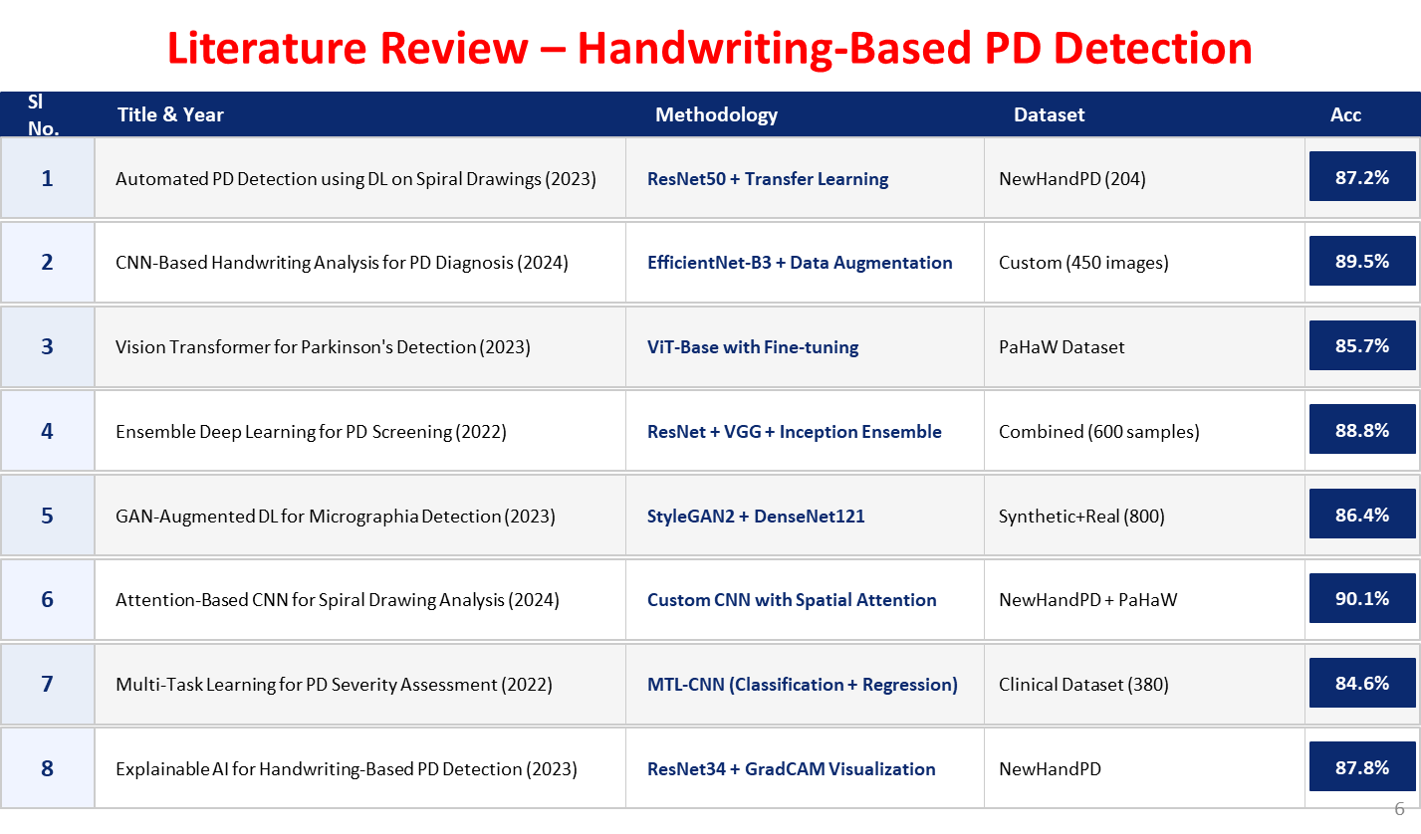
5

Slide 6
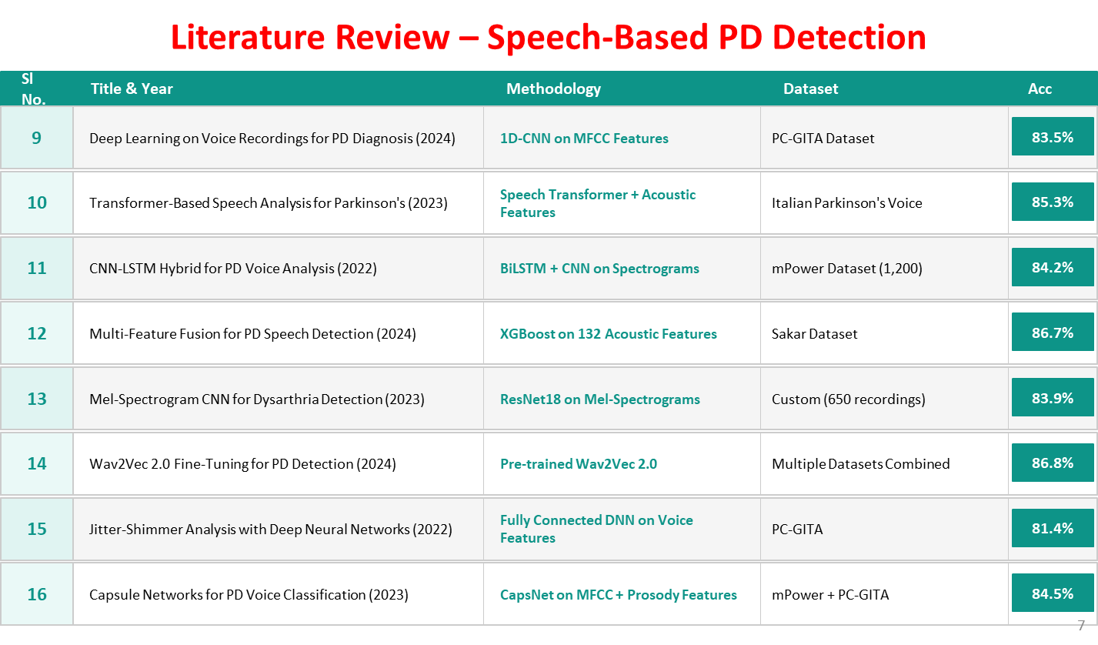
6

Slide 7
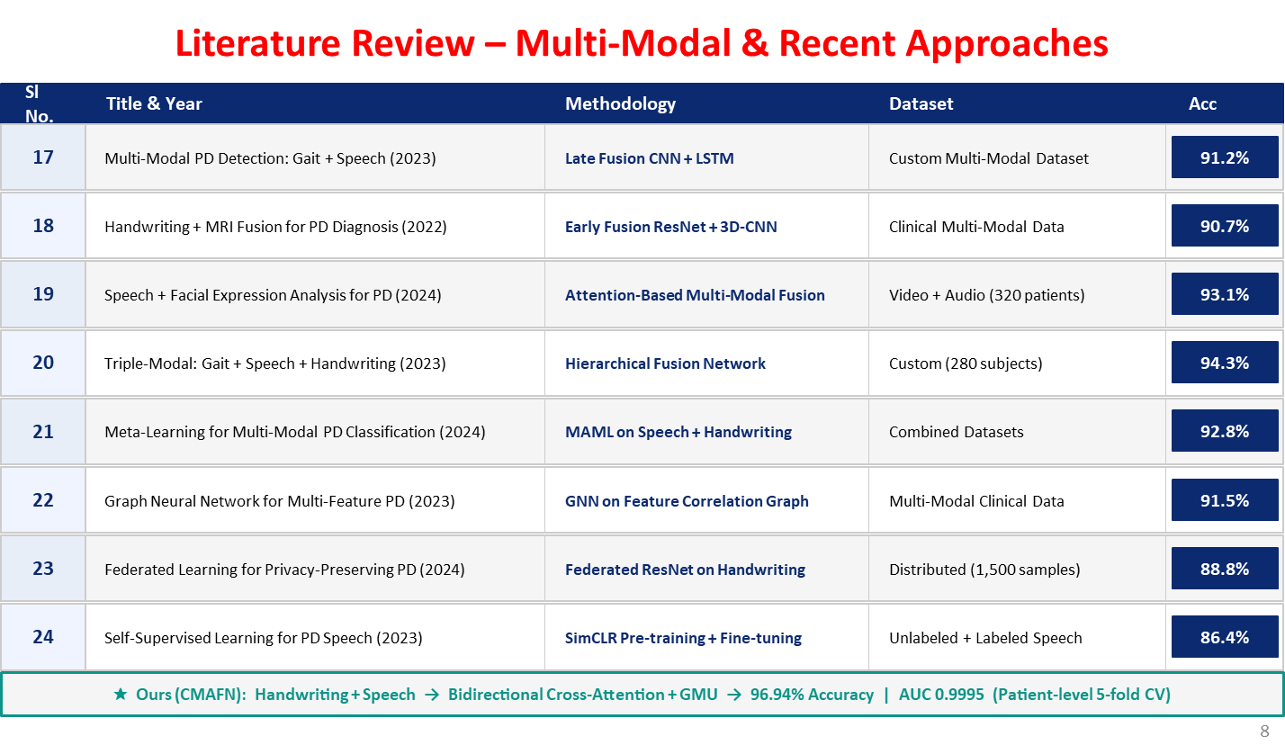
7

Slide 8
Background & Related Work / Literature Review
Gaps Identified / Improvements over Existing Solutions
Existing Gaps / Limitations | Proposed Solution in This Work
Existing systems rely on only handwriting or speech individually, limiting diagnostic performance. | Proposed a multimodal framework combining handwriting and speech biomarkers for improved PD detection.
Most fusion methods use simple concatenation or late fusion without learning cross-modal relationships. | Introduced Cross-Modal Attention Fusion Network (CMAFN) using bidirectional Transformer cross-attention and GMU.
Limited use of attention mechanisms reduces focus on clinically important patterns. | Integrated CBAM, Multi-Head Attention, and Gated Multimodal Units for enhanced feature learning.
Existing studies suffer from overfitting and data leakage due to improper validation strategies. | Applied patient-level stratified 5-fold cross-validation to ensure reliable and unbiased evaluation.
Many models require GPU-based inference and are difficult to deploy in real-time environments. | Developed a lightweight Flask-based system capable of real-time CPU inference (< 3 seconds).
Unimodal systems achieve comparatively lower accuracy and robustness. | Achieved 96.94% accuracy and 0.9995 AUC-ROC using multimodal cross-modal fusion.
8

Slide 9
Project Objectives
Develop a handwriting analysis module using 16 clinical biomarkers and deep learning techniques.
Build a multi-path speech analysis system using XLS-R, MFCC, Mel-Spectrogram CNN, and acoustic features.
Design a Cross-Modal Attention Fusion Network (CMAFN) for integrating handwriting and speech modalities.
Apply patient-level stratified 5-fold cross-validation to ensure reliable and unbiased evaluation.
Implement anti-overfitting strategies such as dropout, label smoothing, and modality regularization.
Deploy the framework as a real-time Flask web application for non-invasive PD screening.
Achieve high diagnostic accuracy and robust multimodal Parkinson’s Disease detection performance.
9

Slide 10
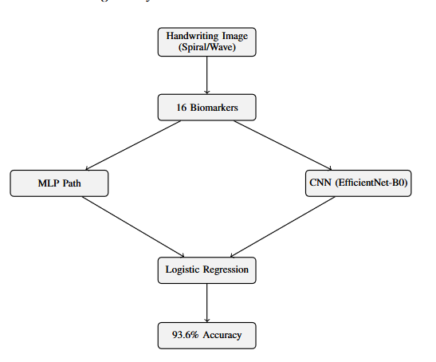
Proposed Solution
Handwriting Analysis Module Architecture
Input handwritten spiral and wave images are preprocessed and resized to 224×224 resolution.
OpenCV-based image processing techniques are used to extract 16 clinically relevant handwriting biomarkers.
Extracted biomarkers include stroke width, contour roughness, entropy, curvature statistics, fractal dimension, and Hu moments.
The architecture uses a dual-pathway learning framework for robust feature extraction.
The first pathway uses a Residual MLP model trained on engineered biomarker features.
The second pathway uses EfficientNet-B0 with CBAM attention to learn deep visual handwriting patterns.
Outputs from both pathways are combined using Logistic Regression meta-stacking for final prediction.
The proposed handwriting module achieves 93.6% accuracy with 0.985 AUC-ROC performance.
10

Slide 11
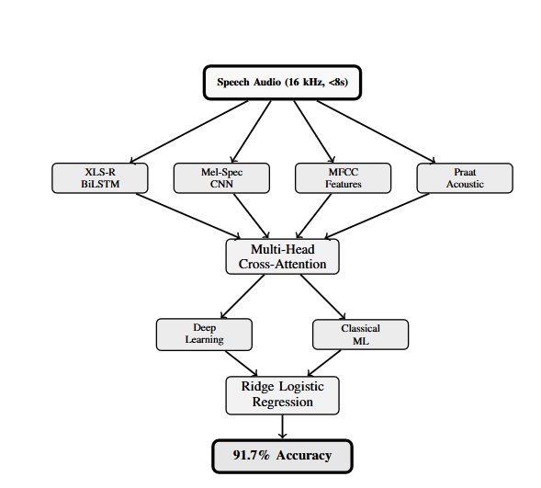
Proposed Solution
Speech Analysis Module Architecture
Input speech audio recordings are standardized to 16 kHz with a maximum duration of 8 seconds.
The architecture uses a multi-pathway speech processing framework for extracting complementary vocal biomarkers.
11

Slide 12
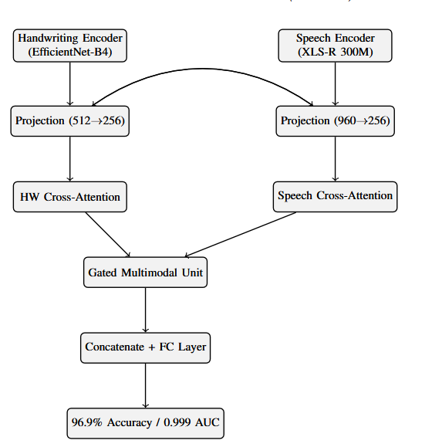
Proposed Solution
Speech Analysis Module Architecture
12

Slide 13
Proposed Solution
Key Components / Features / Modules
13

Slide 14
Proposed Solution
Algorithms / Technologies, Frameworks, and Tools Used
14

Slide 15
Simulation and Results
Dataset Descriptions / Input – Output Descriptions
15

Slide 16
Simulation and Results
Parameters Descriptions (if any) / Initial Conditions
16

Slide 17
Simulation and Results
Implementation Outcomes ( Tables / Figures / User Interface Snaps)
17

Slide 18
Summary
Key Findings
Limitations
Future Directions
18

Slide 19
References
In APA format

Slide 20

20

