Slide 1

Senior Design Project Review
Parkinson’s Detection Using Handwriting and Speech
SDP ID: 20250854
Presented By:
Name of the Student(s) with Regd. No.:
Tanguturi Venkata Thanuj (22BCE20003)
Katam Krishna Chaitanya (22BCE7359)
Pathakuntla Narendar Reddy (22BCE7707)
SCOPE
VIT-AP University,
Amravati, India
1

Slide 2
Presentation Outline
Introduction
Project Overview and Problem Statement
Motivations
Background & Related Work/ Literature Review
Existing Solutions / Literature Survey
Gaps Identified / Improvements Over Existing Solutions
Project Objectives
Proposed Solution
System Architecture /Workflow Diagram /Model Diagram /Block Diagram/UML diagrams
Key Components/Features/Modules
Algorithms Used/Technologies, Frameworks, and Tools Used
Simulation and Results
Summary ( Findings, Limitations, Future Directions )
References
2

Slide 3
Introduction
Project Overview
Parkinson’s Disease (PD) is a progressive neurodegenerative disorder where significant neuronal damage occurs before visible symptoms appear, making early detection essential. This project proposes a multimodal deep learning framework that combines handwriting and speech biomarkers for non-invasive PD screening. Using EfficientNet-B0, XLS-R 300M, and a novel Cross-Modal Attention Fusion Network (CMAFN), the system achieves 96.94% accuracy and 0.9995 AUC-ROC, while supporting real-time clinical screening through a Flask-based web application.
Problem Statement
Traditional Parkinson’s Disease diagnosis depends on subjective clinical assessments such as UPDRS and expensive neuroimaging techniques like DaTSCAN, which are costly, clinician-dependent, and often detect the disease only at later stages. Therefore, there is a strong need for an automated, low-cost, and non-invasive screening system that can identify early Parkinson’s biomarkers from simple handwriting drawings and short speech recordings.
3

Slide 4
Introduction
Motivations
Need for Early Detection Parkinson’s Disease symptoms appear only after significant neuronal damage, making early diagnosis essential for timely treatment and disease management.
Limitations of Traditional Diagnosis Current methods such as UPDRS and DaTSCAN are expensive, subjective, clinician-dependent, and often detect PD at later stages.
Non-Invasive and Accessible Screening Handwriting and speech biomarkers can be captured using simple consumer devices, enabling low-cost and scalable PD screening.
Complementary Biomarkers Handwriting reflects motor impairments, while speech captures vocal abnormalities, and combining both provides more reliable diagnostic information.
Advancements in Deep Learning and Multimodal Fusion Modern AI techniques such as EfficientNet, XLS-R, and cross-modal attention enable accurate learning of complex neurological patterns, improving PD detection performance.
4

Slide 5
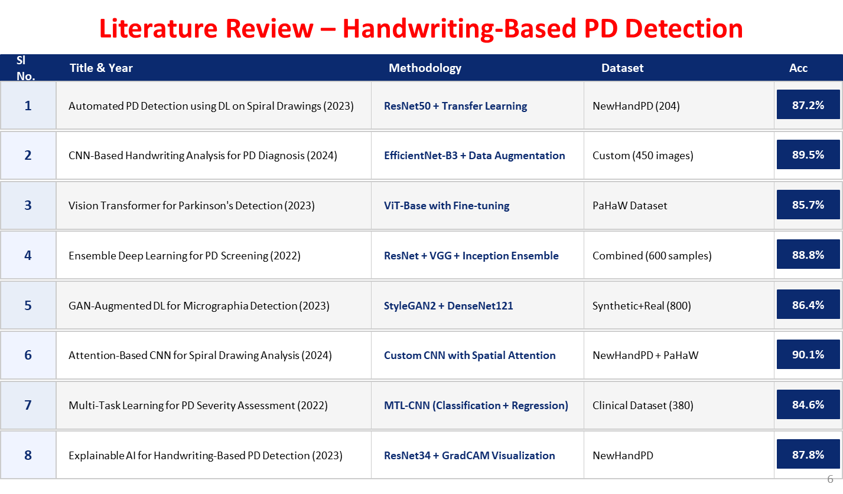
5

Slide 6
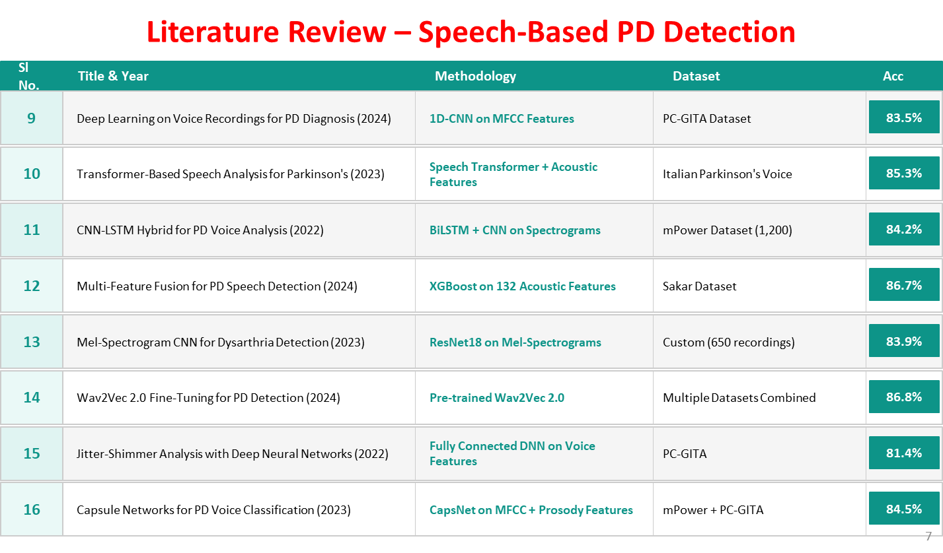
6

Slide 7
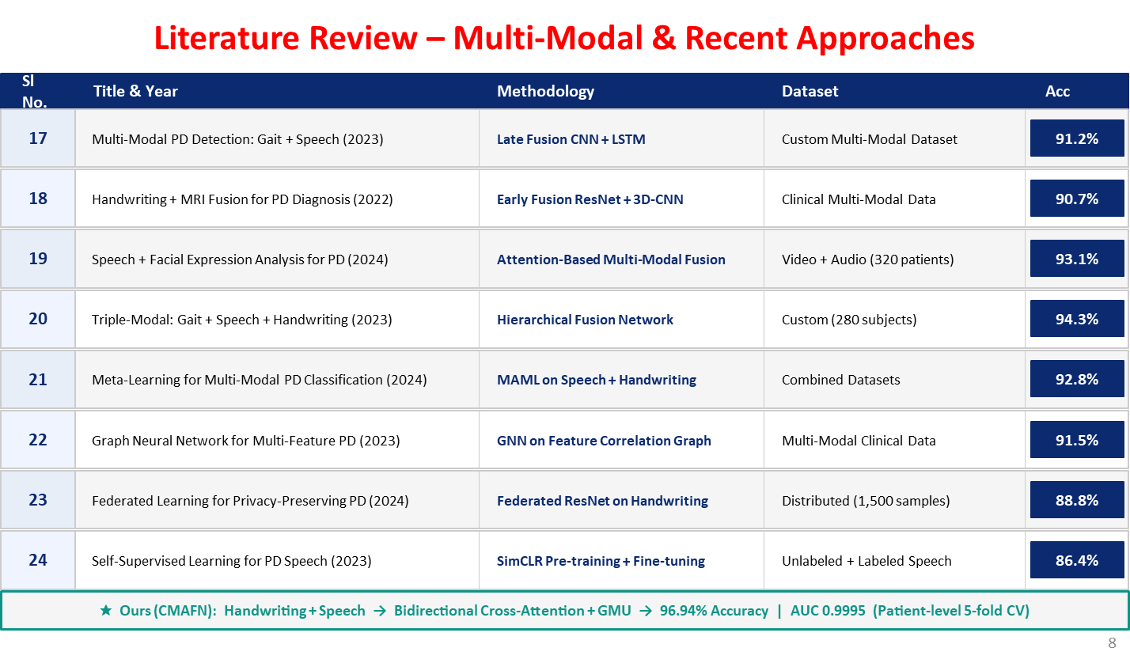
7

Slide 8
Background & Related Work / Literature Review
Gaps Identified / Improvements over Existing Solutions
Existing Gaps / Limitations | Proposed Solution in This Work
Existing systems rely on only handwriting or speech individually, limiting diagnostic performance. | Proposed a multimodal framework combining handwriting and speech biomarkers for improved PD detection.
Most fusion methods use simple concatenation or late fusion without learning cross-modal relationships. | Introduced Cross-Modal Attention Fusion Network (CMAFN) using bidirectional Transformer cross-attention and GMU.
Limited use of attention mechanisms reduces focus on clinically important patterns. | Integrated CBAM, Multi-Head Attention, and Gated Multimodal Units for enhanced feature learning.
Existing studies suffer from overfitting and data leakage due to improper validation strategies. | Applied patient-level stratified 5-fold cross-validation to ensure reliable and unbiased evaluation.
Many models require GPU-based inference and are difficult to deploy in real-time environments. | Developed a lightweight Flask-based system capable of real-time CPU inference (< 3 seconds).
Unimodal systems achieve comparatively lower accuracy and robustness. | Achieved 96.94% accuracy and 0.9995 AUC-ROC using multimodal cross-modal fusion.
8

Slide 9
Project Objectives
Develop a handwriting analysis module using 16 clinical biomarkers and deep learning techniques.
Build a multi-path speech analysis system using XLS-R, MFCC, Mel-Spectrogram CNN, and acoustic features.
Design a Cross-Modal Attention Fusion Network (CMAFN) for integrating handwriting and speech modalities.
Apply patient-level stratified 5-fold cross-validation to ensure reliable and unbiased evaluation.
Implement anti-overfitting strategies such as dropout, label smoothing, and modality regularization.
Deploy the framework as a real-time Flask web application for non-invasive PD screening.
Achieve high diagnostic accuracy and robust multimodal Parkinson’s Disease detection performance.
9

Slide 10
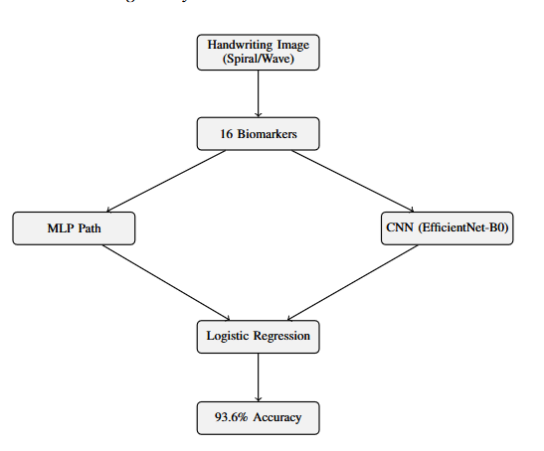
Proposed Solution
Handwriting Analysis Module Architecture
Input handwritten spiral and wave images are preprocessed and resized to 224×224 resolution.
OpenCV-based image processing techniques are used to extract 16 clinically relevant handwriting biomarkers.
Extracted biomarkers include stroke width, contour roughness, entropy, curvature statistics, fractal dimension, and Hu moments.
The architecture uses a dual-pathway learning framework for robust feature extraction.
The first pathway uses a Residual MLP model trained on engineered biomarker features.
The second pathway uses EfficientNet-B0 with CBAM attention to learn deep visual handwriting patterns.
Outputs from both pathways are combined using Logistic Regression meta-stacking for final prediction.
The proposed handwriting module achieves 93.6% accuracy with 0.985 AUC-ROC performance.
10

Slide 11
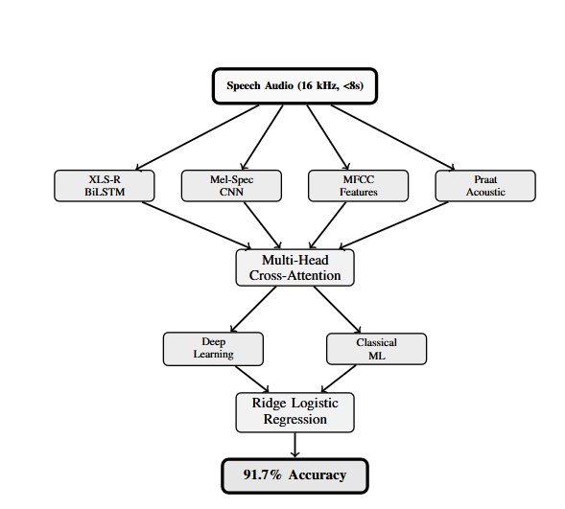
Proposed Solution
Speech Analysis Module Architecture
Input speech audio recordings are standardized to 16 kHz with a maximum duration of 8 seconds.
The architecture uses a multi-pathway speech processing framework for extracting complementary vocal biomarkers.
The first pathway uses XLS-R 300M with BiLSTM to capture self-supervised speech representations and temporal dependencies.
The second pathway uses a Mel-Spectrogram CNN to learn spectral and time-frequency speech patterns.
The third pathway extracts MFCC and delta coefficients to capture vocal tract and acoustic characteristics.
The fourth pathway uses Praat-based acoustic features such as jitter, shimmer, HNR, pitch, and formants.
Features from all pathways are integrated using Multi-Head Cross-Attention for effective multimodal speech feature fusion.
The fused features are processed through both Deep Learning and Classical Machine Learning ensemble models.
Ridge Logistic Regression is used as the stacking meta-learner for final prediction.
The proposed speech module achieves 91.7% accuracy with 0.971 AUC-ROC performance.
11

Slide 12
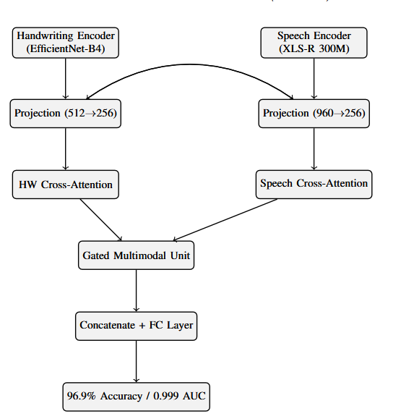
Proposed Solution
Cross-Modal Attention Fusion Network (CMAFN) Architecture
The fusion framework integrates handwriting and speech modalities for multimodal Parkinson’s Disease detection.
Handwriting inputs consist of spiral and wave images processed through the handwriting analysis module with 16 clinical biomarkers.
Speech inputs consist of short audio recordings processed through the speech analysis module using XLS-R, MFCC, and acoustic features.
Features extracted from both modalities are encoded into high-dimensional representations for multimodal learning.
A bidirectional Cross-Modal Attention mechanism is used to learn interactions between handwriting and speech biomarkers.
Transformer-based attention enables the model to capture complementary motor and vocal impairment patterns effectively.
A Gated Multimodal Unit (GMU) dynamically controls the contribution of each modality during fusion.
The fused multimodal representation is passed through classification layers for Parkinson’s Disease risk prediction.
The system provides PD risk categorization such as LOW, MODERATE, and HIGH for clinical decision support.
The proposed CMAFN model achieves 96.94% accuracy with 0.9995 AUC-ROC, outperforming unimodal approaches.
12

Slide 13
Proposed Solution
Key Components / Features / Modules
Handwriting Analysis Module – Extracts 16 handwriting biomarkers using OpenCV and deep learning.
Speech Analysis Module – Processes speech using XLS-R, MFCC, Mel-Spectrogram CNN, and acoustic features.
CMAFN Fusion Module – Integrates handwriting and speech using cross-modal attention and GMU.
Attention Mechanisms – Uses CBAM and Multi-Head Attention for enhanced feature learning.
Feature Engineering – Extracts spatial, spectral, and acoustic Parkinson’s biomarkers.
Deep Learning + ML Ensemble – Combines CNN, BiLSTM, Transformer, and classical ML models.
Patient-Level Validation – Uses stratified 5-fold cross-validation to avoid data leakage.
Real-Time Web Application – Flask-based system for non-invasive PD screening and risk prediction.
13

Slide 14
Proposed Solution
Algorithms / Technologies, Frameworks, and Tools Used
Category | Technologies / Algorithms / Tools Used
Deep Learning Models | EfficientNet-B0, XLS-R 300M, BiLSTM, Transformer Attention
Attention Mechanisms | CBAM, Multi-Head Cross-Attention, Gated Multimodal Unit (GMU)
Machine Learning Models | Logistic Regression, Random Forest, SVM, XGBoost, LightGBM
Feature Extraction | MFCC, Mel-Spectrogram, Praat Acoustic Features, OpenCV Biomarkers
Image Processing | OpenCV, Otsu Thresholding, Morphological Operations
Audio Processing | Librosa, Praat, NumPy
Frameworks | PyTorch, Scikit-learn, Flask
Validation Techniques | Stratified 5-Fold Cross-Validation, PCA, SMOTE
Deployment Tools | Flask, Gunicorn, Render
Development Tools | Python, Jupyter Notebook, VS Code
14

Slide 15
Simulation and Results
Dataset Descriptions / Input – Output Descriptions
Component | Description
Handwriting Dataset | NewHandPD and PaHaW datasets containing spiral and wave handwriting images.
Handwriting Samples | 3,264 handwriting images collected from 65 participants.
Speech Dataset | Italian Parkinson’s Voice and Speech dataset from IEEE DataPort.
Speech Samples | 831 audio recordings collected from 61 participants.
Image Input | Spiral and wave images resized to 224×224 resolution.
Audio Input | Speech recordings standardized to 16 kHz with duration less than 8 seconds.
Handwriting Features | Stroke width, contour roughness, entropy, curvature, fractal dimension, Hu moments, and other biomarkers.
Speech Features | XLS-R embeddings, MFCC, Mel-Spectrogram, jitter, shimmer, HNR, pitch, and formants.
System Output | Parkinson’s Disease prediction with PD risk categories: LOW, MODERATE, and HIGH.
Evaluation Strategy | Patient-level stratified 5-fold cross-validation to avoid data leakage.
15

Slide 16
Simulation and Results
Parameters Descriptions (if any) / Initial Conditions
Parameter / Initial Condition | Description
Image Resolution | Handwriting images resized to 224 × 224 pixels
Audio Sampling Rate | 16 kHz standardized speech audio
Maximum Audio Length | Less than 8 seconds
Number of Handwriting Biomarkers | 16 spatial clinical features
MFCC Features | 40 MFCC coefficients with delta features
Mel-Spectrogram Size | 128 Mel frequency bins
XLS-R Model | facebook/wav2vec2-xls-r-300m
Cross-Validation | Patient-level stratified 5-fold CV
Dropout Rate | Up to 0.6 for overfitting reduction
PCA Dimension Reduction | 2247 → 512 dimensions
Attention Mechanisms | CBAM and Multi-Head Cross-Attention
Optimization Techniques | AdamW optimizer, Label Smoothing, Early Stopping
Inference Environment | CPU-based real-time inference
Final Output | PD Risk Prediction: LOW / MODERATE / HIGH
16

Slide 17
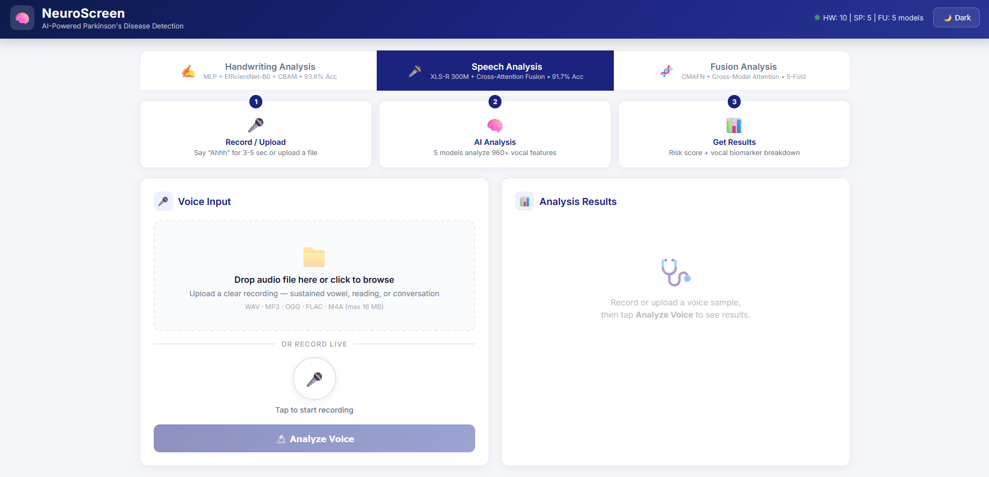
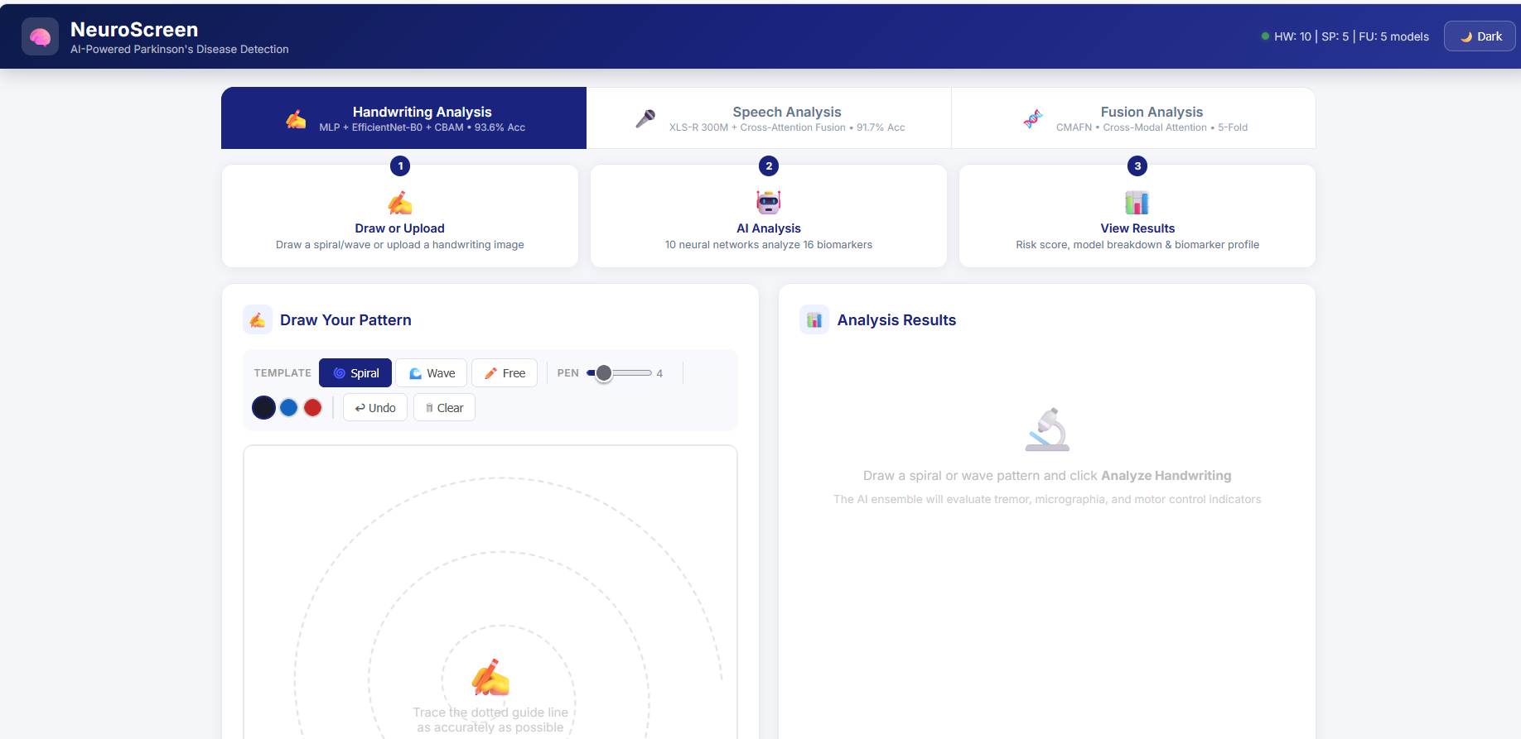
Simulation and Results
Implementation Outcomes ( Tables / Figures / User Interface Snaps)
17

Slide 18
Summary
Key Findings
The proposed multimodal framework successfully combines handwriting and speech biomarkers for Parkinson’s Disease detection.
Cross-Modal Attention Fusion Network (CMAFN) achieved 96.94% accuracy with 0.9995 AUC-ROC.
Multimodal fusion significantly outperformed unimodal handwriting and speech models.
The system supports real-time, non-invasive, and CPU-efficient clinical screening.
Limitations
The current system performs only binary classification (PD vs Healthy Control).
Model performance depends on the quality of handwriting images and speech recordings.
Speech dataset is primarily based on Italian voice recordings, limiting language generalization.
Limited dataset diversity may affect large-scale real-world deployment.
Future Directions
Extend the framework for Parkinson’s Disease severity prediction and progression monitoring.
Integrate additional biomarkers such as gait analysis and facial expression recognition.
Improve cross-language and cross-dataset generalization capabilities.
Develop lightweight mobile and telemedicine-based deployment solutions.
18

Slide 19
References
Zhao, A., Liu, Y., Yu, X., & Xing, X. (2025). Artificial intelligence-enabled detection and assessment of Parkinson's disease using multimodal data: A survey. arXiv. https://arxiv.org/abs/2502.10703 (arXiv)
Huang, W., Xu, Y., Zhou, Y., Li, Z., Huang, J., & Pang, M. (2025). A multimodal in vitro diagnostic method for Parkinson's disease combining facial expressions and behavioral gait data. arXiv. https://arxiv.org/abs/2506.17596 (arXiv)
Miah, A. S. M., Suzuki, T., & Shin, J. (2025). A methodological and structural review of Parkinsons disease detection across diverse data modalities. arXiv. https://arxiv.org/abs/2505.00525 (arXiv)
Islam, M. S., Adnan, T., Freyberg, J., Lee, S., Abdelkader, A., Pawlik, M., Schwartz, C., Jaffe, K., Schneider, R. B., Dorsey, E. R., & Hoque, E. (2024). Accessible, at-home detection of Parkinson's disease via multi-task video analysis. arXiv. https://arxiv.org/abs/2406.14856 (arXiv)
Tan, M., & Le, Q. V. (2019). EfficientNet: Rethinking model scaling for convolutional neural networks. Proceedings of the 36th International Conference on Machine Learning, 6105–6114.
Baevski, A., Zhou, H., Mohamed, A., & Auli, M. (2020). wav2vec 2.0: A framework for self-supervised learning of speech representations. Advances in Neural Information Processing Systems, 33, 12449–12460.
Woo, S., Park, J., Lee, J. Y., & Kweon, I. S. (2018). CBAM: Convolutional block attention module. Proceedings of the European Conference on Computer Vision (ECCV), 3–19.
Vasquez-Correa, J. C., Arias-Vergara, T., Orozco-Arroyave, J. R., Eskofier, B. M., & Noth, E. (2019). Multimodal assessment of Parkinson’s disease: A deep learning approach. IEEE Journal of Biomedical and Health Informatics, 23(4), 1618–1630.
Orozco-Arroyave, J. R., Hönig, F., Arias-Londoño, J. D., Vargas-Bonilla, J. F., Daqrouq, K., Skodda, S., Rusz, J., & Nöth, E. (2016). Automatic detection of Parkinson’s disease in running speech spoken in three different languages. The Journal of the Acoustical Society of America, 139(1), 481–500.
Pereira, C. R., Pereira, D. R., Silva, F. A., Hook, C., Weber, S. A., & Papa, J. P. (2018). A step towards the automated diagnosis of Parkinson’s disease: Analyzing handwriting movements. Expert Systems with Applications, 58, 171–179.

Slide 20

20

