Slide 1




SalesMail AI
AI-Powered Personalized Email Generation System

Slide 2



Problem Statement
Sales teams manually write individual emails for thousands of customers — a slow, repetitive process
Generic, one-size-fits-all emails have poor open and conversion rates
No easy way to combine customer purchase history, behavior, and spending patterns into personalized outreach
Teams have no visibility into which customers to prioritize or what tone/type of email to send.

Slide 3



Project Overview
Browse and search real retail customers from merged transaction data
Auto-generate an AI Intelligence Card for any selected customer (value tier, opportunity, recommended email type & tone)
Generate fully personalized emails in one click — single or bulk
Send emails directly to customer inboxes via SMTP (live sending)
Export bulk drafts to JSON for CRM integration
Upload any custom CSV — system switches to new data instantly
Works 100% offline with DEMO_MODE (zero LLM calls, rule-based fallback)

Slide 4
Tech Stack
Layer | Technology
Frontend | React 19 + Vite + Tailwind CSS
Backend API | FastAPI (Python)
AI / LLM | Gemini 2.5 Flash Lite
Data Processing | Pandas
Caching | Python in-memory dictionary
Email Delivery | Python smtplib (SMTP)

Slide 5
System Architecture
[React Frontend]
↓
[FastAPI Backend]
↓ ↓
[Customer] [LLM Service]
Service ↓
(FastMcp) [Generated Email]
↓ ↓
[CSV Data] [SMTP → Inbox]
React frontend handles user actions and sends requests to backend
FastAPI backend controls logic and manages all operations
Customer data is processed using Pandas before sending to AI
LLM generates personalized emails using selected customer data
SMTP service sends emails securely to customer inboxes

Slide 6
Sample Dataset
Customer Dataset
99,457 retail customers from CSV
Example:
customer_id, age, category, total_orders, email
C0011381, 20, Clothing, 1, user@gmail.com
Users can upload their own CSV
Default dataset remains unchanged

Slide 7
Customer Segmentation
Segment | Rule | Color
High Value | Spend ≥ 10,000 | Purple
Recent Buyer | Purchase within 14 days | Blue
Active | Purchase within 30 days | Green
Inactive | No purchase for 60+ days | Red

Slide 8
AI Customer Intelligence
Flow:
User selects customer
API call → /customers/{id}/summary
AI generates insights
Fields:
Value Tier
Summary
Sales Opportunity
Email Type
Tone
“Apply AI Suggestions” auto-fills email settings

Slide 9
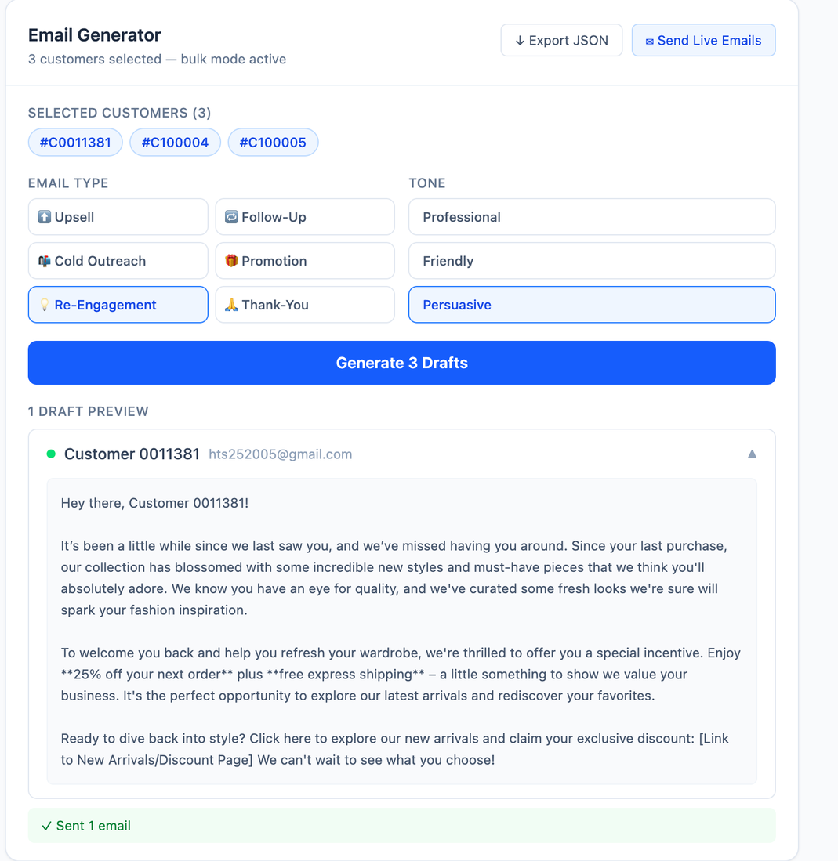
Email Generation
Email Engine
6 Types: Upsell, Follow-Up, Cold Outreach, Promotion, Re-engagement, Thank You
3 Tones: Professional, Friendly, Persuasive
Prompt:
Write a [type] email. Tone: [tone].
Customer: [name], [age], [category].
Output only email body.
Only selected data sent to AI
Secure + optimized

Slide 10
Caching & Fallback
Layer 1 — In-Memory Cache
Cache key: (customer_id, email_type, tone)
Repeat request returns instantly with zero LLM cost
Separate summary cache keyed by customer_id
Layer 2 — Rule-Based Fallback
On LLM failure (quota/network/key), rule-based template runs automatically
Dynamic fill from customer attributes
User still receives valid output
Layer 3 — Demo Mode
DEMO_MODE=true bypasses all LLM calls
App works fully offline for demos/testing

Slide 11
Frontend
Customer List (Left Panel)
Search by name, email, or customer ID
Filters: category, segment, min/max spend
Combined filter logic handled in one backend search query
Checkbox multi-select for bulk mode
Pagination: 50 customers per page
Email Composer (Right Panel)
Controls for email type and tone
AI suggestions auto-fill using “Apply AI Suggestions”
Single Mode: select customer → generate email
Bulk Mode: multi-select → generate all → collapsible previews
Options to copy, export JSON, and send live emails
Intelligence Panel
Loads automatically when a customer is selected
Displays AI or Rule-based source badge

Slide 12
Live Email Sending
Live Email Delivery via SMTP
Flow
User reviews generated draft(s)
Clicks Send
Frontend sends drafts to /send-email/ (aliases supported)
Backend opens SMTP connection using starttls()
Sends each draft to customer inbox
Response Includes
Sent count
Failed count
Error details for failed addresses
Compatibility
Works with Gmail, Outlook, or any standard SMTP server
SMTP Configuration (.env)
SMTP_HOST=smtp.gmail.com
SMTP_PORT=587
SMTP_USER=yourmail@gmail.com
SMTP_PASS=your_app_password
SMTP_FROM=yourmail@gmail.com

Slide 13
API Endpoints
Method | Endpoint | Purpose
GET | /customers/ | List customers
GET | /customers/search/ | Filter/search
GET | /customers/{id}/summary | AI insights
POST | /generate-email/ | Single email
POST | /generate-email/bulk/ | Bulk emails
POST | /send-email/ | Send emails
POST | /upload-csv/ | Upload dataset
10

Slide 14
Results & Future Scope
What was achieved:
End-to-end GenAI workflow: selection -> intelligence -> generation -> delivery
99,457 customers searchable/filterable quickly
Live SMTP delivery working
Robust fallback path without API keys
Caching removes repeat LLM calls
Key learnings:
Prompt engineering for structured + creative outputs
Multi-provider abstraction with one SDK style
FastAPI + React integration in production-like flow
In-memory caching for latency/cost optimization
Future scope:
Open-rate tracking and A/B testing
Scheduled delivery optimization
HTML-branded templates
Extended agentic workflows using MCP scaffold

Slide 15

Thank You

