Slide 1
Craft Demo (Amazon ETL Pipeline)

Slide 2
About me
I am a Data Engineer with over 6 years of experience in designing, developing, and optimizing data pipelines for batch and streaming processes.
I am from Vijayawada, Andhra Pradesh
Been solving a lot of data problems in the InsureTech Space
Currently working as a Data Engineer in MetLife Insurance
Expertise: Python, SQL, Spark, Data Modelling, AWS, GCP, Azure

Slide 3
Key Challenges and Impact I Worked
Cut operational costs by 15% through optimised ETL processes, including improvements in selecting the right spark configs, compression algorithms, hashing algorithms for deduplication, handling database locks via isolations, alerting, monitoring, and short circuit techniques.
I developed an IoT-based analytics platform on AWS, handling data ingestion, analysis, and visualization. The platform provides valuable insights into industrial machines and reduces the need for over 30 on-site workers. Throughout the project, I took on multiple roles including data engineer, data analyst, infrastructure and platform engineer.

Slide 4
Case Study
You are assigned the task of designing the backend ETL pipeline and data warehouse for large e-commerce players
like Amazon Shopping App. Here you are required to store all the information about products, brands, categories,
sub-categories, sellers, customers, orders, sales, shipping and delivery. The solution should include the tech stack
for batch processing where the source of the data is product OLTP system.
The backend data warehouse should be able to solve for the following business scenarios:
1. Provide the Product Organisations about the growth/depreciation trends and categorise the products by sales quantities Month over Month
2. Study Seller Behaviour and Statistics (both at individual and demographic level) to categorise them into high, medium and low buckets based on quality of service (consider sales, returns & refunds)
3. Study Consumer Behaviour and Statistics (both at individual and demographic level) to categorise them into high, medium and low buckets based on quality (consider buy, return & refund), spends (consider sales transaction amount) and frequency (consider transaction counts)

Slide 5
Assumptions
• Data Consistency: Source database (PostgreSQL RDS) maintains ACID compliance, and microservices provide clean, timely data.
• DMS Configuration: AWS DMS correctly captures CDC changes and streams them without interruptions.
• Source Data Quality: Source data schema remains stable, without aggressive schema drifts.
• AWS Infrastructure: High availability and reliability of AWS services (DMS, Glue, Redshift, S3, etc.).
• Redshift Performance: Cluster auto-scaling handles ETL load, and query performance is optimized.
• IAM Roles: Permissions are correctly configured for secure inter-service communication.
• Network Stability: No network latency or connectivity issues between AWS services.
• Scalability: Assumed data growth is manageable, and architecture can scale horizontally.
• Visualization Compatibility: QuickSight is fully compatible with the Redshift data structure.

Slide 6
Data MODEL for OLTP
• Objective: Capture transactional data for a large-scale e-commerce platform.
• Key Tables:
• Products: Tracks product details, stock levels, pricing.
• Sellers: Contains seller information, licenses, and demographic segments.
• Orders & Order_Items: Separates orders and individual product details for flexible reporting.
• Customers: Stores customer profiles, including prime membership status.
• Payments: Links orders to payment methods and amounts.
• Returns: Manages product return information and refunds.
• Shipping & Delivery: Tracks order shipments, delivery statuses, and carrier info.
• Relationships:
• Foreign keys ensure data integrity between products, orders, sellers, and customers.
• Designed for high scalability, supporting millions of transactions with minimal redundancy.
• Rationale:
• Structured to enable efficient queries and transformations for reporting and analytics.
• Optimized for CDC ingestion to capture incremental changes in real-time.

Slide 7
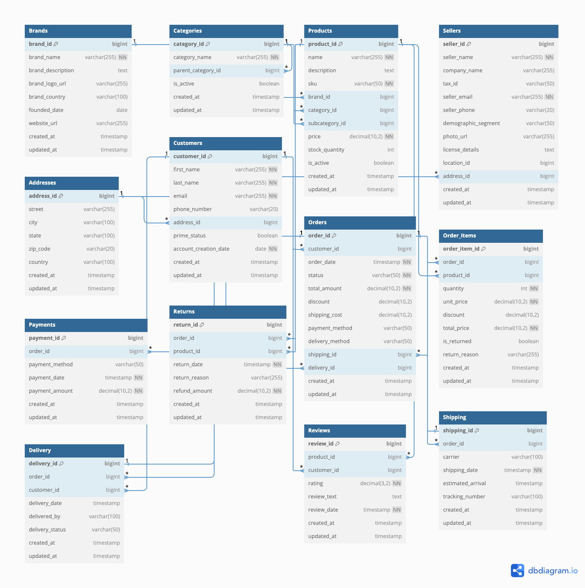

Slide 8
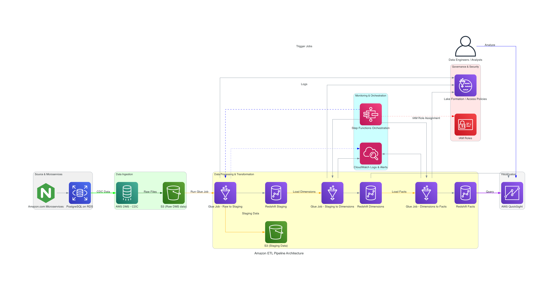
ARChitecture overview

Slide 9
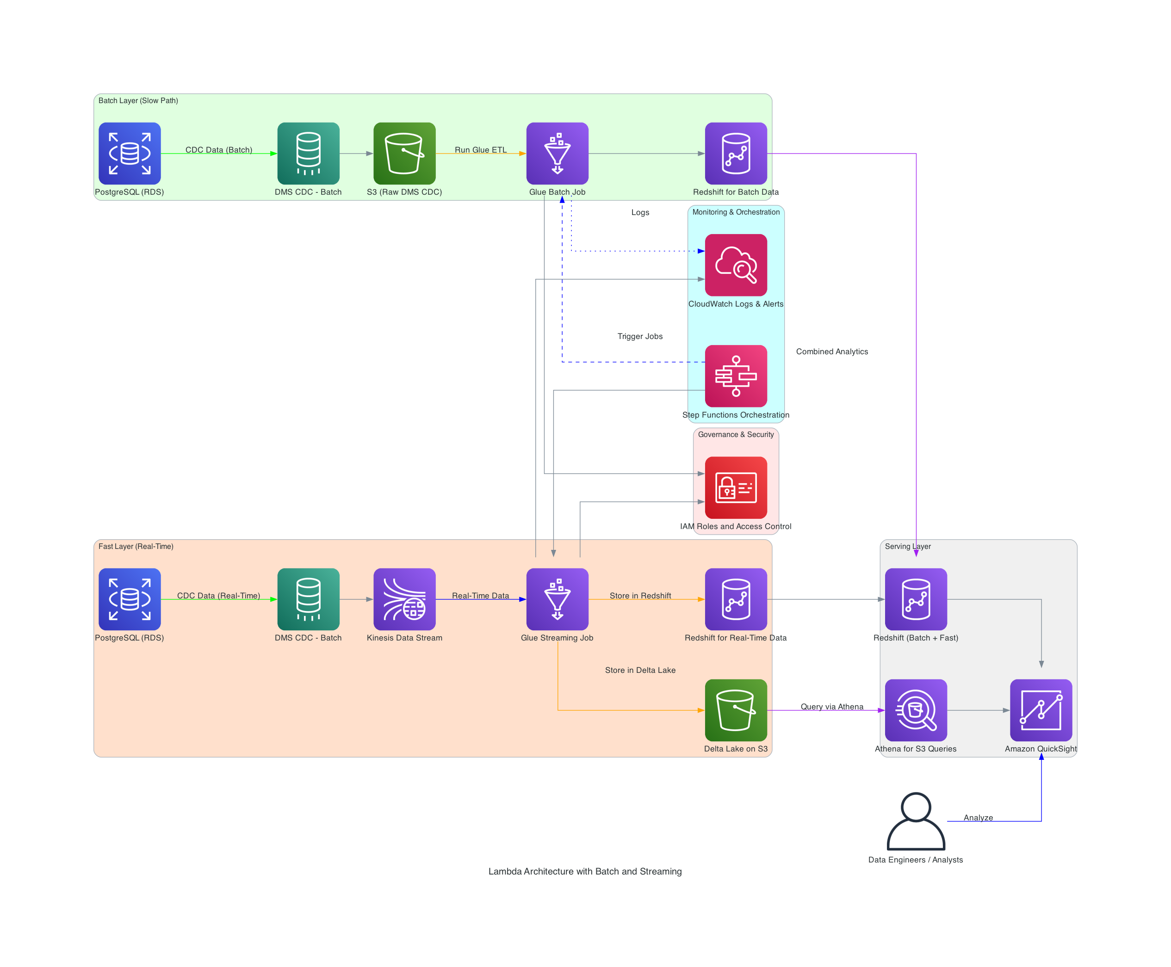
LAMBDA
ARCHITECTURE

Slide 10
INGESTION
• Approach: Change Data Capture (CDC) to extract real-time incremental changes from the OLTP database.
• Tools & Tech Stack:
• Amazon DMS: Captures changes from PostgreSQL (OLTP) via Write-Ahead Logs (WAL).
• Amazon S3: Used as a raw layer for raw CDC data.
• Why CDC?:
• Real-Time Updates: Captures only changes (inserts, updates, deletes) for efficient data movement.
• Minimizes DB Overhead: CDC uses transaction logs (WAL), avoiding direct database queries and reducing lock contention.
• Scalable: Optimized for high-frequency data changes at Amazon scale without full table scans.
References: https://www.dataengineeringweekly.com/p/evaluating-change-data-capture-tools

Slide 11
Best Practices & Design Decisions for Ingestion
• Initial Full Load:
• Will Utilize DMS for the first full load, capturing historical data into S3 before transforming and loading into
Redshift with Glue.
• Post Full-Load:
• Switch to CDC for real-time updates, pushing changes to S3 before loading into Redshift.
• Key Design Choices:
1. S3 as Staging: Ensures decoupling of ingestion from transformation and scalable data storage.
2. Data Partitioning: Partition S3 data (database/schema/table) for optimized querying and cost control.
3. Schema Evolution: Use Glue Data Catalog to handle schema changes automatically.
4. High Availability: Multi-AZ DMS replication and S3 redundancy for fault tolerance.
5. Data Consistency: DMS checkpointing and Redshift MERGE statements to ensure accuracy.
6. Security: Encrypt data in S3 and enforce IAM role-based access.
7. Scalability: Ensure DMS and Redshift can scale as data volumes grow, with efficient CDC batching windows.
8. Error Handling: CloudWatch alarms and retries ensure smooth operation in case of failures.

Slide 12
Transform Section Overview
• Config-Driven Architecture: Flexible and scalable ETL pipeline driven by configuration files.
• Data Quality & Transformations: Applied at multiple stages using Spark SQL and DataFrame API.
• Preactions & Redshift Load: Truncate staging tables before load using preactions.
• Error Handling: Retry mechanism with exponential backoff for fault tolerance.
• Data Quality: Null checks, valid date checks, range checks, applied via SQL or DataFrame API.
• Transformations: Enrichment, formatting, derived columns handled using SQL and DataFrame API.
• Config-Driven Rules: Defined in JSON for flexibility, supports different rules for each table.
• Truncate & Load: Uses preactions to truncate tables before load.
• DIST,SORT Keys, Compression, Encoding: Optimized for query performance based on data access patterns.
• S3 Temp Directory: Leveraged for efficient data transfer to Redshift.
• Retry Mechanism: Retries up to 3 times with exponential backoff in case of failure.
• CloudWatch Monitoring: Logs and alerts set up for real-time error tracking and troubleshooting.
• Auto Scaling: Glue and Redshift both auto-scale to handle data at Amazon scale.

Slide 13
Security and best practices
• IAM Roles: Follows least-privilege principle, securing access to S3, Redshift, and Glue.
• Encryption: Data encrypted at rest (S3, Redshift) with server-side encryption.
• S3 Lifecycle Policies: Automated archival and deletion of raw DMS files after processing.
• Parallelism & Memory: Optimized Spark configurations to handle large data volumes efficiently.
• Partitioning & File Size: Parquet files partitioned by business keys, ideal size 128MB - 1GB.
• Redshift Query Optimization: Concurrency scaling and SORT/DIST key optimizations for fast queries.

Slide 14
LOAD SECTION OVERVIEW
• Transition from staging to dimensions and facts in Redshift.
• Two types of operations:
1. Append-only for Fact Tables
2. SCD Type 2 for Dimension Tables.
• Ensuring no data duplication during failure scenarios.
• Use of merge operations in Redshift for SCD Type 2 logic.
• Utilize SCD Type 2 to track historical changes in dimensions.
• Use Redshift’s MERGE statement for updates:
• Matched Rows (Update): Close the current record (is_current_record = False) and set the expiry date.
• Unmatched Rows (Insert): Insert new records with a start date and is_current_record = True.
• Handle CDC flags (I/U/D) from the staging layer.
• Fact tables are append-only:
• Load new transactions without updating existing records.
• Pre-actions ensure no duplicates in the case of job retries:
• Delete any partial records before reloading.
• Use of optimized sorting and distribution keys for query performance.

Slide 15
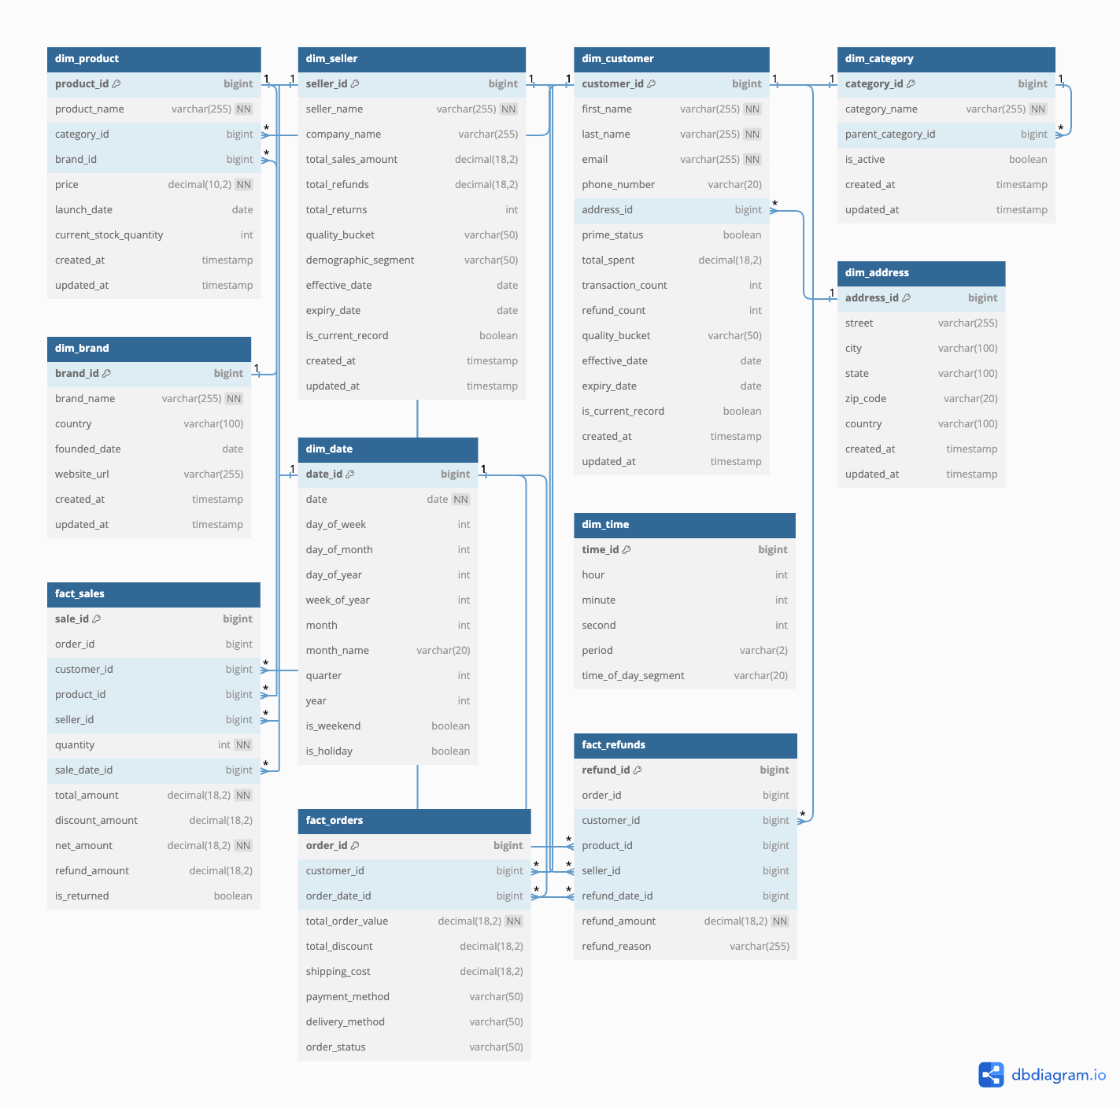

Slide 16
BEST PRACTICES
• Preactions/Postactions:
• Preactions: Truncate stage tables or clean up partial loads.
• Postactions: Maintain metadata (e.g., audit logs).
• Batching and Parallelism: Efficient batch processing and parallel writes to Redshift.
• Compression and Encoding: Use of ZSTD for optimal storage and performance.
• Error Handling and Idempotency: Ensure the load process can be restarted without data loss.
• Distribution Style: Used KEY for dimensions and EVEN for staging tables.
• Sort Keys: Optimized for common query patterns (e.g., date_id).
• Monitoring and Alerting: Use CloudWatch to monitor Glue jobs and Redshift queries.

Slide 17
MONITORING,ALERTING and ORCHESTRATION
• Monitoring the ETL pipeline using AWS CloudWatch.
• Alerting on job failures or anomalies using SNS and CloudWatch Alarms.
• Orchestration of the pipeline using AWS Step Functions or Apache Airflow.
• Track Glue job metrics: Execution time, job status, memory, and CPU usage.
• Custom Metrics: Set up custom CloudWatch metrics to monitor specific steps or data quality issues in the pipeline.
• Logs: Capture detailed logs from Glue jobs for debugging and performance analysis.
• CloudWatch Alarms: Set alarms for job failures, execution delays, or resource bottlenecks.
• SNS Notifications: Receive email/SMS alerts when jobs fail or performance issues arise.
• Automated Responses: Trigger automated Lambda functions to retry jobs or notify the operations team.
• Step-by-step orchestration: Orchestrate the ETL pipeline with defined steps and dependencies.
• Automatic retries: Configure automatic retries for job failures or errors.
• Parallel execution: Handle multiple workflows in parallel for high efficiency.
• Error handling: Define custom failure paths to handle errors gracefully.

Slide 18
Governance, Visualization, and Data Security Overview
• Governance starts with data lineage, which tracks data through its lifecycle from source to destination. We can easily track the origin of data, transformations applied, and how it is being consumed.
• Auditability is a key feature, ensuring that detailed logs and metadata are kept for auditing and compliance requirements.
• We have built-in data quality rules that run at each stage to ensure that invalid data doesn’t pass through the pipeline. This ensures the trustworthiness of the reports and insights generated.
• Version control of data ensures we can trace back to a specific version of the dataset, which is important for regulatory audits and resolving discrepancies.

Slide 19
Governance with AWS Lake Formation
• AWS Lake Formation enables us to enforce fine-grained access control, allowing role-based access to certain rows or columns based on the sensitivity of the data.
• Lake Formation also allows us to set tag-based access control to define security policies at the column and row level, ensuring compliance with privacy regulations like GDPR.
• Data masking helps protect sensitive information (e.g., PII) by only showing the required portions to authorized users.
• We maintain audit trails to track who accessed the data and what modifications were made, ensuring transparency and compliance.

Slide 20
Data Security in the ETL Pipeline
• Data security is a priority across the entire pipeline:
• Encryption at rest is enabled for all storage points, such as S3 and Redshift, using AWS KMS (Key Management Service).
• Encryption in transit ensures that all communication between services like Glue, S3, and Redshift is secure using TLS (Transport Layer Security).
• Role-based access control (RBAC) ensures that only authorized users can run jobs or access sensitive data.
• For fields that contain personally identifiable information (PII), we can implement column-level encryption, ensuring only authorized personnel can access sensitive data.

Slide 21
Visualization
• Amazon QuickSight provides an intuitive and scalable platform for building dynamic dashboards.
• We can build custom reports and interactive dashboards that allow users to drill down into specific metrics (e.g., sales by product category, refunds by seller).
• QuickSight supports real-time updates through auto-refresh, ensuring business users always have the latest data.
• We apply role-based access control to limit who can access certain reports or dashboards, ensuring data security at the visualization layer.

Slide 22
Automated Testing and Validation
• Unit testing ensures each transformation and rule applied to the data works as expected, catching any issues early.
• Integration tests validate the entire flow from ingestion to loading into the data warehouse.
• We have data validation rules to verify that all records meet quality standards before they are loaded into Redshift, preventing bad data from polluting reports.
• Schema validation ensures that any changes in the schema (e.g., new columns) are caught and addressed in the pipeline before they affect downstream analytics.

Slide 23
Scalability of the Data Pipeline
• Glue auto-scaling ensures that as the data volume grows, Glue jobs can scale dynamically, reducing operational overhead.
• Amazon Redshift offers the ability to scale compute resources independently from storage, optimizing both performance and cost.
• S3’s elastic storage capabilities allow it to handle the high volume of CDC data, while partitioning in both S3 and Redshift ensures that queries and processing are fast and efficient, even with massive datasets.

Slide 24
THANK YOU

