Slide 1
Craft Demo (Amazon ETL Pipeline)

Slide 2
About me
I am a Data Engineer with over 6 years of experience in designing, developing, and optimizing data pipelines for batch and streaming processes.
I am from Vijayawada, Andhra Pradesh
Been solving a lot of data problems in the InsureTech Space
Currently working as a Data Engineer in MetLife Insurance
Expertise: Python, SQL, Spark, Data Modelling, AWS, GCP, Azure

Slide 3
Key Challenges and Impact I Worked
Cut operational costs by 15% through optimised ETL processes, including improvements in selecting the right spark configs, compression algorithms, hashing algorithms for deduplication, handling database locks via isolations, alerting, monitoring, and short circuit techniques.
I developed an IoT-based analytics platform on AWS, handling data ingestion, analysis, and visualization. The platform provides valuable insights into industrial machines and reduces the need for over 30 on-site workers. Throughout the project, I took on multiple roles including data engineer, data analyst, infrastructure and platform engineer.

Slide 4
Case Study
You are assigned the task of designing the backend ETL pipeline and data warehouse for large e-commerce players
like Amazon Shopping App. Here you are required to store all the information about products, brands, categories,
sub-categories, sellers, customers, orders, sales, shipping and delivery. The solution should include the tech stack
for batch processing where the source of the data is product OLTP system.
The backend data warehouse should be able to solve for the following business scenarios:
1. Provide the Product Organisations about the growth/depreciation trends and categorise the products by sales quantities Month over Month
2. Study Seller Behaviour and Statistics (both at individual and demographic level) to categorise them into high, medium and low buckets based on quality of service (consider sales, returns & refunds)
3. Study Consumer Behaviour and Statistics (both at individual and demographic level) to categorise them into high, medium and low buckets based on quality (consider buy, return & refund), spends (consider sales transaction amount) and frequency (consider transaction counts)

Slide 5
Assumptions

Slide 6
Data MODEL for OLTP
• Objective: Capture transactional data for a large-scale e-commerce platform.
• Key Tables:
• Products: Tracks product details, stock levels, pricing.
• Sellers: Contains seller information, licenses, and demographic segments.
• Orders & Order_Items: Separates orders and individual product details for flexible reporting.
• Customers: Stores customer profiles, including prime membership status.
• Payments: Links orders to payment methods and amounts.
• Returns: Manages product return information and refunds.
• Shipping & Delivery: Tracks order shipments, delivery statuses, and carrier info.
• Relationships:
• Foreign keys ensure data integrity between products, orders, sellers, and customers.
• Designed for high scalability, supporting millions of transactions with minimal redundancy.
• Rationale:
• Structured to enable efficient queries and transformations for reporting and analytics.
• Optimized for CDC ingestion to capture incremental changes in real-time.

Slide 7
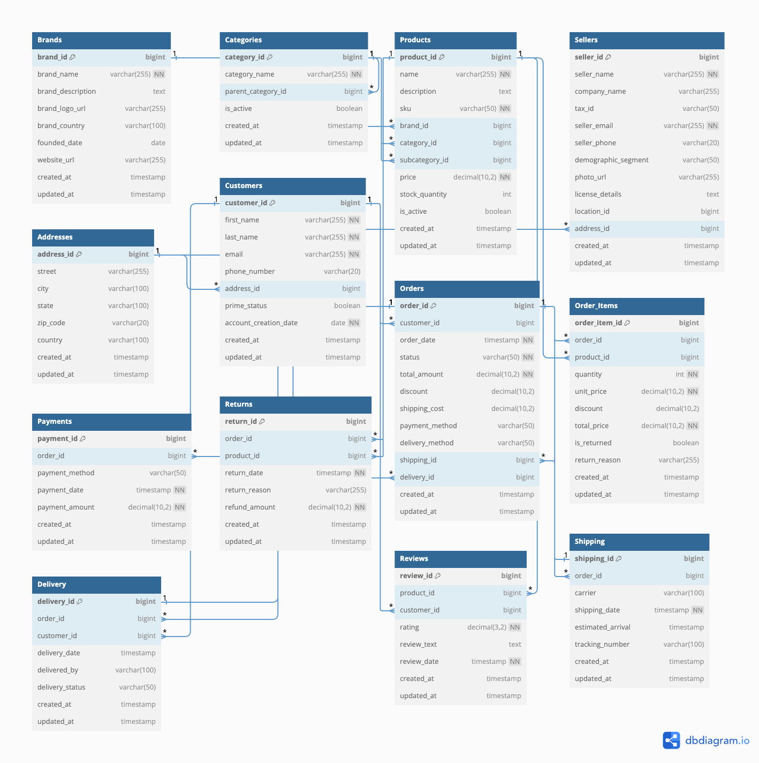

Slide 8
ARChitecture overview

Slide 9
INGESTION
• Approach: Change Data Capture (CDC) to extract real-time incremental changes from the OLTP database.
• Tools & Tech Stack:
• Amazon DMS: Captures changes from PostgreSQL (OLTP) via Write-Ahead Logs (WAL).
• Amazon S3: Used as a staging layer for raw CDC data.
• AWS Glue: Performs data transformations before loading into the data warehouse.
• Amazon Redshift: Final destination for processed data, enabling fast querying and analytics.
• Why CDC?:
• Real-Time Updates: Captures only changes (inserts, updates, deletes) for efficient data movement.
• Minimizes DB Overhead: CDC uses transaction logs, avoiding direct database queries and reducing lock contention.
• Scalable: Optimized for high-frequency data changes at Amazon scale without full table scans.
References: https://www.dataengineeringweekly.com/p/evaluating-change-data-capture-tools

Slide 10
Best Practices & Design Decisions for Ingestion
• Initial Full Load:
• Will Utilize DMS for the first full load, capturing historical data into S3 before transforming and loading into
Redshift with Glue.
• Post Full-Load:
• Switch to CDC for real-time updates, pushing changes to S3 before loading into Redshift.
• Key Design Choices:
1. S3 as Staging: Ensures decoupling of ingestion from transformation and scalable data storage.
2. Data Partitioning: Partition S3 data (daily/hourly) for optimized querying and cost control.
3. Schema Evolution: Use Glue Data Catalog to handle schema changes automatically.
4. High Availability: Multi-AZ DMS replication and S3 redundancy for fault tolerance.
5. Data Consistency: DMS checkpointing and Redshift MERGE statements to ensure accuracy.
6. Security: Encrypt data in S3 and enforce IAM role-based access.
7. Scalability: Ensure DMS and Redshift can scale as data volumes grow, with efficient CDC batching windows.
8. Error Handling: CloudWatch alarms and retries ensure smooth operation in case of failures.

Slide 11
Data Processing Stratergy
• Medallion Architecture:
• Bronze (S3): Stores raw data from DMS CDC.
• Silver (S3): Data quality checks, cleansing, and transformations using AWS Glue.
• Gold (Redshift): Final enriched data for analytics and reporting.
• Why Medallion?
• Traceability: Provides full data lineage and allows for reprocessing if needed.
• Separation of Concerns: Isolates raw, cleaned, and final data stages for better management.
• Optimized Performance: Query only from the Gold layer in Redshift for fast analytics.
• SCD Type 2:
• Selective Use: Implemented for critical dimensions (e.g., Customers, Products) to track historical changes.
• Why: Essential for historical data analysis and auditing, but avoided for non-critical dimensions to reduce overhead.

