Slide 1
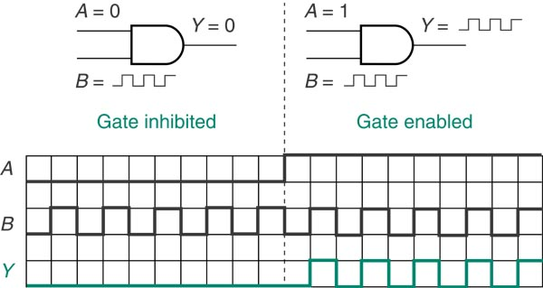
Logic Gate Inhibit
Control
Signal

Slide 2
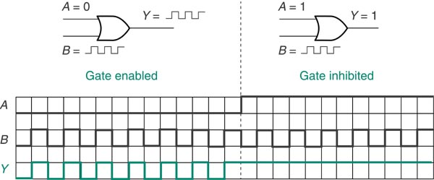
Logic Gate Inhibit
Control
Signal

Slide 3
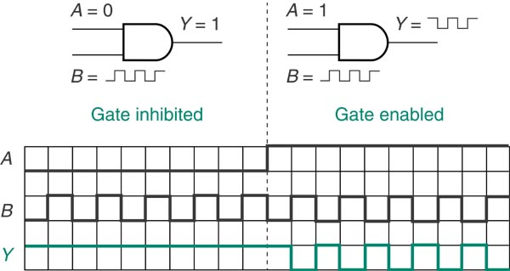
Logic Gate Inhibit
Control
Signal

Slide 4
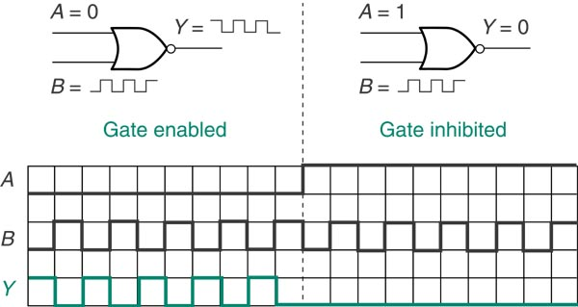
Logic Gate Inhibit
Control
Signal

Slide 5
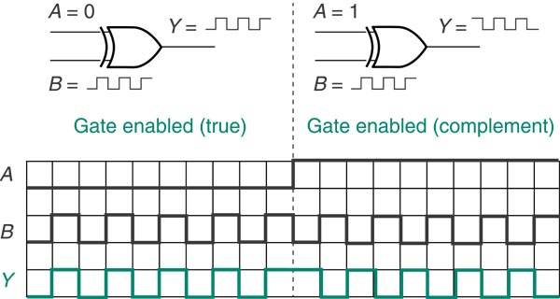
Logic Gate Inhibit
Control
Signal

Slide 6
Logic Gate Inhibit
Control | AND | OR | NAND | NOR | XOR | XNOR
A = 0 | Y = 0 | Y = B | Y = 1 |  | Y = B
A = 1 | Y = B | Y = 1 |  | Y = 0 |  | Y = B
Control A
Signal B
?
Y

Slide 7
Logic Switches
Provides a logic HIGH or LOW depending on switch position.
Commonly used types include normally-open pushbutton, normally-closed pushbutton, single-pole single-throw, and single-pole double-throw.
N.O. Pb
N.C. Pb
S-P S-T
S-P D-T

Slide 8
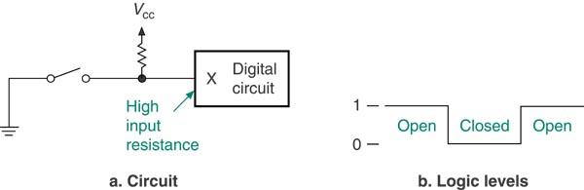
Logic Switches¹ (Active-HIGH)
OPEN → TRUE → ‘1’

Slide 9
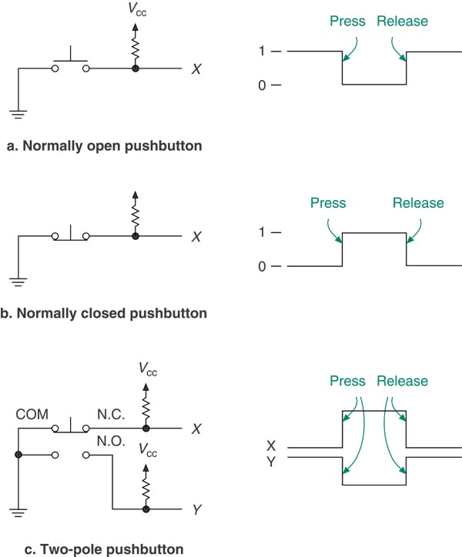
Logic Switches (Active-HIGH)
Shown in de-energized position
OPEN → TRUE → ‘1’

Slide 10
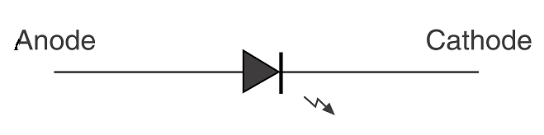
Light Emitting Diodes (LED’s)
Used to indicate the status of a digital output.
Has two terminals the anode and the cathode.
If the anode is approximately 1.5 V greater than the cathode, current flows and the LED illuminates.

Slide 11
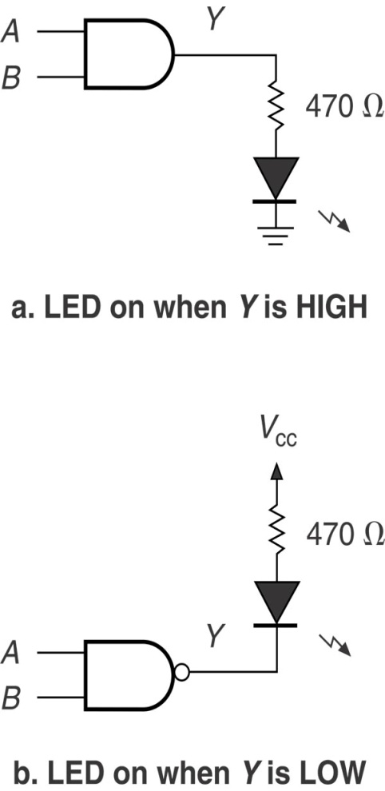
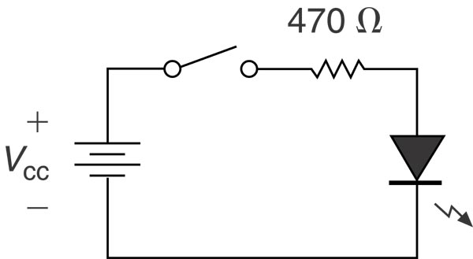
Light Emitting Diodes¹
Used to provide a visual indication of a logic state.
Can be wired to display active-HIGH or active-LOW.

Slide 12
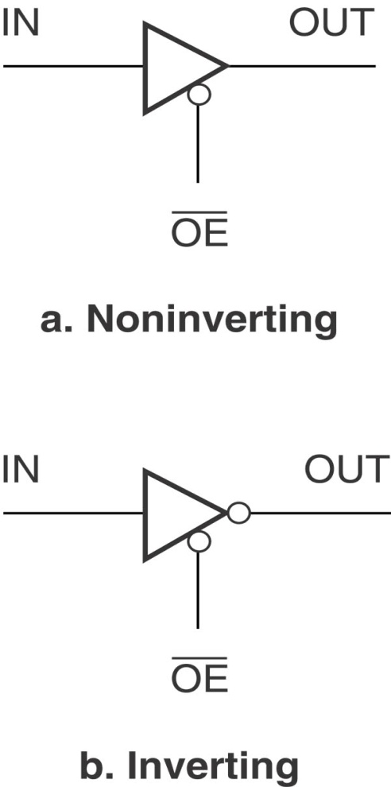
Tristate Buffer
Three output states, HIGH, LOW and high-impedance.
Requires a separate input to control which output state is selected.

Slide 13
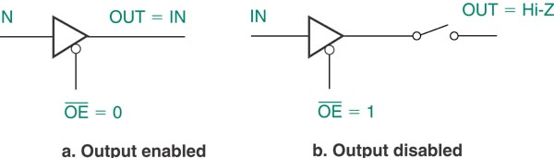
Tristate Buffer

Slide 14
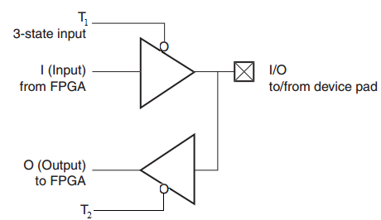
Input output pins of the FPGA

Slide 15
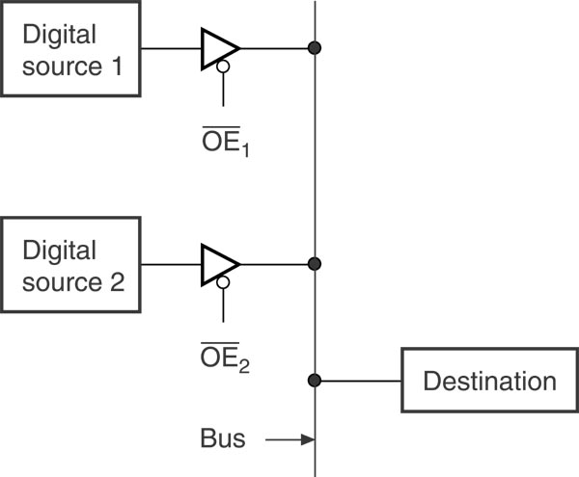
Tristate Buffer Utilization
Used to connect multiple outputs together.
Used in controlling the operation of buses.

Slide 16
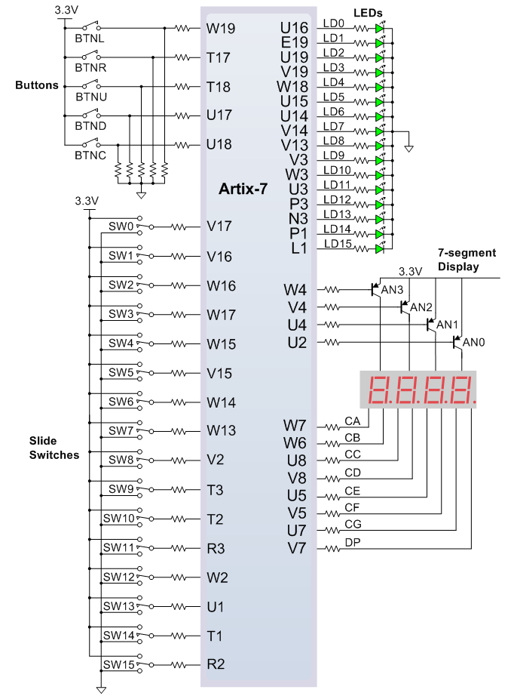
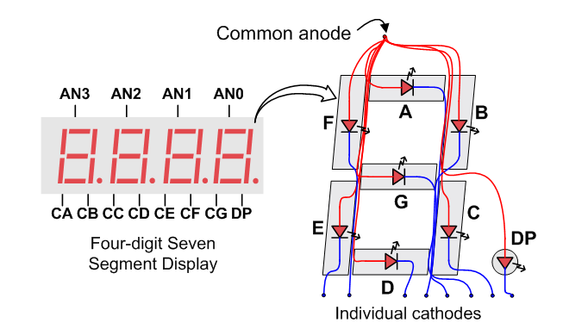
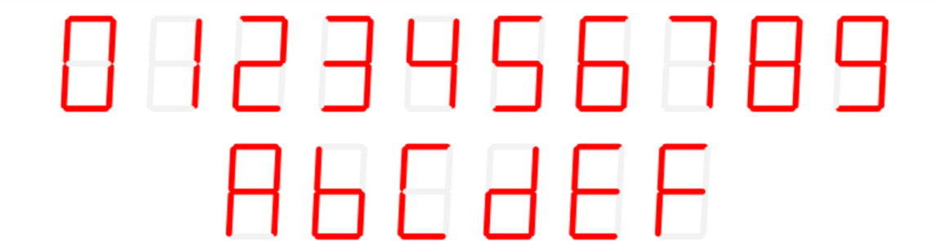
FPGA GPIO

