Slide 2
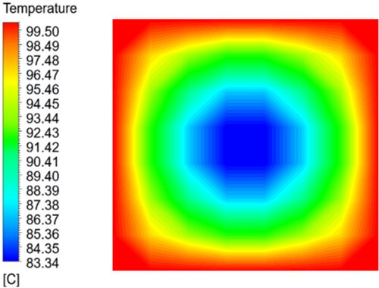
Introduction:
What is Heat Transfer?
Heat transfer is the movement of thermal energy from one
object or material to another, driven by temperature differences.
It occurs through three primary mechanisms: conduction, convection, and radiation.
What are Multidimensional Systems?
Multidimensional systems involve heat transfer in more than one spatial dimension (2D or 3D).
Examples: Heat flow in a rectangular plate (2D) or a cylindrical rod (3D), Heat exchangers.
Why Study Multidimensional Heat Transfer?
Many real-world applications involve complex geometries and multidimensional heat flow.
Understanding these systems is critical for designing efficient thermal management solutions in engineering, energy systems, and environmental studies.

Slide 3
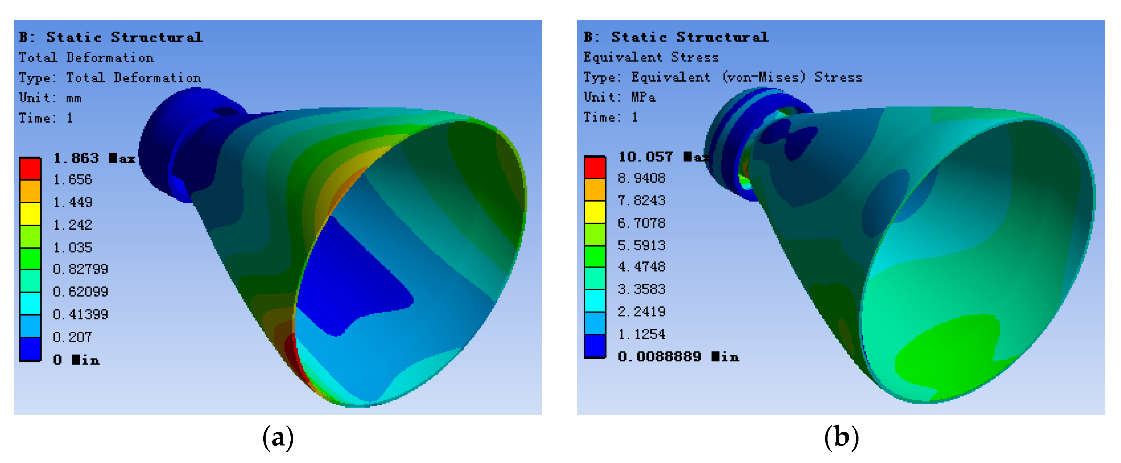
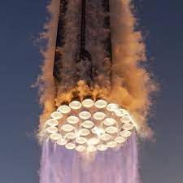
Heat Transfer In Multidimensional Systems:
What Makes It Multidimensional?
Heat flows in multiple directions (x, y, z) simultaneously.
Example: Heat spreading through a metal plate or
radiating from a cylindrical heater.
Why Does It Matter?
Real-world systems are rarely 1D:
Electronics Cooling: Heat spreads across a chip and into heat sinks.
HVAC Systems: Heat transfers through ducts and rooms in 3D.
Industrial Processes: Heat exchangers and reactors involve complex geometries.
How Do We Analyze It?
Numerical Methods: Finite Element Analysis (FEA) or Computational Fluid Dynamics (CFD).
Visualization Tools: Temperature contours, heat flux vectors, and 3D simulations.
Did You Know?
Multidimensional heat transfer is critical in designing everything from spacecraft heat shields to energy-efficient buildings.

Slide 4
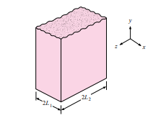


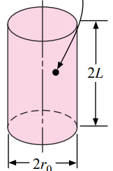

the infinite rectangular bar can be formed from two infinite plates of thickness
2L1 and 2L2, respectively.
the solution for a three-dimensional block may be expressed as a product of three
infinite-plate solutions for plates having the thickness of the three sides of the block.
solution for a cylinder of finite length could be expressed as a product of solutions of the infinite cylinder and an infinite plate
Combinations could also be made with the infinite-cylinder and infinite plate solutions to obtain temperature distributions in semi-infinite bars and cylinders.
To & Qo = center temperature & Heat
For a multidimensional body formed by intersection of three one-dimensional systems, the heat loss is given by.

Slide 5
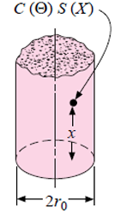
Example: A semi-infinite aluminum cylinder 5 cm in diameter is initially at a uniform temperature of 200◦C. It is suddenly subjected to a convection boundary condition at 70◦C with h = 525 W/m^2 · ◦C. Calculate the temperatures at the axis and surface of the cylinder 10 cm from the end 1 min after exposure to the environment.
This problem requires a combination of solutions for the infinite cylinder and semi-infinite slab in accordance with Figure 4-18e. For the slab we have: x = 10 cm α = 8.4 × 10^−5 m^2 /s k = 215 W/m · ◦C
To find Solution for infinite Cylinder , we use Chart 4-8 , 4-11 to find X-axis , Curv-eq
To find Solution for Semi infinite Solid , we use Chart 4-5 to find X-axis , Curv-eq

Slide 6
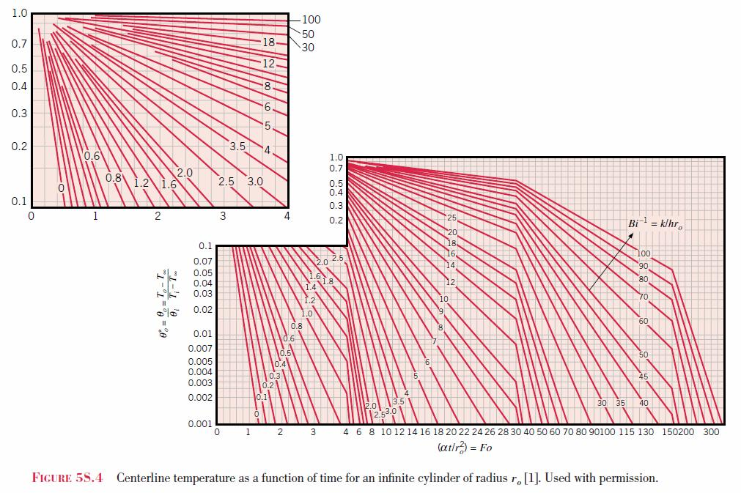
Transient Numerical Method :
Heisler Charts: Useful for temperature calculations in
regular-shaped solids under transient heat flow conditions.
Limitations:
Many practical geometries do not fit standard categories.
Boundary conditions often vary with time, complicating solutions.
Mathematical Challenges: Complex shapes and transient boundary conditions may make analytical solutions impossible.
Solution: Numerical techniques with computers are ideal for such problems.
Focus: Analysis is simplified to 2D systems for ease, with easy extension to 3D.

Slide 7

Thermal Resistance & capacity Formulation:
Each volume element acts as a node, connected to neighboring nodes via thermal resistances.
Steady-state: Net energy transfer into a node is zero.
Unsteady-state: Net energy transfer increases the node’s internal energy.
Each node behaves as a “lumped capacity”, collectively determining the solid’s transient behavior.
We define the thermal capacity as:
Resistance & volume elements for various geometries and boundary conditions are provided in Table 3-3 in HeatTransfer by J.P. Holman.
Key idea: Using thermal resistance and capacitance allows the forward-difference equation for all nodes and boundary conditions to be expressed in a single compact form

Slide 8


For complex numerical problems with varied boundary conditions or nonuniform space increments:
Define all nodal resistances and capacities.
Choose a suitable time increment (τ) for calculations.
Stability requirement: τ must be ≤ the most restrictive nodal relation
To Avoid round-off errors in computer solutions, especially with small thermal resistances, Express Ti^p+1​ in the following form for improved calculation accuracy:
where q˙i is the heat generation per unit volume and Vi is the volume element shown by dashed lines in the table.

Slide 9
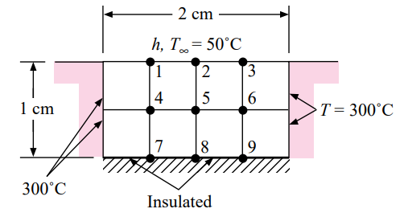
Example: A 1 by 2 cm ceramic strip [k = 3.0 W/m · ◦C] is embedded in a high-thermal-conductivity material, as shown in Figure below, so that the sides are maintained at a constant temperature of 300◦C. The bottom surface of the ceramic is insulated, and the top surface is exposed to a convection environment with h = 200 W/m^2 · ◦C and T∞ = 50◦C. At time zero the ceramic is uniform in temperature at 300◦C. Calculate the temperatures at nodes 1 to 9 after a time of 12 s. For the ceramic ρ = 1600 kg/m3 and c = 0.8 kJ/kg · ◦C. Also calculate the total heat loss in this time.

