Slide 1
Democratic Competition I: Voters & Political Culture
POL1036: Comparative European Politics – Video Lecture

Slide 2
Recap: Separation of Powers
Executive
Decision-making
Initiates most bills, sets agenda
Implementation, budget management
Approves gov., no-confidence votes
Review & annul measures
Enact laws, appoint judges
Legislature
Law-making
Judiciary
Review
Review & annul laws

Slide 3
Institutions are the nuts and bolts of government within which political actors behave

Slide 4
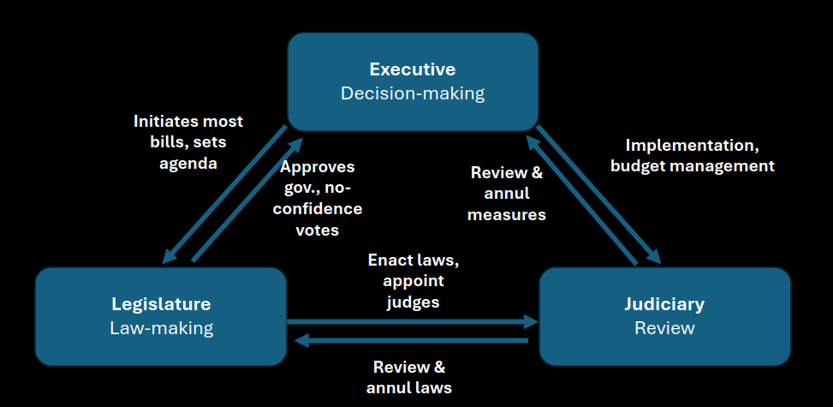
Institutions
Parliament & Government
Electoral system
Seeking Office
Individuals
Voters
Vote based on political culture
Groups
Parties
Seeking Votes
Democratic Competition

Slide 5
Political Culture?
Patterns of attitudes, values and beliefs about politics, conscious or unconscious, explicit or implicit
Understanding values and attitudes helps us understand how actors are likely to behave in democratic competition
Voting...
But also vote-seeking (next week!)
In turn can help us understand stability of institutions
Important: is always changing! New issues and identities come forward

Slide 6
Drivers: Political Interests and Identity
Political Interests
Material (money, health, security, …)
Ideal (justice, freedom, citizenship, equality, …)
Political identity
Social class
Ethnic group
Gender
Age
Regional group
…
Politics = struggle between people/groups with varying interests according to identiy

Slide 7
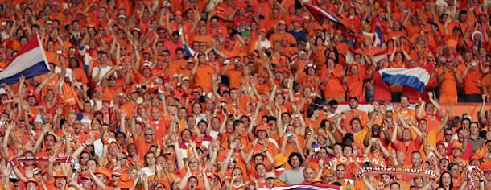
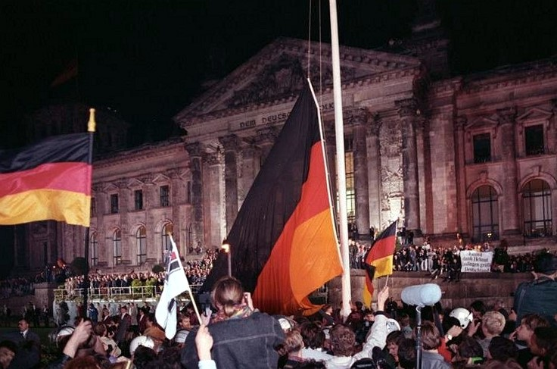
Key components of Political Culture
National pride and identity

Slide 8
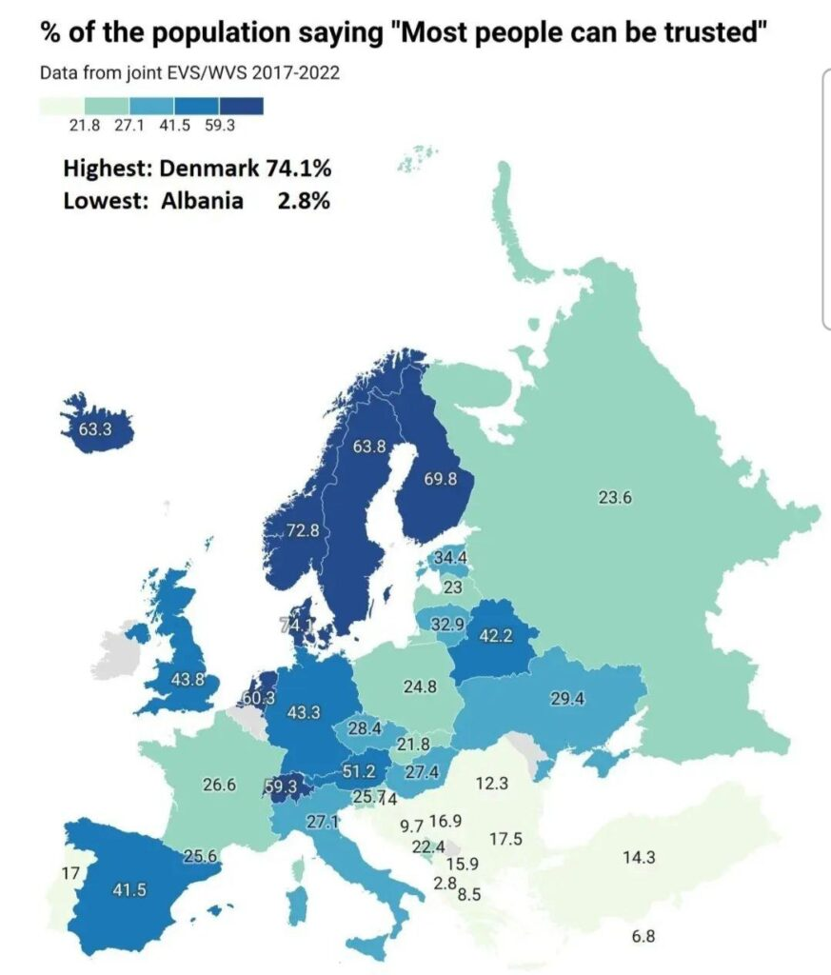
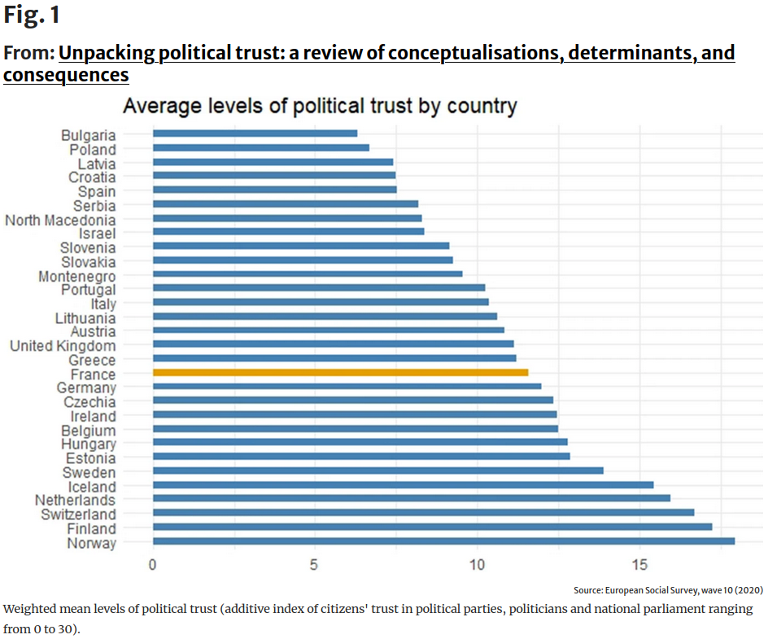
Key components of Political Culture
National pride and identity
Social and political trust and cooperation

Slide 9
Key components of Political Culture
National pride and identity
Social and political trust and cooperation
Competence
Subjective efficacy (my vote/actions matter)
System efficacy (political system works well)

Slide 10
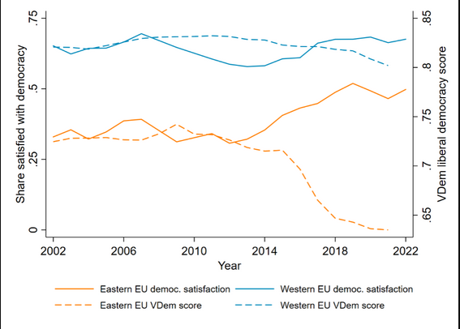
Key components of Political Culture
National pride and identity
Social and political trust and cooperation
Competence
Political support

Slide 11
Key components of Political Culture
National pride and identity
Social and political trust and cooperation
Competence
Political support
Citizenship
Alienation

Slide 12
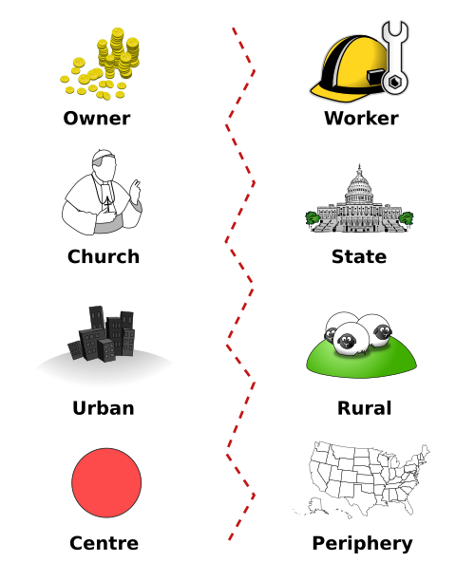
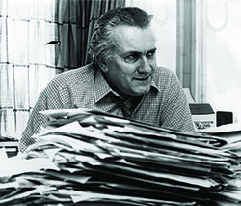
Structuring political culture: Cleavages
Stein Rokkan: Objective social differences (class, religion, race, ...) of which there is a subjective awareness (cultures, ideologies, orientiations) & that become locuses of political organisation
Owner
Worker
Church
State
Industry
Rural
Centre
Periphery

Slide 13
When do social divisions become cleavages?
Ruritania
Novaya Zembla
Ruritania is divided between Nordland, where most people speak the sharp‑sounding Ruric language, and the southern province of Valdora, where the softer Romance‑like tongue Valdorik dominates. The capital, Brünnheim, sits uneasily on the border between the two, claimed symbolically by both communities. The country is also split religiously between about half the population following the old Hill Church and a large secular minority concentrated in the industrial north. However, the north is significantly wealthier than the agrarian south. Political parties are organized almost entirely along Nordland–Valdora lines, leading to fragmented coalitions and frequent cabinet crises.
Novaya Zemblaya is divided by both language and religion: about two‑thirds of the population speak the clipped Slavic‑based Zemblan, one quarter speak the melodious Romanzh, and a small minority use the northern tongue Kjoric. Most provinces are linguistically homogeneous, yet within each language there are distinct regional dialects and a mix of faiths, including the Old Church and the Reformed Communion . Merchants and farmers from different language and religious groups often share the same economic interests in alpine tourism and offshore banking, further cutting across these divisions. No single city dominates national life: the lake cities of Lyst, Vorengradt, and Bellemar share federal institutions, and most Zemblayans identify strongly with the republic itself.

Slide 14
When do social divisions become cleavages?
Ruritania
Novaya Zembla
Ruritania is divided between Nordland, where most people speak the sharp‑sounding Ruric language, and the southern province of Valdora, where the softer Romance‑like tongue Valdorik dominates. The capital, Brünnheim, sits uneasily on the border between the two, claimed symbolically by both communities. The country is also split religiously between about half the population following the old Hill Church and a large secular minority concentrated in the industrial north. However, the north is significantly wealthier than the agrarian south. Political parties are organized almost entirely along Nordland–Valdora lines, leading to fragmented coalitions and frequent cabinet crises.
Novaya Zemblaya is divided by both language and religion: about two‑thirds of the population speak the clipped Slavic‑based Zemblan, one quarter speak the melodious Romanzh, and a small minority use the northern tongue Kjoric. Most provinces are linguistically homogeneous, yet within each language there are distinct regional dialects and a mix of faiths, including the Old Church and the Reformed Communion . Merchants and farmers from different language and religious groups often share the same economic interests in alpine tourism and offshore banking, further cutting across these divisions. No single city dominates national life: the lake cities of Lyst, Vorengradt, and Bellemar share federal institutions, and most Zemblayans identify strongly with the republic itself.

Slide 15
Cross-cutting cleavages can moderate differences, reinforcing cleavages can exacerbate them into conflict

Slide 16
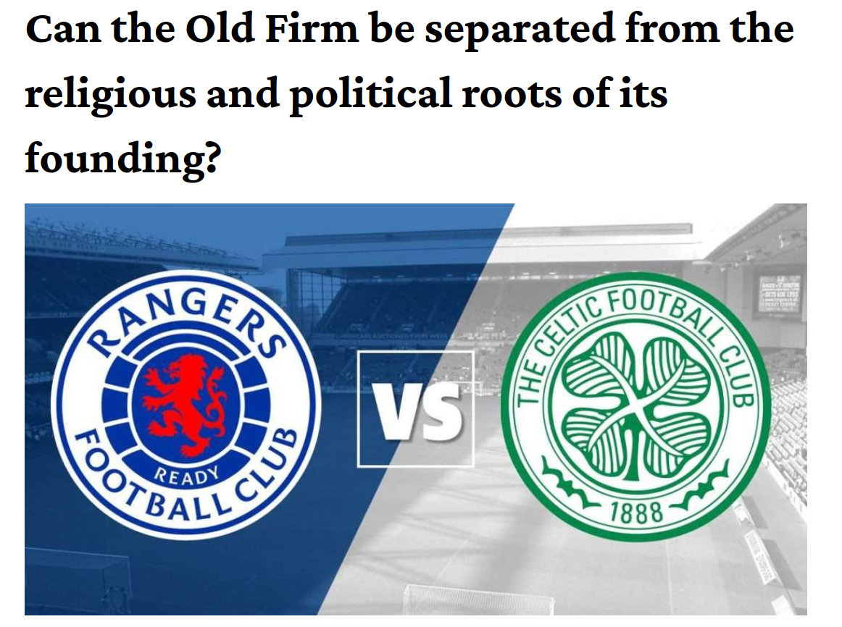
https://glasgowguardian.co.uk/2025/03/02/can-the-old-firm-be-separated-from-the-religious-and-political-roots-of-its-founding/

Slide 17
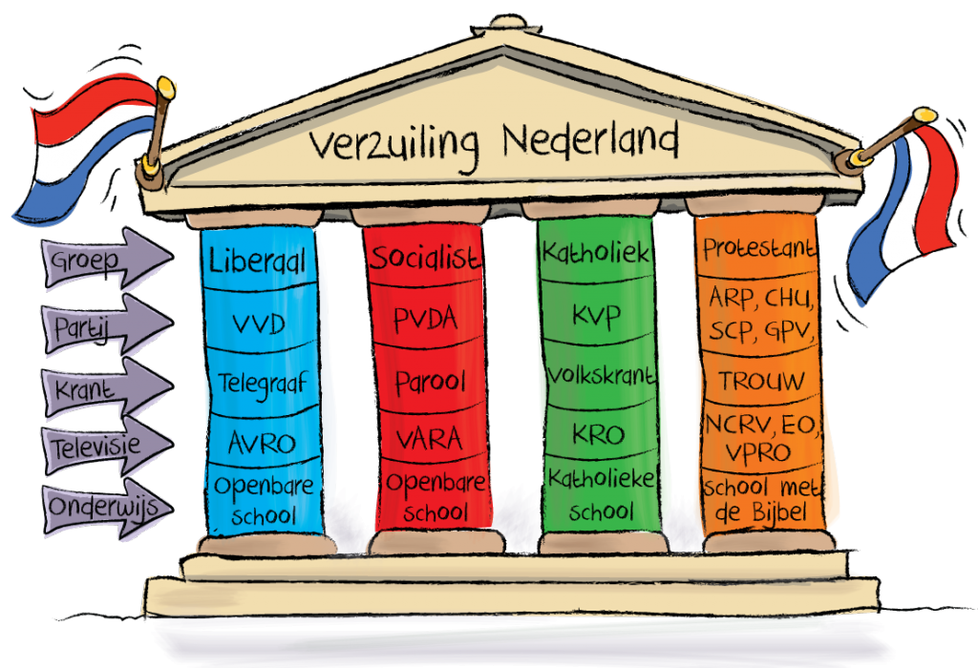
From pillarization...
One group
Same party
Same newspaper
Same television
Same education

Slide 18
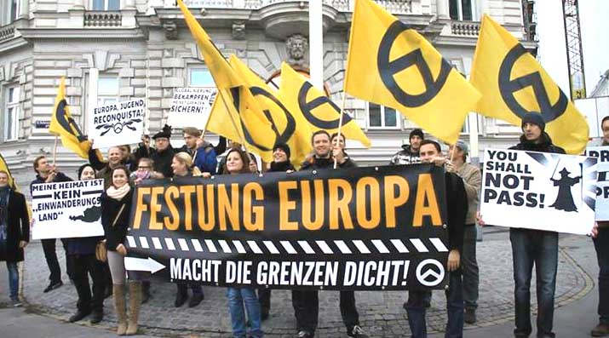
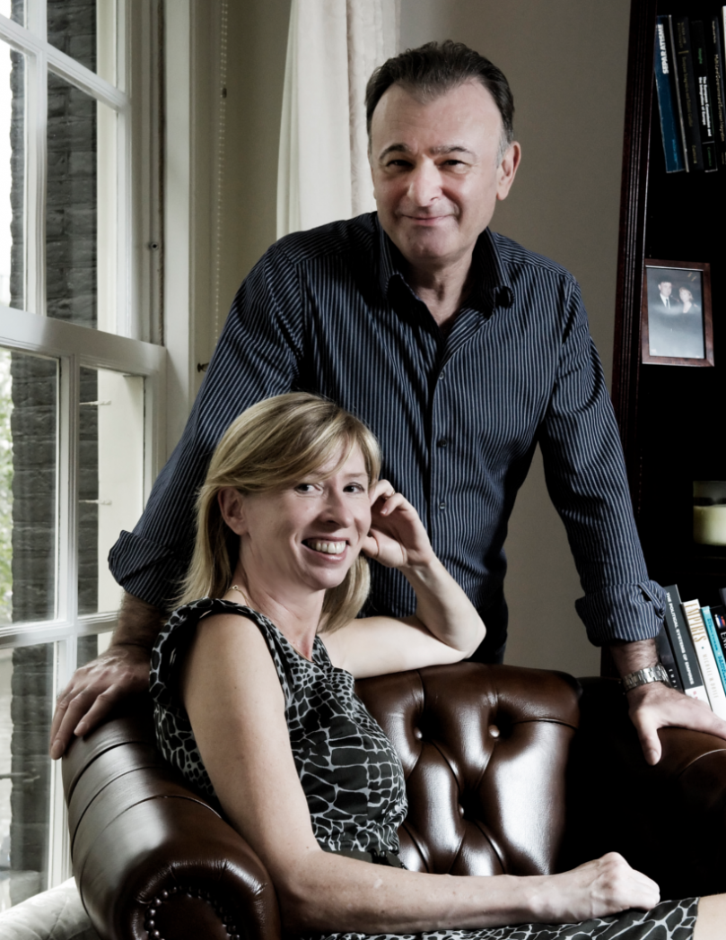
… to a Transnational Cleavage
Hooghe & Marks:
Political conflict is now value and culture-driven
Triggered by:
Immigration
EU integration
globalization
"Defending national, political, social and economic ways of life against external actors who penetrate the state."

Slide 19
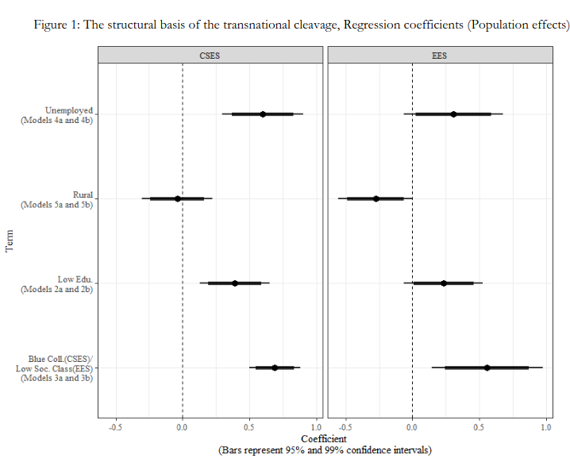
Reinforcing the transnational cleavage
National elections
European elections
https://www.eustudies.org/conference/papers/download/947

Slide 20
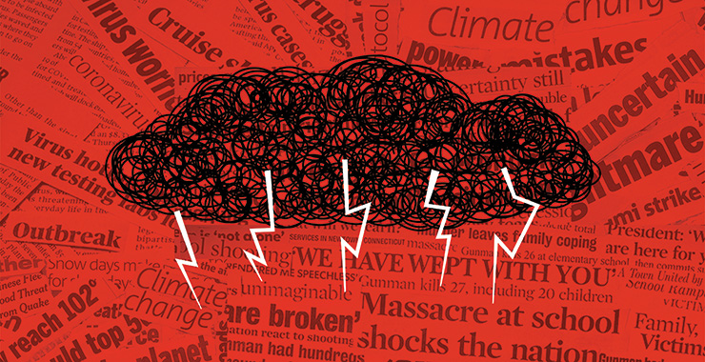

Making sense of our subjective experience of a complex world: Ideologies

Slide 21
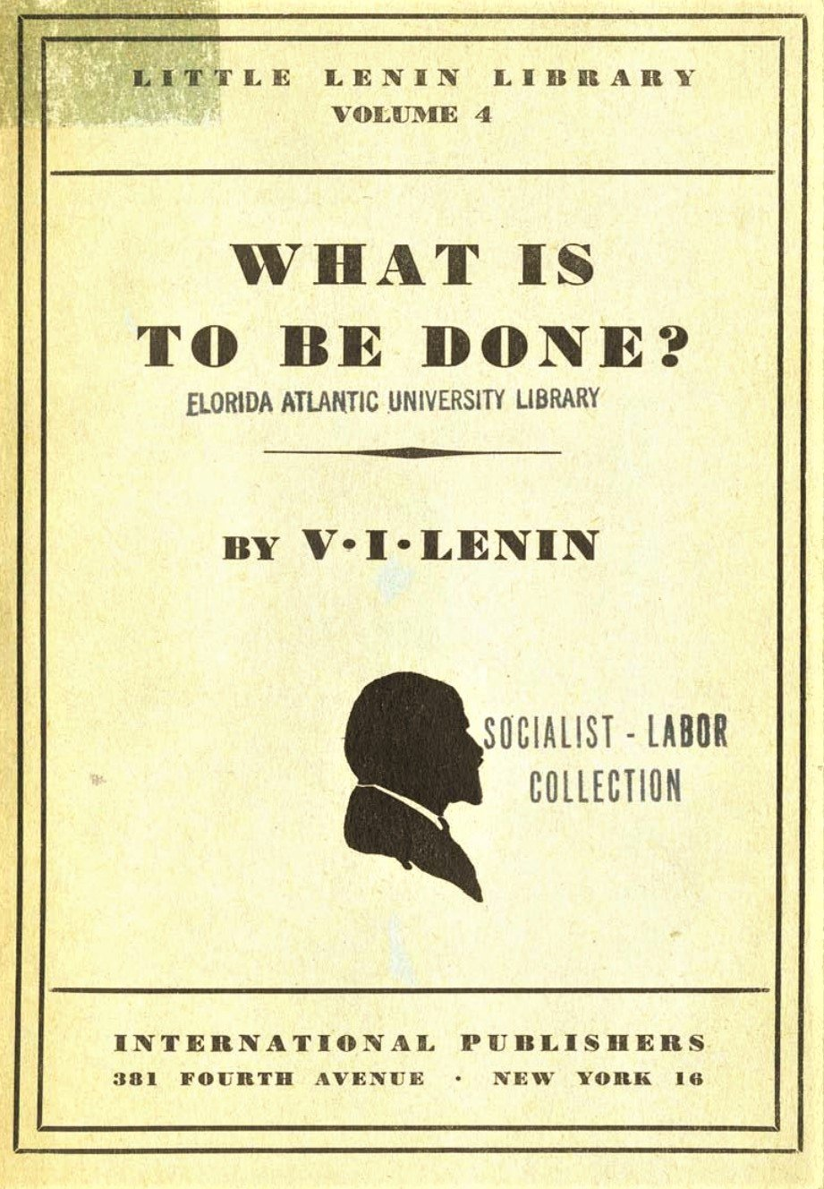
Ideologies are..
Complex and abstract systems of beliefs about politics...
That claim to offer empirical explanations of the political world...
As well as a normative prescription of how political life could and should be...
And how we can achieve that (a plan of action)
Essentially contestable concepts
Extremely varied

Slide 22
4 + 3 main democratic ideologies
Views about state intervention in society & economy
Christian Democracy
Conservatism
Social Democract / Socialism
Left
Liberalism
Right
Green political though, nationalism, populism?

Slide 23
Conservatism
Organic Society
Pessimistic view of human nature
Representative democracy
Inequality
Invisible hand of the market

Slide 24
Liberalism
Limited state power
Parliamentary government and the division of powers
Optimistic view of human nature
Slow reform by individual action
Free trade

Slide 25
Christian Democracy
Natural Law
Family, Church, Community
Subsidiarity
Protection of the weak and the poor
Harmony, integration and consultation

Slide 26
Socialism & Social Democracy
Optimistic view of human nature
Equality of opportunity
Participatory Democracy
Mixed Economy
Peaceful Reform

Slide 27
Looser ideologies
Nationalism
Ethno-nationalism & Territory
National independence
Green Political Thought
Sustainable Development
Decentralisation
Direct Participation & democracy
Populism
Feelings of neglect
Us vs them
Failed democracy

Slide 28
Conclusions
Individuals have a unique set of attitudes and values...
… but they ore often determined by social and economic groups...
… and built around interests linked to identity
Cleavages are important to understand political conflict and can change
Ideologies help people understand and interpret a complex world
Next lecture: how does this translate into parties?

