Slide 1
How to do Comparative Politics
POL1036: Comparative European Politics – Lecture 3 - 22/1/2026

Slide 2
Schedule
Today:
Research Question sets the tone
Comparison and the causal process
The cases you choose determine the answers you will get
Next week: Europe & Democracy

Slide 3
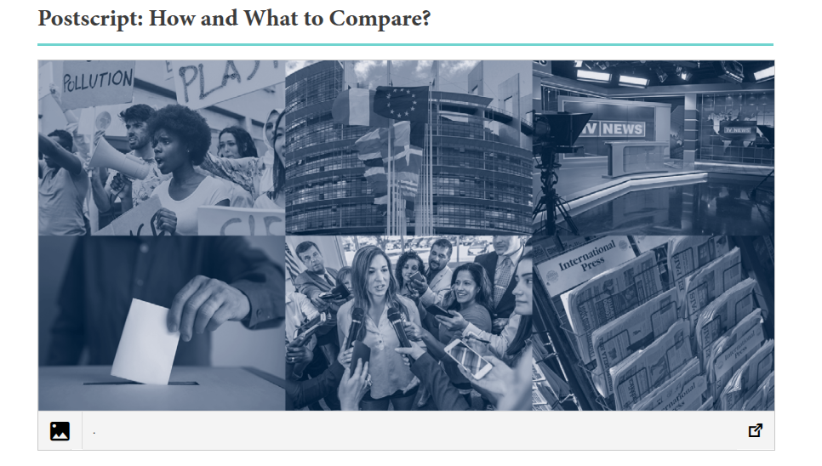
Do the Reading
https://www.cambridge.org/highereducation/books/foundations-of-comparative-politics/C261B8D6D6DAA4F83DBEDA6C078BF47F/postscript-how-and-what-to-compare/9CAF591F7AFE5A2A3FB488DB1840D30F

Slide 4
Recap: Variety in European Democracies
Head of state
Political System
Parliaments
Party systems
Executive Majority
Party systems
State structure
...

Slide 5
Recap: Comparison Matters
Learn more about own country
Learn more about other countries
Generalist theories & knowledge on politics & government

Slide 6
If A, then B If X, then Y

Slide 7
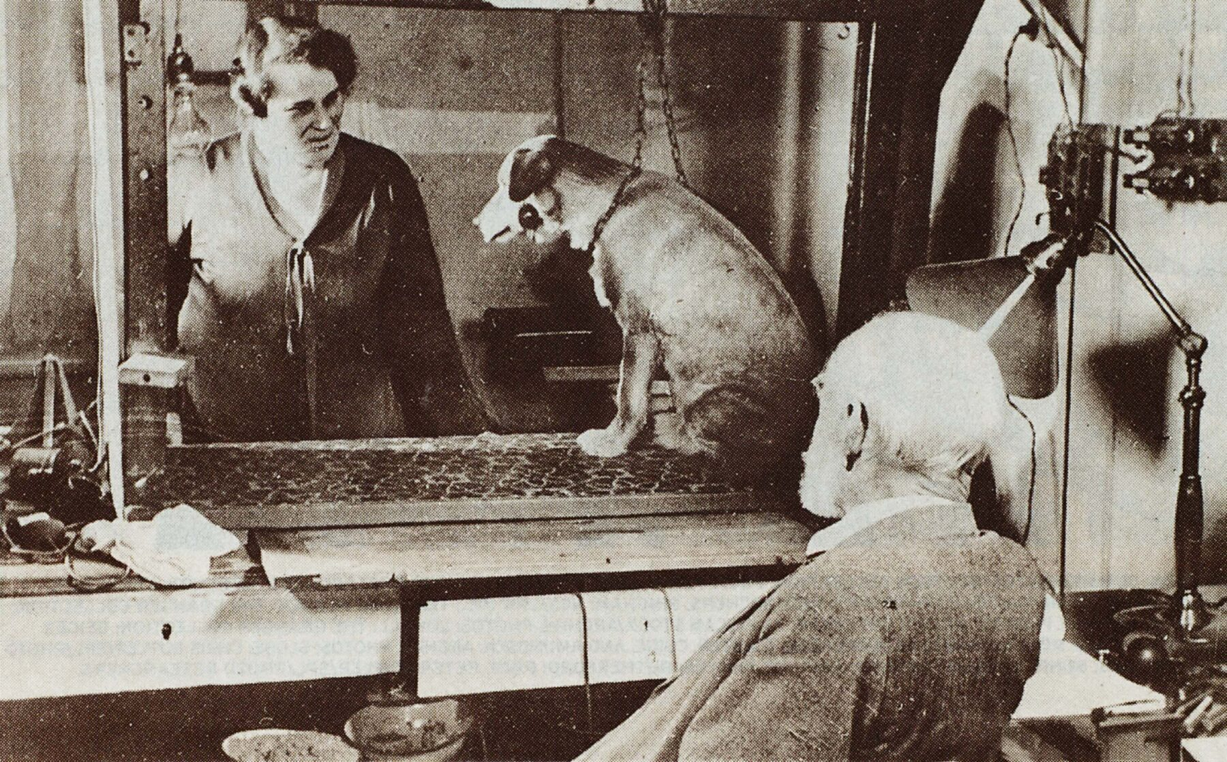
Example of Psychology: Pavlov's Dog

Slide 8
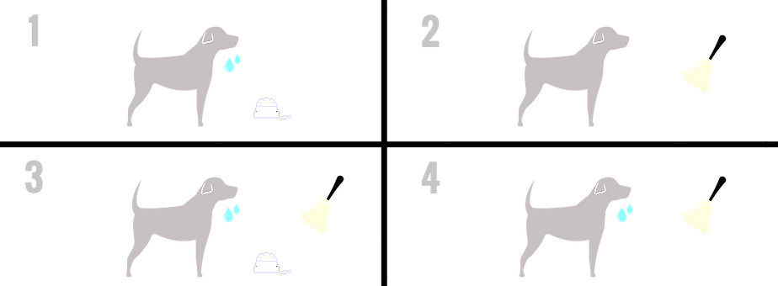
Pavlov's Dog

Slide 9
But in Political Science, similar experiments are often impossible

Slide 10
Comparison makes this possible, but there is no unique method because it depends on your research question

Slide 11
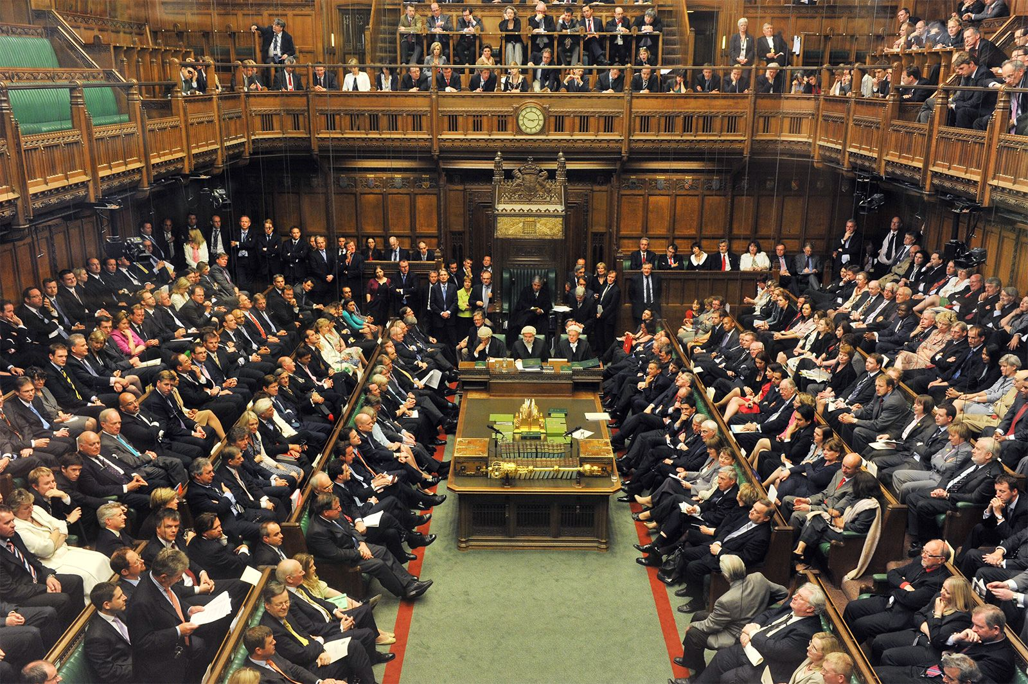
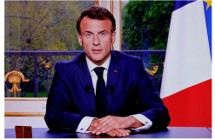

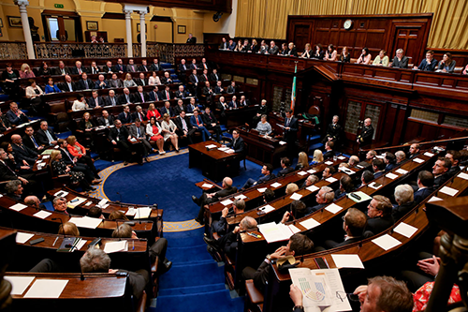
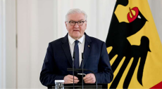
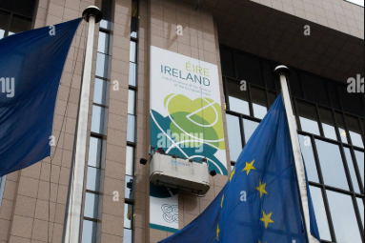
1. Dimension of comparison
Spatial Functional Longitudinal
Cross-sectional Cross-organizational Cross-temporal
Size of Parliament
UK vs IE
French President vs
German Chancellor
Irish EU Presidency
2013 vs 2026

Slide 12
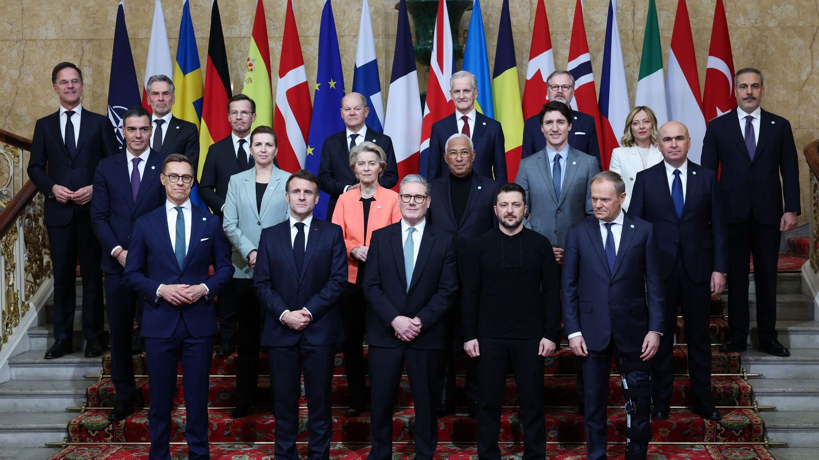
2. Unit of Analysis
Individuals

Slide 13
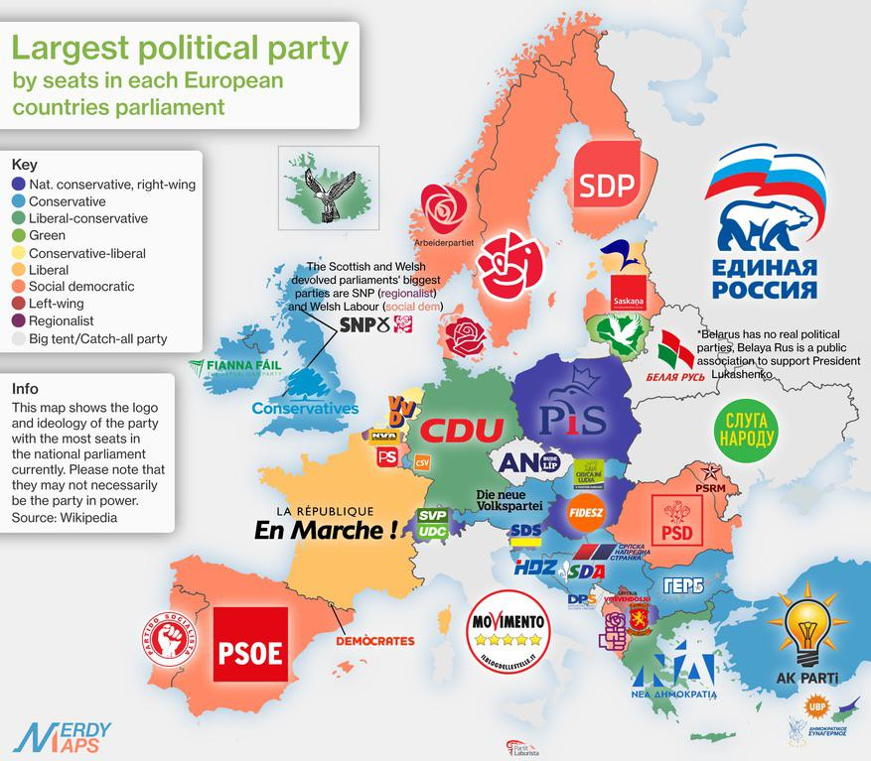
2. Unit of Analysis
Institutions
Map dates from 2020

Slide 14
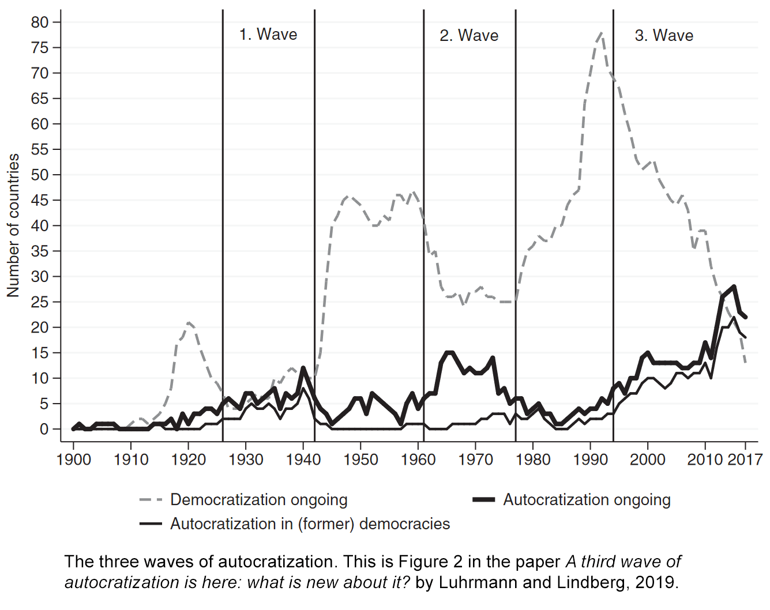
2. Unit of Analysis
Trends

Slide 15
The dependent variable (DV) is the variation you want to explain: you hypothesize it depends on something else.
The independent variable (IV) is the explanation: it is independent because your hypothesis does not try to explain why it varies.
3. Independent & Dependent Variables

Slide 16
Voting System Election Fairness IV DV
Independent Variable
Dependent
Variable
Hypothesis
(Theory-building vs theory-testing)

Slide 17
But be wary of causal process!
X
A
B
C
Y
Green
ministers
Policy
Company
Behaviour
Electoral
pressure on non-Greens
Policy
Company
Behaviour

Slide 18
+ Spurious Association
Green
party
Green
ministers
Policy
Company
Behaviour
Service
economy
Electoral
pressure on non-Greens
Policy
Company
Behaviour
Emissions

Slide 19
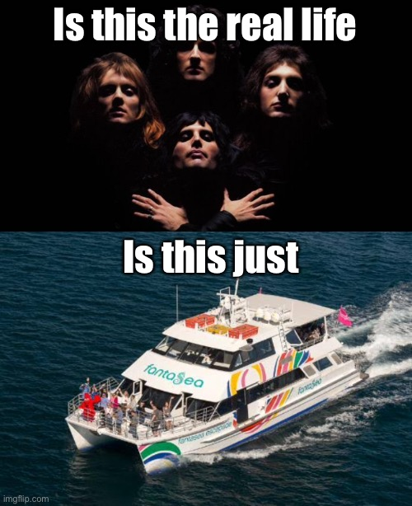
+ Internal & External Validity
Service
economy
Company
Behaviour
Internal validity: Causal or Correlation?
External Validity: Generalization?

Slide 20
So for real: How do we compare?
John Stuart Mill's System of Logic (1843)
Maximize experimental variance
Read: create contrast between X and Y (or be biased)
Minimize error variance
Read: limit effects of unmeasured variables (for instance by raising # of cases)
Control external variance
Read: make sure you take into account different possible influences

Slide 21
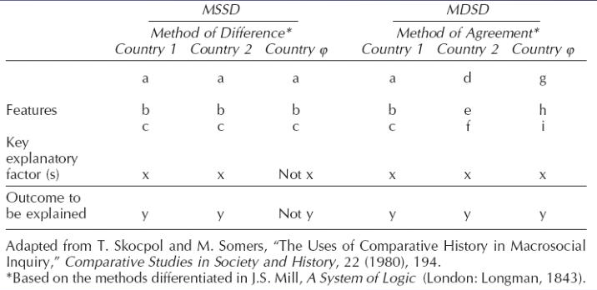
In practice: MSSD (MoD) vs MDSD (MoA)
Constant
Constant​

Slide 22
So what cases should you choose?

Slide 23
Strategies Extensive (Large-N, quantitative): Many cases, few variables Intensive (Small-N, Qualitative): Few cases, many variables

Slide 24
Examples
Electoral Systems around the world
Semi-Presidentialism in Europe
Gender Quota Database
Institutional Design and Party Government in Post-communist Europe
Non-scientific: If it were my home

Slide 25
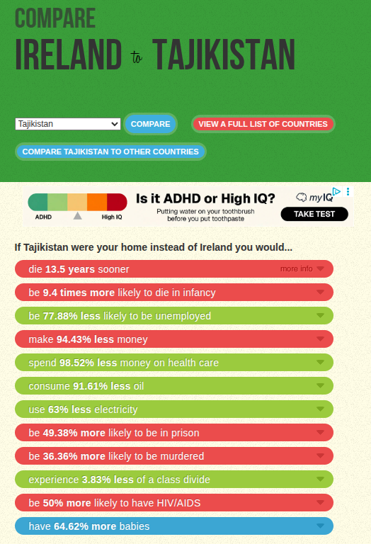

Slide 26
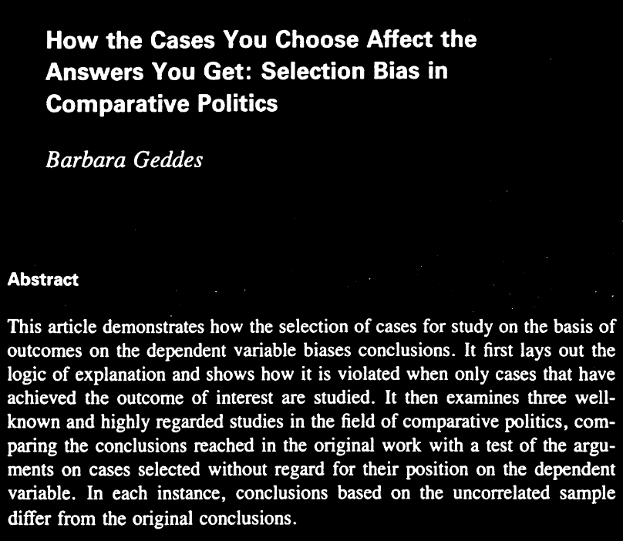

Slide 27
You must analyse the advantages and disadvantages of your case selection for answering the question in your group project.

Slide 28
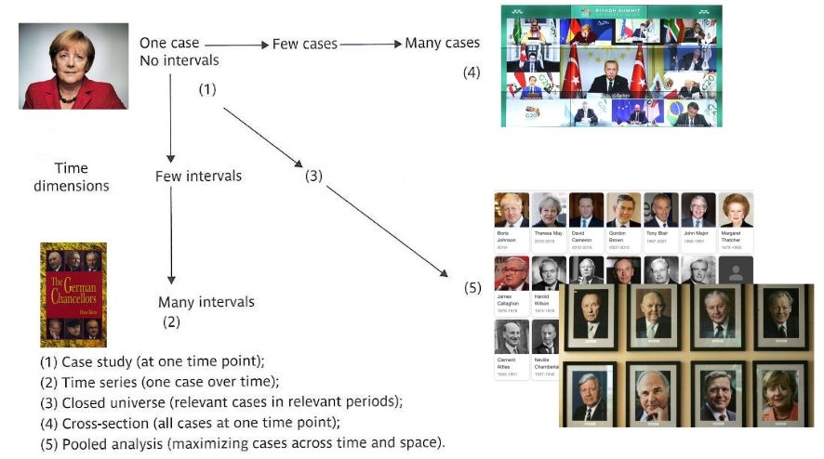
Types of Research Design (Keman, 2008)

Slide 29
Single Case
Comparison?
Limited external validity (usually post-hoc)

Slide 30
Gun Ownership & Crime
US: High Gun Ownership -> High Crime
If A, then B?
CH: High Gun Ownership -> Low Crime

Slide 31
Gun Ownership & Crime
US: High Gun Ownership -> High Crime
If A, then B?
CH: High Gun Ownership -> Low Crime

Slide 32
Single Case
Comparison?
Limited external validity (usually post-hoc)
Allows for great # of variables
Different types:
Representative case (NL for coalitions)
Prototype case (USA for democracies)
Deviant case (Democracy in developing country)
Archetypical case (France for semi-presidentialism)

Slide 33
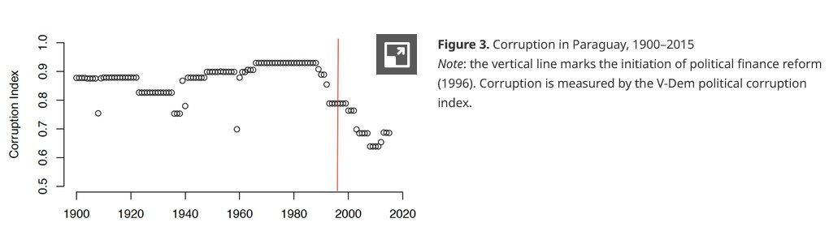
Other types
Time series (one case over time)
Which factors have become relevant?
Natural Experiments, f.i. Hummel et al (2019) on political finance reform & corruption

Slide 34
Other types
Time series (one case over time)
Closed Universe (relevant cases and periods)
Limited in cases and intervals
Interval based on external factors (such as before/after dramatic event)

Slide 35
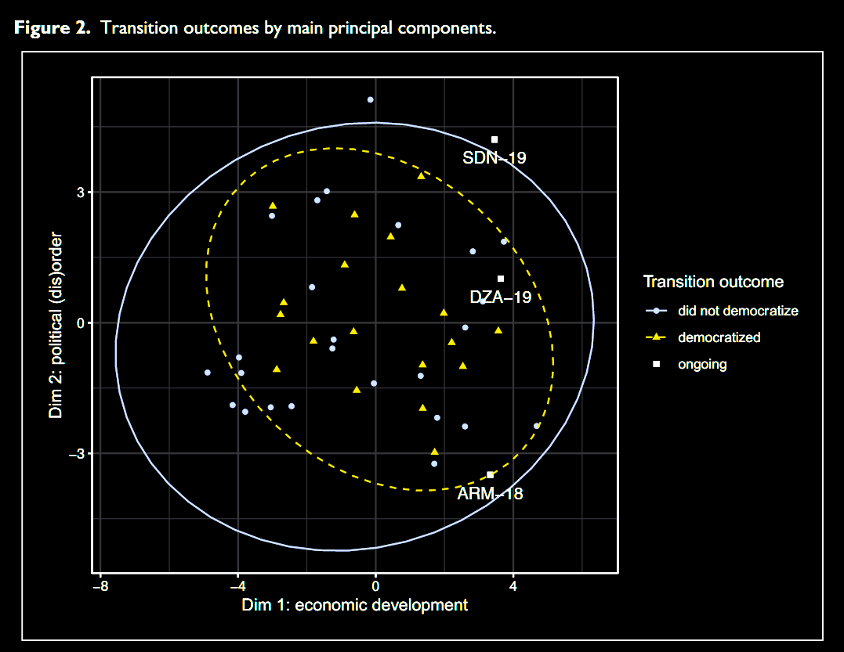
Political (dis)order & Economic Development do not contribute to democratization after authoritarian breakdown
Lachapelle, J., & Hellmeier, S. (2022). Pathways to democracy after authoritarian breakdown: Comparative case selection and lessons from the past. International Political Science Review, 45(1), 123-143. https://doi.org/10.1177/01925121221138408 (Original work published 2024)

Slide 36
Other types
Time series (one case over time)
Closed Universe (relevant cases and periods)
Cross-section (all cases at one time point)
Cases with much in common
Creates mid-level theories
Pooled analysis (maximum cases across time & space)
Very sophisticated quantitative analyses

