Slide 1
Final Group Project Recommendations
Focus on 2 countries
Isolate the main effect(s)
Similar political systems but different in independent and dependent variable (MSSD)
Different political systems but similar in independent and dependent variable (MDSD)
Independent variable: Read the literature!
Minimum six academic sources

Slide 2
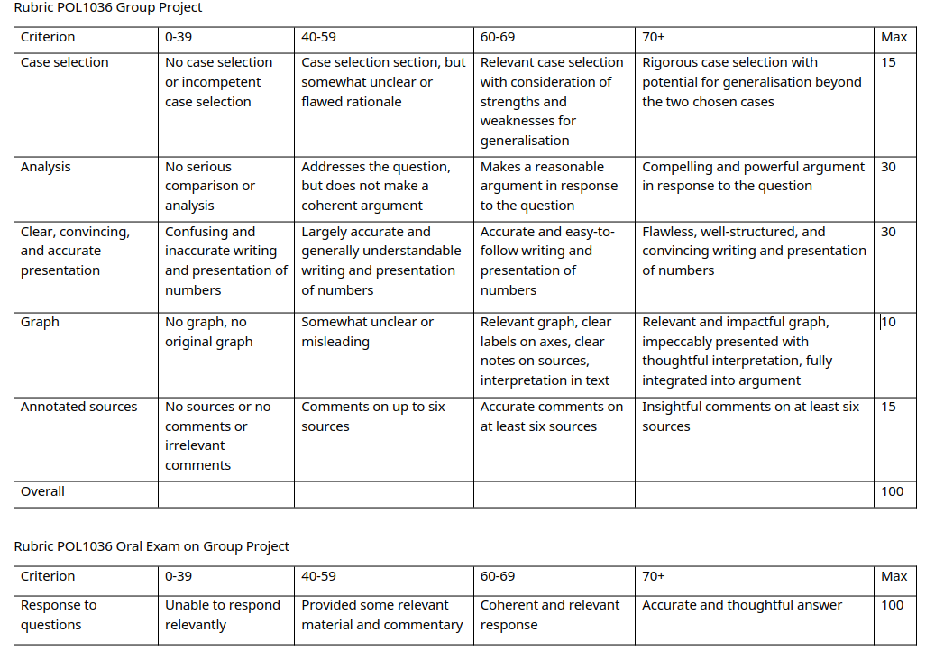

Slide 3
Oral Exam
Friendly chat (I promise)
All group members should be familiar with the entire project and the texts referenced ("I didn't write that part/read that source" is not acceptable)
Serves as multiplier of draft mark:
Group project draft grade=60
Weak performance at oral exam: 60*0.66=40
Strong performance at oral exam: 60*1.33=80
Absent for oral exam: 60*0=0
Overview of when your oral exam takes place will be posted on Loop soon (weeks 12 and 13)!

Slide 4
Written Exam
50% of final grade
Two sets of questions (50 points each) relating to figure/table not seen in class
Three types of questions
Reproducible knowledge
Application of knowledge
Critical thinking
Material: Lectures! (can be supported with readings, but is not a requirement)

Slide 5
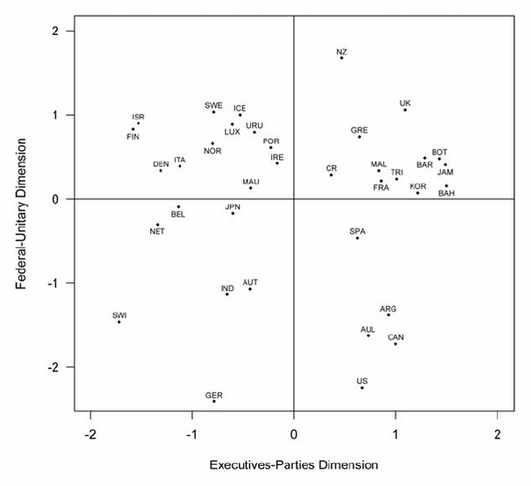
Example Exam Question
The figure below comes from Lijphart’s Patterns of Democracy (1999, 2012). Answer the following questions:
A) Explain the difference between a consensus and a majoritarian democracy as defined by Lijphart. REPRODUCE
B) The figure displays two dimensions. Explain the difference between the two and how they relate to the position of Belgium on the figure. APPLY
C) Discuss the following statement: Based on this figure, Ireland is a consensus democracy. CRITICAL THINKING

Slide 6
Institutions I: Constitutions
POL1036: Comparative European Politics – Lecture 7 - 15/2/2026

Slide 7
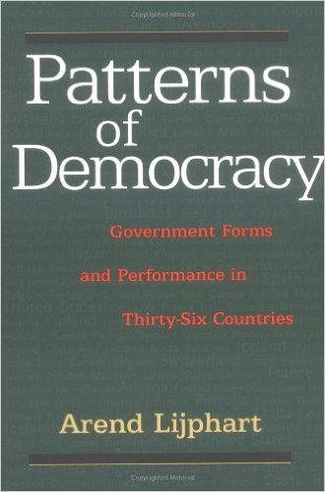
Recap: Patterns of Democracy (Lijphart, 1999)
Majoritarian
Democracy
Bare Majority
Consensus
Democracy
Maximal Majority
Difference? Institutions!
Notes:
Institutions were the main thing making a difference between countries within this perspective

Slide 8
Recap: Executive – Parties Dimension
Institution | Majoritarian | Consensus
Executive Majority | Single-Party (power concentration) | Multiparty (power-sharing)
Executive-Legislative Relation | Dominant Executive | Balance of Power
Party System | Two-Party | Multi-Party
Electoral System | Majoritarian, Disproportional | Proportional
Interest Groups | Pluralist, Competitive | Coordinated, Compromise-oriented

Slide 9
Recap: Federal – Unitary Dimension
Institution | Majoritarian | Consensus
Government centralization | Unitary & Centralized | Federal & Decentralized
Parliamentary power distribution | Unicameral | Bicameral
Constitutions | Flexible, simple majority for am. | Rigid, super majority for am.
Constitutionality of laws | Legislature | Courts
Central Banks | Dependent on executive | Independent

Slide 10
Institutions are the nuts and bolts of government within which political actors behave

Slide 11

Constitutions as rules of the game and blueprints of power
Voting, running for office, …
Balancing act
Rights of citizens
Power of Government

Slide 12
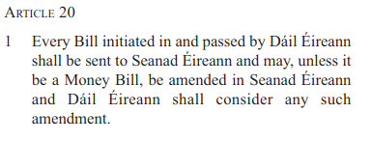
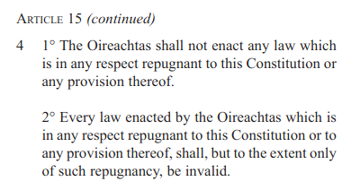

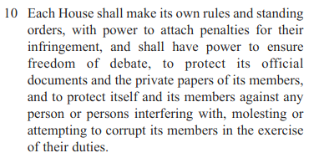
Constitutions are...
Fundamental
https://www.irishstatutebook.ie/pdf/en.cons.pdf

Slide 13


Constitutions are...
Fundamental
Entrenched

Slide 14
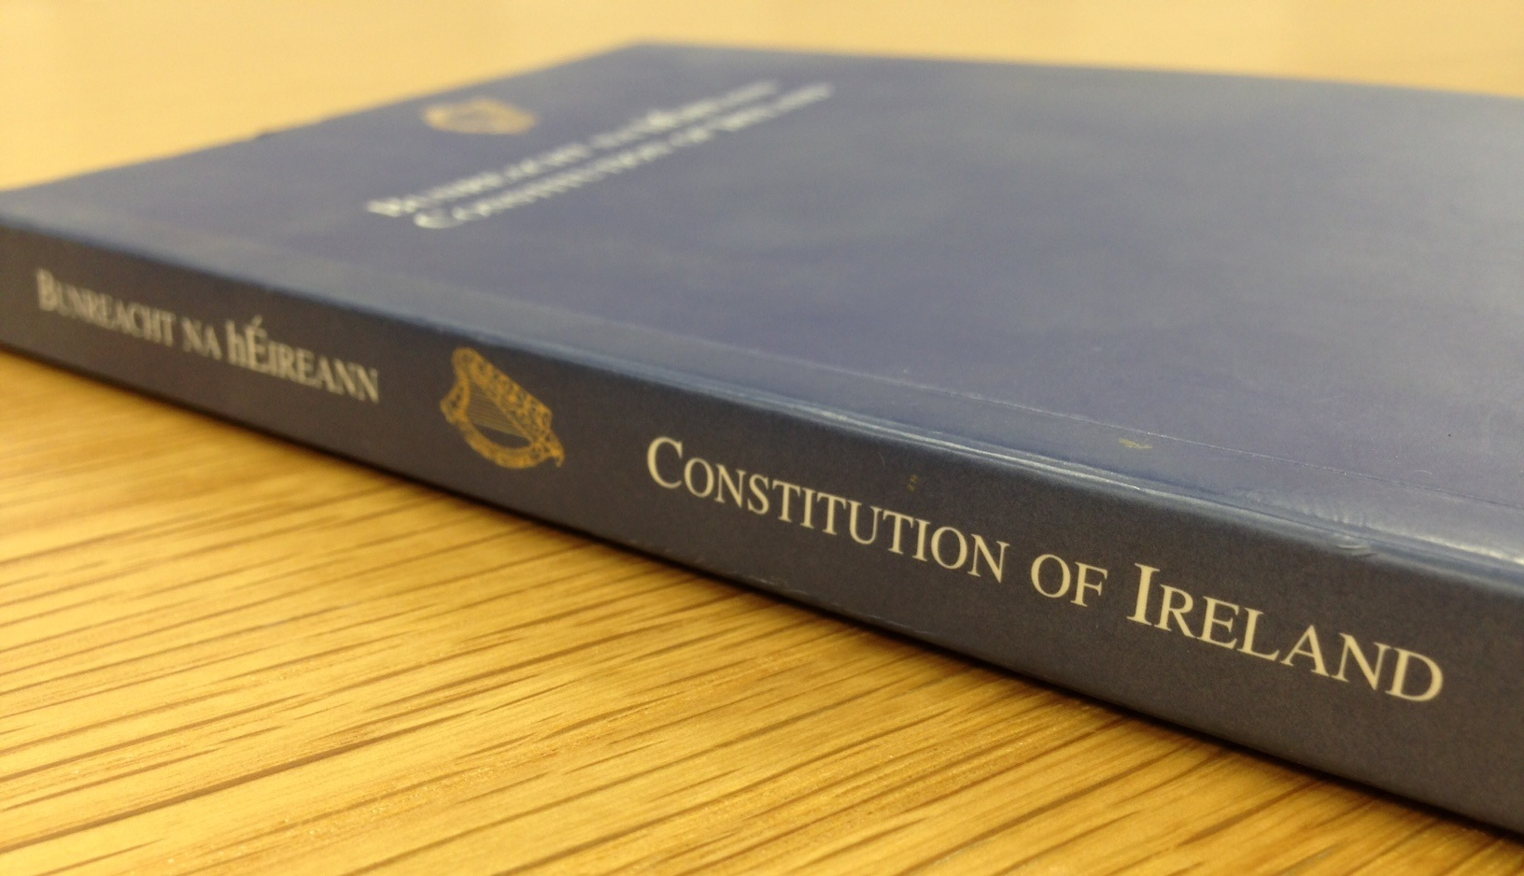
Constitutions are...
Fundamental
Entrenched
Codified
But in UK, San Marino, Israel, Canada, New-Zealand, Saudi-Arabia and China: uncodified (but not 'unwritten')

Slide 15
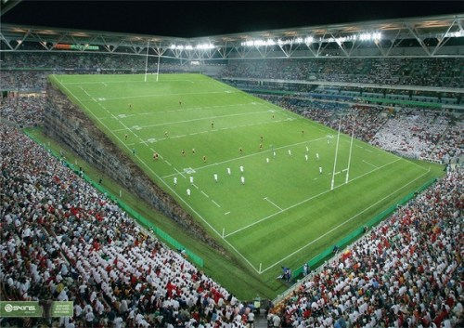
Constitutions are...
Fundamental
Entrenched
Codified
Allocations of powers
Fair and impartial
Aim for 'Level Playing Field'

Slide 16
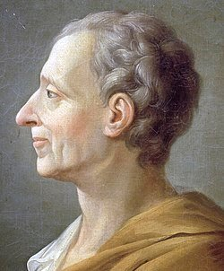
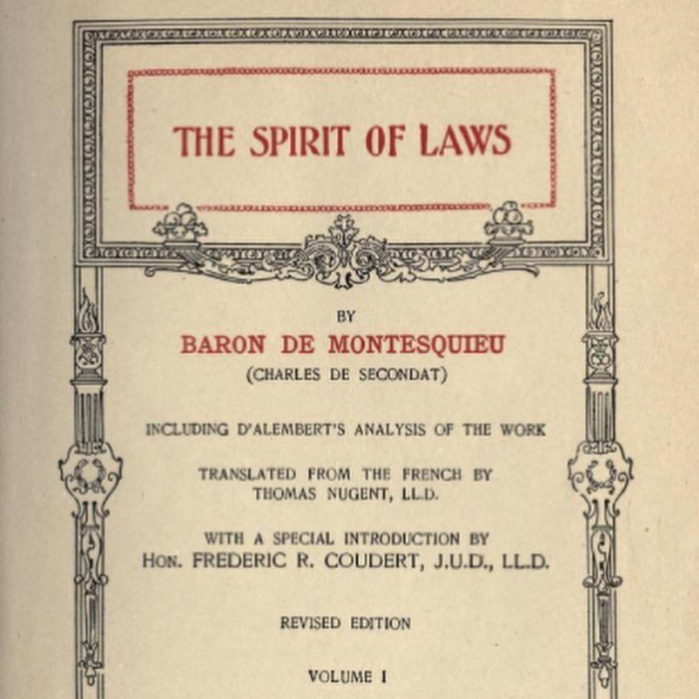
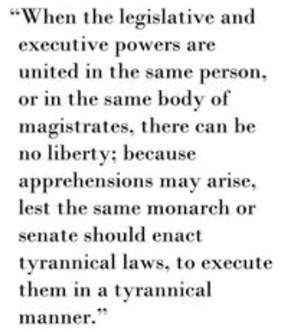
Core Principles of Democratic Constitutions
Rule of Law
Transfer of Power
Separation of Powers + Checks & Balances

Slide 17
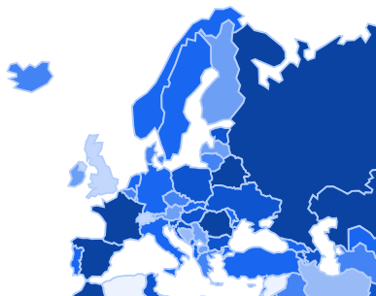
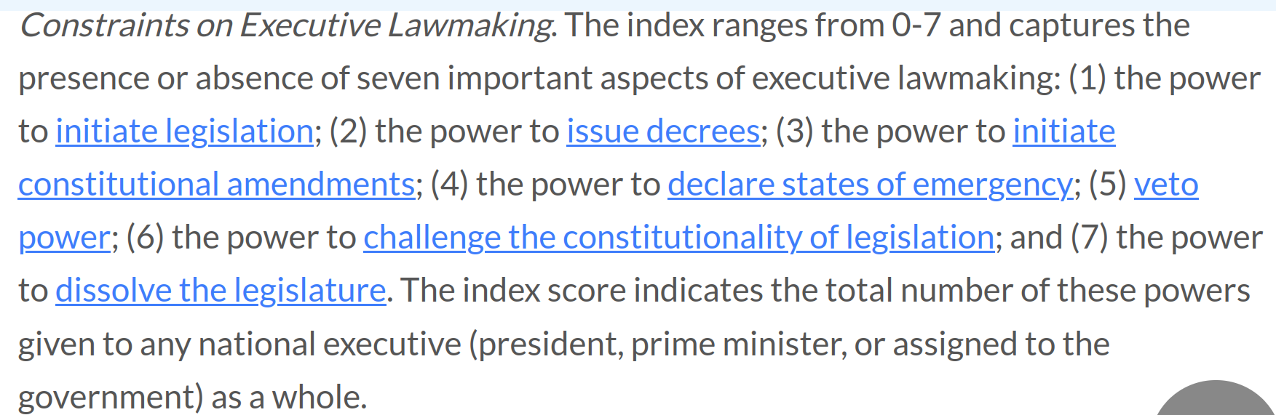
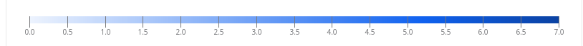
Separation of powers: Executive
https://constituteproject.org/countries

Slide 18
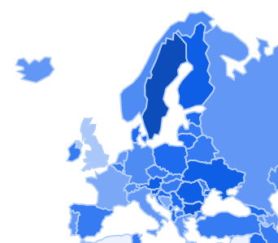
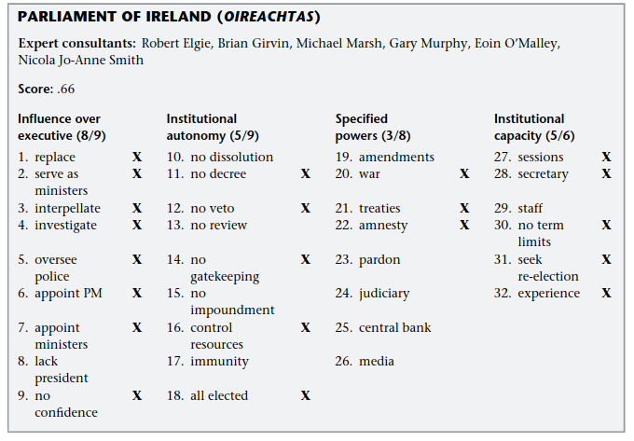
Separation of powers: Legislative
Fish MS, Kroenig M. Country Studies. In: The Handbook of National Legislatures: A Global Survey. Cambridge University Press; 2009:330.
https://constituteproject.org/countries

Slide 19
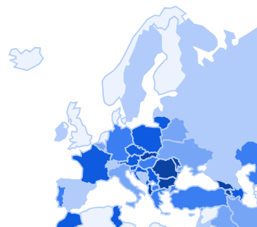
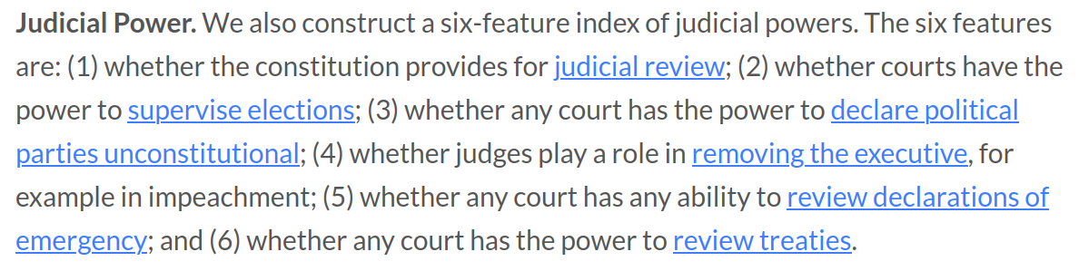
Separation of powers: Judicial
https://constituteproject.org/countries

Slide 20
Core Principles of Democratic Constitutions
Rule of Law
Transfer of Power
Separation of Powers + Checks & Balances
Relations between Government and Citizens

Slide 21
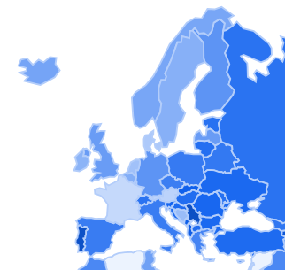
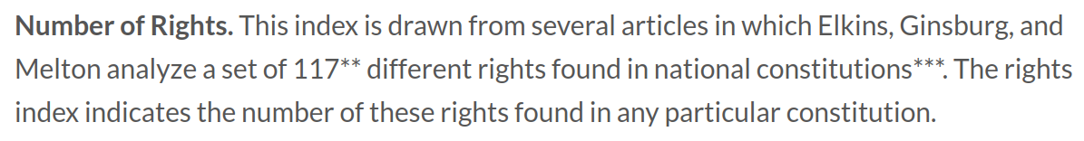
Gov. Vs Citizens: Number of Rights
https://constituteproject.org/countries

Slide 22
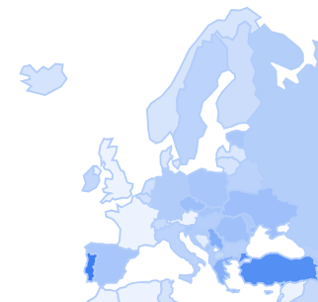
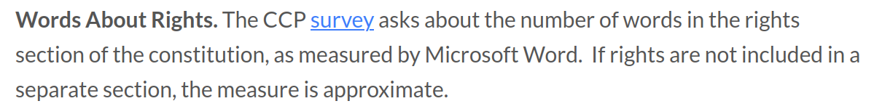
Gov. Vs Citizens: Words about Rights
https://constituteproject.org/countries

Slide 23
Core Principles of Democratic Constitutions
Rule of Law
Transfer of Power
Separation of Powers + Checks & Balances
Relations between Government and Citizens
Locus of Sovereignty
Government Accountability
Final Arbiter

Slide 24
Who is this final arbiter?
American/Judicial Review Model: ordinary courts under supreme/high court
Austrian/continental/European/Constitutional review model: specialized constitutional courts or supreme/high courts in special chambers
Mixed/American Continental Model: ordinary courts under supreme/high court or constitutional court
French model: special bodies or special chambers of supreme/high court
Other bodies (National Council, Parliament, …)
No constitutional/Judicial Review

Slide 25
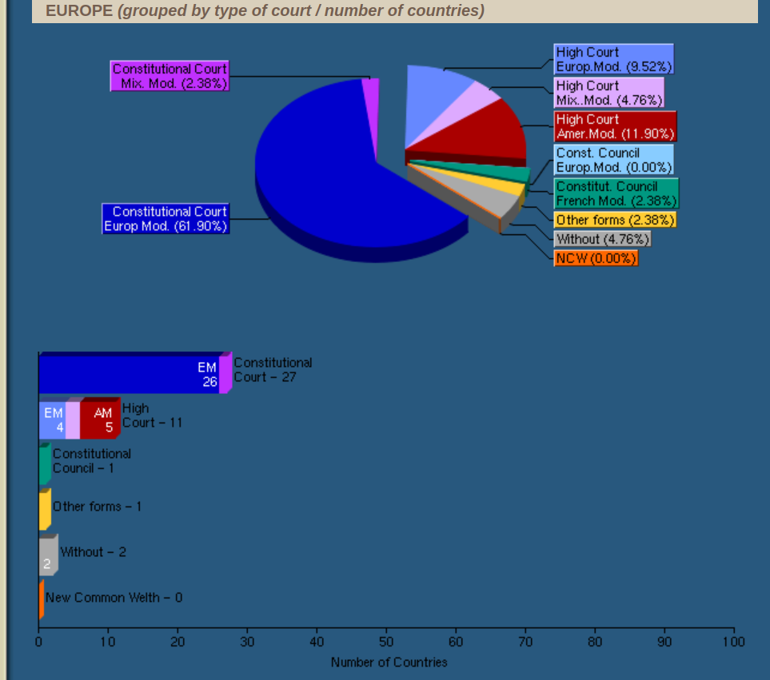
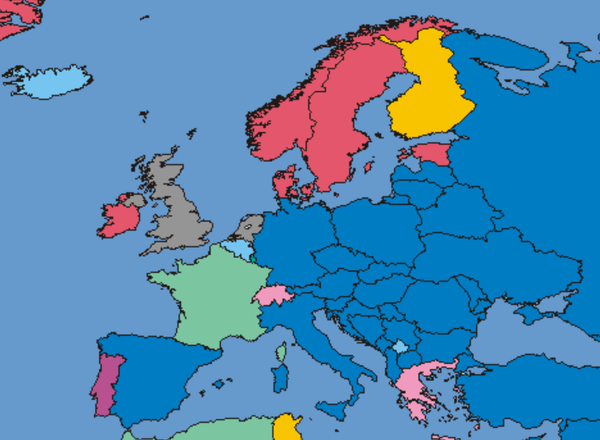
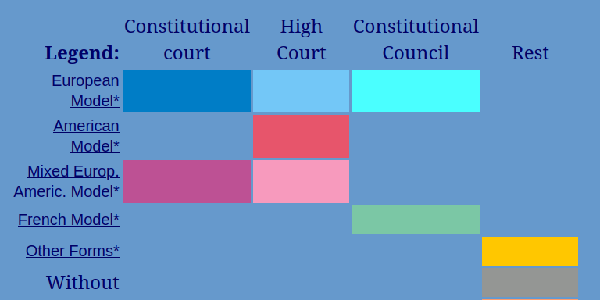
Who is this final arbiter?
https://www.concourts.net/comparison.php

Slide 26
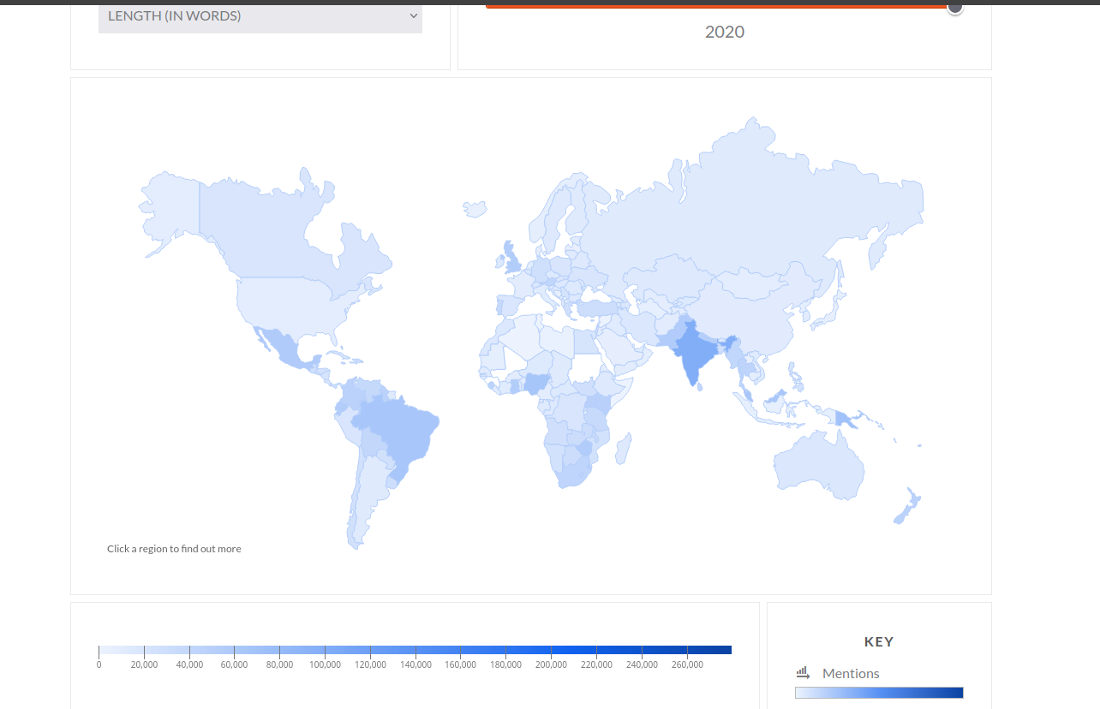
Variation in Length

Slide 27
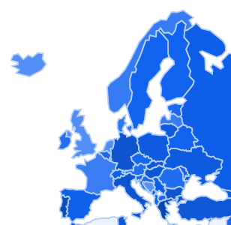
Variation in Scope
Notes:
UK still high, so why this unwritten consideration?

Slide 28
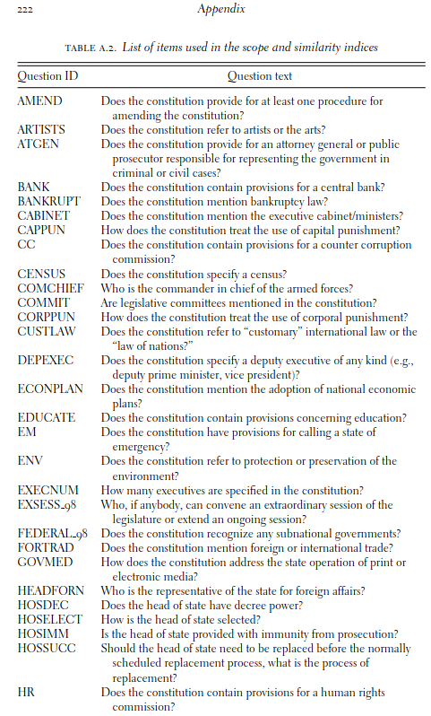
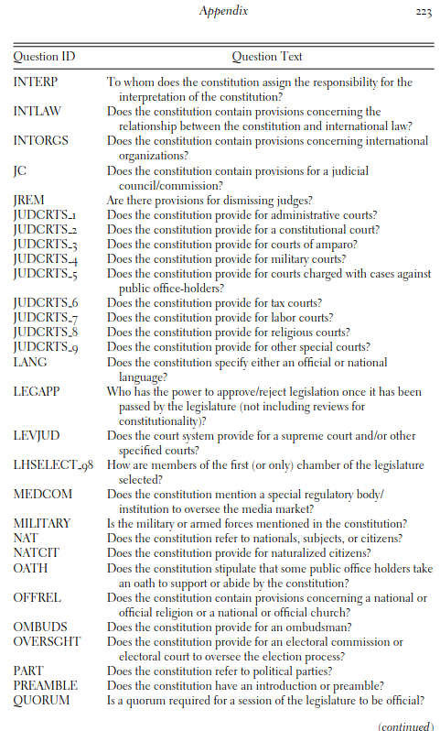
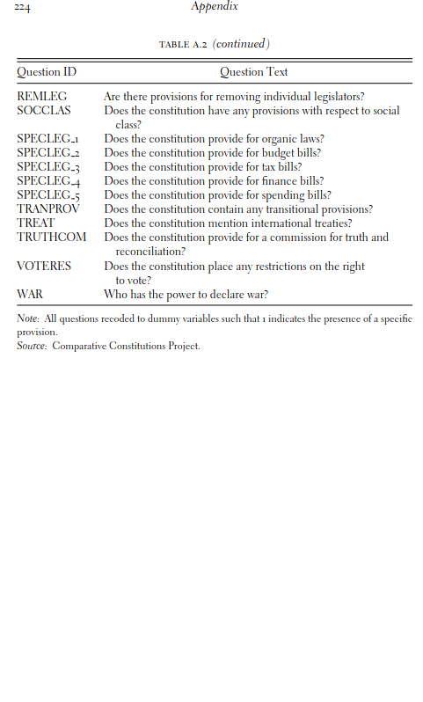

Slide 29
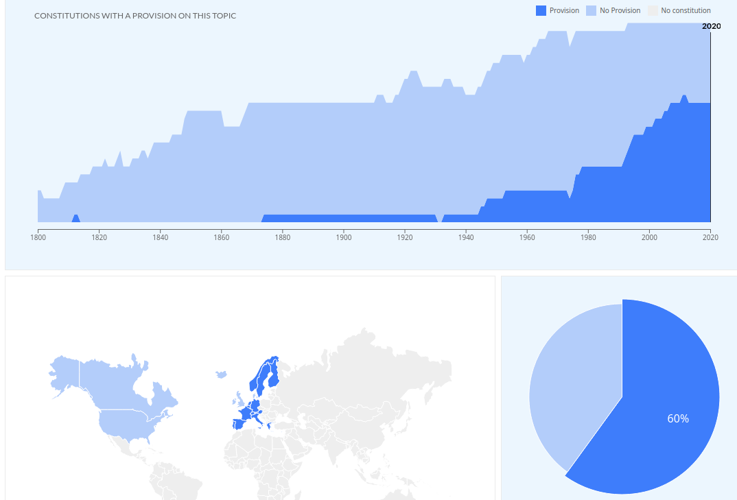
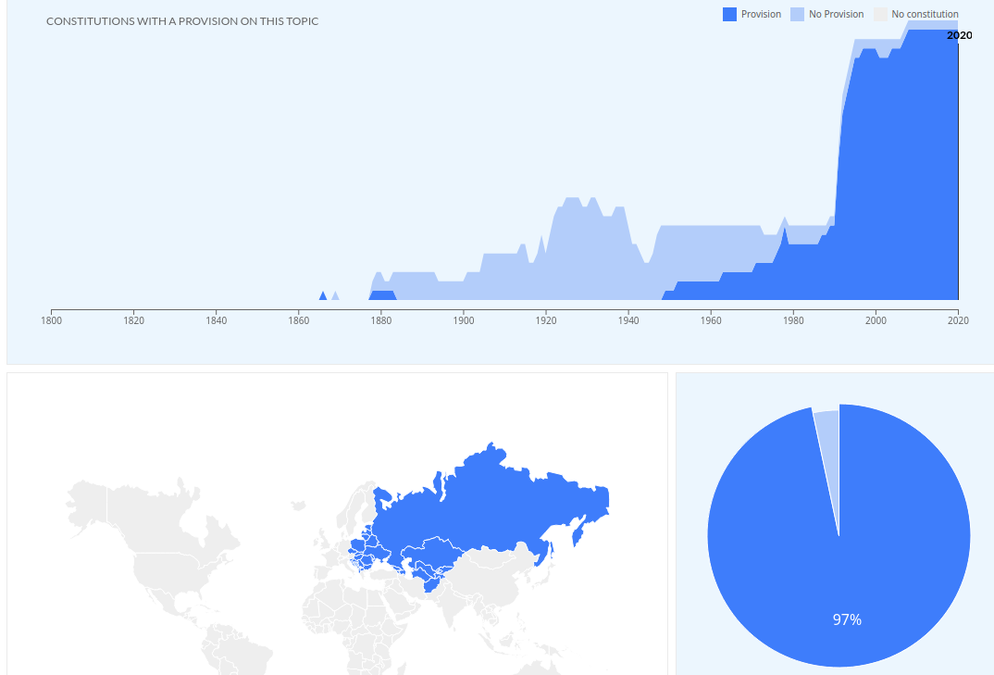
Provisions on Environmental Protection?
Western-Europe + US & Canada
Central & Eastern Europe (& others)
https://constituteproject.org/topics

Slide 30
Conclusion
Constitutions are the rules of the political game
Set of entrenched and fundamental laws
In democracies they establish RoL and limit gov. power vs citizens through separation of power and checks and balances
Wide variation in Europe on many different facets
Thursday: The Legislature

