Slide 1
Monday: Who is this final arbiter?
American/Judicial Review Model: ordinary courts under supreme/high court
Austrian/continental/European/Constitutional review model: specialized constitutional courts or supreme/high courts in special chambers
Mixed/American Continental Model: ordinary courts under supreme/high court or constitutional court
French model: special bodies or special chambers of supreme/high court
Other bodies (National Council, Parliament, …)
No constitutional/Judicial Review

Slide 2
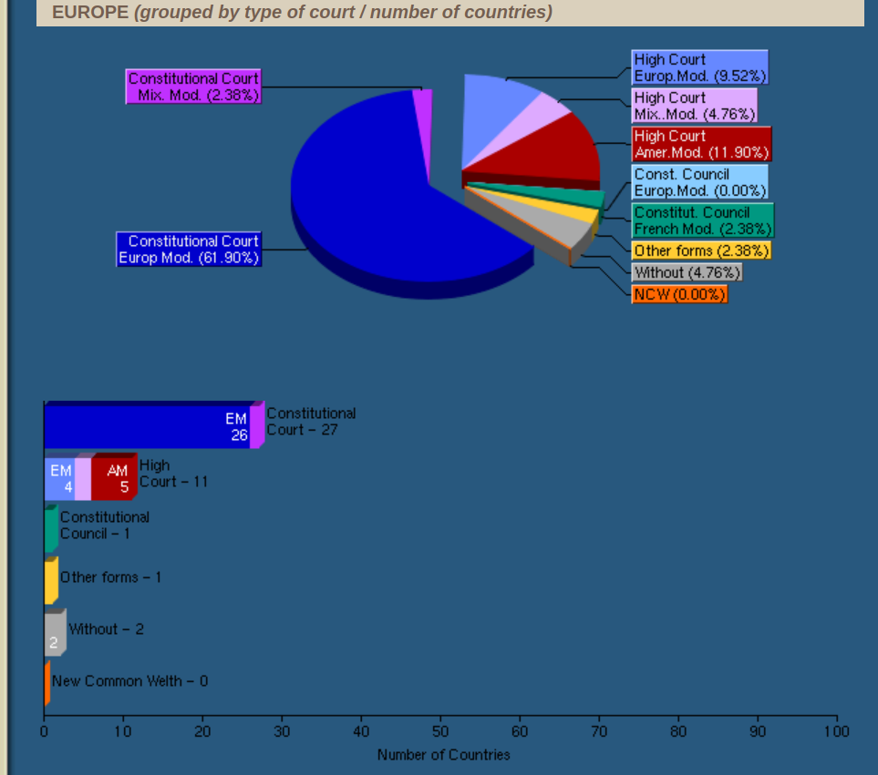
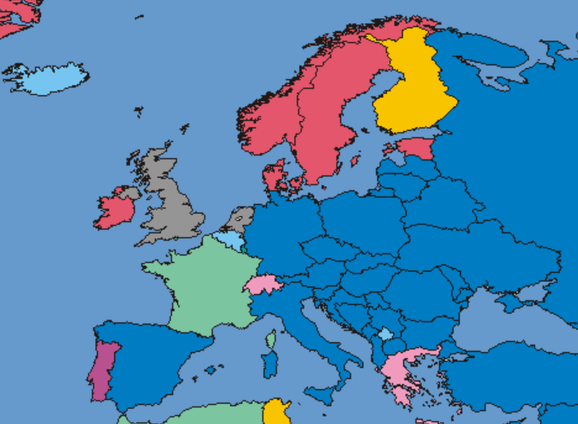
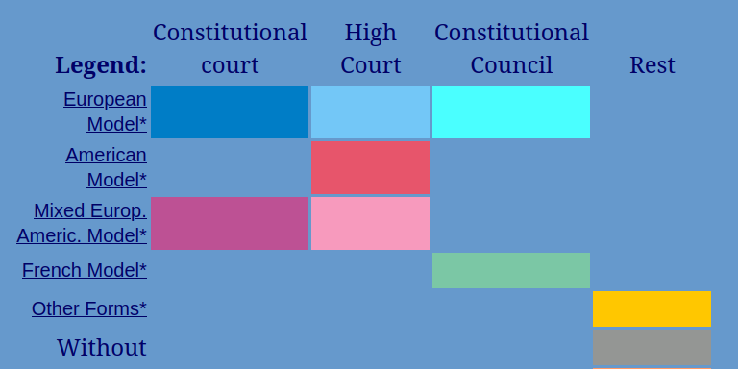
Who is this final arbiter?
https://www.concourts.net/comparison.php

Slide 3
Why Greece and Switzerland are Mixed, and not American
Greece
Switzerland
American: all courts can refuse to apply statutes considered unconstitutional
But: Special Highest Court that has a special role in constitutional matters and creates a unified constitutional interpretation
American: Swiss courts (including Federal Supreme Court) can review state laws
But: the Federal Supreme Court only does partial and weak review over federal laws
Mixed systems look ‘American’...
but add European‑style top-down centralization or limits.

Slide 4
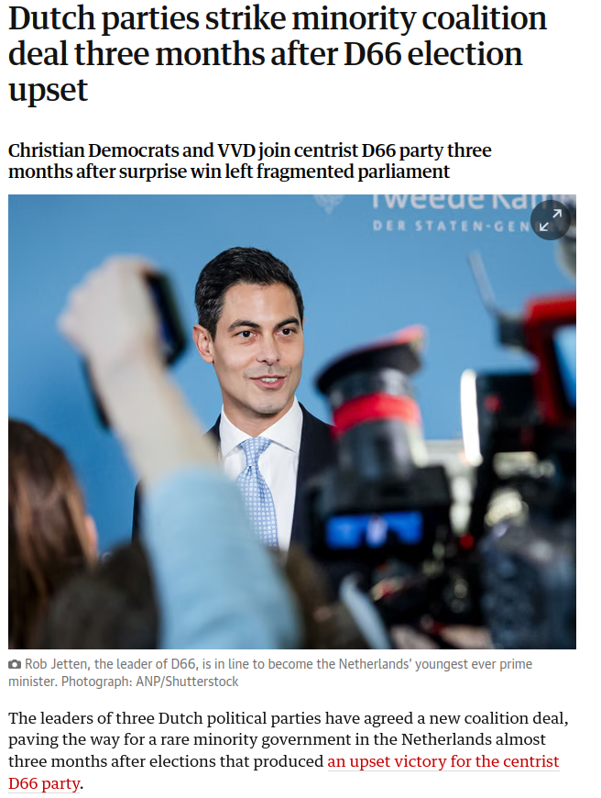
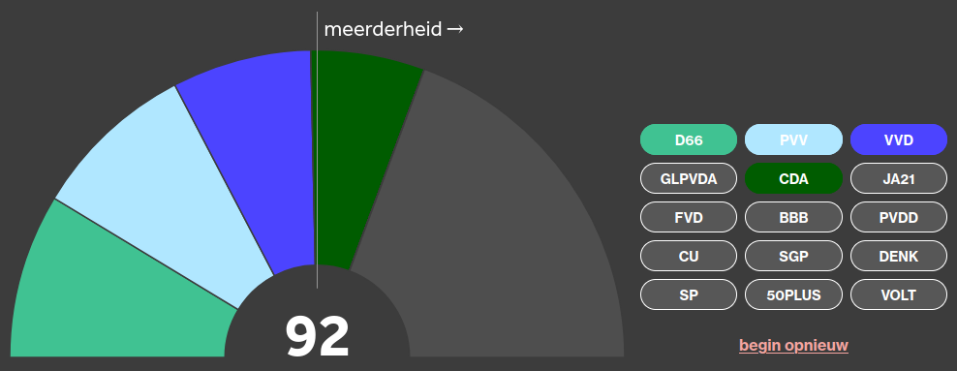
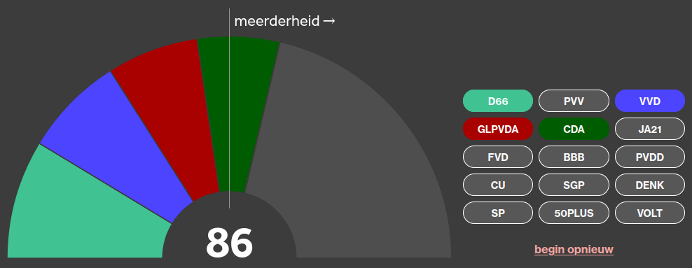
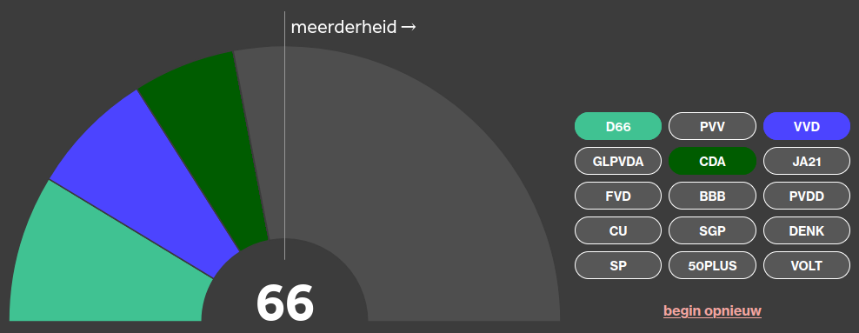
Dutch Minority Government and the link between the Executive and the Legislature
https://www.theguardian.com/world/2026/jan/28/dutch-minority-coalition-after-d66-election-upset

Slide 5
Institutions II: Executive
POL1036: Comparative European Politics – Lecture 8 - 19/2/2026

Slide 6

Recap: Constitutions as rules of the game and blueprints of power
Voting, running for office, …
Balancing act
Rights of citizens
Power of Government

Slide 7
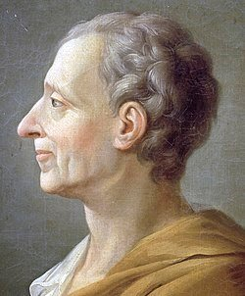
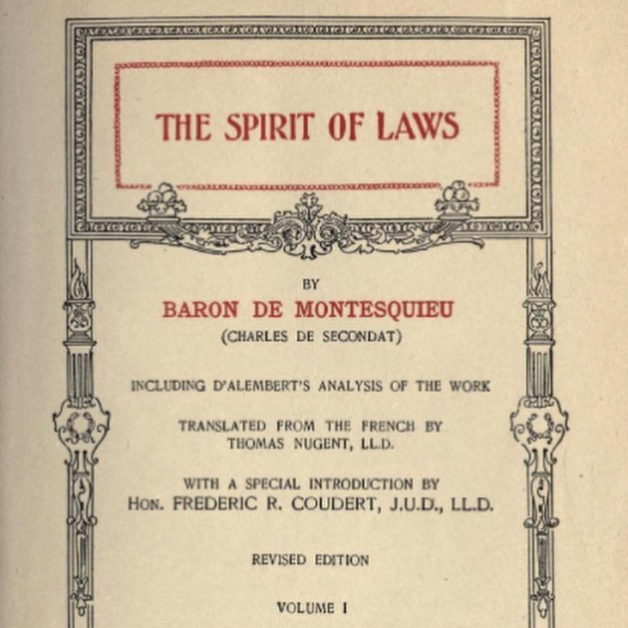
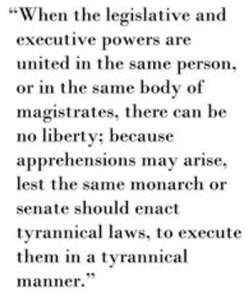
Recap: Core Principles of Democratic Constitutions
Rule of Law
Transfer of Power
Separation of Powers + Checks & Balances

Slide 8
Separation of Powers
Executive
Decision-making
Initiates most bills, sets agenda
Implementation, budget management
Approves gov., no-confidence votes
Review & annul measures
Enact laws, appoint judges
Legislature
Law-making
Judiciary
Review
Review & annul laws

Slide 9

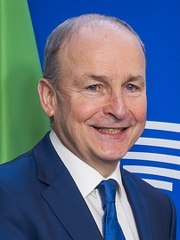

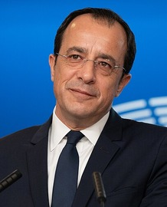
Heads of State vs Government
Head of Government
Executive
Power
Head of state
Both Ceremonial
Power

Slide 10


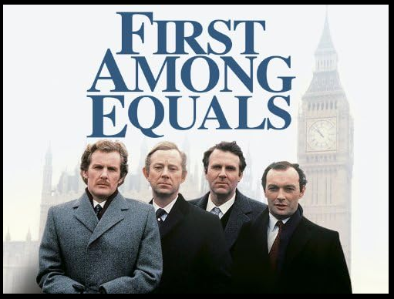


The Collective Executive in Parliamentary Systems
Cabinet/Council of Ministers
Headed by PM/Chancelor/Premier
(primus inter pares)

Slide 11
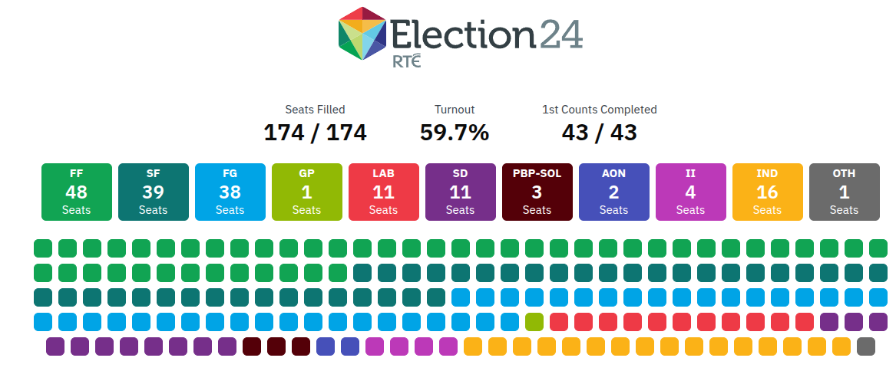

Always directly linked to the Legislature
The cabinet is a “buckle which fastens the legislative … to the executive part of the state. In origin it belongs to the one, in its functions it belongs to the other”
(The English Constitution, Walter Bagehot, 1894)

Slide 12

Always directly linked to the Legislature
Based on or supported by legislative majority (to survive a vote of no-confidence)
Therefore always responsible and accountable to legislature

Slide 13
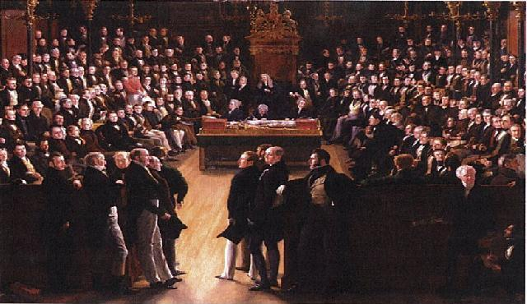
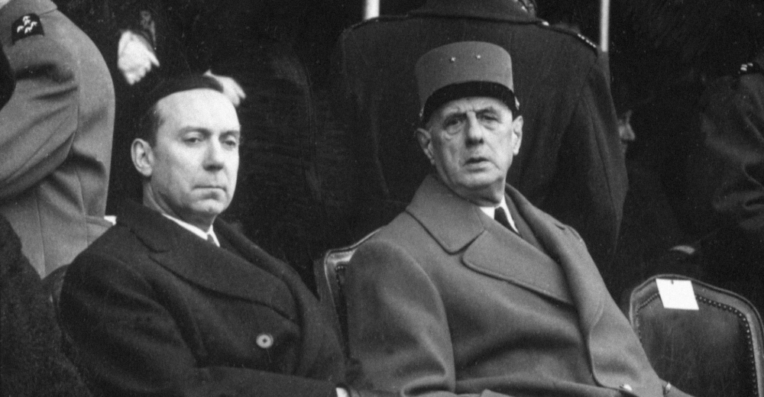
The rise of the Semi-Presidential Regime
Chaos in the French 4th Republic:
21 prime ministers from 1947 to 58
Stability in the French 5th Republic:
dual executive

Slide 14
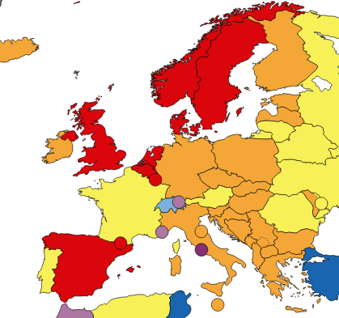
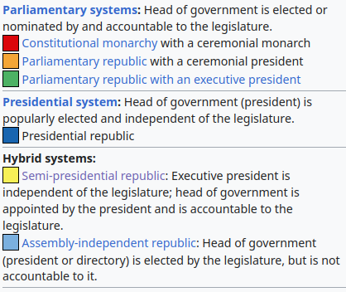
The Executive in Semi-Presidential Regimes
PM responsible to parliament + Directly elected President (Robert Elgie)
Europe: Quite a few cases with great variation

Slide 15
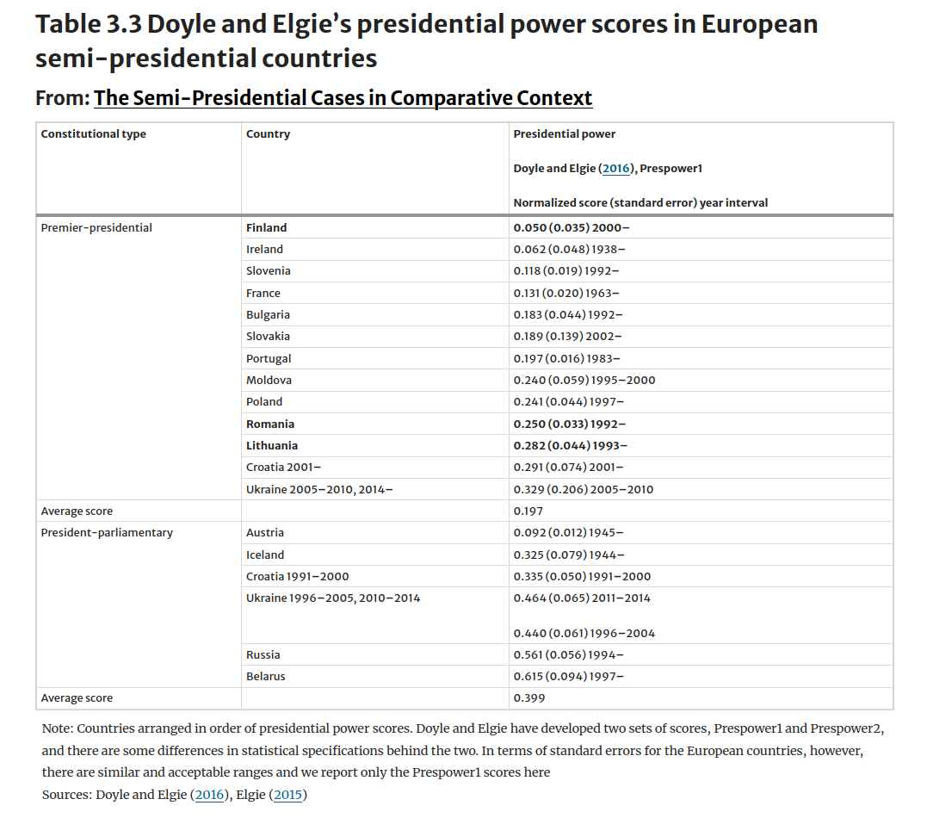
PM primarily responsible to legislature
Raunio, T., Sedelius, T. (2020). The Semi-Presidential Cases in Comparative Context. In: Semi-Presidential Policy-Making in Europe. Palgrave Studies in Presidential Politics. Palgrave Macmillan, Cham. https://doi.org/10.1007/978-3-030-16431-7_3
PM appointed by president and can be removed by president and legislature

Slide 16
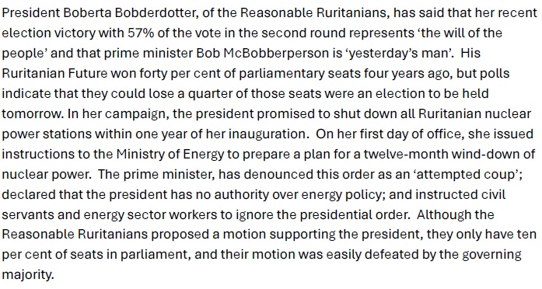

Slide 17
Cohabitation and the primacy of parties in parliamentary democracy
Example of inter-executive conflict based on the PM and the president being from different parties (Cohabitation)
Clear dual democratic legitimacy
We cannot understand parliamentary democracy without parties

Slide 18
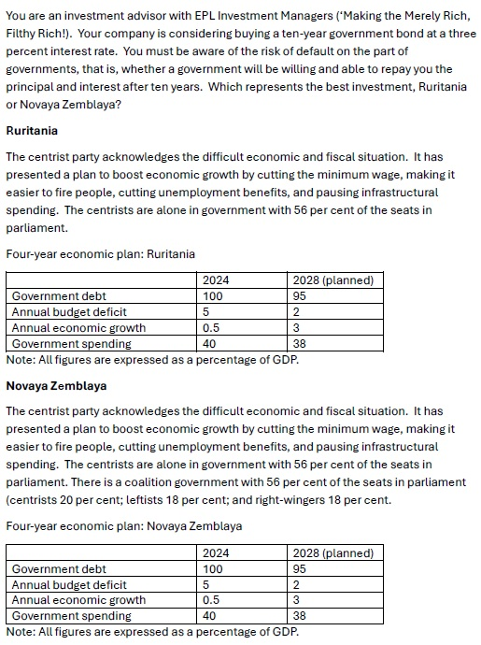
Parties as Veto-Players
NZ: more veto-players
More actors who need to agree
Less likely to change status quo (Tsebelis)
More veto-players:
Pro: Commitment to SQ is more credible
Contra: Less flexibility to react to change

Slide 19
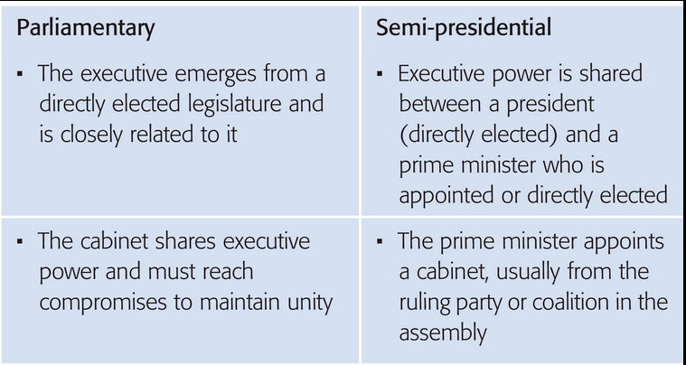
Conclusion
But both can be broadly considered as parliamentary democracies since (part of) the executive is derived from the legislature

Slide 20
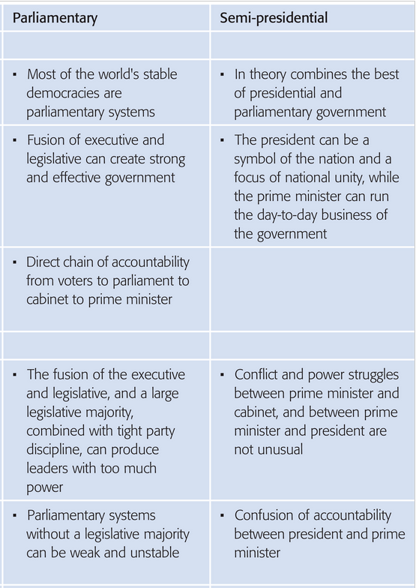
Conclusion: Pro's & Cons
PRO
PRO
Have a good Reading Week!

