Slide 1
Housekeeping
No class on Thursday! Replaced by pre-recorded lecture
Check Loop for schedule of oral exam
Can't make it? Let me know before EOB 04/03 (whole group needs to be present!)
Other options: Fri 27/03 and Fri 03/04
No strict structure for research paper/video, but include the basics: Intro, lit review, methods with discussion of variables, results, conclusion.

Slide 2
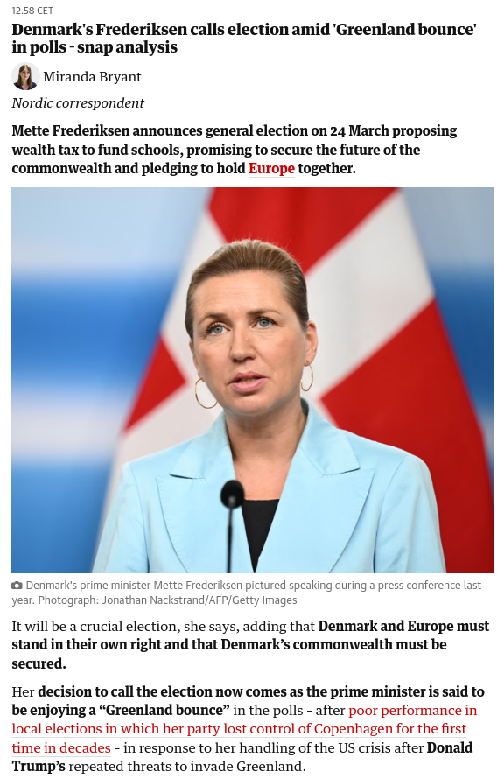
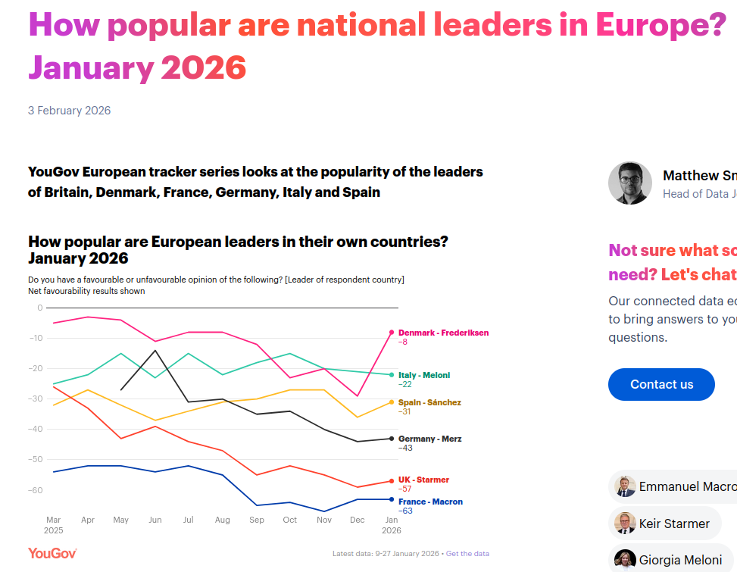
26/02: Danish PM calls snap elections (-ish)
https://yougov.com/en-gb/articles/54020-how-popular-are-national-leaders-in-europe-january-2026

Slide 3
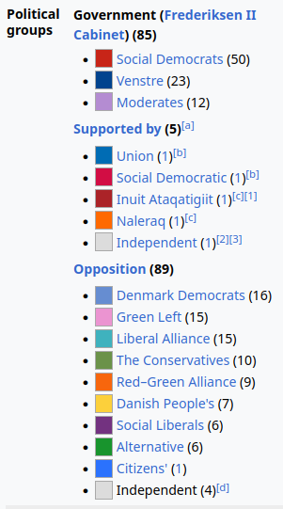
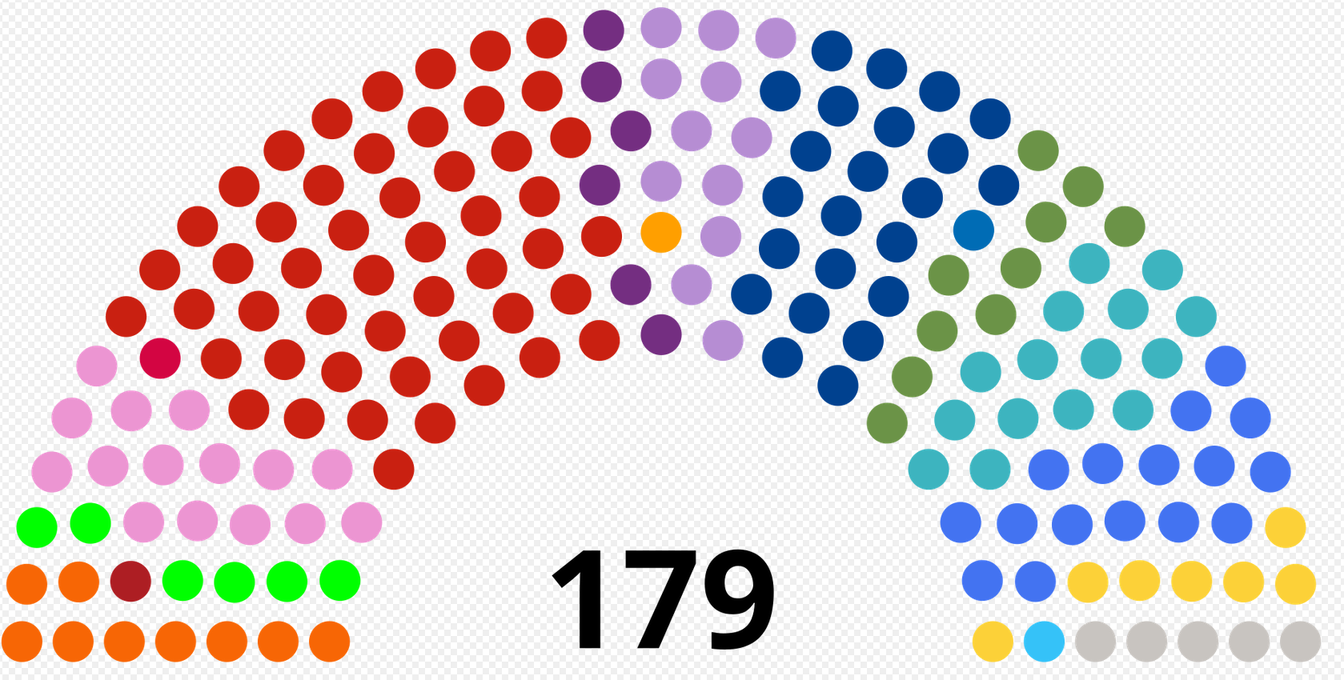
Minority government to...?
Notes:
Goal? Might be to get a majority, but seems unlikely
Probably prevent bigger losses, which was what was initially predicted
Today we will look at this side of the institutional equation

Slide 4
Institutions II: Legislature
POL1036: Comparative European Politics – Lecture 9 - 02/3/2026

Slide 5
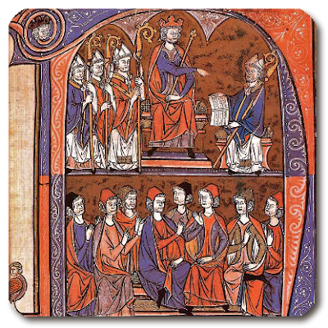
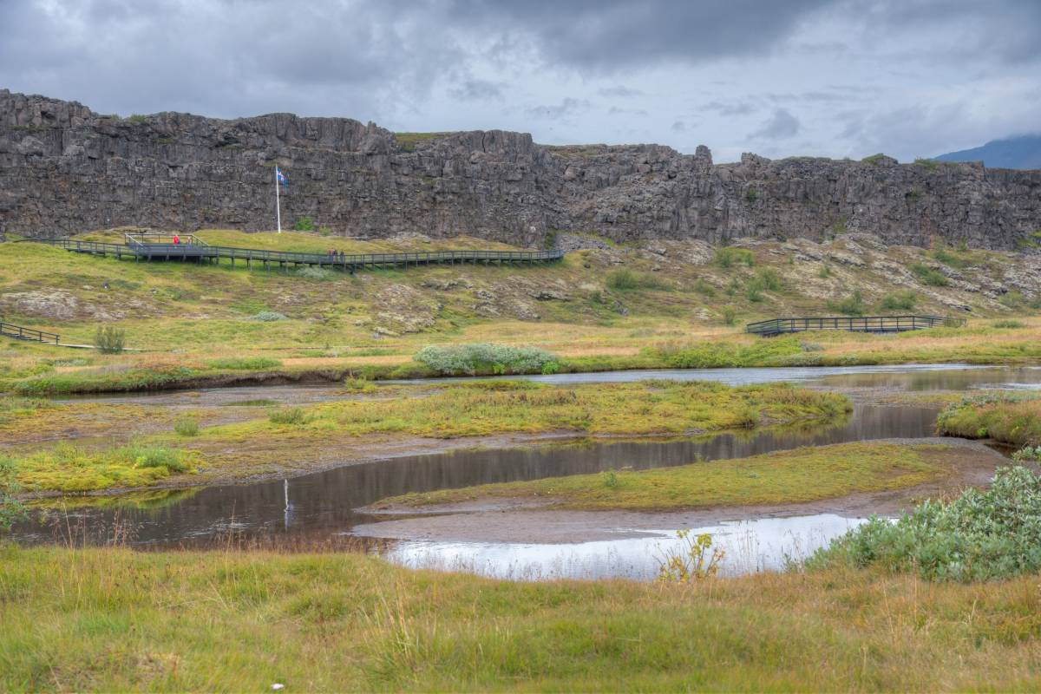
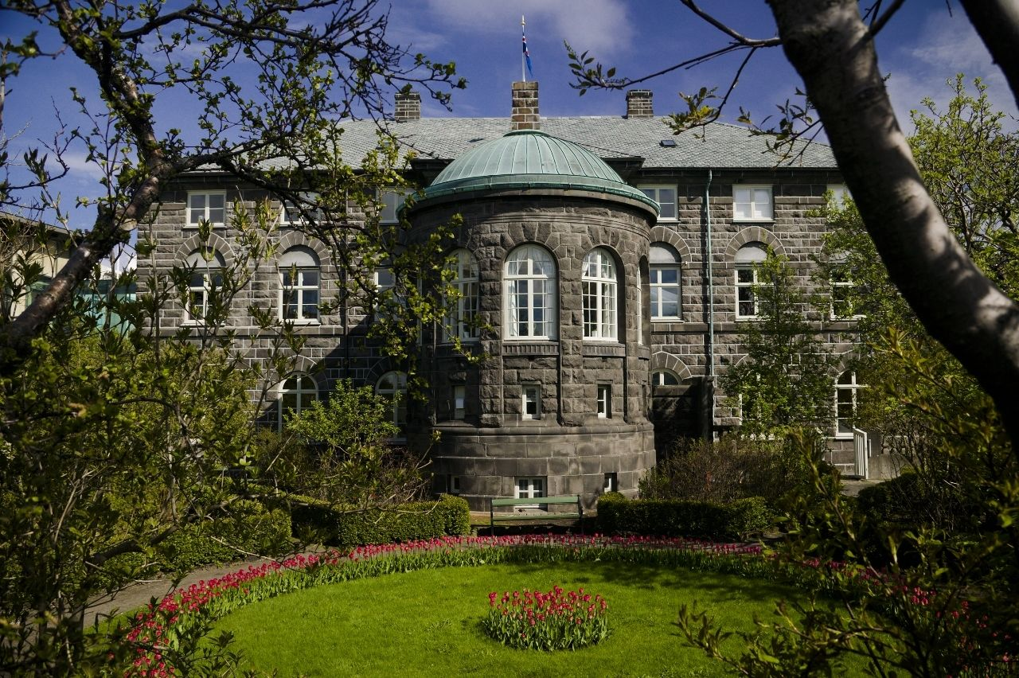

Precursors of parliamentary legislatures

Slide 6





Many names...

Slide 7
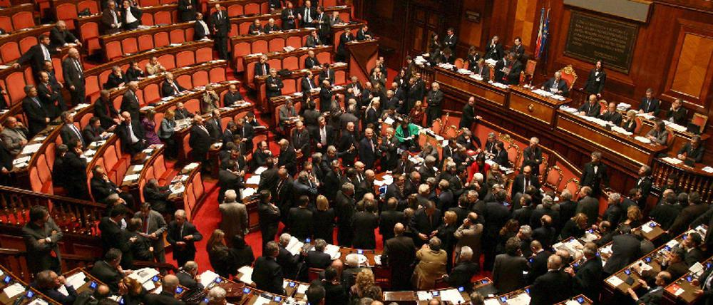
… but all are 'talking shops'

Slide 8
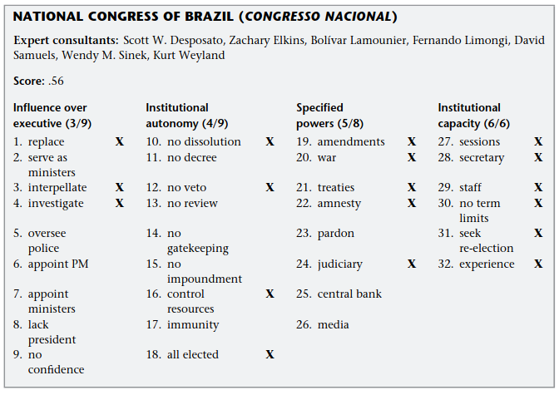
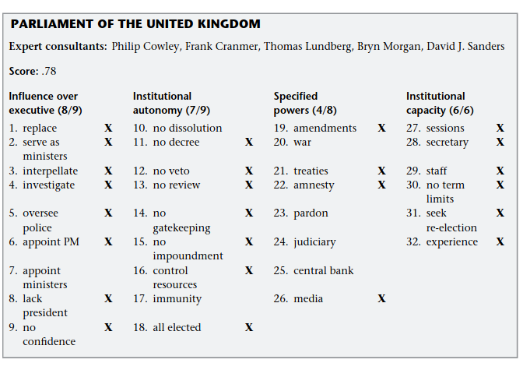
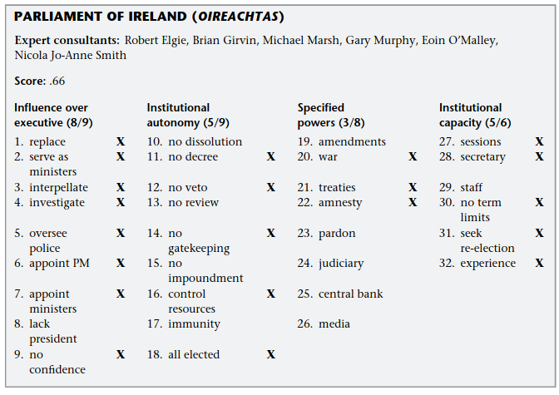
European Legislatures: Strong in terms of powers...
Fish MS, Kroenig M. Country Studies. In: The Handbook of National Legislatures: A Global Survey. Cambridge University Press; 2009. Scores are for the Parliamentary Powers Index.

Slide 9
But how hard does a government have to work to get an MP's vote in these countries?

Slide 10
Recap: Separation of Powers
Executive
Decision-making
Initiates most bills, sets agenda
Implementation, budget management
Approves gov., no-confidence votes
Review & annul measures
Enact laws, appoint judges
Legislature
Law-making
Judiciary
Review
Review & annul laws

Slide 11
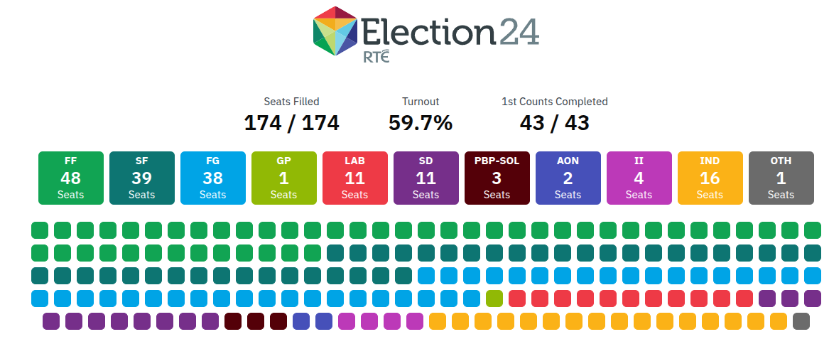
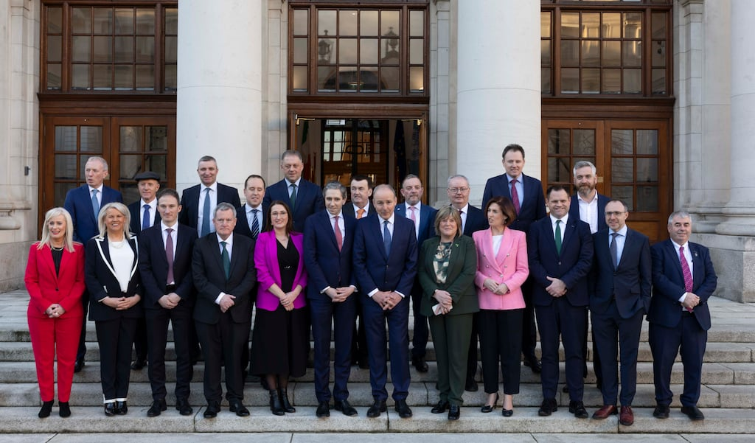
Recap: Always directly linked to the Legislature
The cabinet is a “buckle which fastens the legislative … to the executive part of the state. In origin it belongs to the one, in its functions it belongs to the other”
(The English Constitution, Walter Bagehot, 1894)

Slide 12
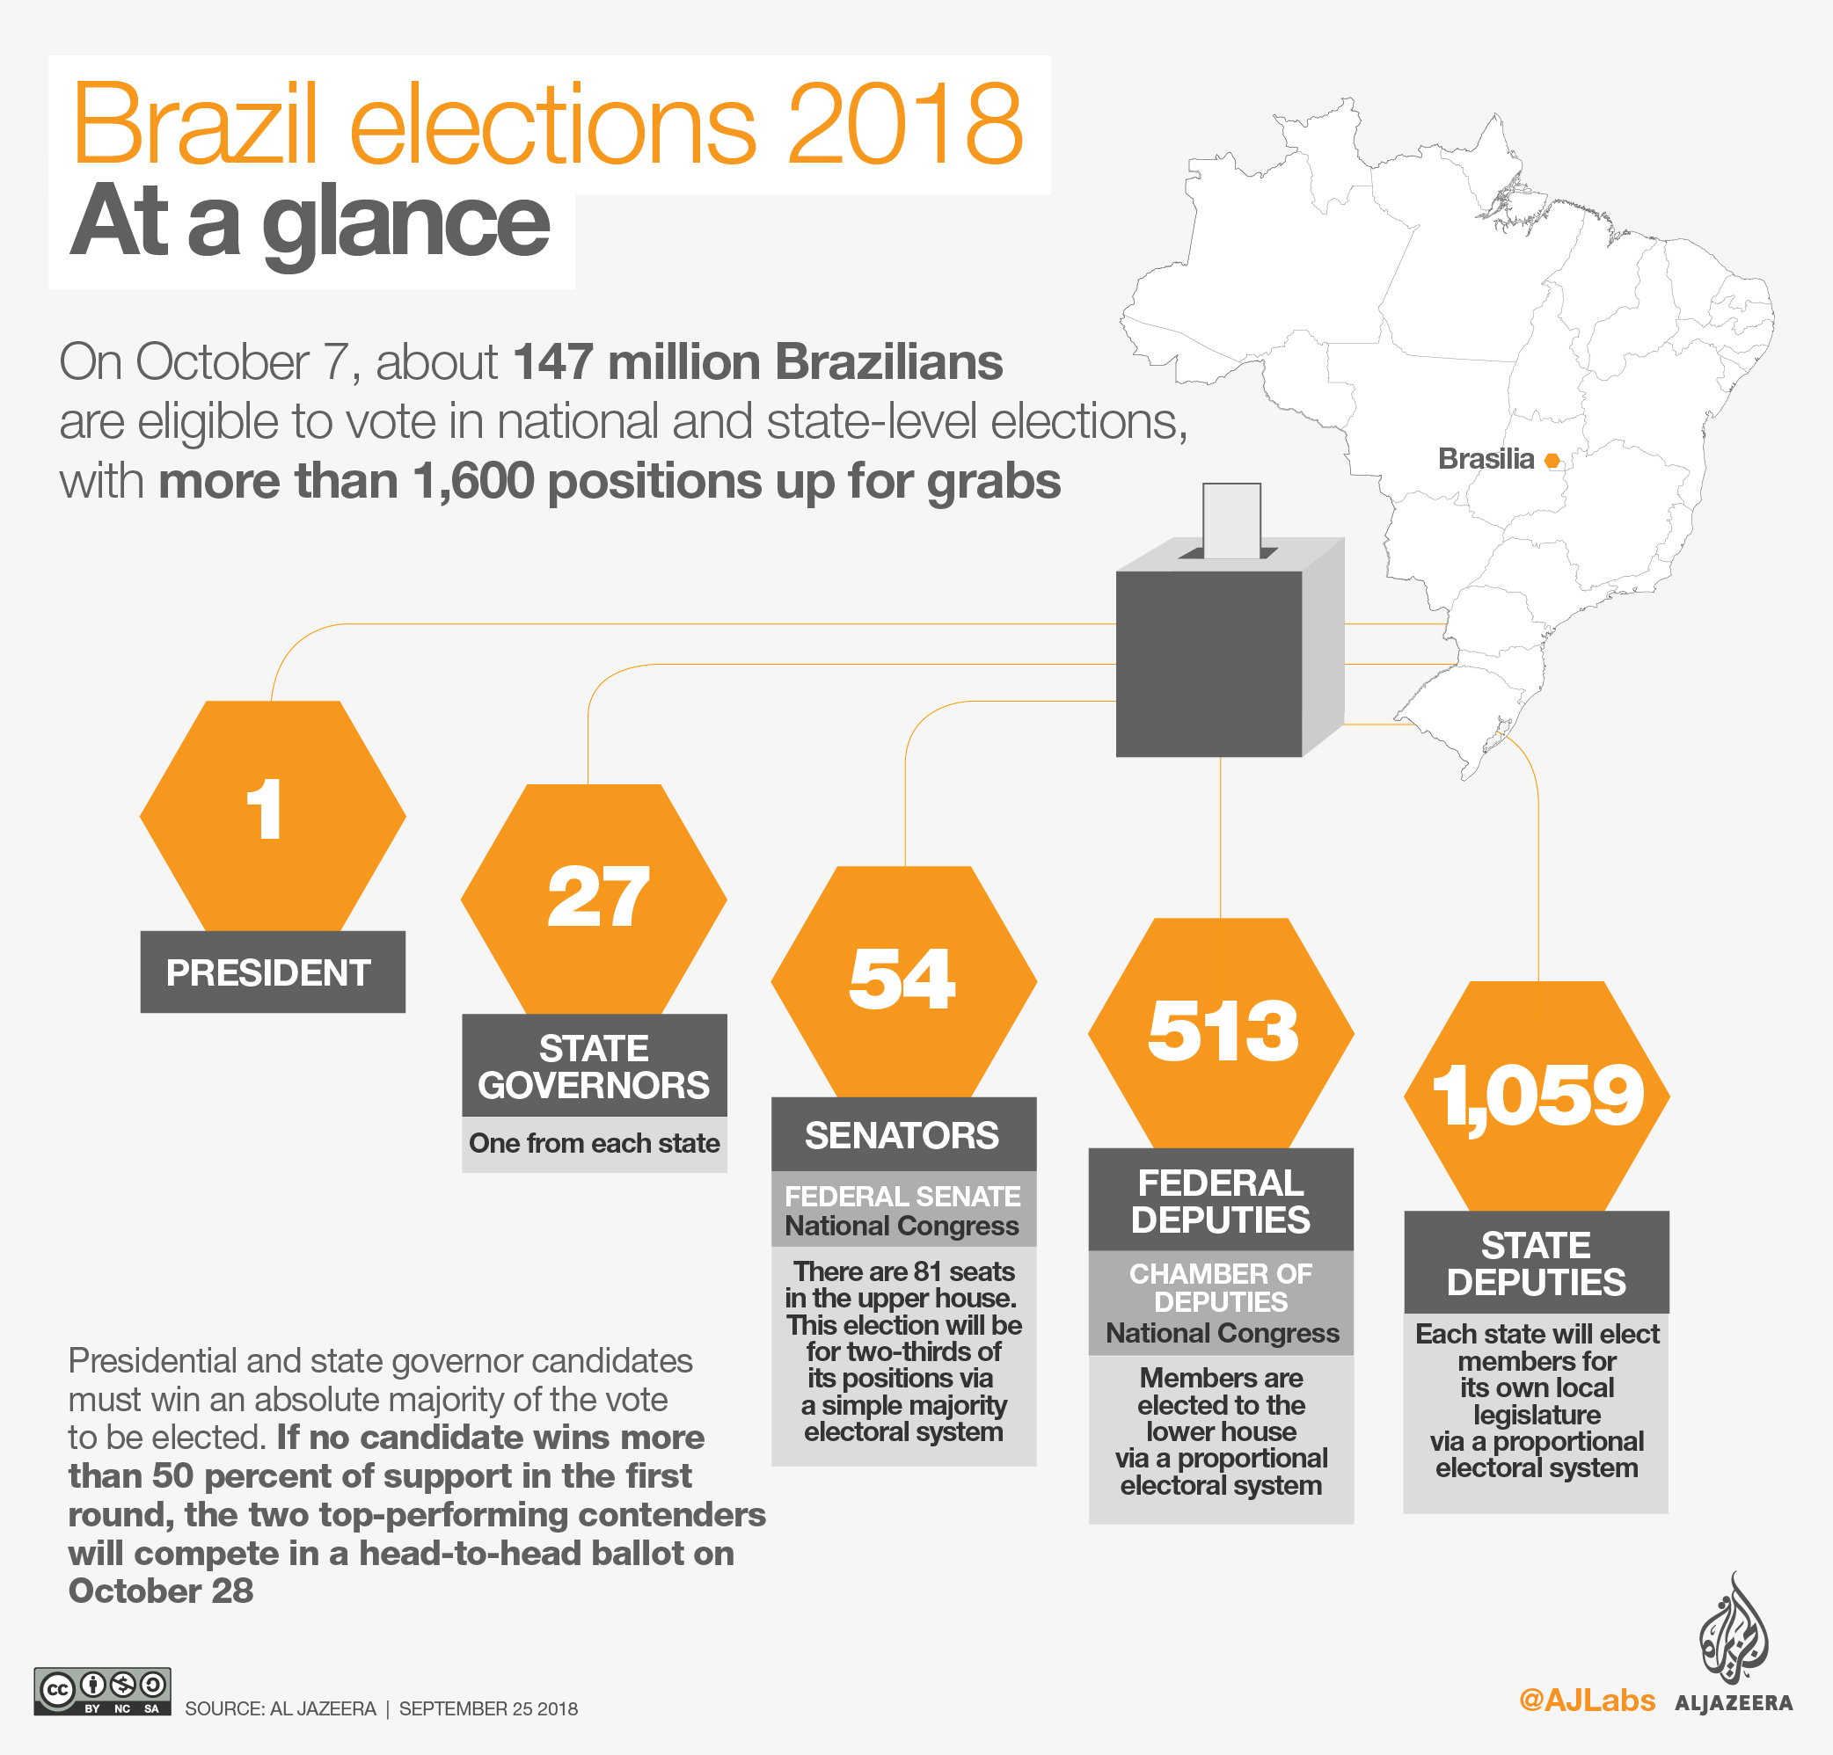
European Legislatures are Generally Weak vs the Executive
Europe: Legislature wields power through government
Brazil: Government is elected independently from legislature

Slide 13
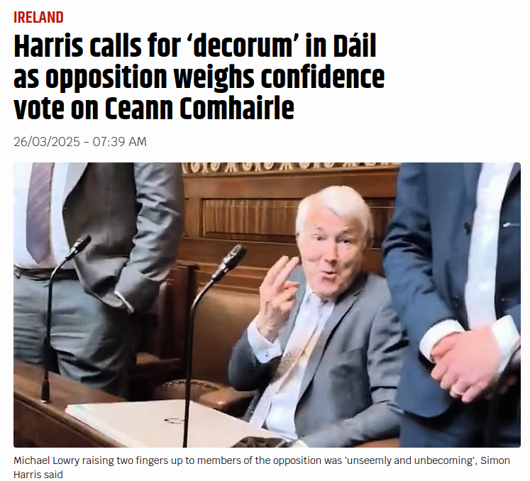
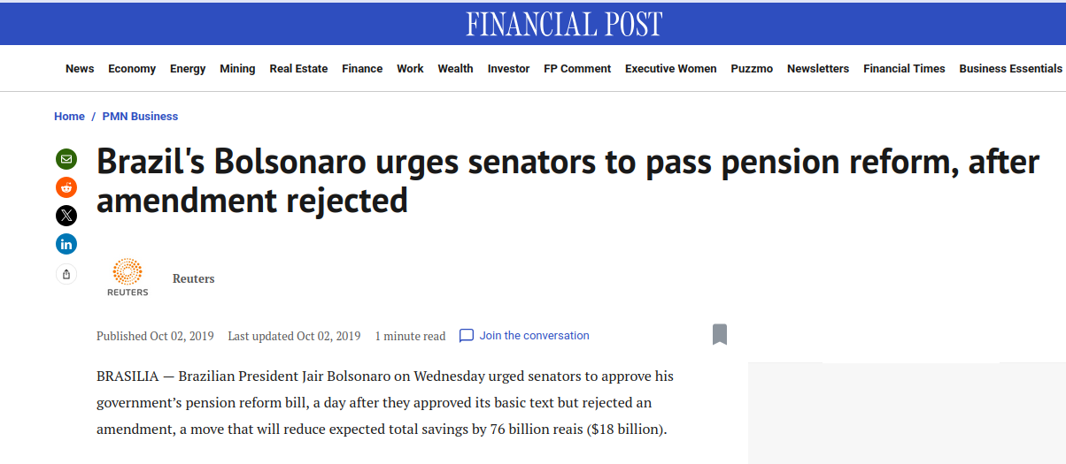
European Legislatures are Generally Weak vs. the Executive
Europe: Conflict between majority and opposition
Brazil: Conflict between Government and Legislature

Slide 14
Parliament & Government are like two machines driven by the same motor – the party. Maurice Duverger (1954: 46) about the UK

Slide 15
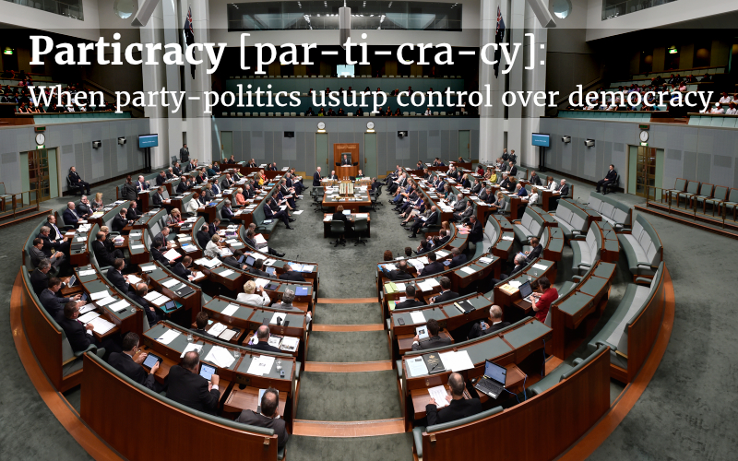
Parties dominate parliaments...
MPs are committed to parties
Parties support government
Transparent voting leads to high party discipline
Professionalization makes MPs dependent on their party
… & Governments
Compiled by parties
Can put pressure on government

Slide 16
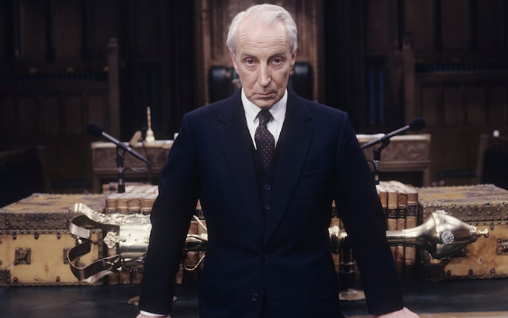
But MPs are not just "sheep" or "lobby fodder"
We tend to overstate the power of the party "whip"
Instead: fundamental coincidence between interest and identity
Share views with other MPs
Vote-Trading
Votes are usually for parties
Career perspectives
The party’s interest is the MP’s interest.

Slide 17
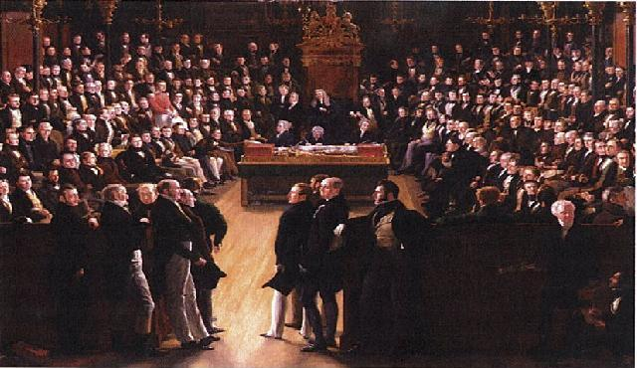
"Golden Age" of Parliaments?
Parliaments need political parties:
Low discipline lead to chaos in the French 4th Republic: 21 prime ministers from 1947 to 58

Slide 18
How do European legislatures work if they are dominated by parties? Majoritarian vs. Consensual Parliaments

Slide 19
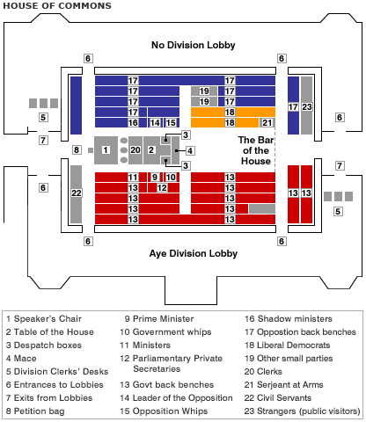
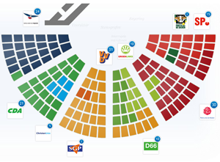
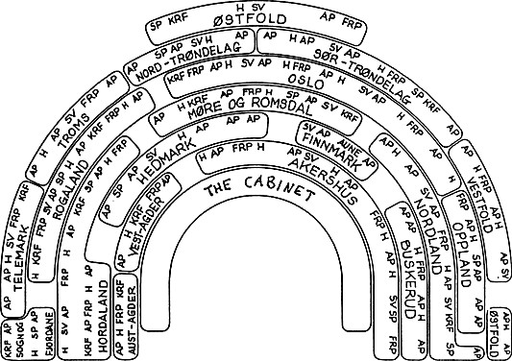
Modes of interaction
Majoritarian: Inter-Party
Consensus: Cross-Party
Consensus: Non-Party
Netherlands
Tweede Kamer
Norway
Storting
United Kingdom
Working Parliaments:
Committees
True Talking Shop

Slide 20
Institutional variations in law-making
 | Majoritarian | Consensus
Agenda-Control | Government | Party Groups and/or President of Parliament
Main area of work | Full Parliament | Committees
Sequence of Debate | Full Parliament first | Committees first

Slide 21
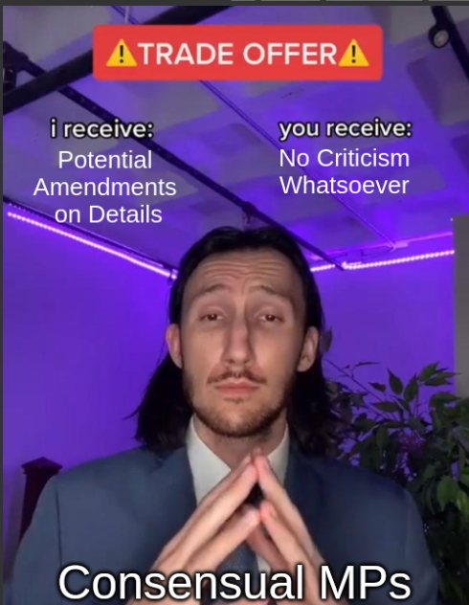
Opposition in Law-Making?
Consensual Legislatures
Majoritarian Legislatures
"Heckling a steam-roller"
- Austin Mitchell, UK Labour MP

Slide 22
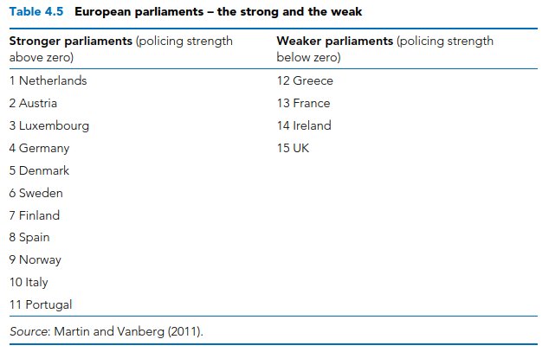
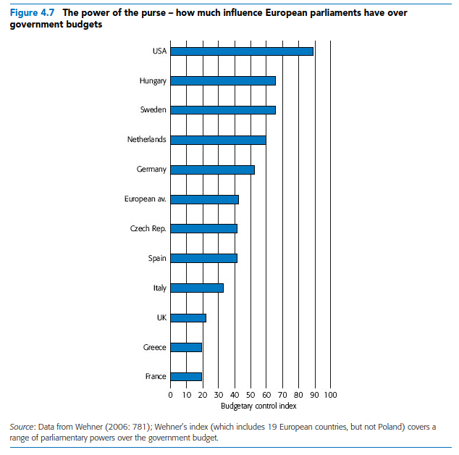
Scrutiny and Oversight of the Executive
Bale, T. (2017). European politics : a comparative introduction (4th ed.). Palgrave. Chapter 4.

Slide 23
When are monitoring committees more powerful?
Committees mirror structure of government.
MPs belong to one committee only.
Committee chairs are distributed proportionally, not controlled by government.
The chair is elected by secret ballot.
The right to summon individuals, including ministers.
The right to all information possessed by the government
Meetings behind closed doors.
Often achieved via self-empowerment!

Slide 24
Application to Ireland
Committees mirror structure of government.
MPs belong to one committee only.
Committee chairs are distributed proportionally, not controlled by government.
The chair is elected by secret ballot.
The right to summon individuals, including ministers.
The right to all information possessed by the government
Meetings behind closed doors.

Slide 25
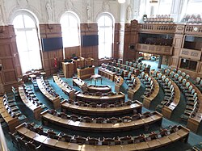
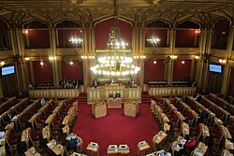
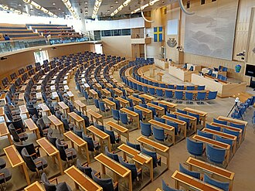
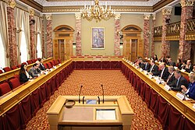
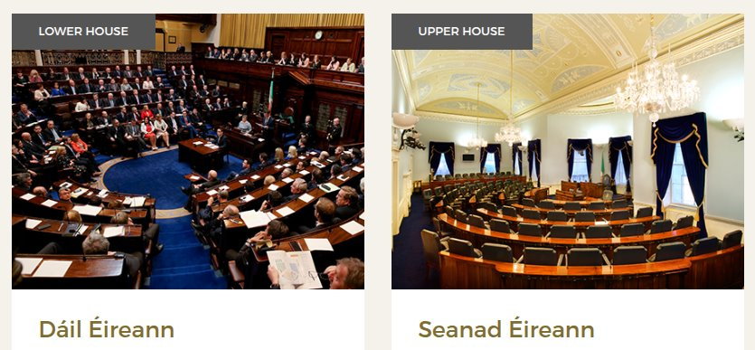
And what about the second chamber?
Unicameral (EU: 14/27)
Bicameral (EU: 13/27)
Folketing (DK)
Storting (NO)
Riksdag (SW)
Chambre (LU)

Slide 26
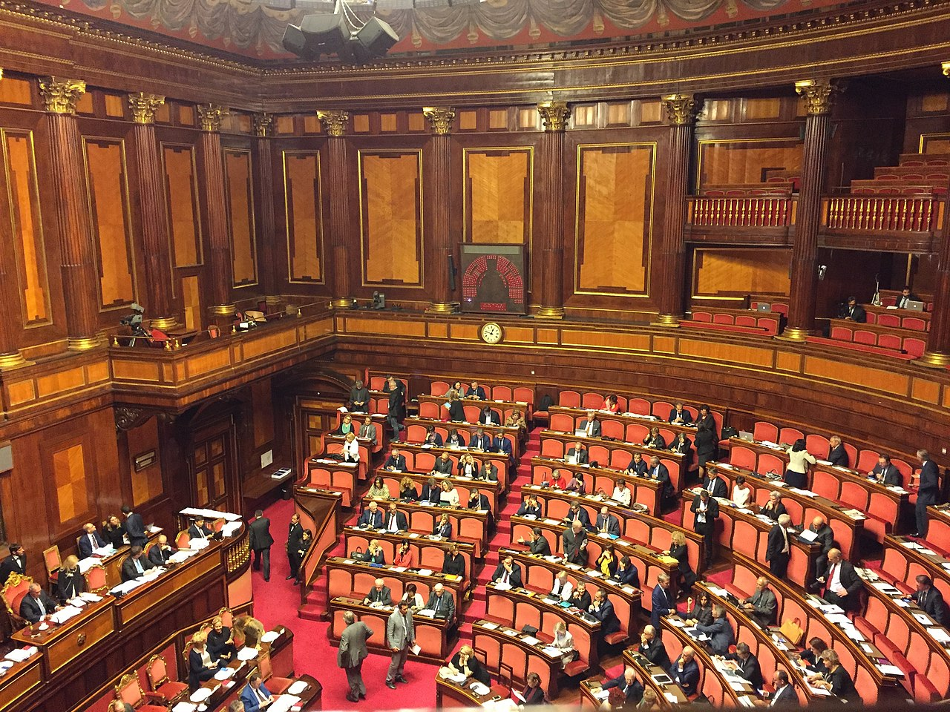
Superfluous or Mischievous?
Usually, upper house can only delay legislation
But sometimes on similar footing: Italian Senato

Slide 27
Conclusions
European legislatures are generally weak in law and policy-making
This is largely because of the domination of political parties
They do have the strength to adequately control and scrutinize the executive, in part due to increasing self-empowerment
There is great variation between:
inter-party theatre of majoritarian parliaments
the cross- party committee work of consensual parliaments

