Slide 1
POL1036: Comparative European Politics
Introduction – 12/1/2026

Slide 2
Comparative Politics?

Slide 3
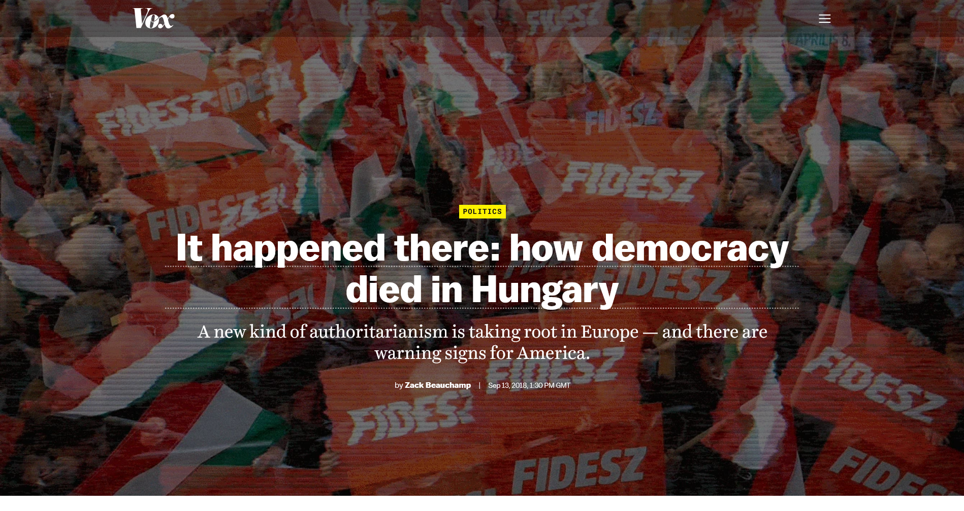

Slide 4
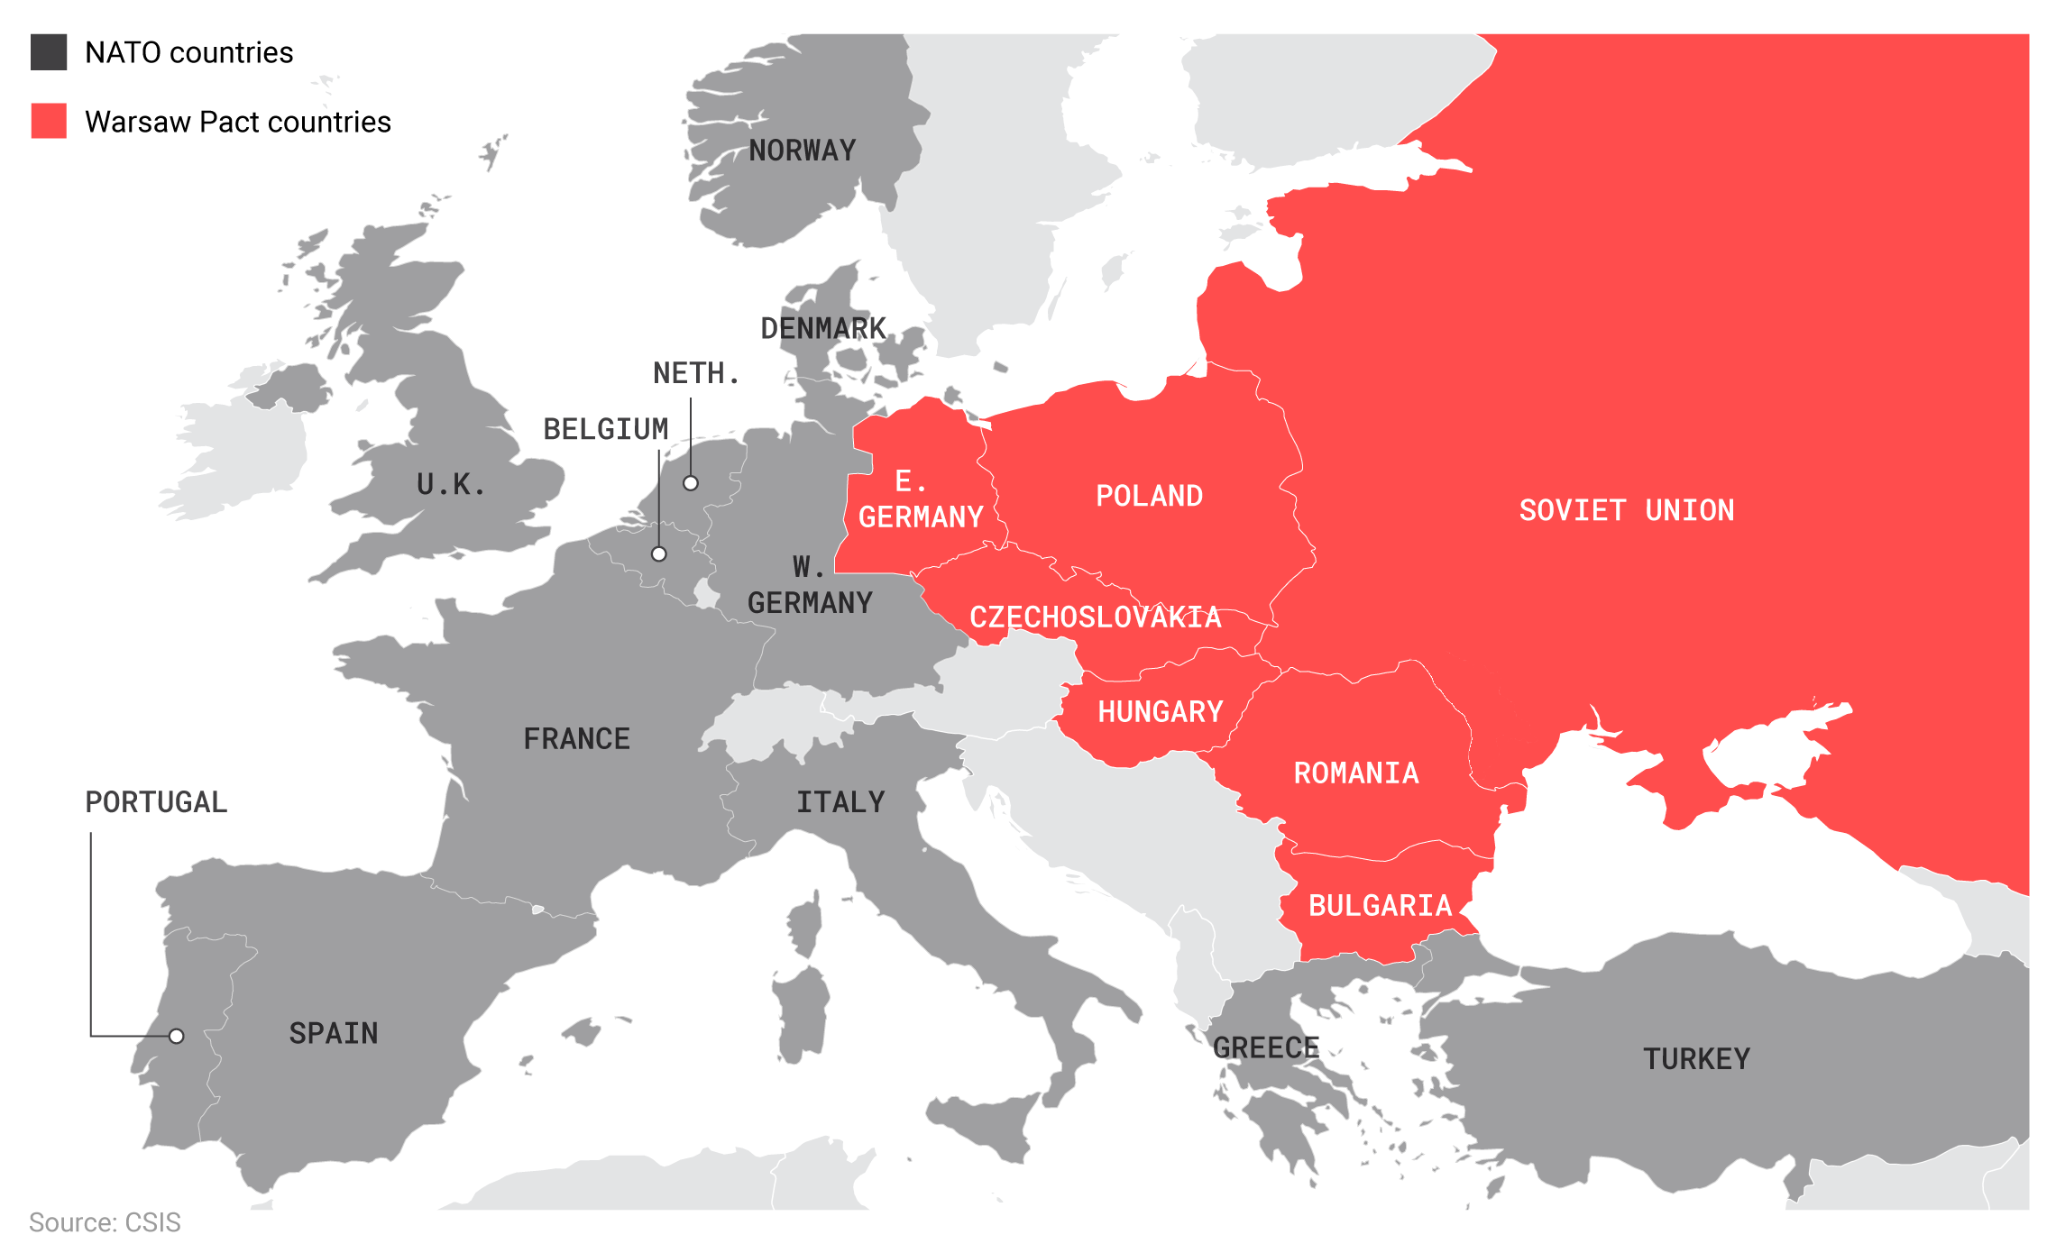
NATO Countries
Warsaw Pact Countries

Slide 5
Pre-2010: democratization success story (-ish)
GOOD
Strong institutions
Competitive party system
Vibrant civil society
Free & diverse media
BAD
2002-2010: socialist-led coalition
Corruption scandals
Tax evasion
Siphoning public funds

Slide 6
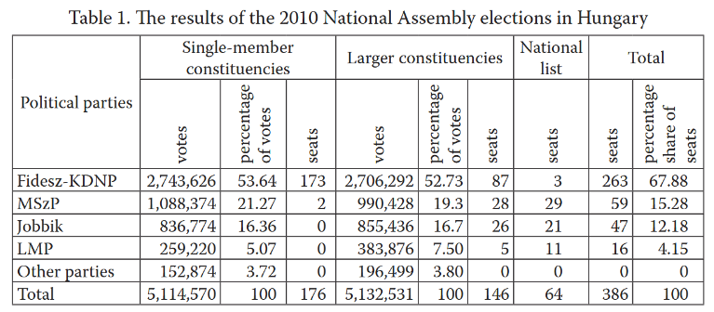
…& the Ugly: 2010 Parliamentary Elections
Orbán’s Fidesz secured 2/3 super majority
Source: Kubas & Czyż (2018). From a Liberal Opposition Party to a Right-Wing Party of Power. Three Decades of the Hungarian Fidesz (1988–2018). DOI: https://doi.org/10.17951/bc.2018.3.47-65

Slide 7
Fidesz locks in the power
Partisan Reforms
Removed checks on power of prime minister
Packed the state with loyal partisans
Control over news media (f.i. helping allied businesspeople take over private sector media)
Electoral reforms:
Gerrymandering
No campaign on private media outlets

Slide 8
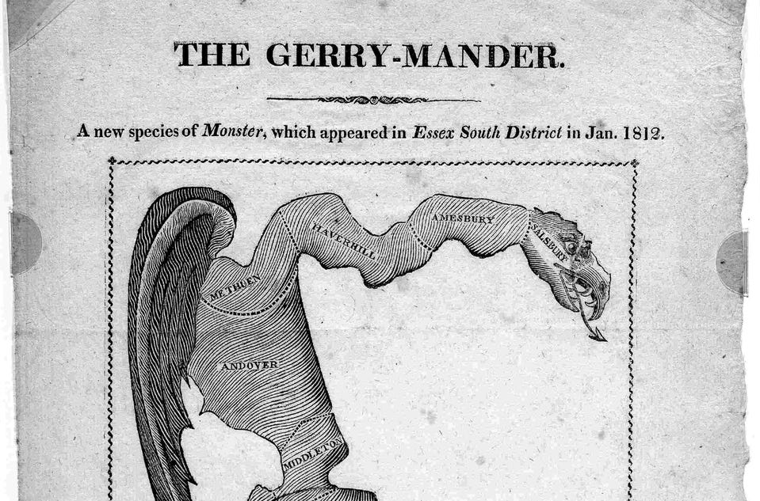
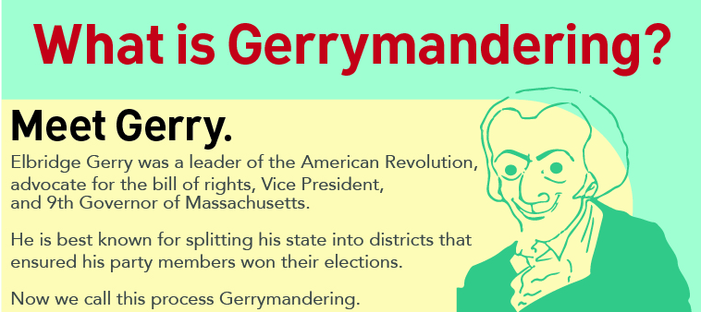
Gerrymandering

Slide 9
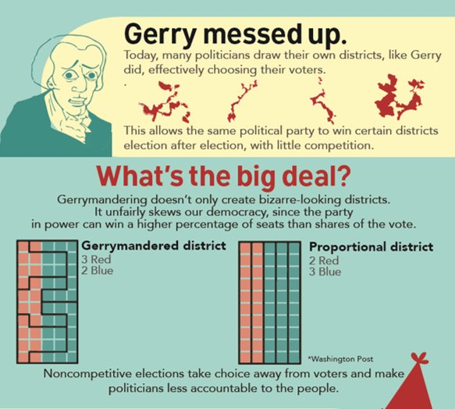
Gerrymandering

Slide 10
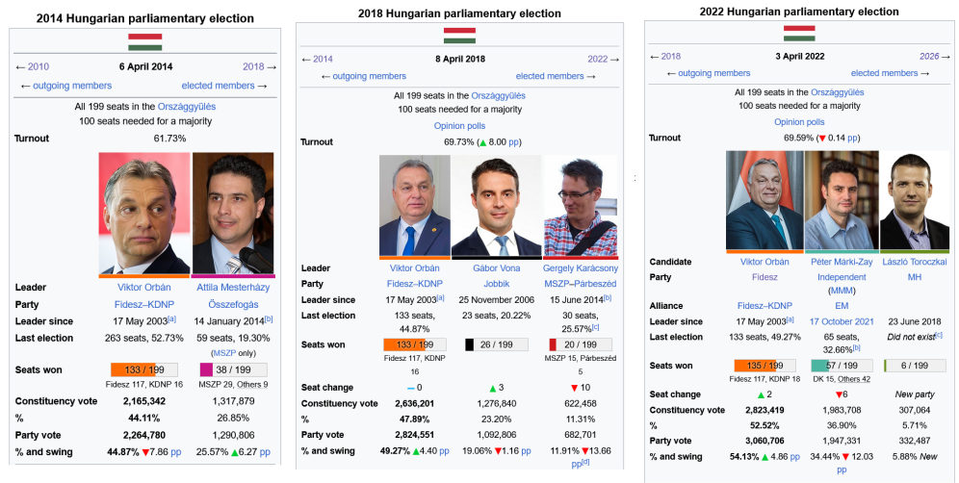
The Fidesz-mander stacks the deck

Slide 11
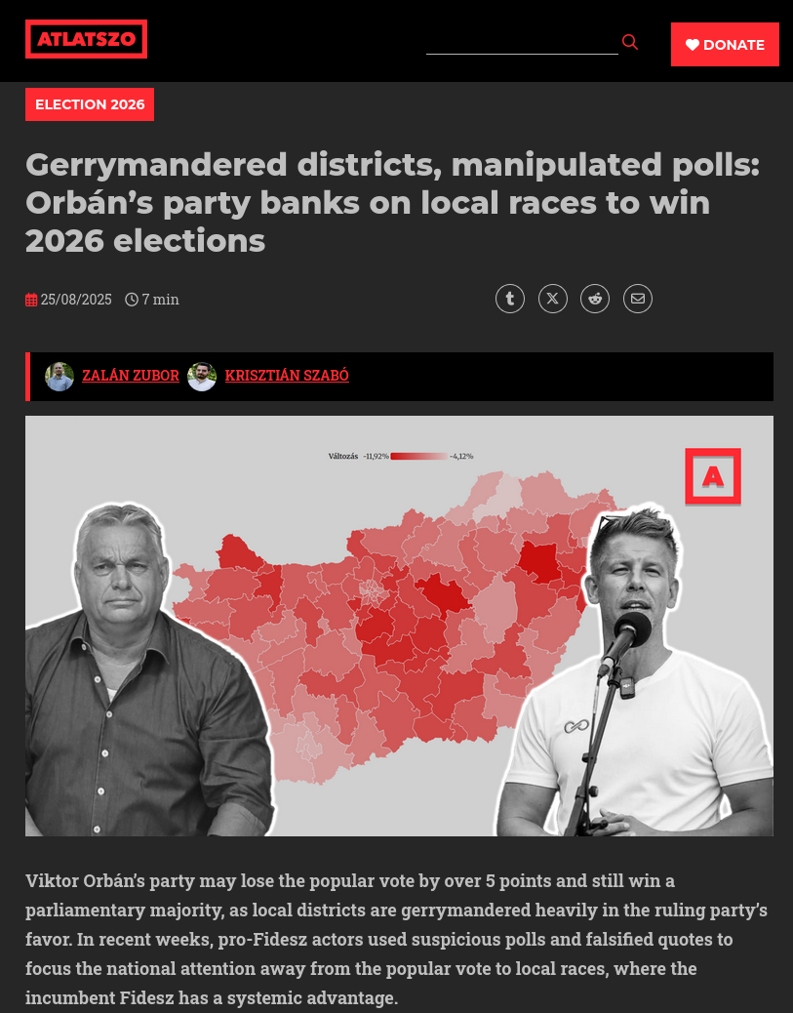
The Fidesz-mander stacks the deck​
https://english.atlatszo.hu/2025/08/25/gerrymandered-districts-manipulated-polls-orbans-party-banks-on-local-races-to-win-2026-elections/

Slide 12
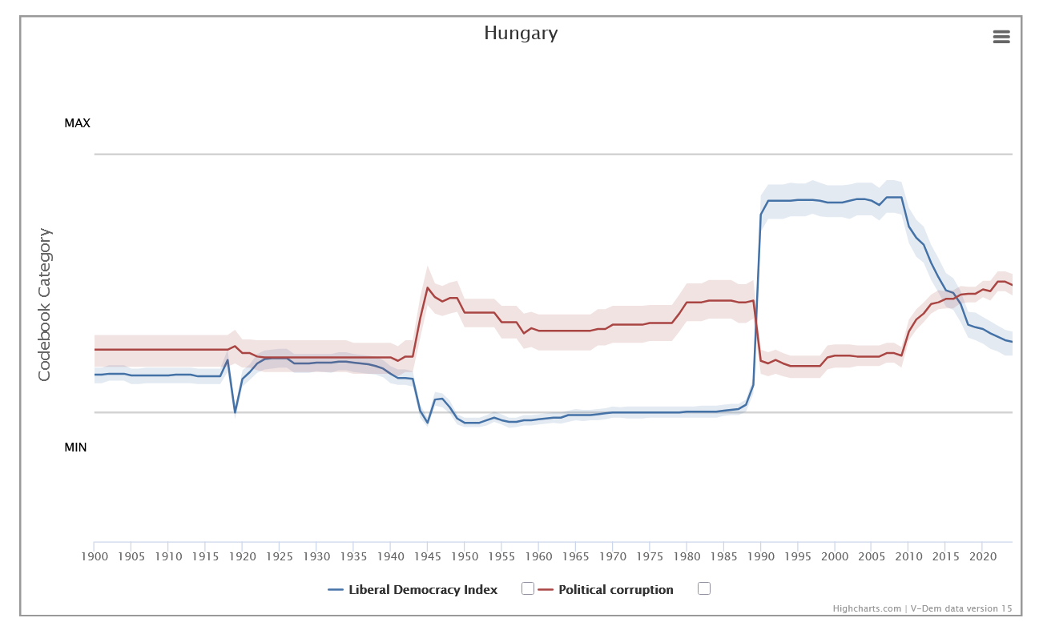
Result: Democratic Backsliding
Fall of Berlin Wall
Fidesz 2010 election win

Slide 13
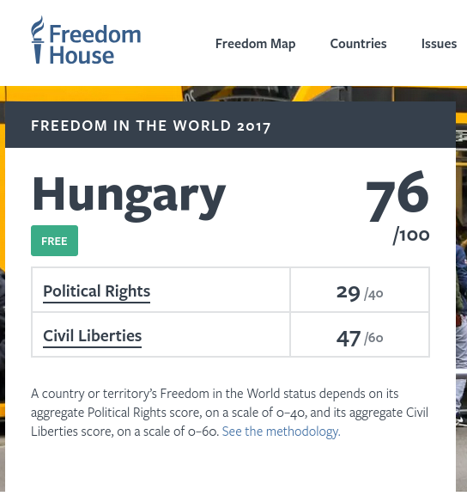
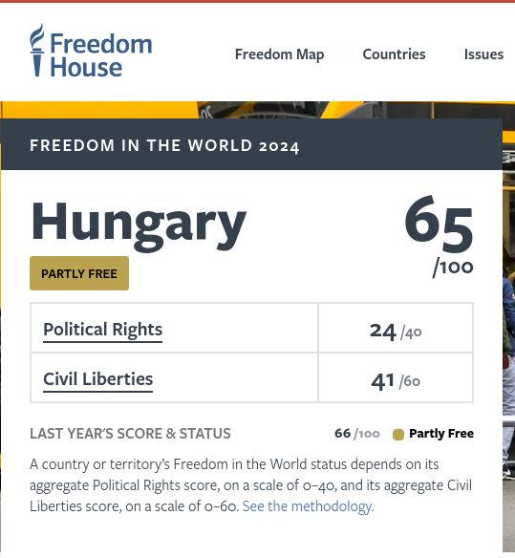
Result: Democratic Backsliding
Only EU country considered partly free

Slide 14
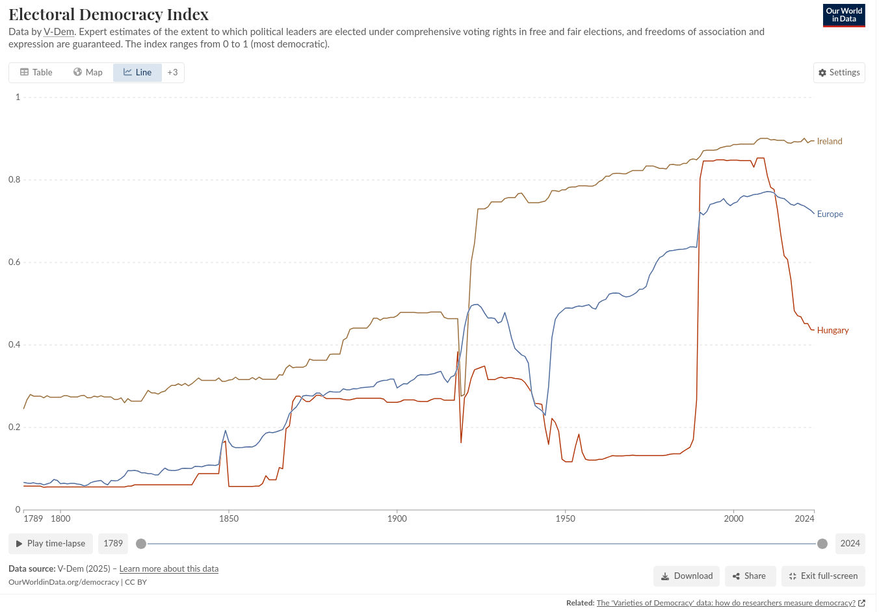
Comparative Politics?
Is Hungary an outlier or part of a broader trend toward democratic backsliding in Europe?
https://ourworldindata.org/democracy#explore-data-on-democracy

Slide 15
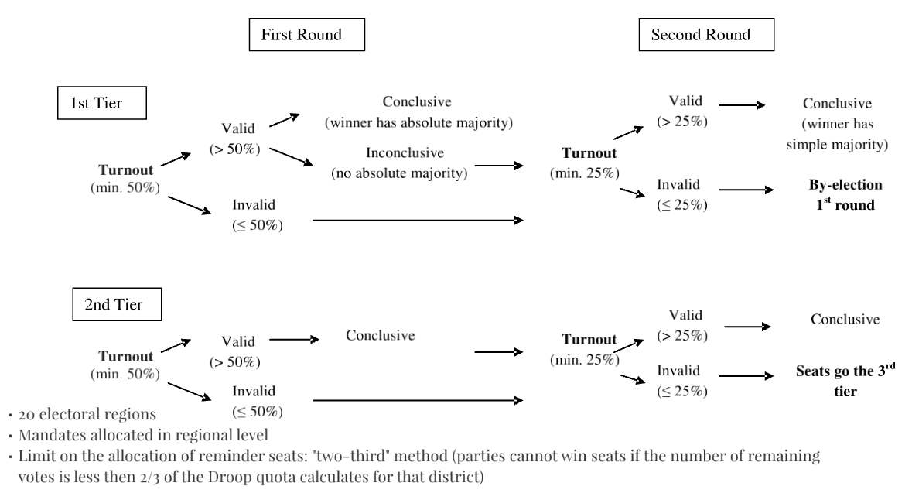
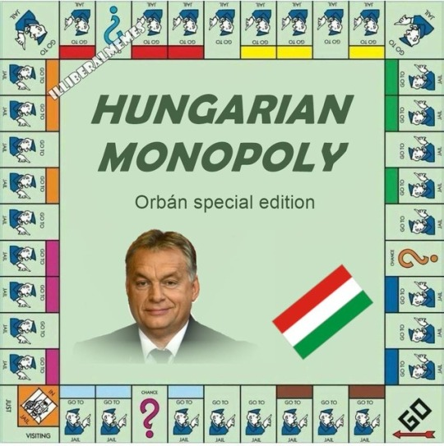
Comparative Politics?
What then explains the difference?
History?
Institutions?
Actors?

Slide 16
Module Goals
Develop analytical framework and empirical skills needed to answer these & other questions
Engage with theory, comparative case studies, data sets, and scholarly debates
Receive hands-on experience by contributing to your very own comparative politics research project

Slide 17
General Overview of Module Content
Comparative Politics and how to do it
Europe & Democracy
Institutions
Democratic Competition
Democratic Backsliding
Reading lists + Glossary on Loop

Slide 18
Assessment (See Syllabus on Loop!)
Written Exam (50%)
Continuous Assessment: Group Project + Oral Exam (50%)
With two randomly allocated colleagues (See Loop)
2000 word research paper / 5-7 min explainer video / 10-12 min video podcast
One-pager due 30/1 7am
Peer-review sessions 5-12 February
Project deadline 21/3 7am
Oral exam Weeks 12-13

Slide 19
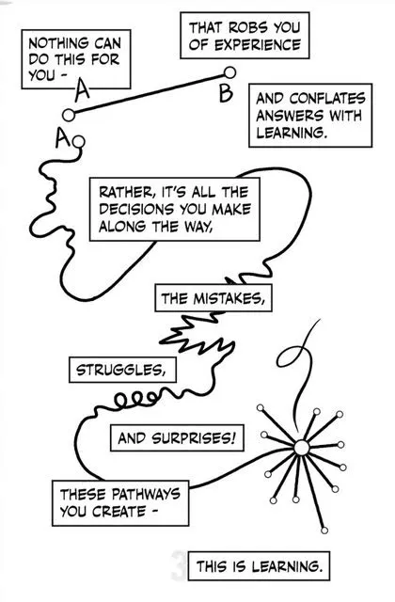
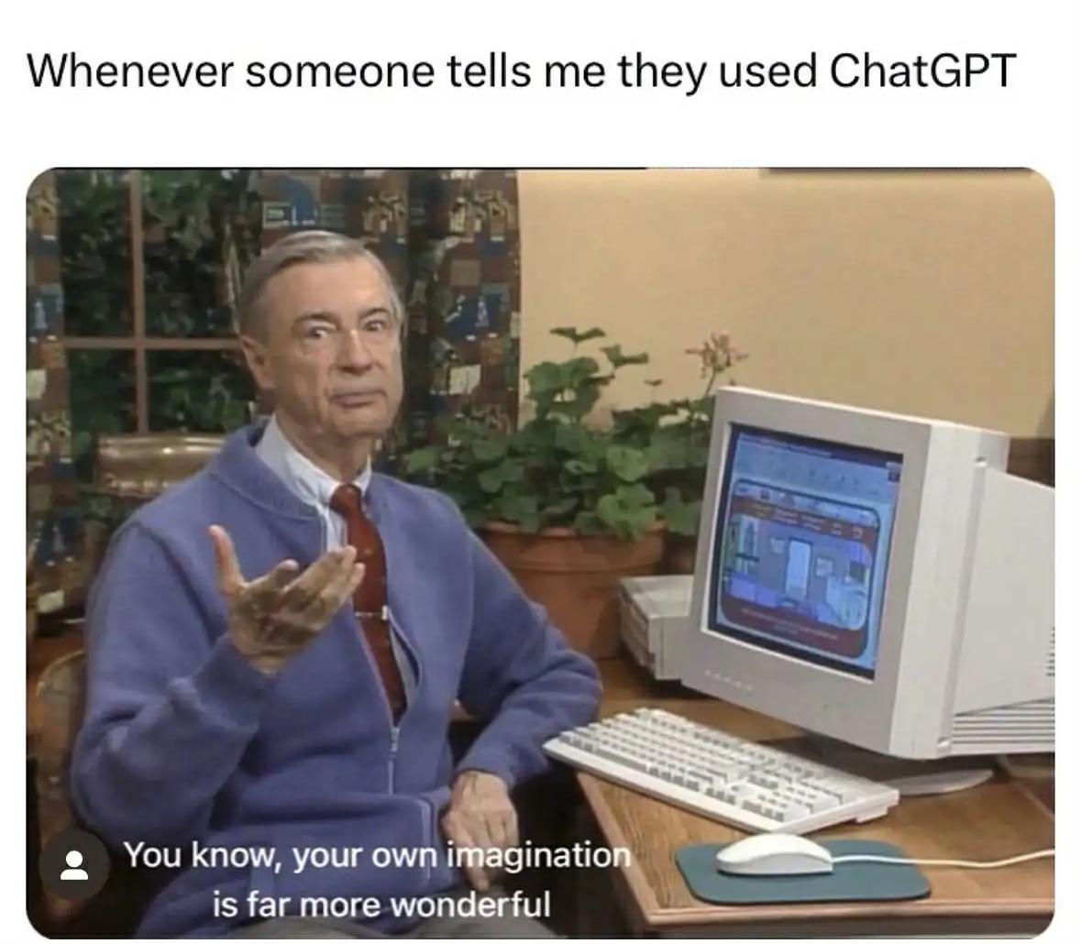
Use of AI

Slide 20
Final Notes
Slides available before class + recordings only for valid absence (but you have my consent to record my voice in class)
Let us openly discuss and disagree
Ask me as many questions as you want
Let me know if you don’t understand
But ultimately, you are responsible for your own learning

Slide 21
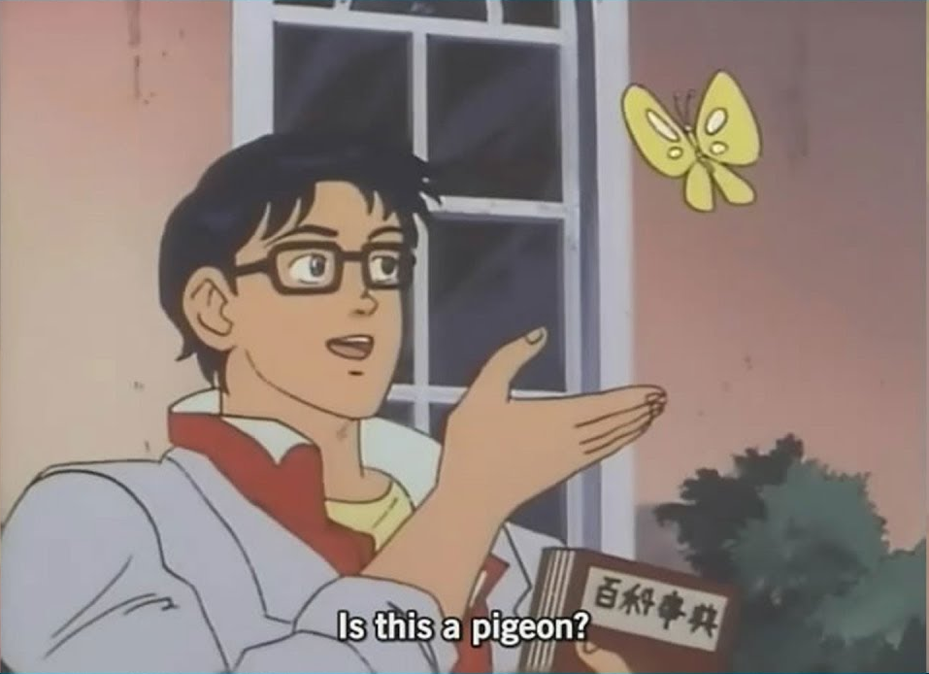
Questions?

