Slide 1
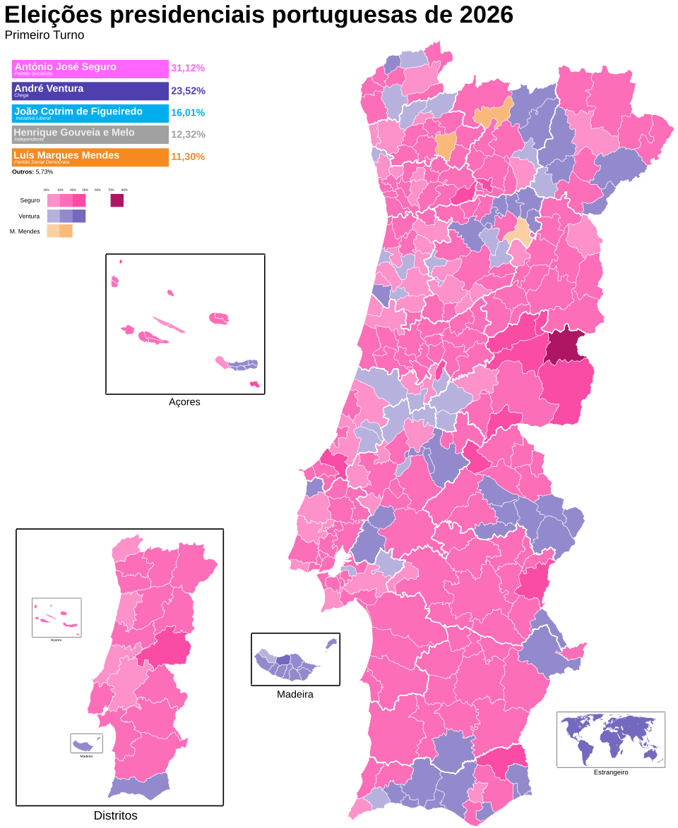
Portuguese Presidential Election: Results 18/1

Slide 2
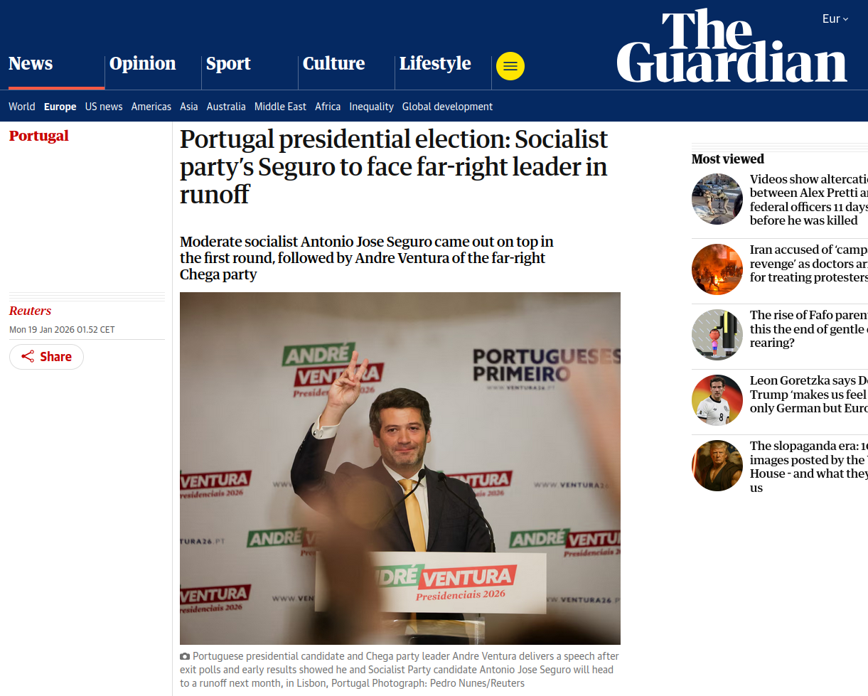
https://www.theguardian.com/world/2026/jan/19/portugal-presidential-election-socialist-party-seguro

Slide 3
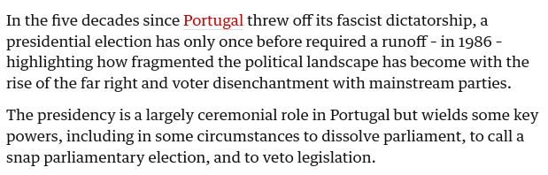

Slide 4
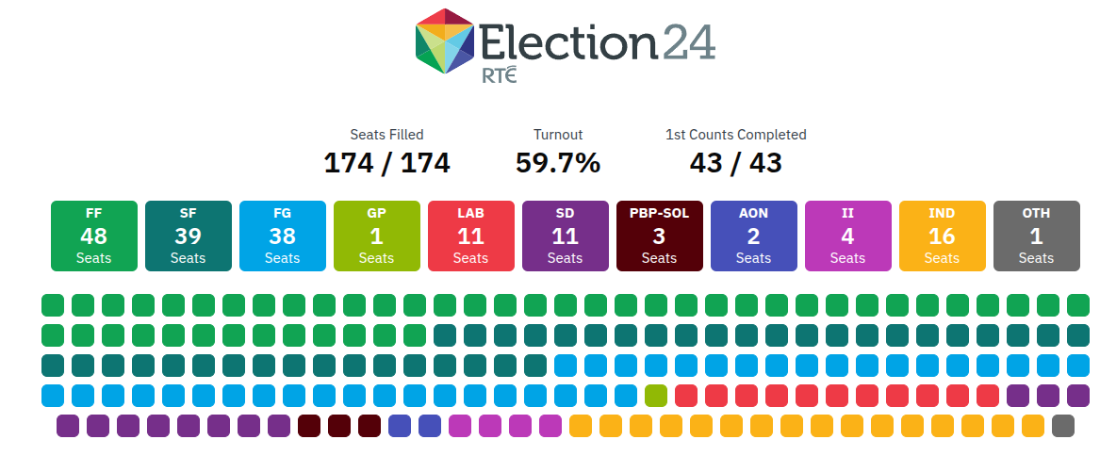
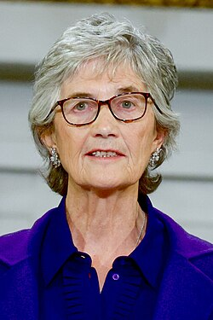
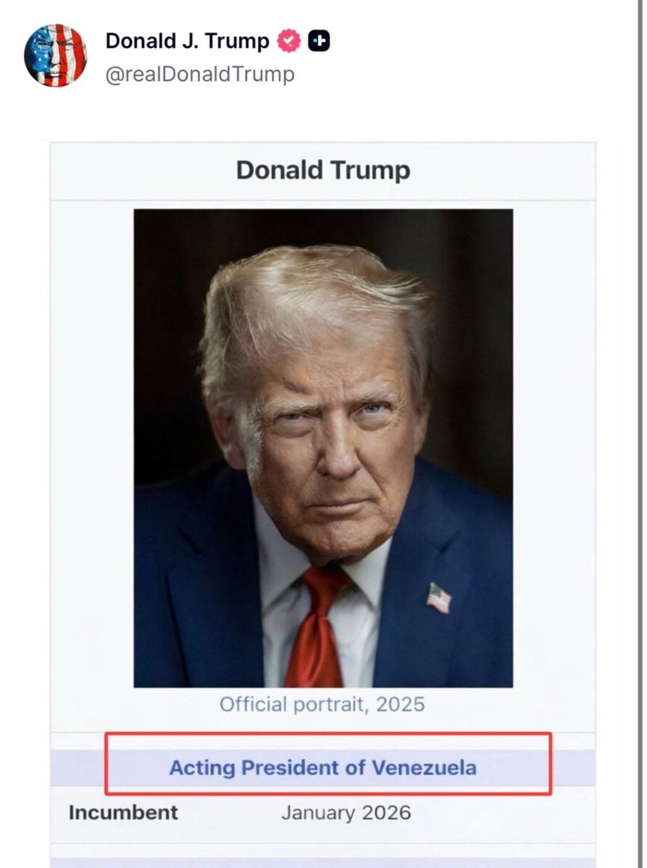
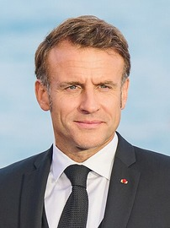
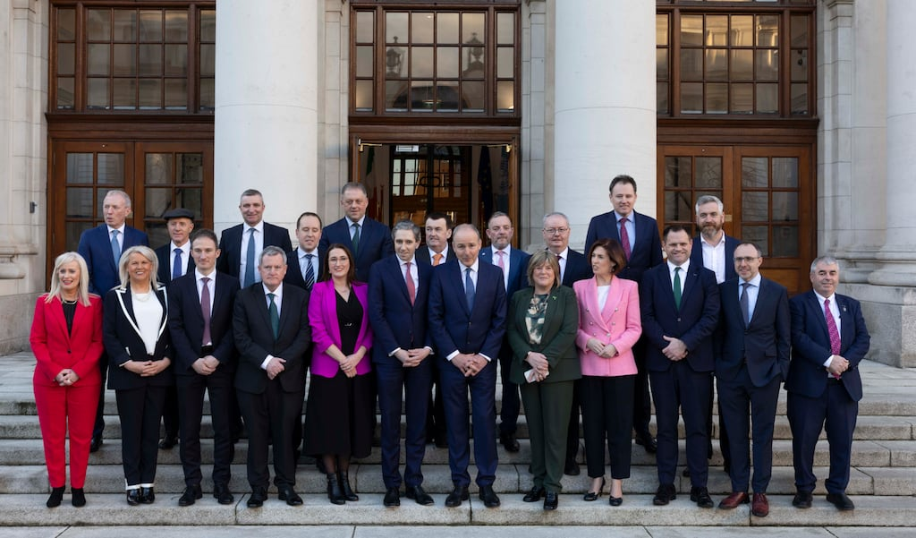
Reminder: Class 2
Head of state ( Monarchy vs Presidential)
Political System (parliamentary vs presidential)
Notes:
Reminder: we have different types of presidents.

Slide 5
Reminder: Class 2
Head of state ( Monarchy vs Presidential)
Political System (parliamentary vs presidential)
Portugal: Semi-presidential with a "moderating" president in between executive, legislative & judiciary

Slide 6
Patterns of Democracy
POL1036: Comparative European Politics – Lecture 5 - 29/1/2026

Slide 7
Schedule
Today:
The concept of Democracy (Cont.)
Majoritarian vs Consensus Democracy
Institutions as the key factors

Slide 8
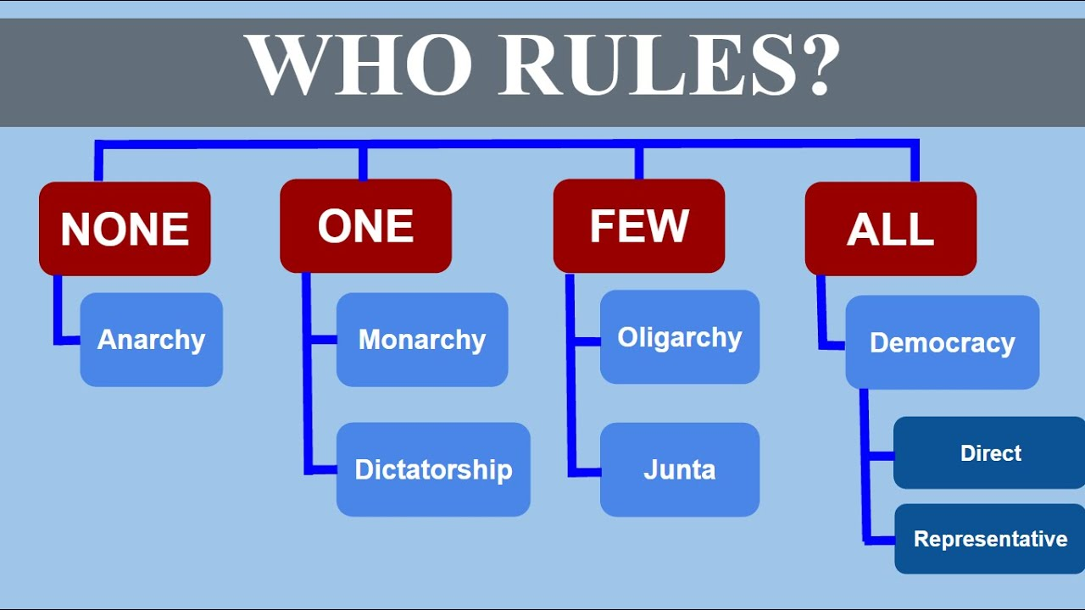

Slide 9
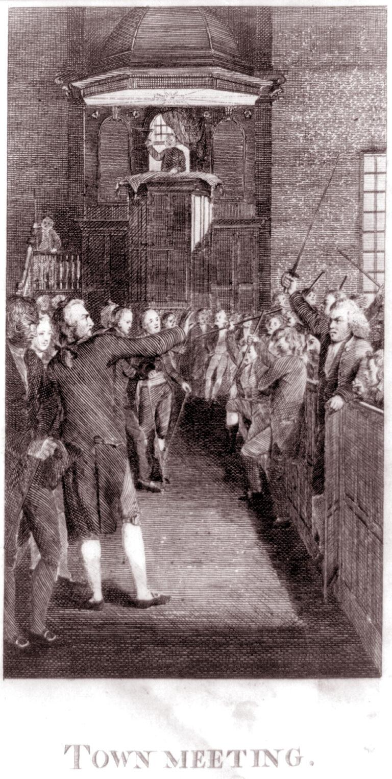
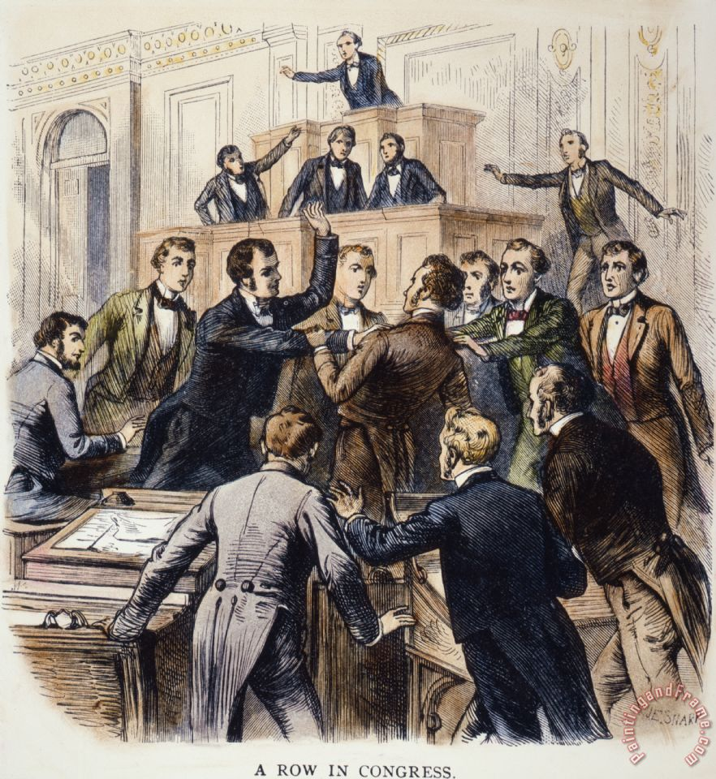
From town halls to representation

Slide 10
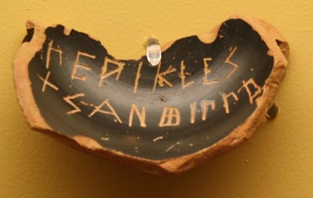
Correction: Athenian Democracy
Assembly (all male citizens)
Finances, military, signing treaties, …
Ostracism
Council (500 randomly elected citizens)
Agenda-setting for assembly
Acted by itself in crisis/war
Executive committee (1 of 10 tribes)
Law courts with randomly elected magistrates

Slide 11
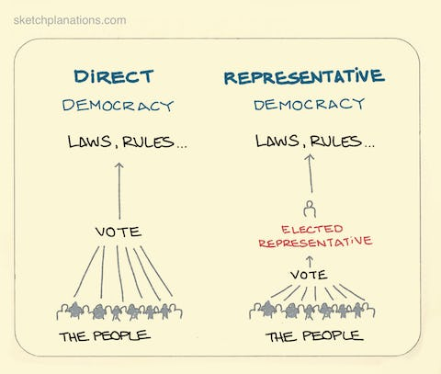
Direct vs Representative Democracy

Slide 12
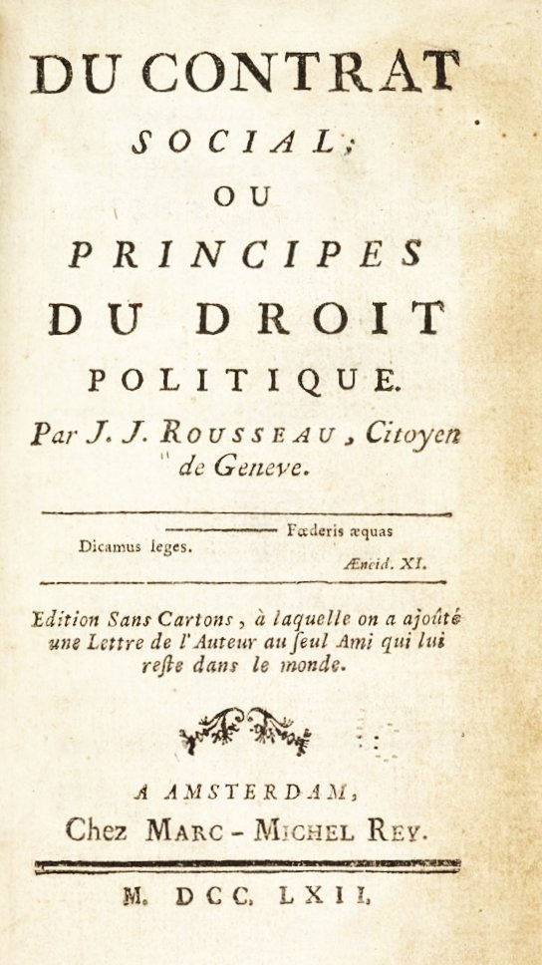
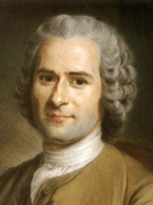
Purpose: Common Good & General Will
Against Plato's idea of the guardian
Good citizens are able to exert their will...
...and might have differing ideas about the common good
Homeless?
Women?
Minorities?

Slide 13
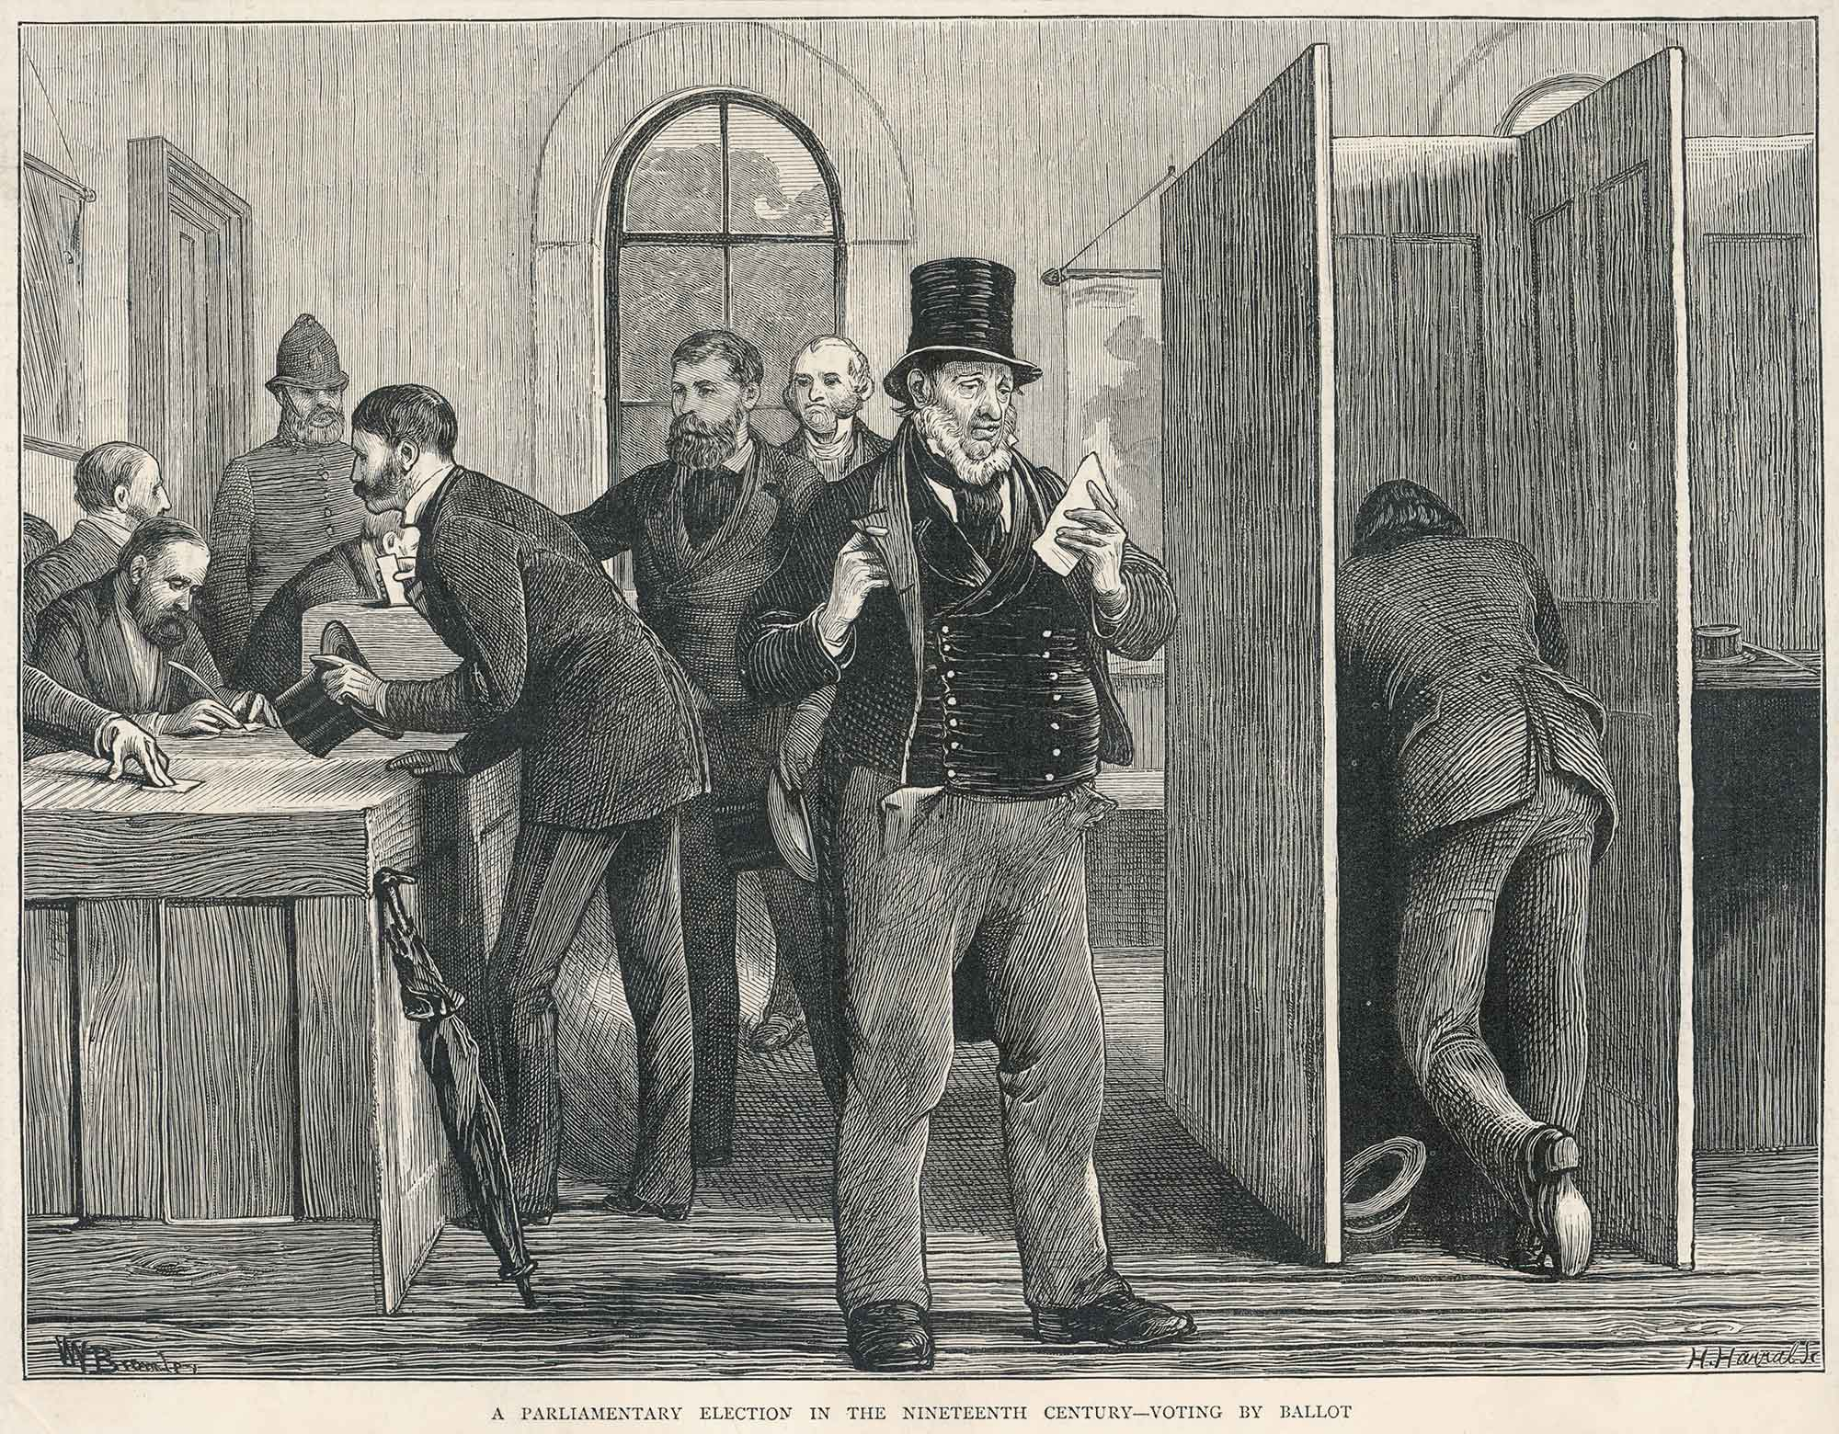
Free, Fair & Frequent Elections

Slide 14
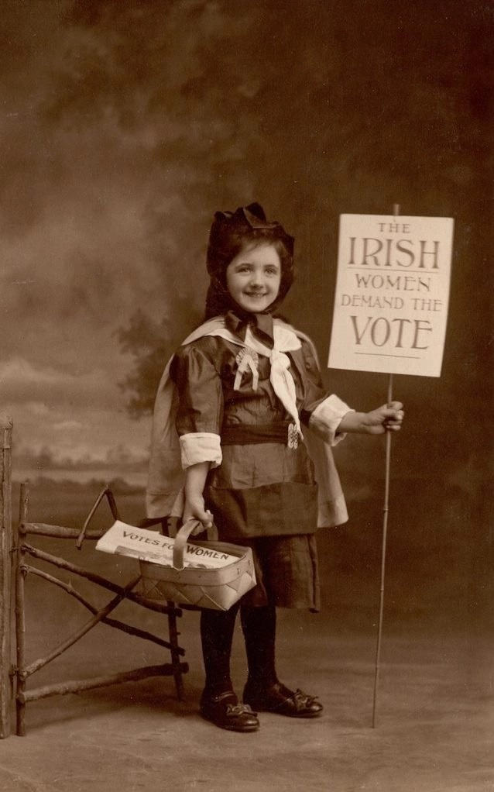
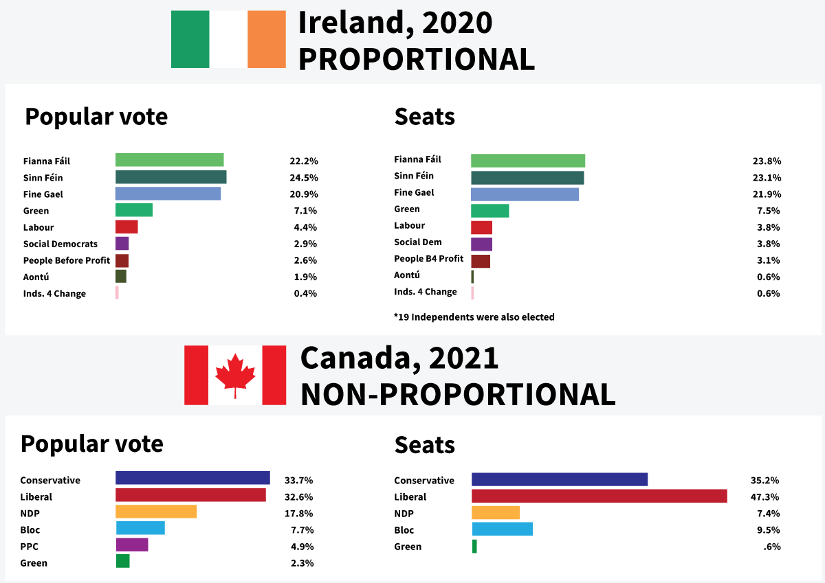
Free, Fair & Frequent Elections

Slide 15
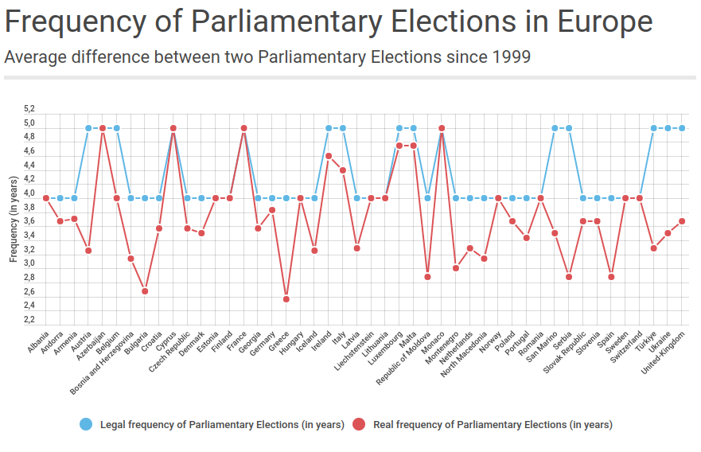
Free, Fair & Frequent Elections
https://www.coe.int/en/web/electoral-assistance/frequency-of-parliamentary-elections

Slide 16
Necessary Institutions for Democracy (Dahl, 1998)
Elected Officials
Free, Fair and Frequent Elections
Freedom of Expression
Alternative Sources of Information
Associational Autonomy
Inclusive Citizenship
Criteria to decide if states = democracies!
Ireland? Russia? Hungary?

Slide 17
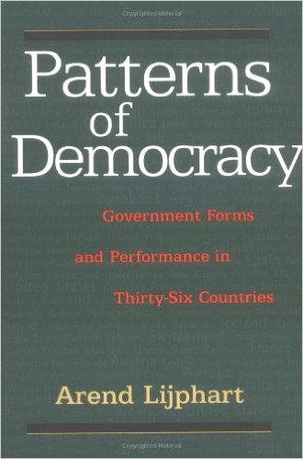
What if the People Disagree? Patterns of Democracy (Lijphart, 1999)
Majoritarian
Democracy
Bare Majority
Consensus
Democracy
Maximal Majority
Difference? Institutions!

Slide 18
Executive – Parties or Joint-Power Dimension
Institution | Majoritarian | Consensus
Executive Majority | Single-Party (power concentration) | Multiparty (power-sharing)
Executive-Legislative Relation | Dominant Executive | Balance of Power
Party System | Two-Party | Multi-Party
Electoral System | Majoritarian, Disproportional | Proportional
Interest Groups | Pluralist, Competitive | Coordinated, Compromise-oriented

Slide 19
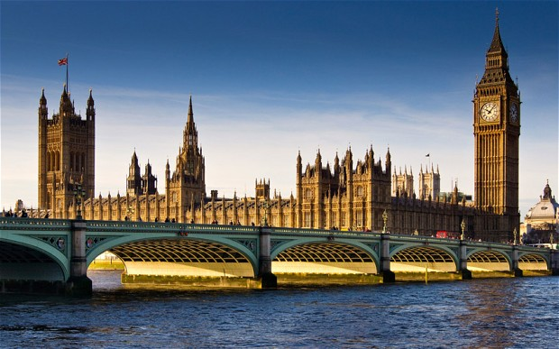
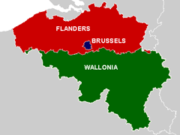
Majoritarian or consensus? 2024 elections
United Kingdom
Belgium

Slide 20
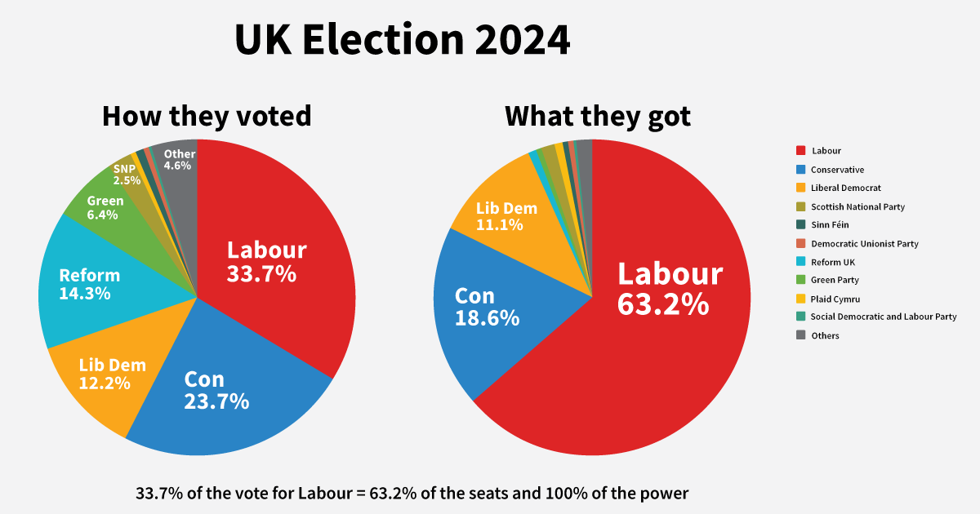
United Kingdom: Concentration of Power
+ only 20.2% of electorate share
"Elective Dictatorship" (Lord Hailsham)

Slide 21
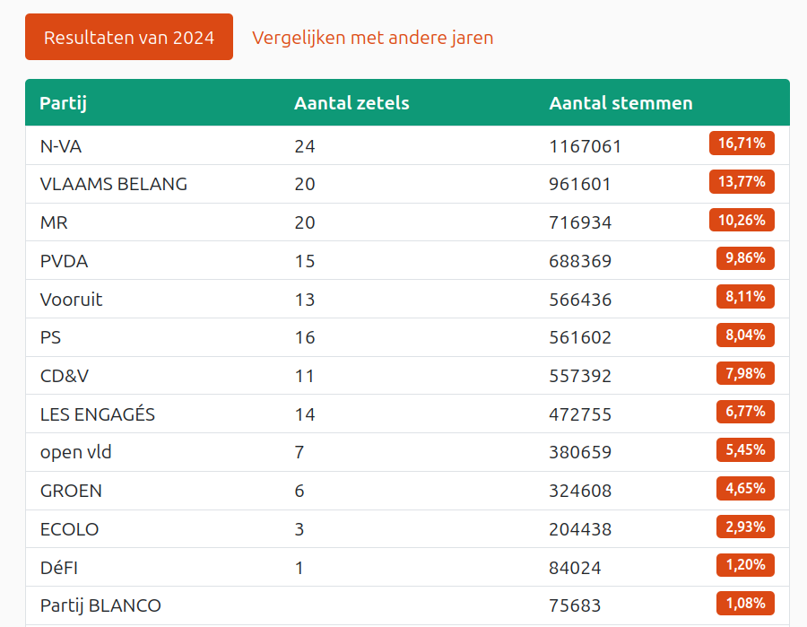
Belgium: Power-Sharing
Gov. Parties vote share: 49.83%
82/150 seats (55.66%)
43% of electorate
Give-and-take relationship with Parliament

Slide 22
Federal – Unitary or Divided-Power Dimension
Institution | Majoritarian | Consensus
Government centralization | Unitary & Centralized | Federal & Decentralized
Parliamentary power distribution | Unicameral | Bicameral
Constitutions | Flexible, simple majority for am. | Rigid, super majority for am.
Constitutionality of laws | Legislature | Courts
Central Banks | Dependent on executive | Independent

Slide 23
Majoritarian or consensus?
United Kingdom
Belgium
Little power for House of Lords
Little power for courts
But: Devolution (including Bank of England)!
Yet not the same as Federal
Senate has similar composition to House
Rigid Constitution + strong Constitutional Court
Substantial power for Flanders etc.

Slide 24
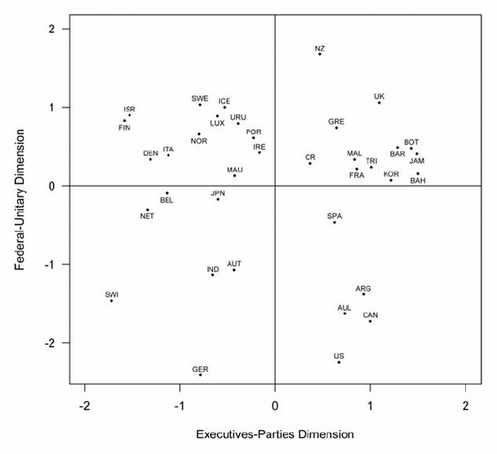
Patterns of Democracy 1945 – 2010 (Lijphart, 2012)
Majoritarian
Consensus
Majoritarian

Slide 25
